Slide 1
Tutorial 1: Using IBM Rational Software Architect for OOA
COMP7201 Analysis and Design of Enterprise Applications in UML Sept 27, 2016

Slide 2
Outline
Introduction to IBM® Rational ® Software Architect
Using Architect to Create Use Case Diagram
Using Architect to Create Class Diagram
Download and Installation of IBM Rational Software Architect

Slide 3
UML
Unified Modeling Language
Version 1.1 by Object Management Group in 1997
Current version 2.5 (June 2015)
A family of graphical notations
helps you specify, visualize, and document models of software systems, including their structure and design, in a way that meets all of these requirements
Notes:
Reference: http://www.omg.org/gettingstarted/what_is_uml.htm

Slide 4
IBM® Rational ® Software Architect
Developed by IBM
“Provides comprehensive design, modeling and development tools for model-driven development (MDD) using robust support for Unified Modeling Language (UML).”
Supports UML 2.2
More information:
http://www-03.ibm.com/software/products/en/rational-software-architect-family
The version we use: 9.1.1
Notes:
References: http://www.ibm.com/developerworks/downloads/r/architect/index.html

Slide 5
In CS Lab
All the PCs with IBM Rational Software Architect version 9.1.1
Start > All Programs > IBM Software Delivery Platform > Rational Software Architect 9.1.1 > IBM Rational Software Architect

Slide 6
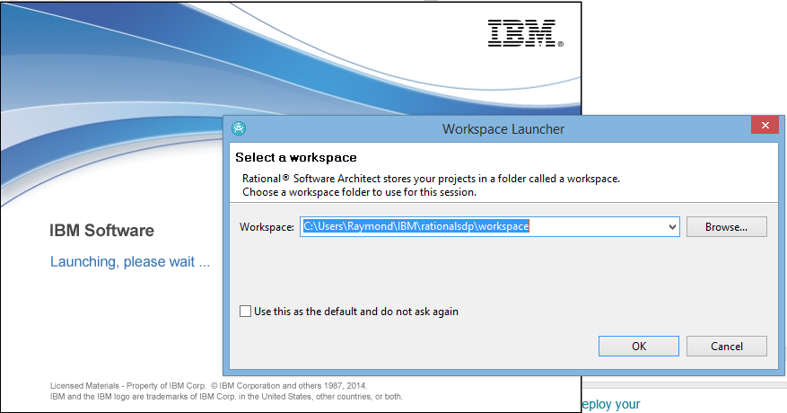
Start
Set the path for your project

Slide 7
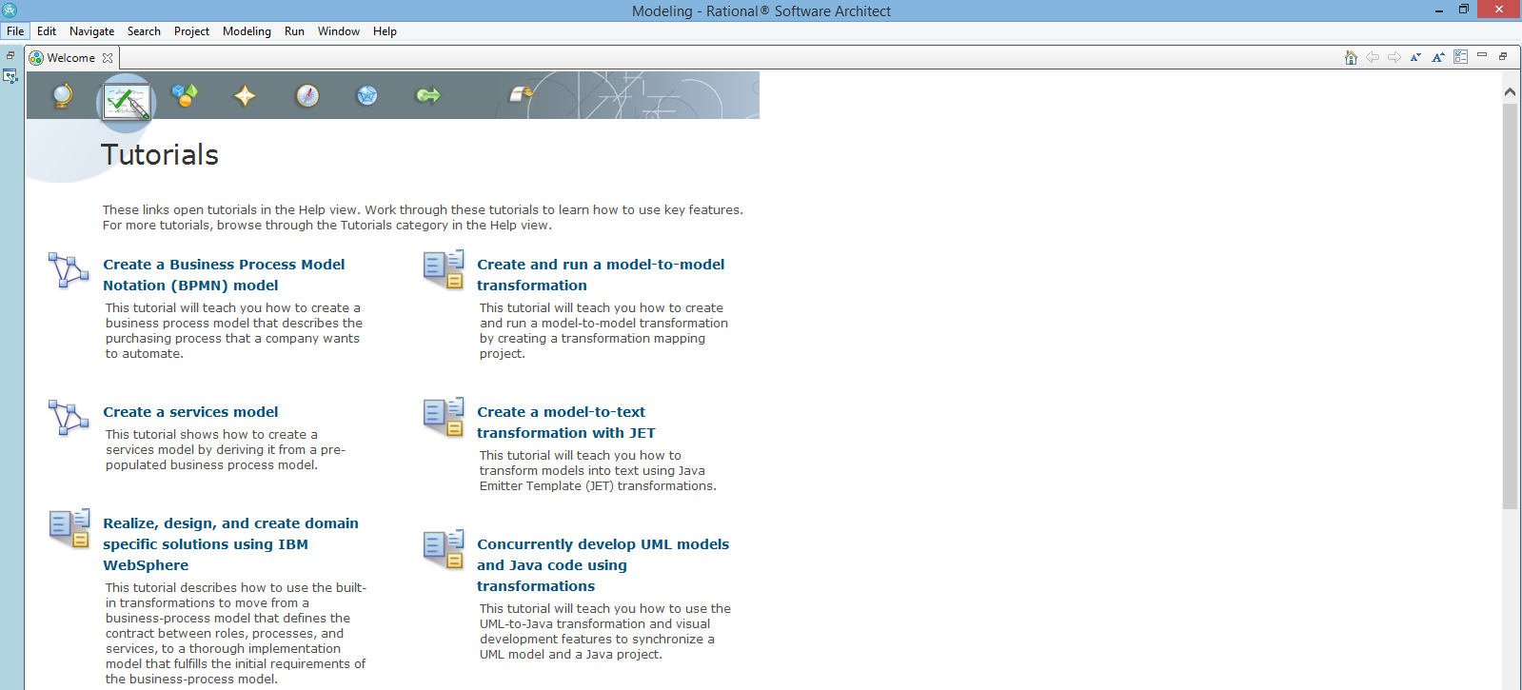
Start

Slide 8
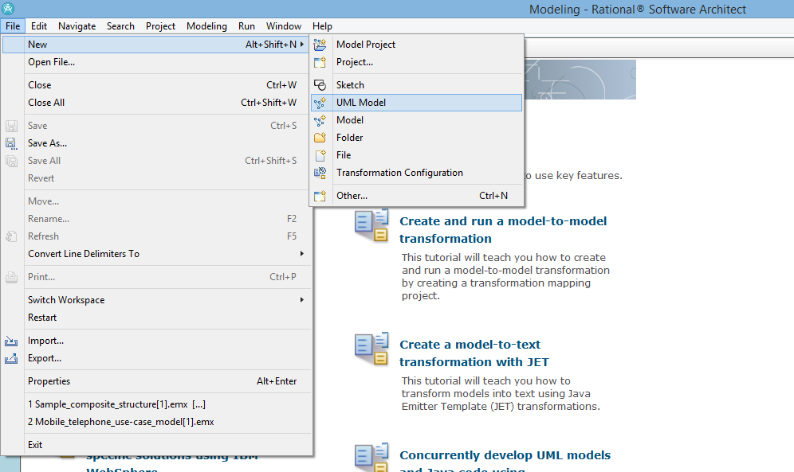
Create a new Project
File > New > UML Model

Slide 9
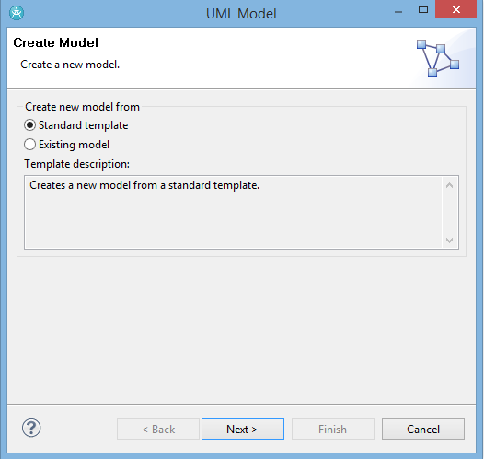
Create a new Project
Choose “Standard Template”

Slide 10
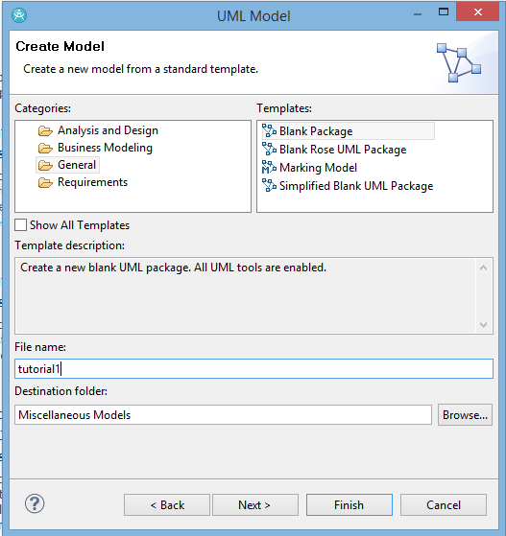
Create a new Project
Type the project name
Default:
“Blank Package”
Click “Finish”

Slide 11
Use Case Diagram

Slide 12
Use Case Modelling
“The process of modelling a system’s functions in terms of business events, who initiated the events, and how the system responds to the events.”
(Lecture notes Object-Oriented Analysis, page 6)

Slide 13
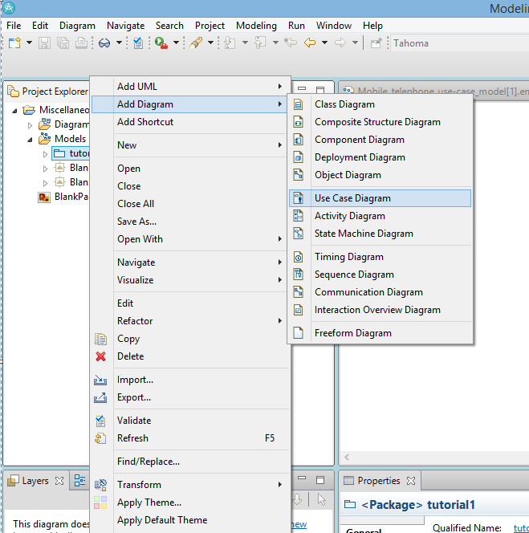
Create a Use Case Diagram
Add Diagram > Use Case Diagram

Slide 14
Actors
“An actor in a use case is an external agent that uses or interacts with the system”
(Lecture notes Object-Oriented Analysis, page 7)

Slide 15
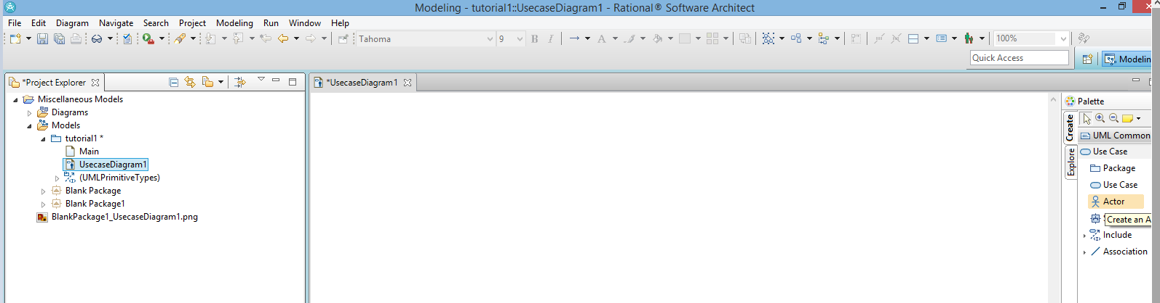
Add an Actor
Choose from the Palette

Slide 16
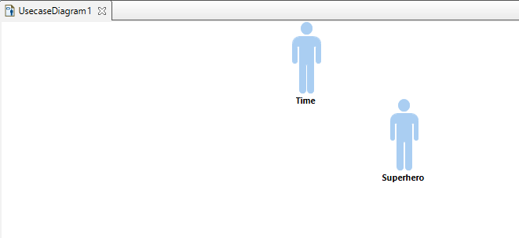
Add an Actor

Slide 17
Use Case
“A use case is a collection of related scenarios, including normal and alternative scenarios”
(Lecture notes Object-Oriented Analysis, page 9)

Slide 18
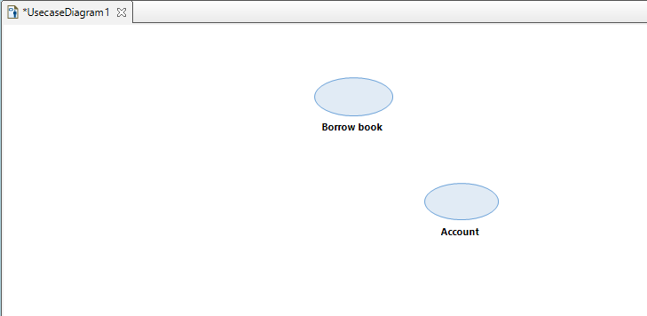
Add a Use Case
Again, you can choose it from the Palette

Slide 19
Associations
“An association describes a group of links with common structure and common semantics”
(Lecture notes Object-Oriented Analysis, page 20)

Slide 20
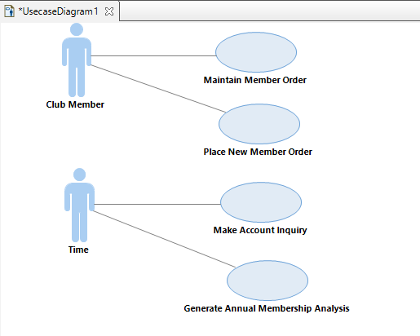
Add a UML Element
Association

Slide 21
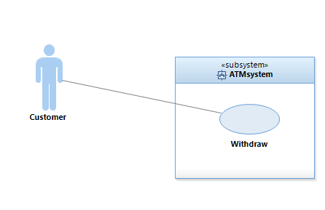
Add a Subsystem

Slide 22
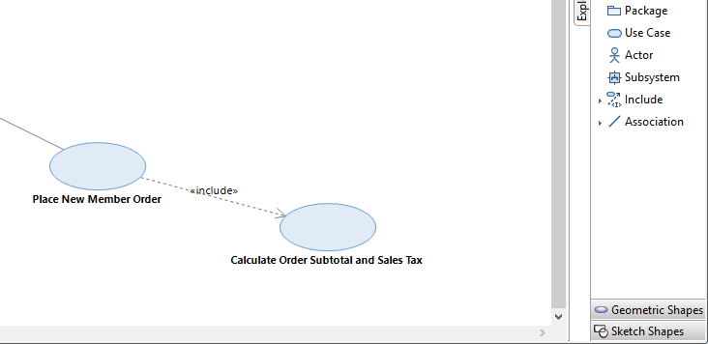
Add a Relationship

Slide 23
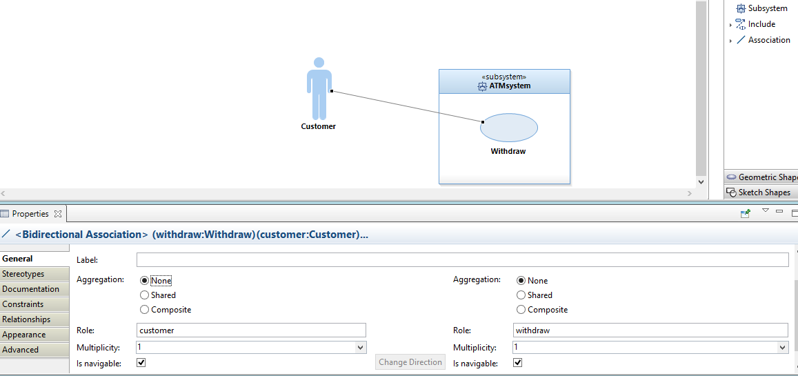
Edit Element Properties

Slide 24
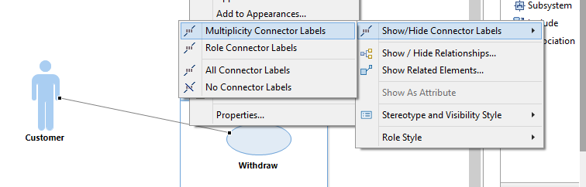
Edit Element Properties
Select the relationship > Right click > Filters > Show/Hide Connector Labels > Multiplicity Connector Labels

Slide 25
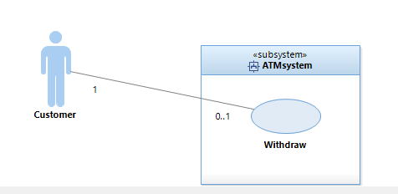
Edit Element Properties

Slide 26
Class Diagram

Slide 27
Class Diagram
“A class diagram describes the types of objects in the system and the various kinds of static relationships that exist among them.”
Notes:
Reference: “UML Distilled Third Edition A brief guide to the standard object modeling language”, by Martin Fowler, Addison-Wesley, 2003

Slide 28
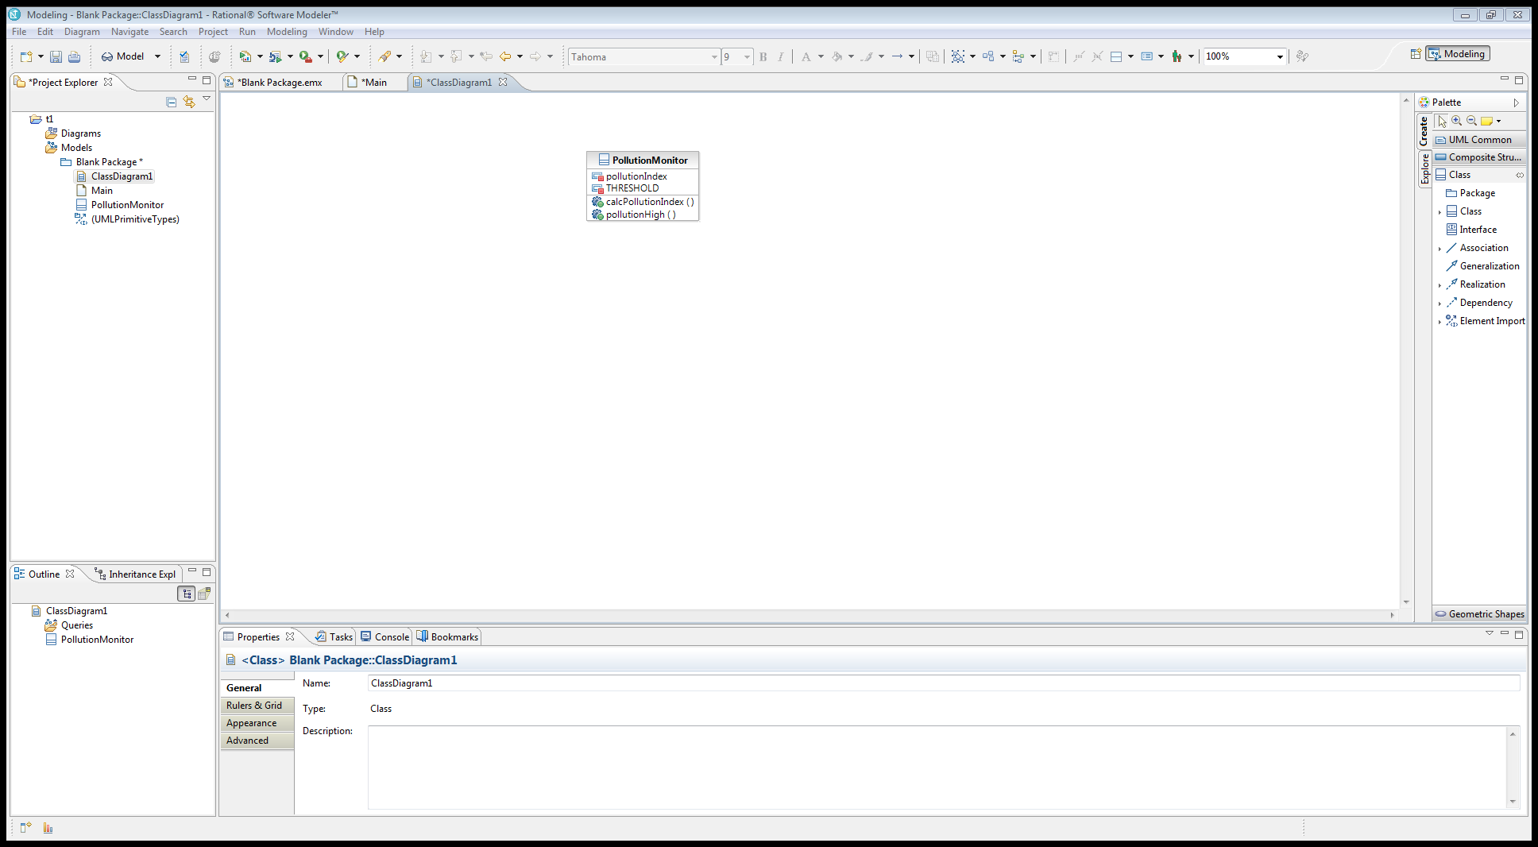
Classes
Divided into three compartments:
Name
Attributes
Operations

Slide 29
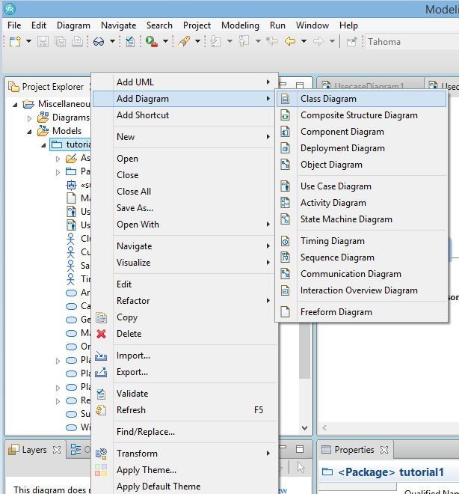
Add a Class Diagram
Add Diagram → Class Diagram

Slide 30
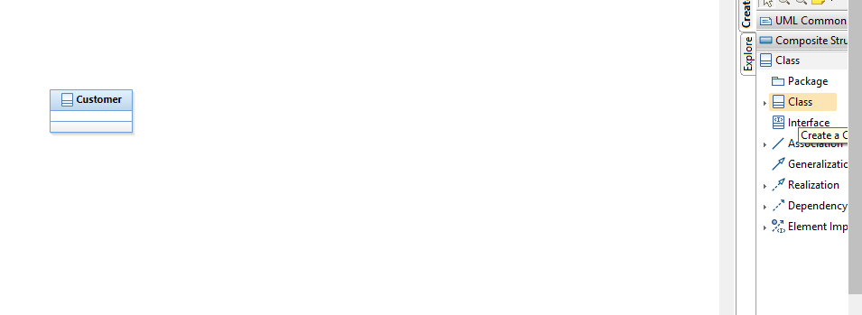
Add a Class

Slide 31
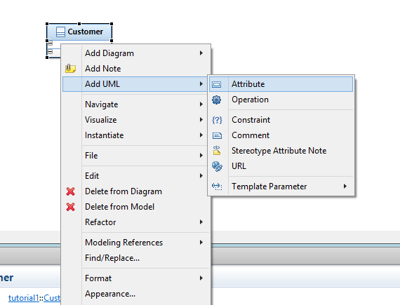
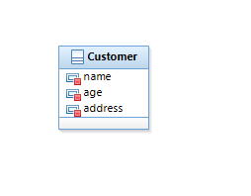
Add an Attribute
Select the Class > Right click > Add UML > Attribute

Slide 32
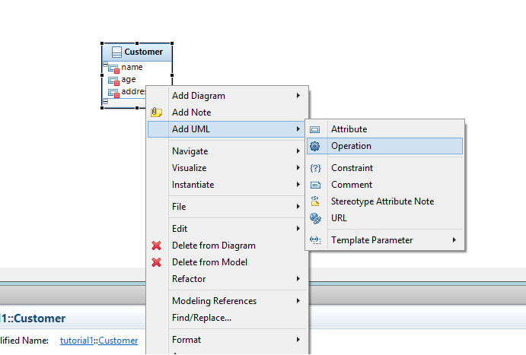
Add an Operation

Slide 33
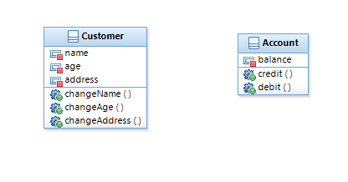
Examples

Slide 34
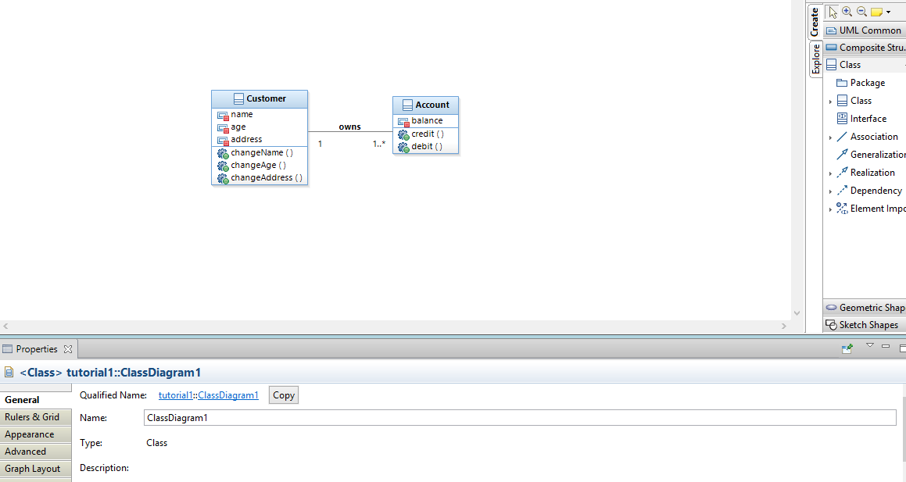
Associations

Slide 35
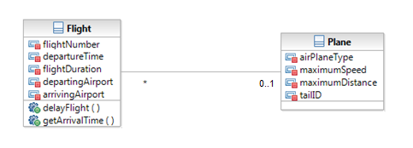
Multiplicity Notation
Indicate how many objects may fill the property
Multiplicity | UML Multiplicity Notation
Exactly 1 | 1 or leave blank
Zero or one | 0..1
* | Zero or more
Specific range | e.g. 1..4, 2..5, etc.

Slide 36
Aggregations
A kind of association
A.k.a. “is-part-of” relationships
Two kinds of aggregations:
Composition (or composition aggregation)
Aggregation (or shared aggregation)
(From Lecture notes Object-Oriented Analysis, page 25)

Slide 37
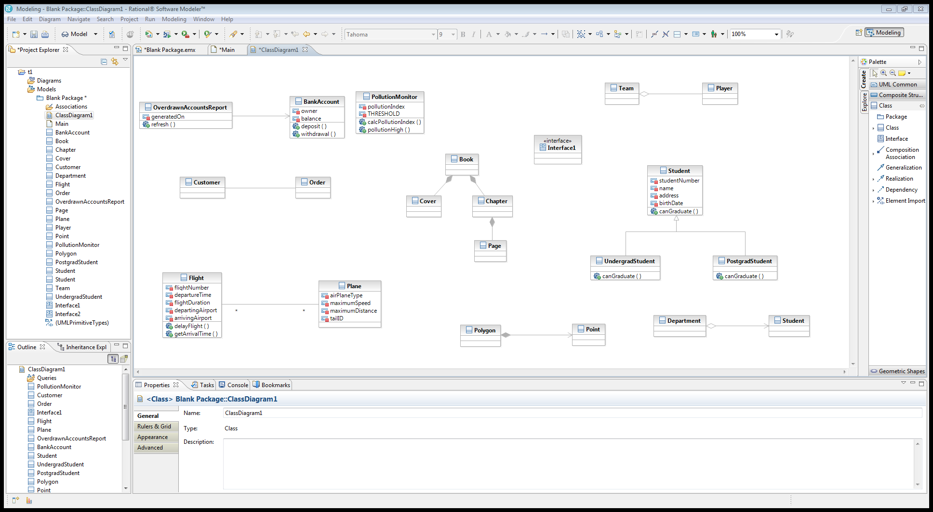

Composition Aggregations
Solid diamond
“No sharing”

Slide 38

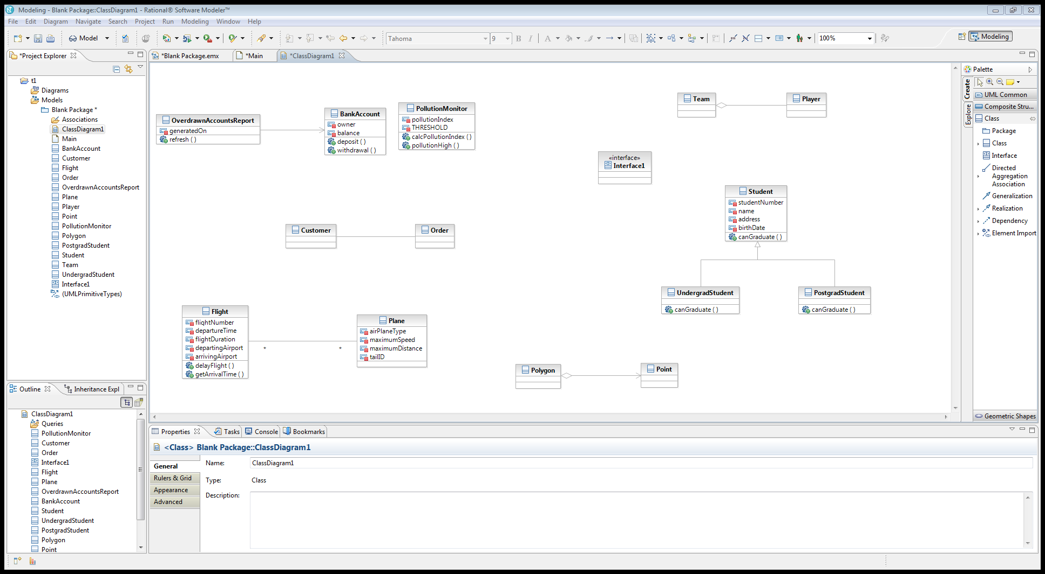
Shared Aggregations
Hollow diamond
May belong to any number of aggregates

Slide 39
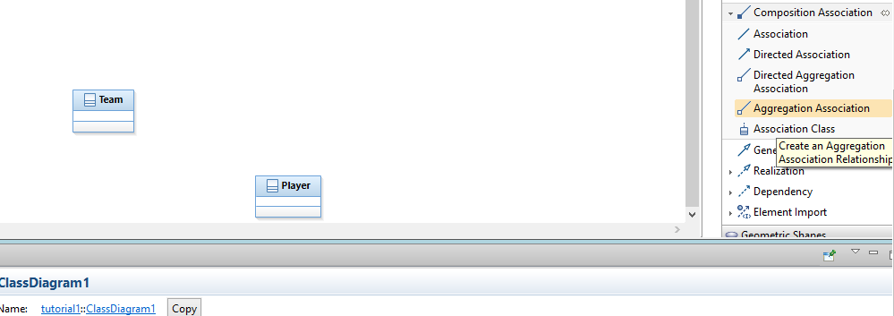
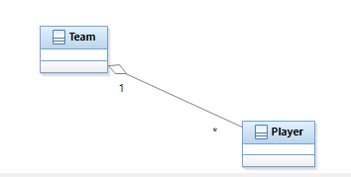
Create Aggregation Association

Slide 40
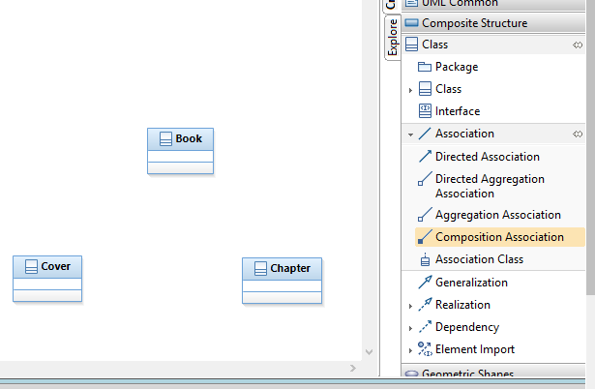
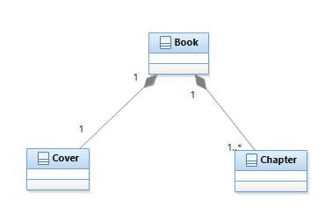
Add a Composition Association

Slide 41
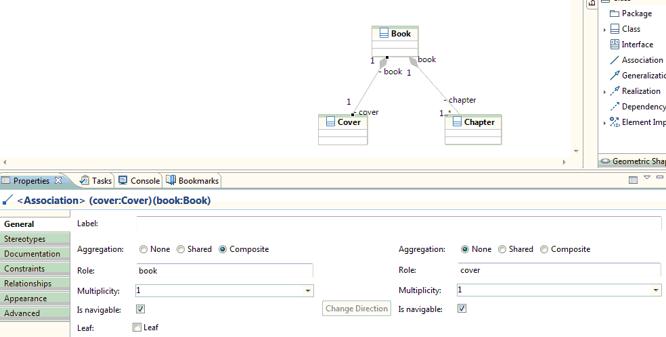
Modify an Association

Slide 42
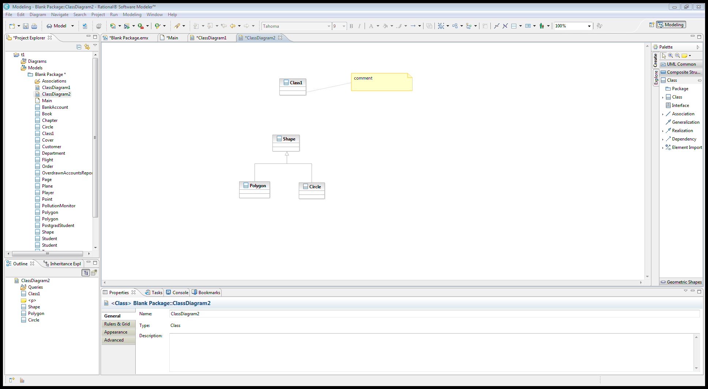
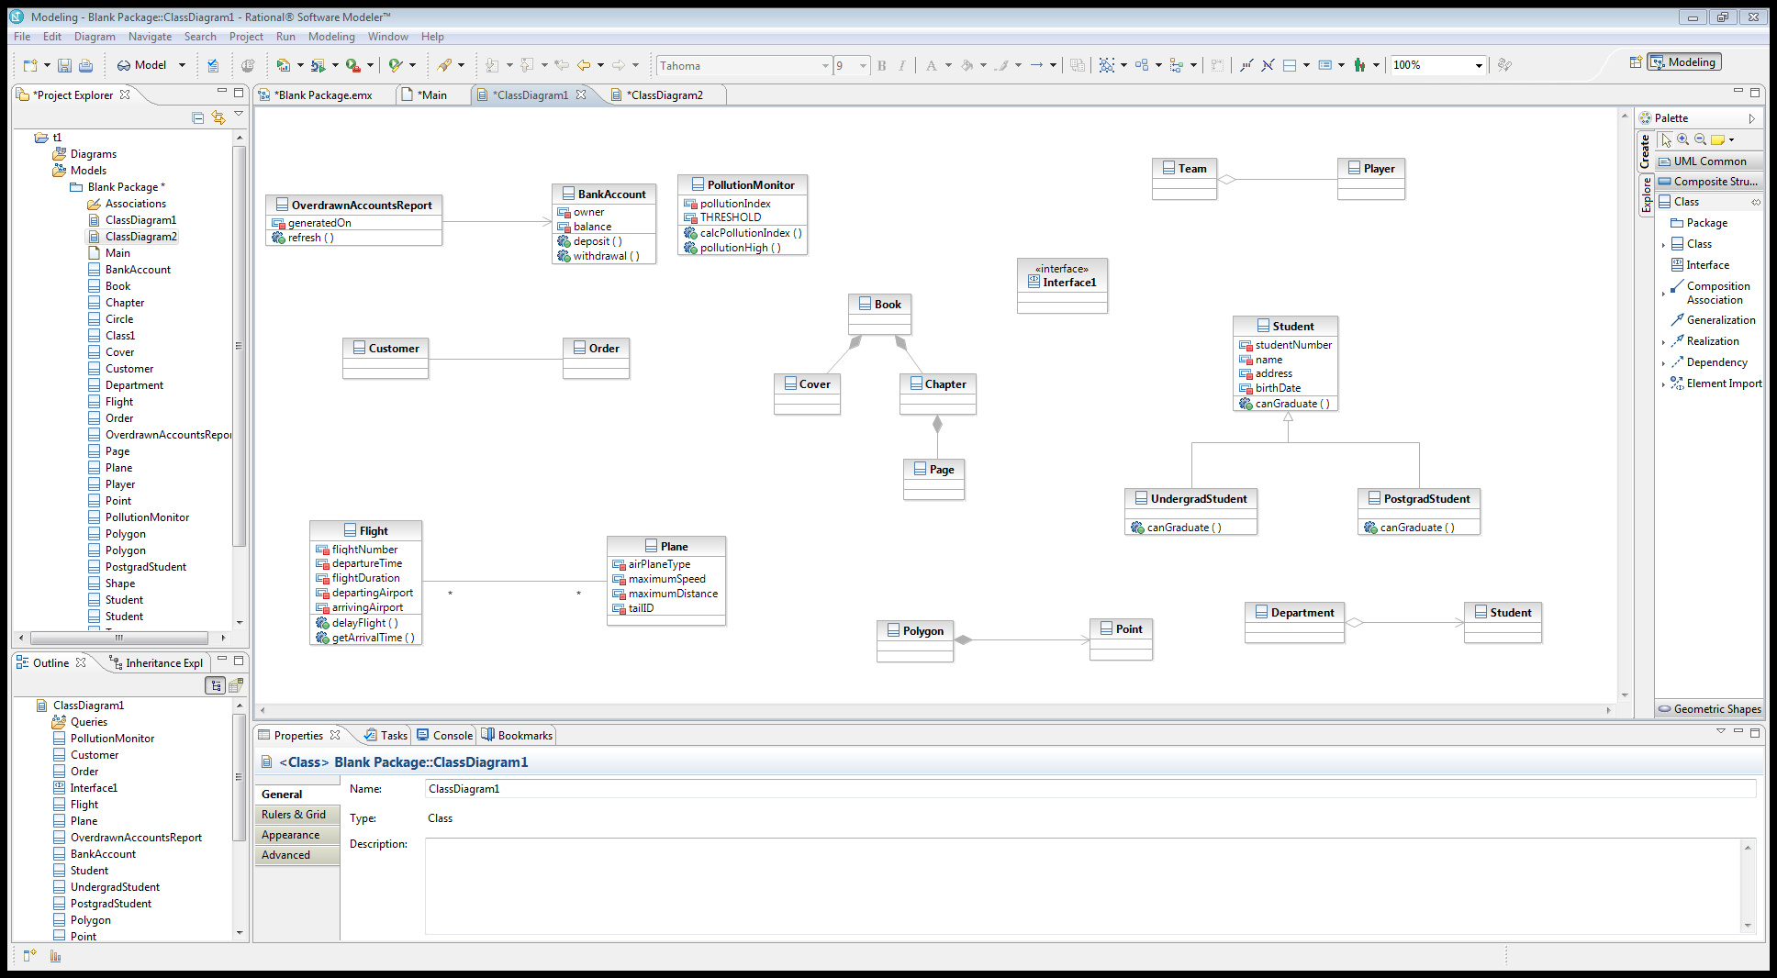
Inheritance
“is a kind of” relationship
Notes:
Reference: http://www.omg.org/spec/UML/2.4.1/Superstructure/PDF/

Slide 43
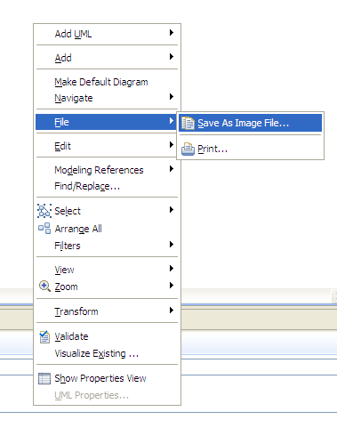
Export as an Image file
File > Save As Image File (GIF, BMP, JPEG, etc.)

Slide 44
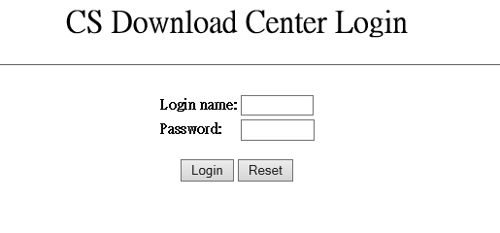
Download
IBM Rational Software Architect is available for download here: https://intranet.cs.hku.hk/download/software/ibm-rational/SoftwareArchitect/

Slide 45
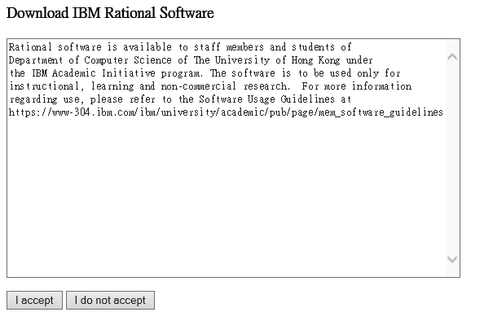
Download

Slide 46
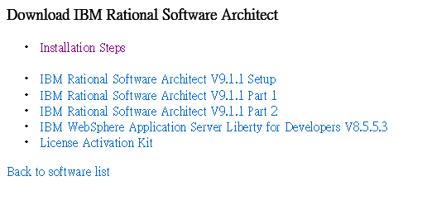
Download

Slide 47
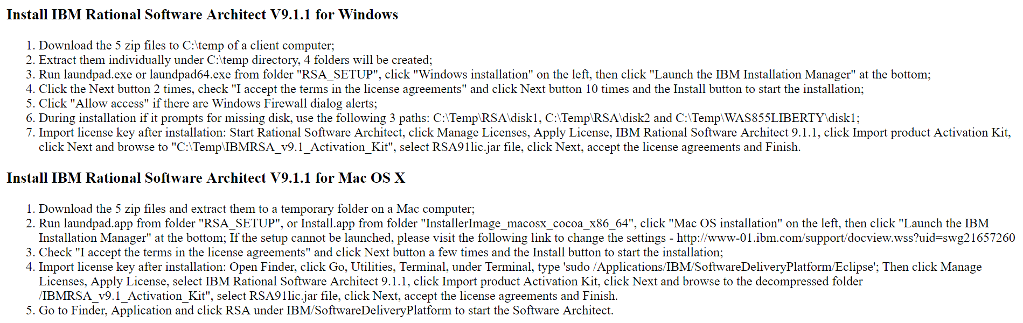
Installation Steps

Slide 48
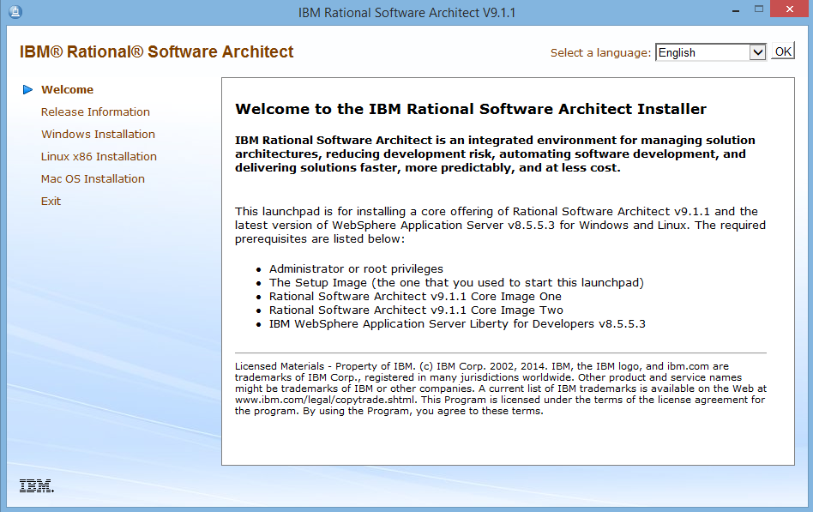
Installation

Slide 49
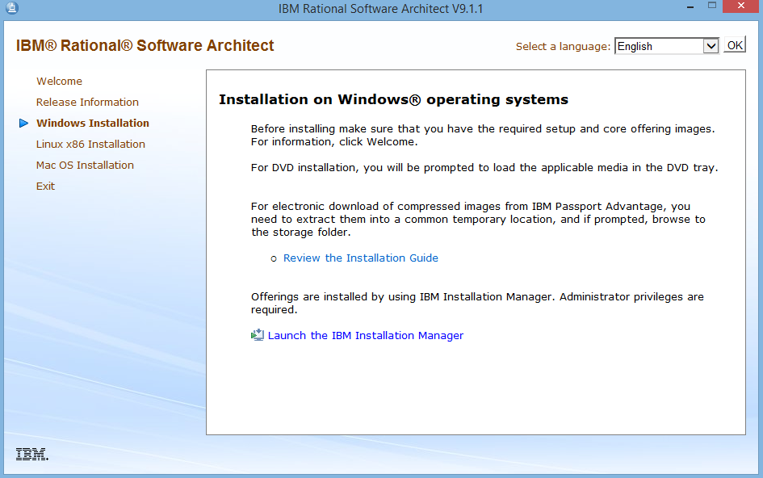
Installation

Slide 50
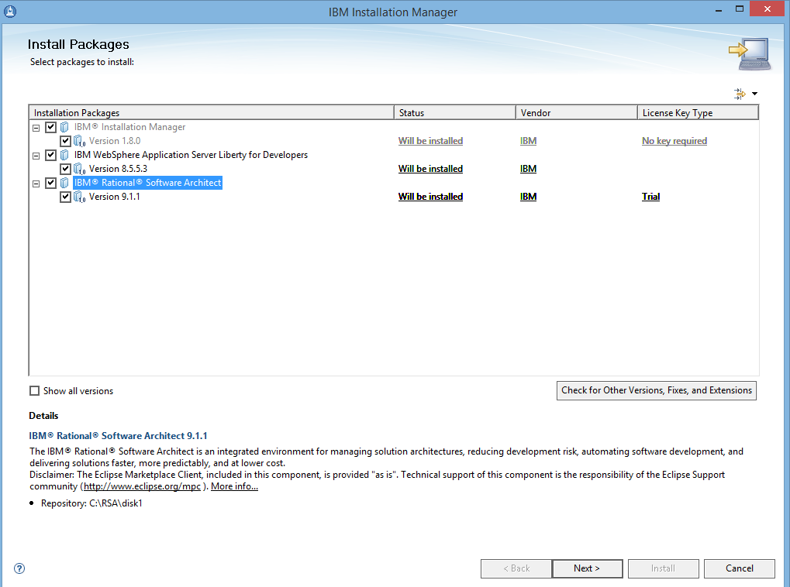
Installation

Slide 51
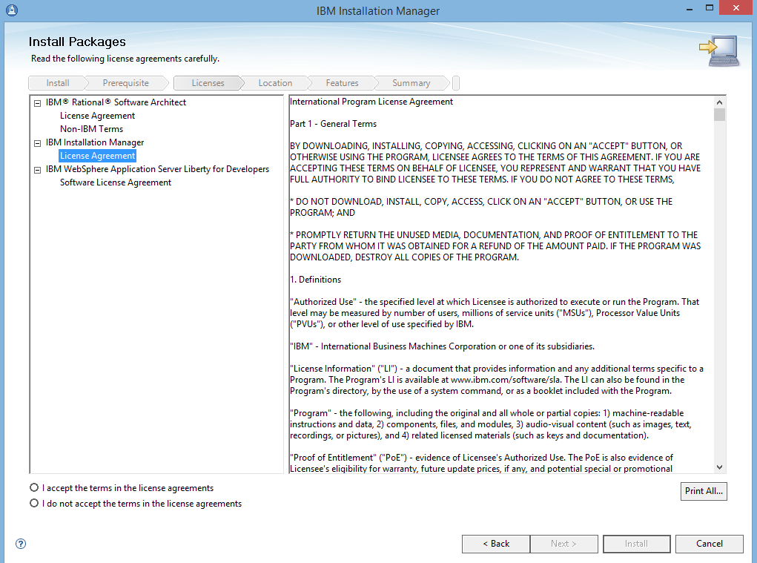
Installation

Slide 52
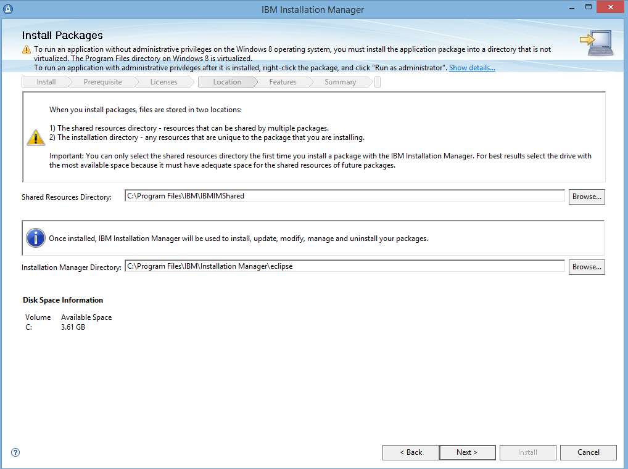
Installation

Slide 53
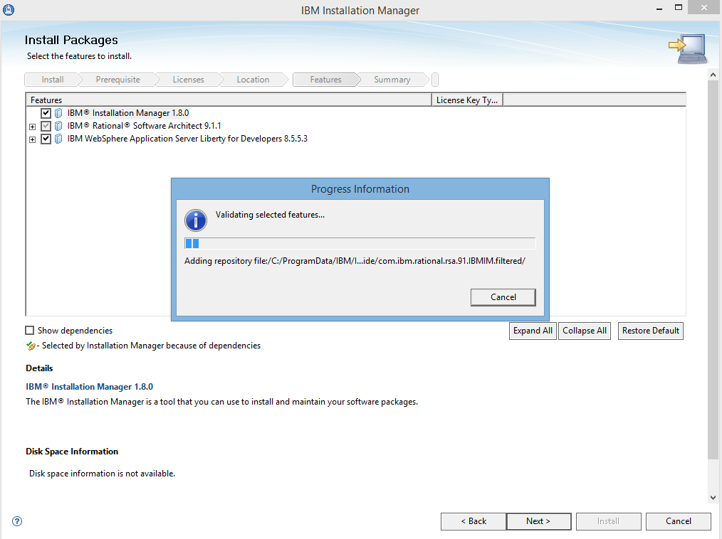
Installation

Slide 54
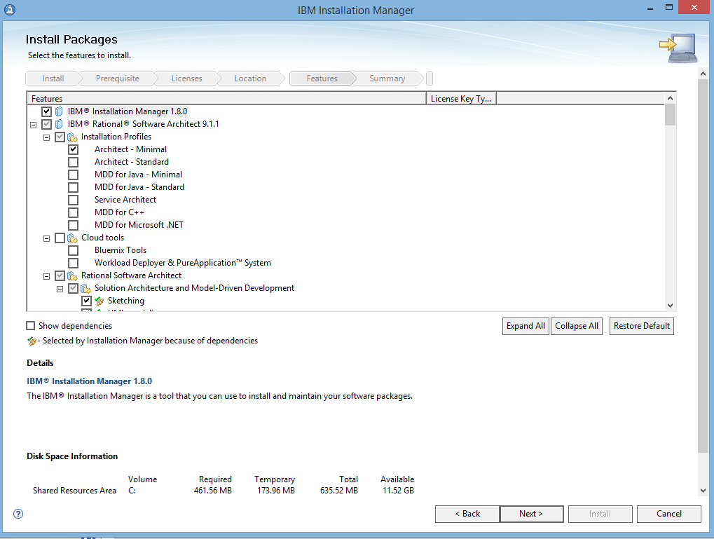
Installation

Slide 55
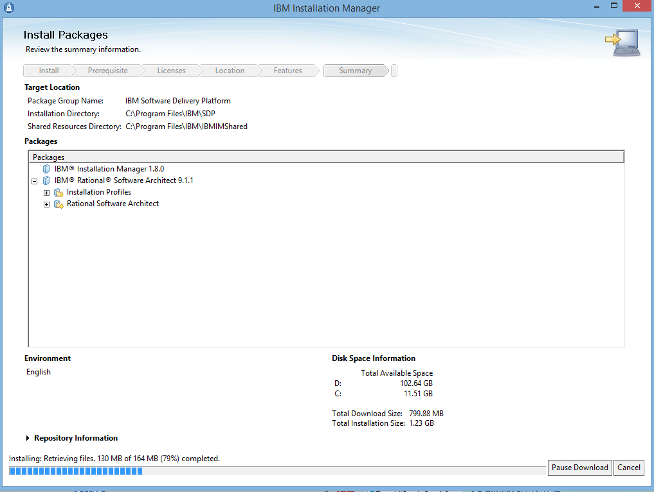
Installation

Slide 56
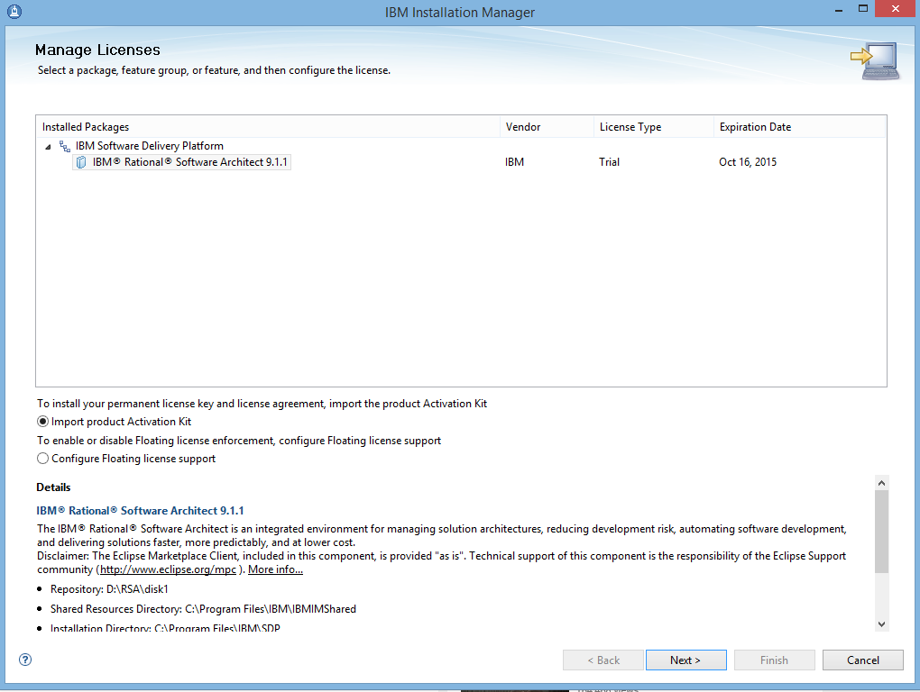
Import License key

Slide 57
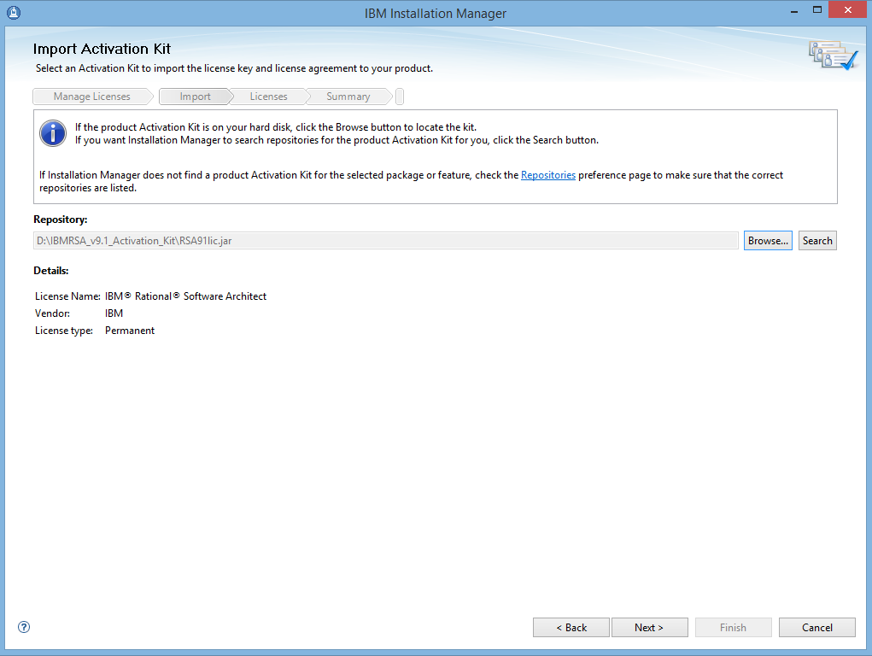
Installation

Slide 58
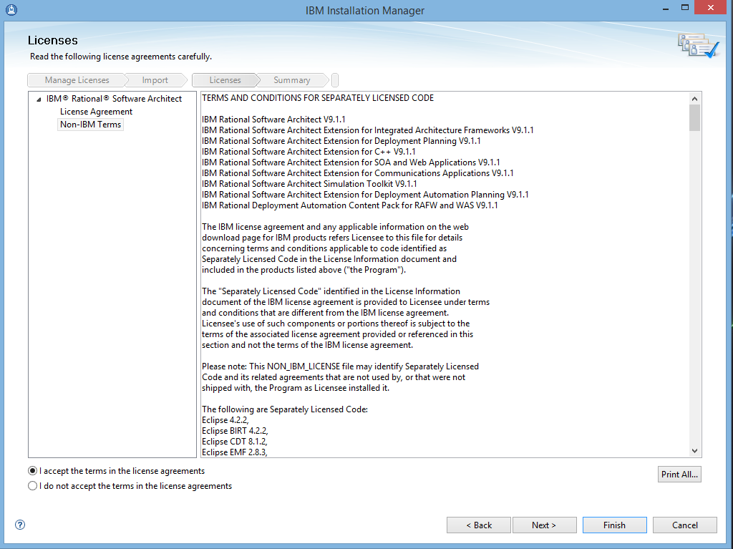
Installation

Slide 59
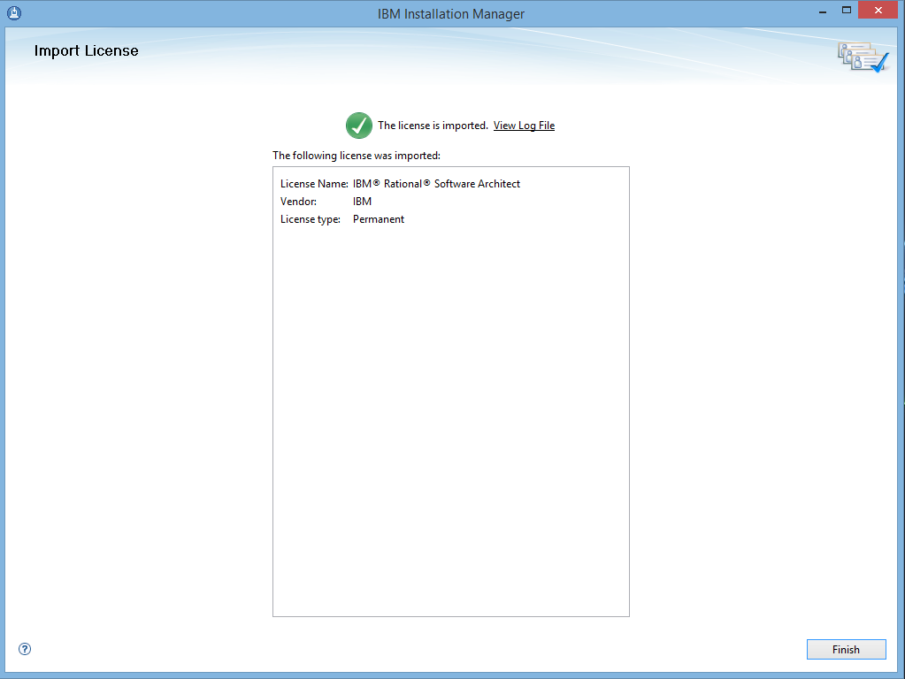
Installation

Slide 60
Remarks
Please contact support@cs.hku.hk for download or installation problems.

Slide 61
Thanks!

