Slide 1
Dynamic Modeling
COMP 7201 Analysis and Design of Enterprise Applications in UML

Slide 2
Outline
Use Case Diagram and Class Diagram
Object-Oriented Analysis Exercises
Create a Sequence Diagram in Architect
Create a State Machine in Architect

Slide 3
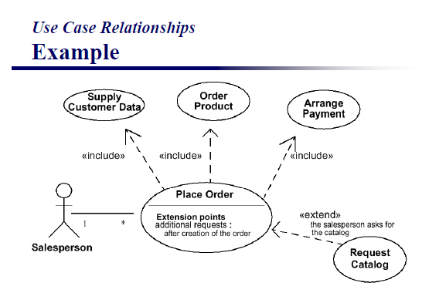
Exercise 1
Draw the following diagram (Lecture notes Object-Oriented Analysis, page 43) in IBM Rational Software Architect

Slide 4
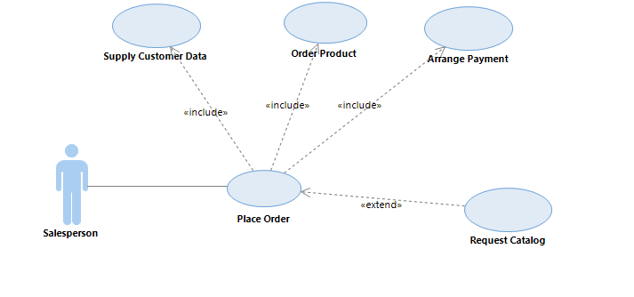
Exercise 1
In IBM Rational Software Architect, it should look like:

Slide 5
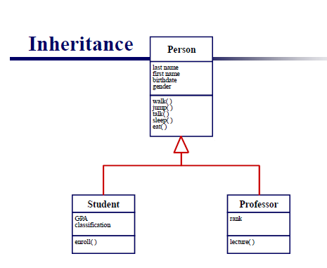
Exercise 2
Draw the following diagram (Lecture notes Object-Oriented Analysis, page 28) in IBM Rational Software Modeler

Slide 6
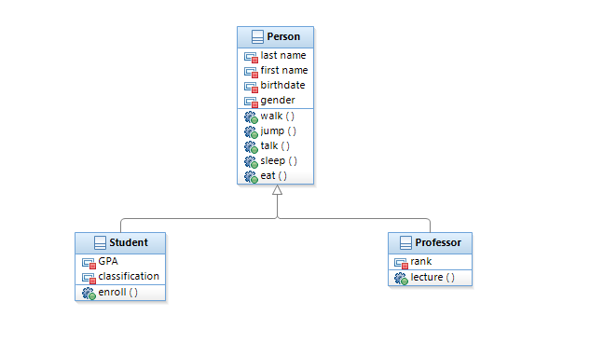
Exercise 2
In IBM Rational Software Architect, it should look like:

Slide 7
Exercise 3
From “Object-Oriented Systems Analysis And Design Using UML”Third Edition, by Simon Bennett, Steve McRobb and Ray Farmer, 1999.
Here is an interview between A and B.
A: You were telling me about concept notes. What do you mean by this?
B: At present, when we come up with an idea for a campaign we use a word-processor to create what we call a concept note. We keep all the note files in one directory for a particular campaign, but it’s often difficult to go back and find a particular one.
A: So is this something you’d want in the new system?
B: Yes. We need some means to enter a concept note and to find it again.

Slide 8
Exercise 3
A: So who would you want to be able to do this?
B: I guess that the staff working on a campaign should be able to create a new note in the system.
A: Only them?
B: Yes, only the staff actually working on a campaign.
A: What about finding them again? Is this just to view them or could people modify them?
B: Well, we don’t change them now. We just add to them. It’s important to see how a concept has developed. So we would only want to view them. But we need some easy way of browsing through them until we find the right one.
A: Can anyone read the concept notes?
B: Yes, any of the staff might need to have a look.

Slide 9
Exercise 3
Based on the above interview, do the following steps:
Step 1: Identifying Actors and Use Cases
Step 2: Constructing Use Case Diagram

Slide 10
Step 1
Identifying uses cases
Create concept note
Browse concept notes
Identifying actors
Staff
Campaign Staff
Use Case | Actor(s) | Description
Create concept note | Campaign Staff | Campaign staff can create a concept note to record ideas.
Browse concept notes | Staff | Staff may view concept notes.

Slide 11
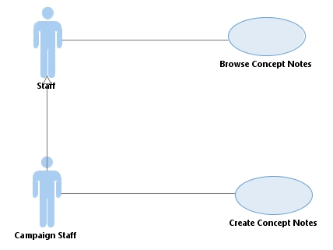
Step 2
Use Case Diagram

Slide 12
Exercise 4
User requirements for a bank account system are as follows:
First, customers log in to the system. Then they select debit or credit, followed by the transaction amount. If it is a debit and the transaction amount is more than the balance, reject the transaction. Otherwise, process the transaction.
Please conduct object-oriented analysis and do steps 1, 2 and 3.
Step 1: Identifying Actors and Use Cases
Step 2: Constructing Use Case Diagram
Step 3: Documenting Use Case Normal Course of Events

Slide 13
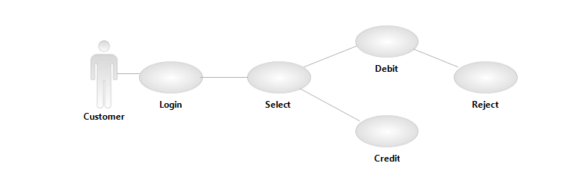
Sample
Step 1: Identifying actors and use cases
How about:

Slide 14
Problems?
Steps or Use cases?

Slide 15
Possible Solution
Step 1
Use Case | Actor(s) | Description
Process Transactions | Customer | Debit or Credit an amount from an account

Slide 16
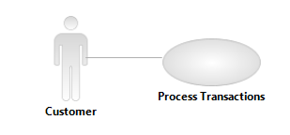
Possible Solution
Step 2

Slide 17
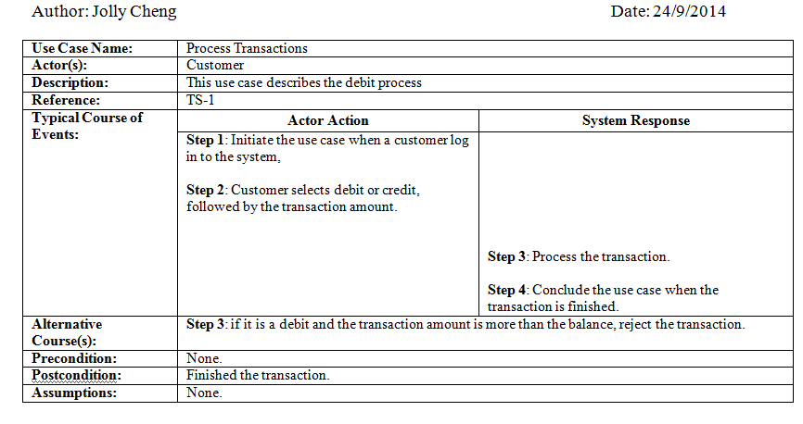
Possible Solution
Author: Jolly Cheng Date: 24/9/2014
Step 3

Slide 18
Exercise 5
User requirement:
To book a guest room, customers must log in the system. For customers who do not have an account, they may apply for a new user name and password. Then, the customers will choose the room type and specify the dates of arrival and departure. After the hotel has confirmed the availability, the customers will pay using a Visa card. However, sometimes there may be technical problems with the Visa authorization process. In such cases, the system will ask the customer for a Master card.

Slide 19
Exercise 5
Please conduct object-oriented analysis with the following steps:
Step 1: Identifying Actors and Use Cases
Step 2: Constructing Use Case Diagram
Step 3: Documenting Use Case Normal Course of Events

Slide 20
Step 1
Use Case | Actor(s) | Description
Book Room | Customer | The process of a customer booking a room

Slide 21
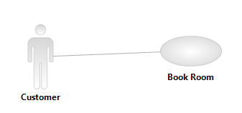
Step 2

Slide 22
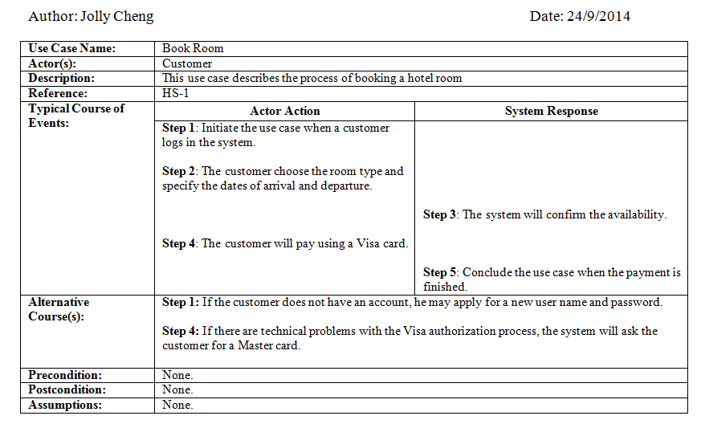
Step 3

Slide 23
Exercise 6
The users advise us about the scenario of putting an elephant into the refrigerator as follows:
Open the refrigerator door. If there is already a giraffe in the refrigerator, remove it. Put the elephant into the refrigerator. Then close the door. On Children’s Day on the 4th of April every year, all the animals must attend the lion’s party. Open the door of the refrigerator automatically so that the elephant may attend the party.

Slide 24
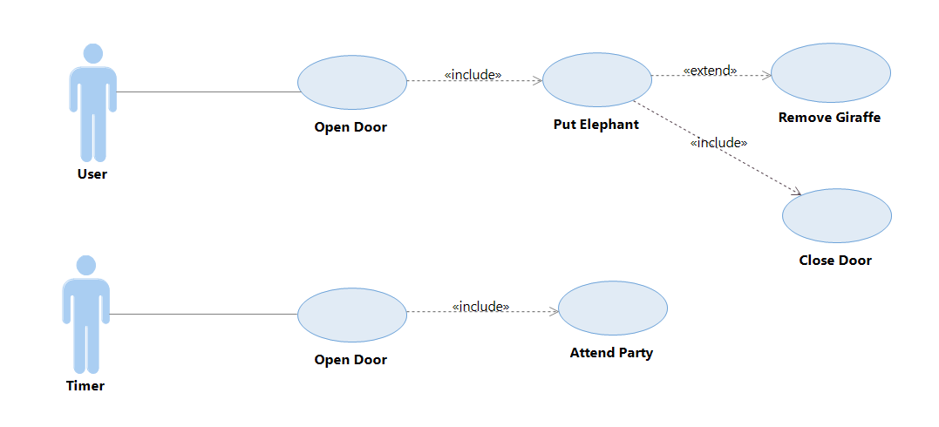
Exercise 6
Discuss any problems in the analysis use case diagram below:

Slide 25
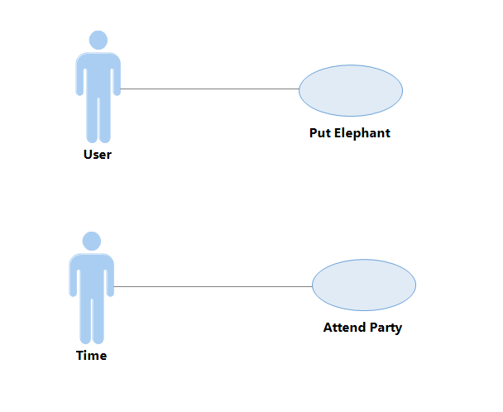
Problems
Steps?
Too many use cases! Some of them are steps only.
Timer??
It should be “Time” as the actor.
Open Door including other use cases???
Open Door should be included in other use cases.
Extend relationship direction????
Incorrect direction.
Sample modification:

Slide 26
Create a Sequence Diagram
Create New Sequence Diagram
Add an Actor
Add a Class Object
Add Messages
Add Combined Fragments
Combined Fragment Example
Temporal Constraints

Slide 27
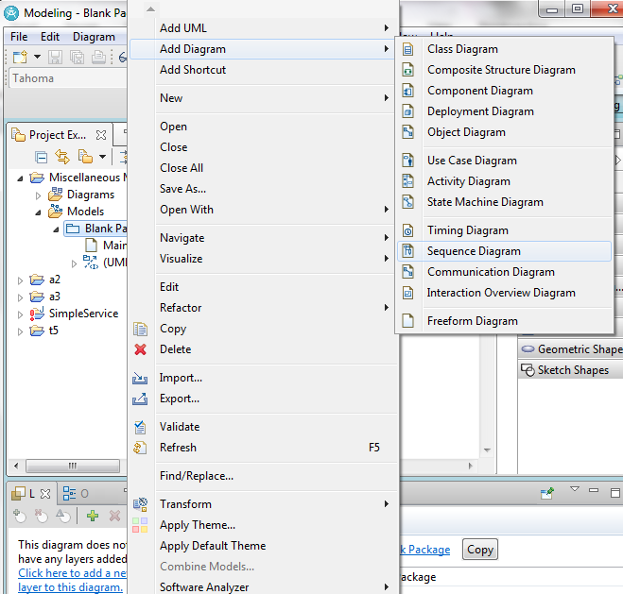
Create New Sequence Diagram

Slide 28
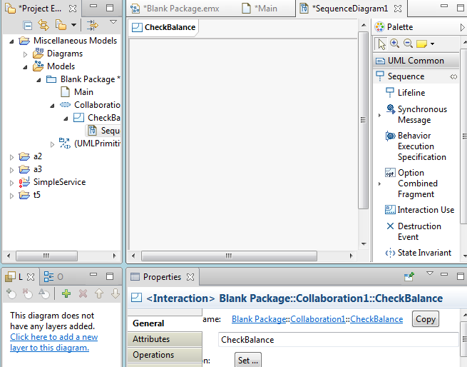
Name the Sequence Diagram

Slide 29
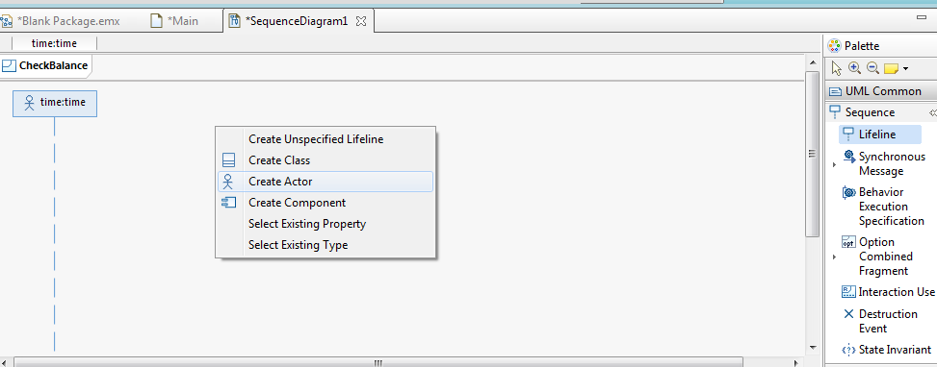
Add an Actor

Slide 30
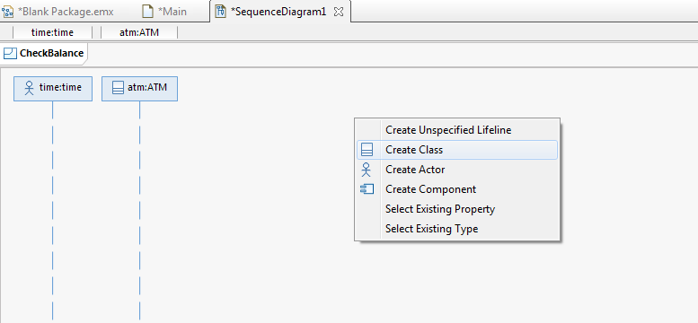
Add an Object

Slide 31
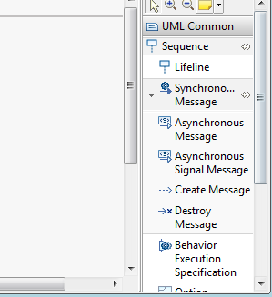
Add Messages

Slide 32
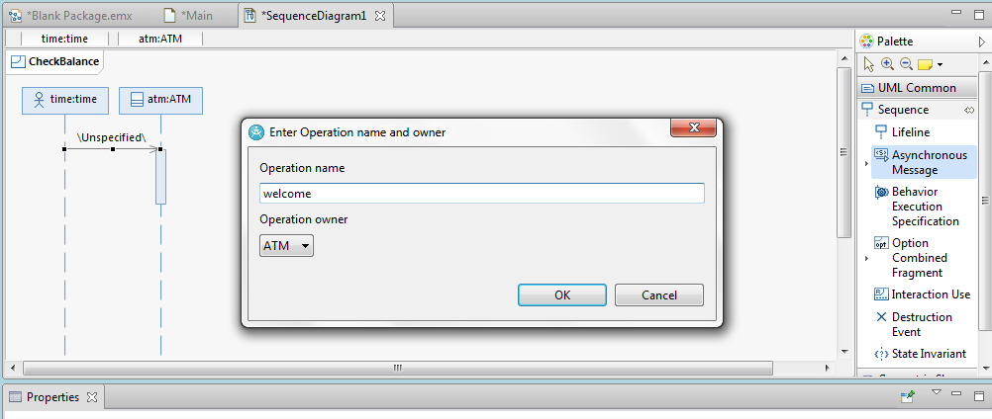
Add Messages

Slide 33
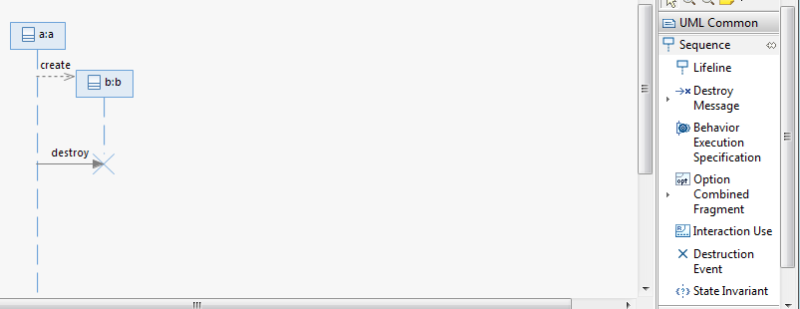
Create and Destroy Messages

Slide 34
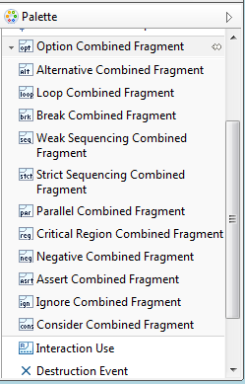
Add Combined Fragments

Slide 35
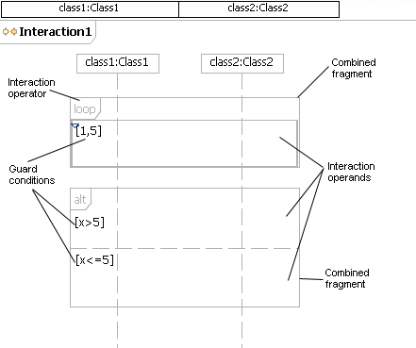
Combined Fragment Example

Slide 36
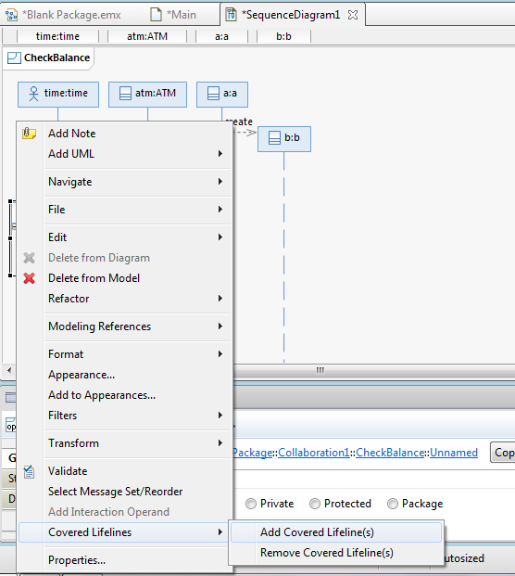
Add Covered Lifeline(s)

Slide 37
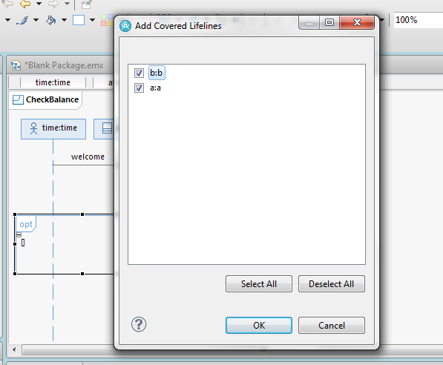
Add Covered Lifeline(s)

Slide 38
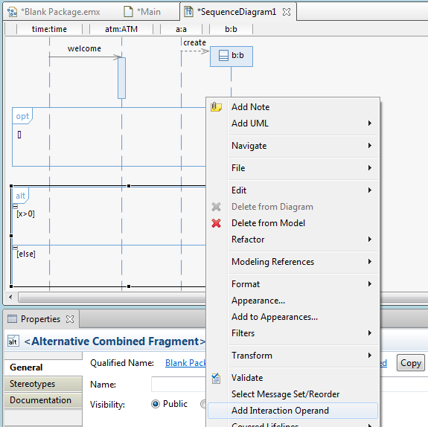
Add Interaction Operand

Slide 39
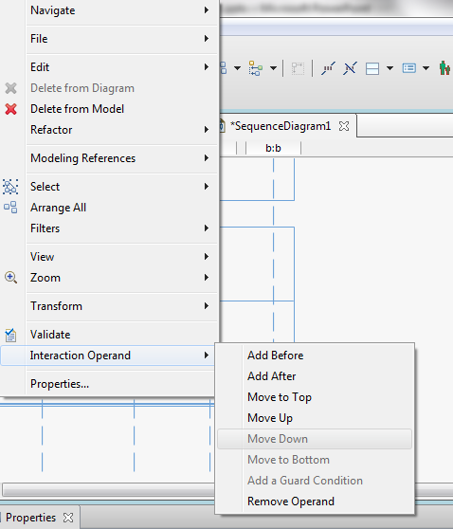
Change Position of Interaction Operand

Slide 40
Temporal Constraints
:B
Alt
Click
1 s
Highlight
Click
{0..1 s}
Click
Open

Slide 41
Temporal Constraints
However, IBM Rational Software Architect 9.1.1 doesn’t directly support this concept very well
Suggestions: use “note” to represent the temporal constraints in the diagram.

Slide 42
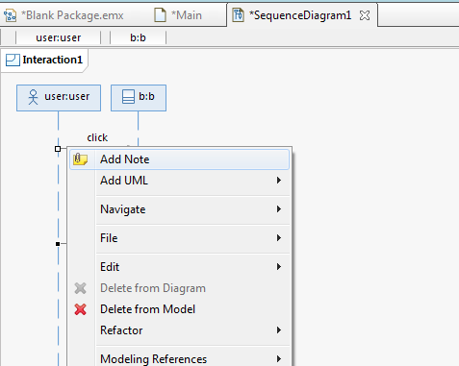
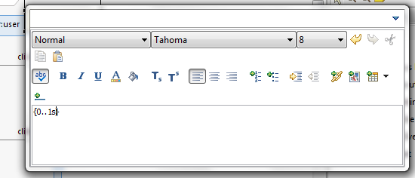
Duration Constraint
Select the two events by pressing SHIFT key
From context menu, select “Add UML” -> “Constraints”
Then type the constraints and adjust the position of the note

Slide 43
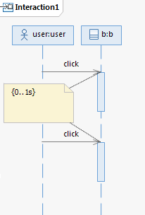
Duration Constraints

Slide 44
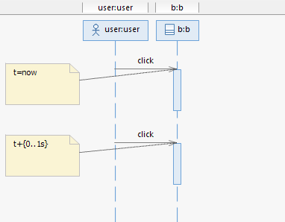
Time Constraints
Select an event
Right-click and “Add Note”
Input the constraints

Slide 45
Create a State Machine
Create a New State Machine
Add States and Transitions
Add an Event
Add an Action
Add a Condition

Slide 46
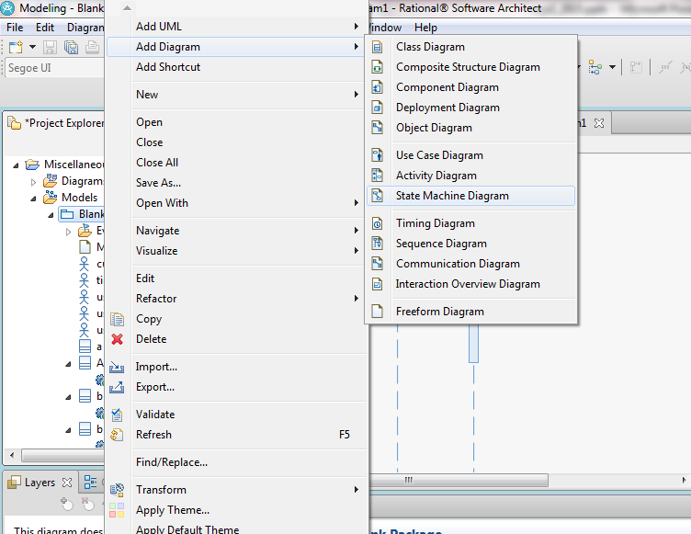
Create a New State Machine

Slide 47
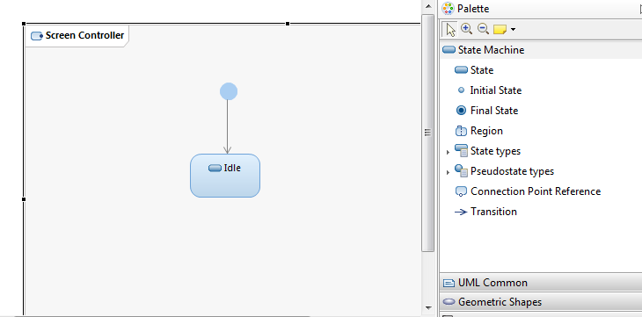
Add States and Transitions

Slide 48
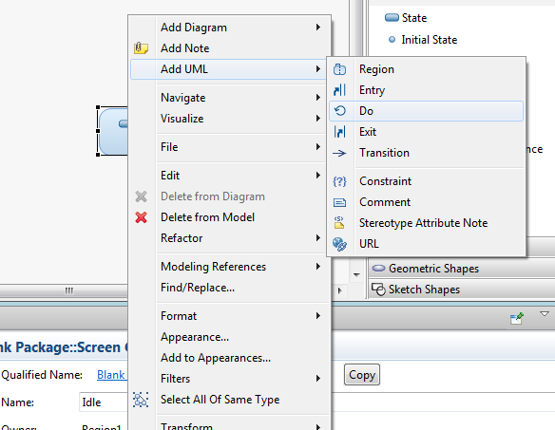

Add Entry/Do/Exit to State

Slide 49
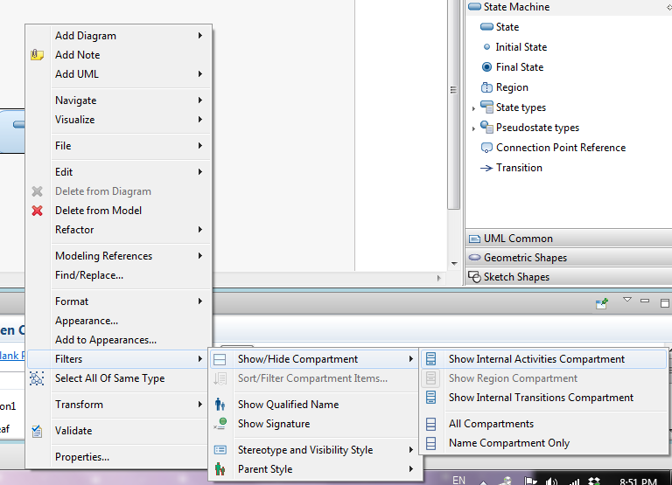
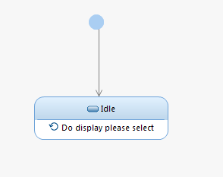
Toggle display Entry/Do/Exit

Slide 50
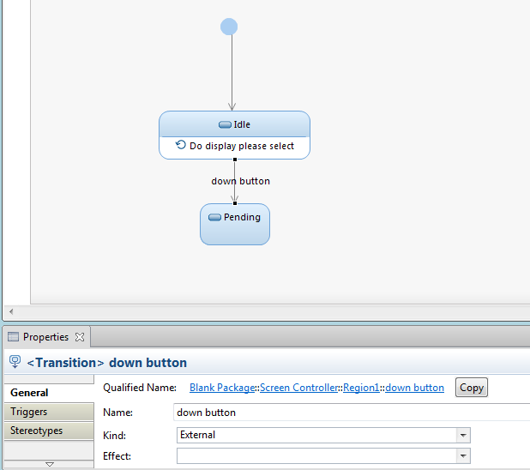
Add an Event

Slide 51
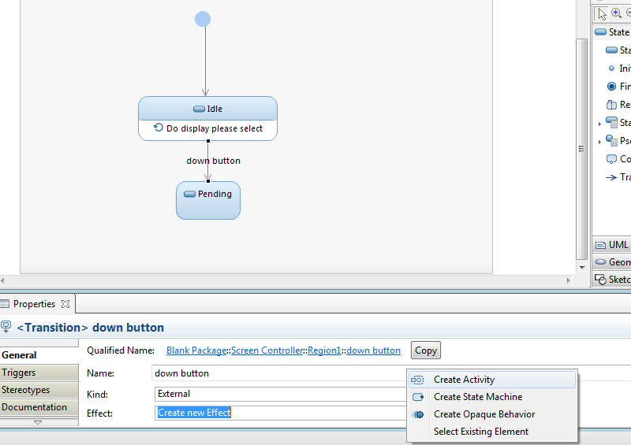
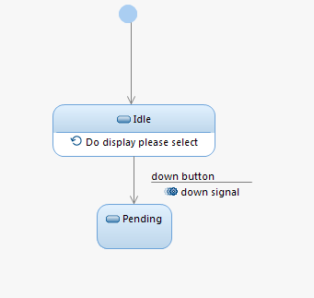
Add an Action
We use effect for an action

Slide 52
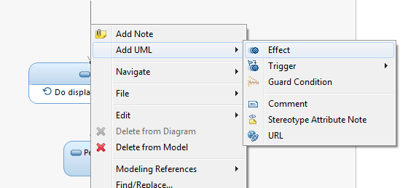

Add an Action
Alternative, select the transition → right-click and “Add UML”→ “Effect” → “Create Activity”

Slide 53
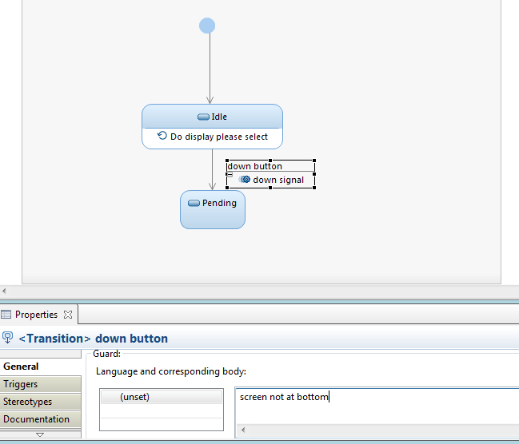
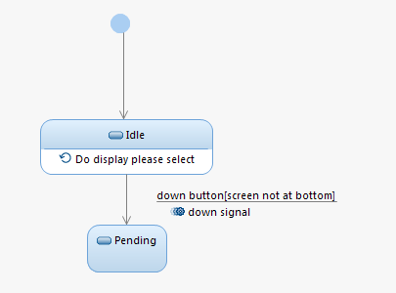
Add a Condition

Slide 54
Thanks!

