Slide 1
Additional notes about asynchronous messages

Slide 2
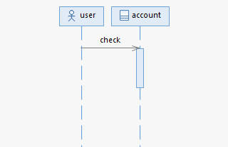
Asynchronous messages
By default, IBM Rational Architect would show the execution occurrences for asynchronous messages
To remove it, before drawing your sequence diagram, please do the following steps

Slide 3
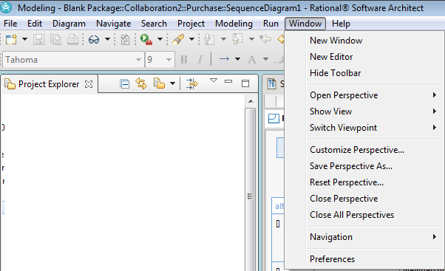
Remove the asy
Window → Perferences

Slide 4
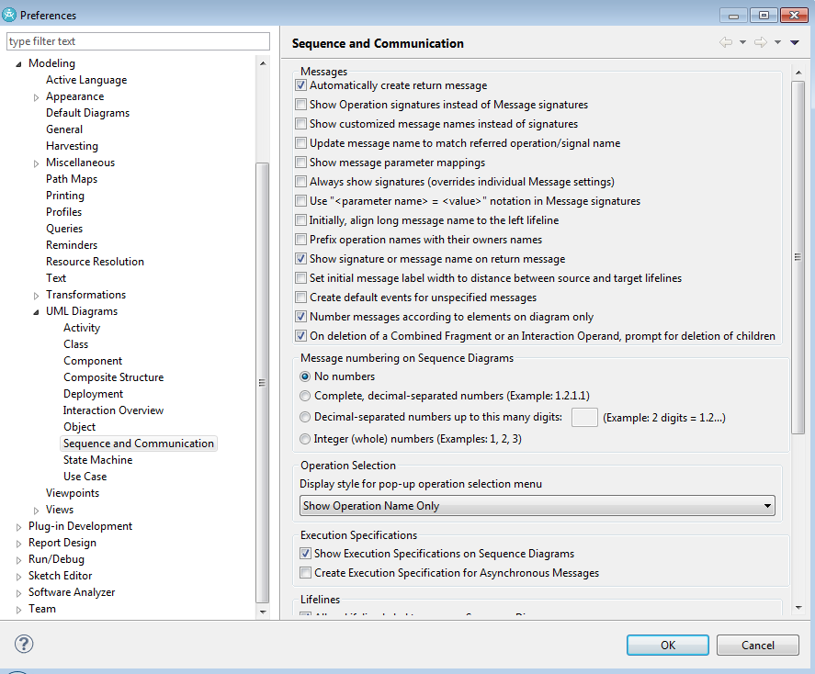
Under “UML Diagrams” → “Sequence and Communications”
In “Execution Specification” → remove the tick for the option “Create Execution Specification for Asynchronous Messages”

Slide 5
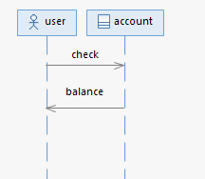
Example

