Slide 1
Progress
Using Latent Dirichlet Allocation to model Traffic State
IS’ 2015] Real-time traffic incident detection using a probabilistic topic model

Slide 2
LDA
Assumes a latent/unobserved Generative Probabalistic Model behind the generation of traffic. E.g. Every observed speed in every segment from probe car data is generated through sampling from this model.
Uses Posterior inference, to get the latent Random Variables: Traffic States as Distributions of speeds, Distributions of Traffic States in every Road Segment

Slide 3
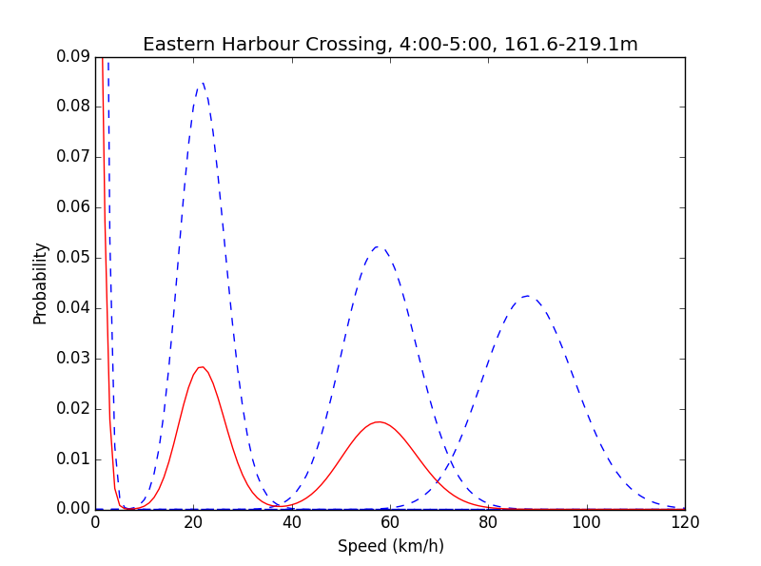
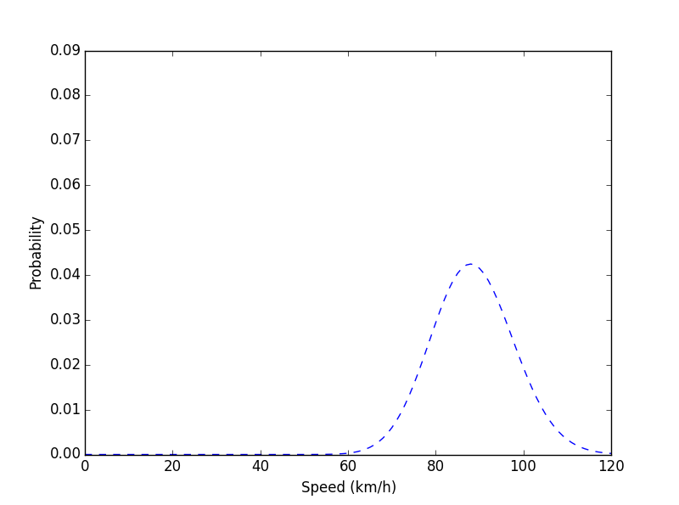
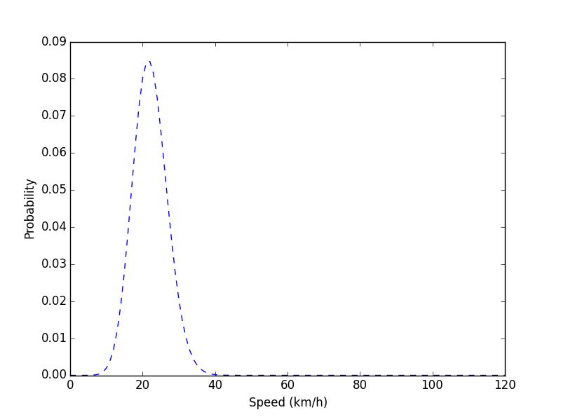
We assume
Every road segment is a mixture of Traffic States (Distribution)
Every Traffic state is a distribution of observed speeds
Distribution of States in Segment Time/Location
Distribution of observed speeds in state
“Smooth” State
“Crowded” State

Slide 4
Generation of every observation
Hyperparameter
Hyperparameter
Eta θ
Alpha θ
Per Segment state Proportions
State Assignement
Speed Observation from PCD
State
Theta θ
Z
B
s
N, for every observation
S, for every segment

Slide 5
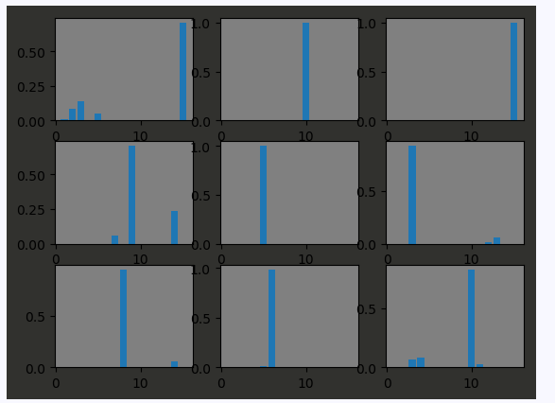
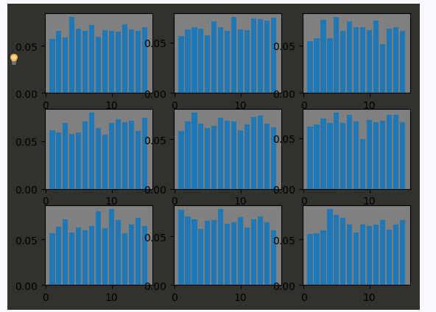
Hyperparameters
I actually haven’t understood how the Hyperparameters in this paper are placed <- My current understanding is that these parameters are important in shaping the Distributions of Distributions. E.g. generating Traffic States and Generating Distributionf over Traffic States.
This might be important, because the for homogeneous data, we need more sparse generative distribution, whereas for hetereogeneous data we need more Uniform base distributions.
Exchangeable alpha=0.01 => Sparsity
Exchangeable alpha=10 => Uniform

Slide 6
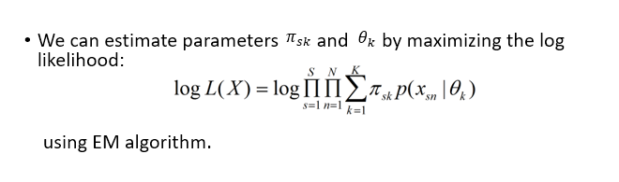
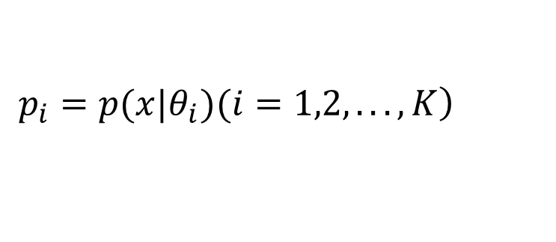

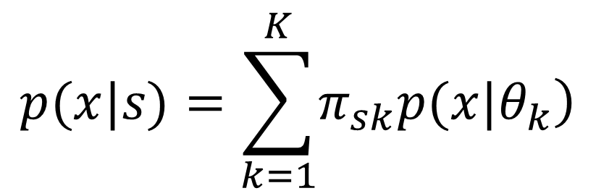

Inferring the Latent Variables
$$K$$
Suppose we have traffic states, each traffic state corresponds to a speed distribution , then we can express the traffic state on a segment as:
$$\left.p_{i}=p(x|θ_{i})(i=1,2,...,K\right)$$
$$s$$
$$p(x|s)=\sum_{k=1}^{K}{\left.π_{sk}p(x|θ_{k}\right)}$$

Slide 7
Why this Works
Posterior Approximation with Latent Variables
Markov Chains
Gibbs Sampling
EM algorithm
If I can get to this part, I can really discuss the algorithms effectiveness

Slide 8
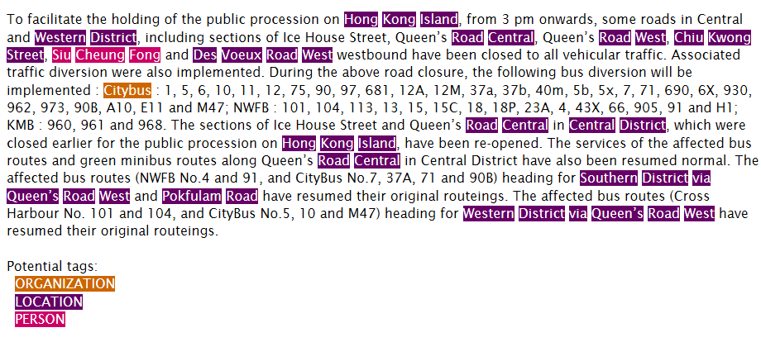
Data
Picking up the Speed Panels Data on Monday
Traffic News Data is well structured. Announcements about same Topic are described same way.
Tried Location Extraction with Java NRP, which is trained in United States

