Slide 1
Proposal
Andres Namm

Slide 2
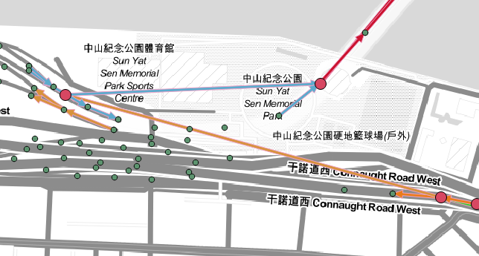
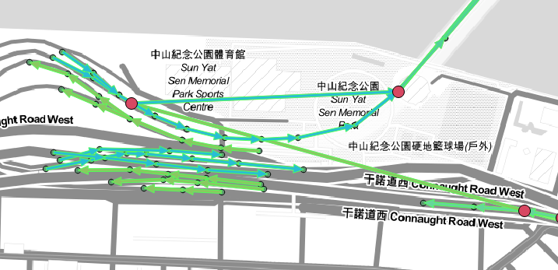
Improvement of RS data including
Speedpanel matching to Segments Spatially
Speedpanels themselves don't provide the best segments for GPS

Slide 3
Improvement for RS data including
RS information averaged over 2 minutes – different amount of cars go through each time
Calculate the average flow based on historical GPS data and give RS weights based on that
Calculate the average flow based on current GPS data
Mixture of the previous

Slide 4
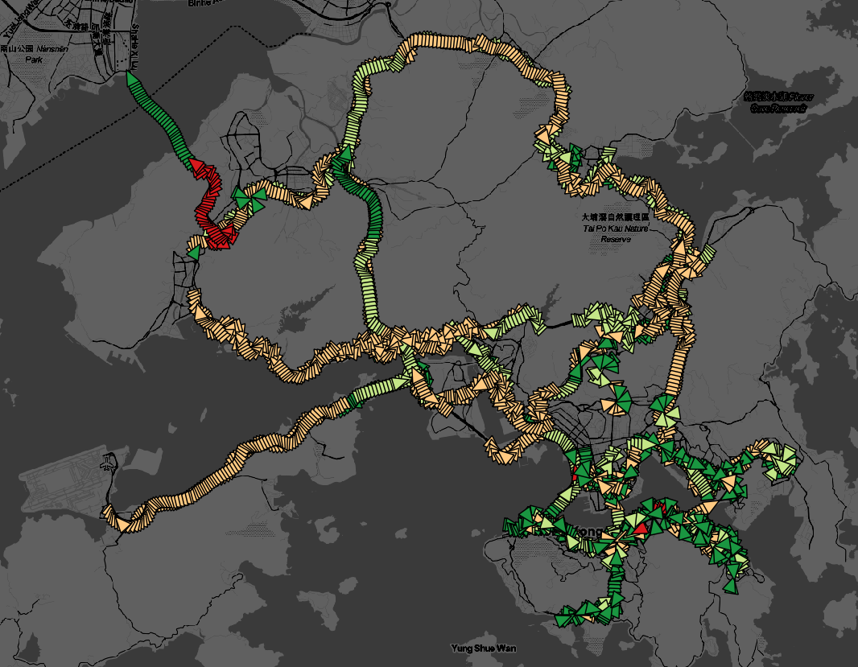

Imrpovement for RS data including
60 percent of the Data from HK island when RS data included
Not only problem with Road Sensors, I would guess

Slide 5
Improvement of Model
Kinoshita article -> Replace Poisson distributions with Gaussians
Currently in the model -> Parameters found by point estimate, consider them as random variables instead -> E.g in the end we will have a distribution over the parameters
This would take into account when training the amount of data in each segment
The distribution change of the parameters.
The reason to consider parameters as Random variables would be to get information about how reliable is the prediction
Try p-value, trust intervals
Find out features wich correlate with AUC

Slide 6
Inclusion of the previous in a probabalistic graph
Done in one article before - M. Hua and J. Pei. Probabilistic path queries in road networks: traffic uncertainty aware path selection

