Slide 1
Department of Land Surveying and Geo-informatics, PolyU
A Review on
Hong Kong Coordinate Systems
Cadastre and Boundary Survey
http://www.lsgi.polyu.edu.hk/cadastre
Date: 26/02/2001

Slide 2
Current Vertical Datum
Hong Kong Principal Datum (HKPD)
  all heights and levels on land.
  relationship to mean sea level.
  Benchmark: Round Head Bolt, etc.
Chart Datum (CD)
  all depths and heights above mean higher high water mark.

Slide 3
Current Horizontal Datum
Local Hong Kong 1980 Datum
  Major Trilateration: Trigonometric (Trig.) Station
  Minor: Urban Survey Mark (USM), Picket box (PB)
  Traverse: Iron spike (IS), Iron tube (IT), Lead plug (LP), Survey Nail (SN), Wooden Peg (Peg), & Cut Mark (CM).

Slide 4
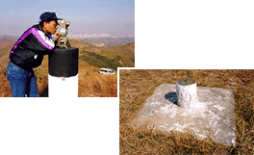
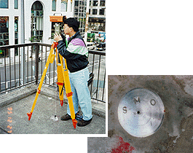
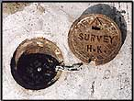
Control Stations

Slide 5
Early Geodetic Control in HK
First HK map showing Trig stations in 1845 by Lt. Collinson R.E.
Another map produced by Tate and Newland in DD Survey 1899-1904.
No survey record found for triangulation, e.g. no methods mentioned.
Uncertainty degree of accuracy.

Slide 6
1924/25 Main Triangulation
A military map of 1/20000 was produced from air photographs by the Royal Air Force with ground controls by the 2nd Colonial Survey Section R.E.

Slide 7
First Triangulation Network
Controls adjusted by Geographical Section in 1928-30.
Re-adjusted by Crown Lands & Survey Office (CL&SO) in 1946 and adopted up to 1963.
Values known as Old Imperial Values (feet); four quadrants appeared.

Slide 8
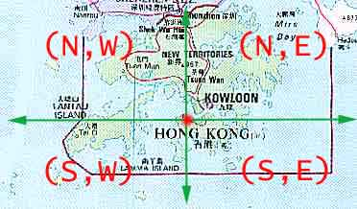
Old Imperial Coordinate System 1928

Slide 9
1963 Datum (New Imperial Values)
Why? Accuracy cannot meet requirements for large scale mapping & boundary surveys. (Re-triangulation).
Clarke 1858 as reference ellipsoid, Patridge Hill as datum origin, Cassini projection for grid system.
Old Imperial to New Imperial
  Northing + 50000 ft; Easting + 120000 ft.
Coordinates in HK territory - +ve values.

Slide 10
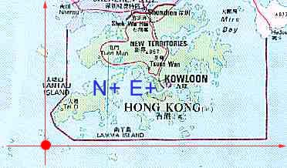
New Imperial Coordinate System 1963

Slide 11
Metrication- Old Metric Values
Why? Metrication policy in 1970s, New Imperial grid was converted to metric unit of measure in 1975-7.
Feet to metre (x 0.3048)
Grid origin further shifted 3550m to the West, i.e. (-3550m E).

Slide 12
HK1980 Grid Datum
Why? EDM technology, distance between Trig. resurveyed in 1978-9 to improve the consistence and accuracy of control network (Trilateration).
International Hayford 1910 as reference ellipsoid, same projection origin, Transverse Mercator projection for grid system.
Northing + 800000m; Easting + 800000m.

Slide 13
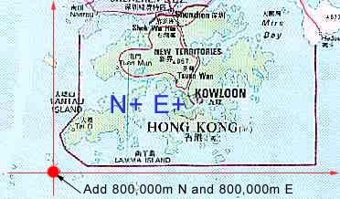
HK 1980 Coordinate System

Slide 14
Nowadays
1990, Survey & Mapping Office (SMO) uses GPS for position fixing.
Provides a link between local HK80 Geodetic Datum and global WGS84 Datum.

Slide 15
Scale of contemporary maps
DD Survey (1:3960, 16 inches to 1 mile) and (1:1980, 32 inches to 1 mile)
1963 Survey (1:1200, 1 inch :100ft) for rural; (1:600, 1 inch :50ft) for urban.
Post 1980 (1:1000)

Slide 16
Conversion Constants
As described, 4 different coordinate systems
Different adjustment, instruments used, etc.
Different control network shifted a certain level, i.e. directions, magnitude at different regions.
Same shifting in local areas.
A Pair of conversion constants applied.

Slide 17
Conversion Constants
Physical features for conversion:
  Old control stations;
  Permanent Survey Mark (PSM);
  Boundary Stone, if available;
  Old radiated points (shots).

