Slide 1
Real time Automatic Incident Detection Based on GPS and Road Sensor Data
Andres Namm

Slide 2
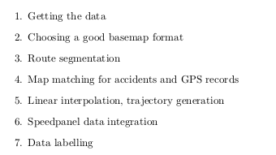
Intro
Data Preprocessing development
E.g. getting 30 GB of GPS data and 5 GB of road sensor Data into the incident detection model
Model Analysis
Documentation
Road sensor data integration

Slide 3
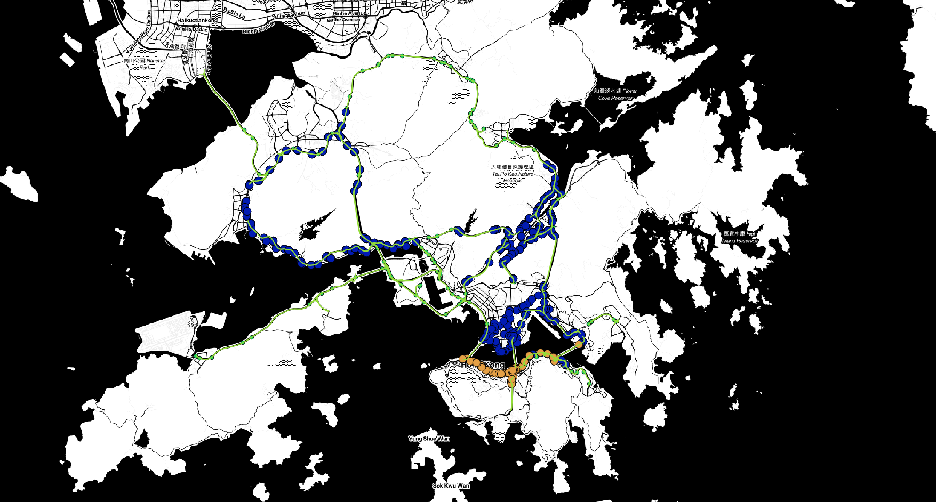
Area

Slide 4
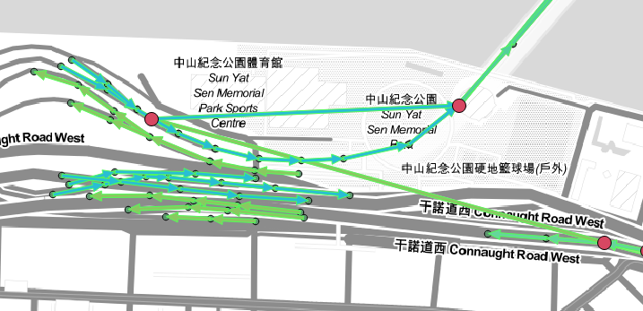
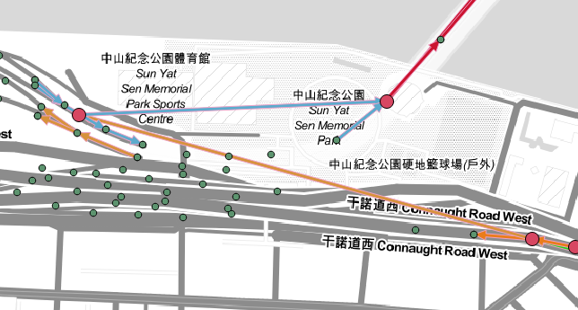
First steps
Segmentation into 50-100 m segments
Matching GPS records and Accidents to roads 25 m boundary
100 m map matching
25 m map matching

Slide 5
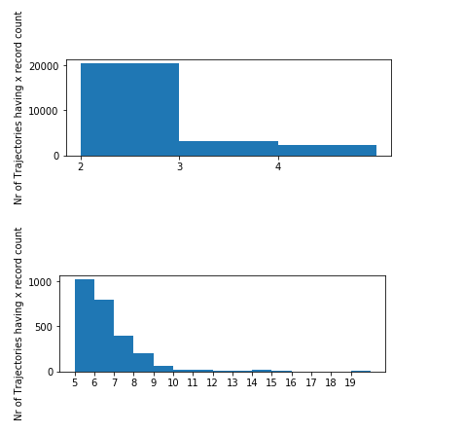
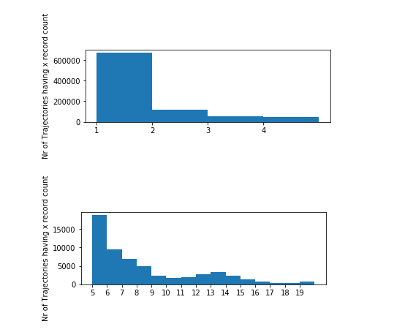
Linear Interpolation – redesign made a difference
Old Code 30 Million Records from GPS 100 m boundary
New Code 90 Million Records from GPS 25 m boundary

Slide 6
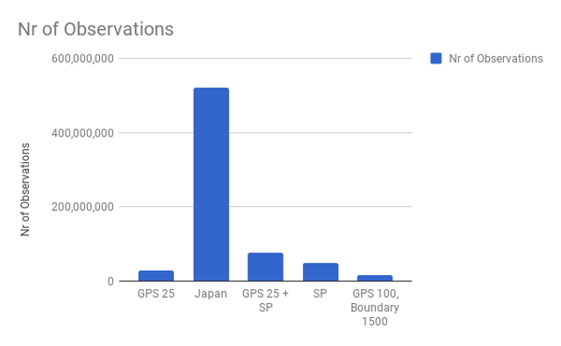
Speedpanel data integration
In some locations more than 4000 % of observations
More than doubled the input Data Size from 30 million to 70 million

Slide 7
Labeling, Model Training
In labeling part I detected another mistake which allowed to match 300 times more GPS observations to accidents and 500 times more GPS + RS observations to accidents
Model training from 30 minutes to 2 hours

Slide 8
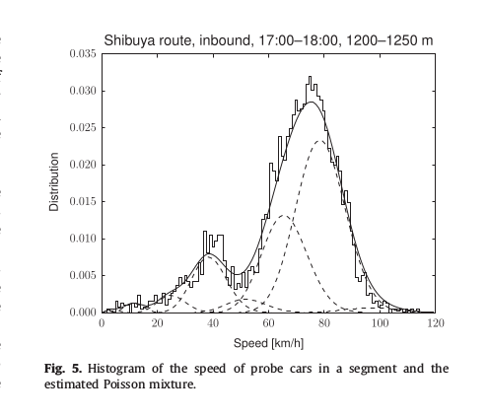
Model
MODEL
1. K global Poisson distribution means
2. For each road segment multinomial distribution over K Poisson distributions
INCIDENT DETECTION
1. Calculate Posterior Distribution with each new observation
2. Calculate KL divergence between old and new distribution

Slide 9
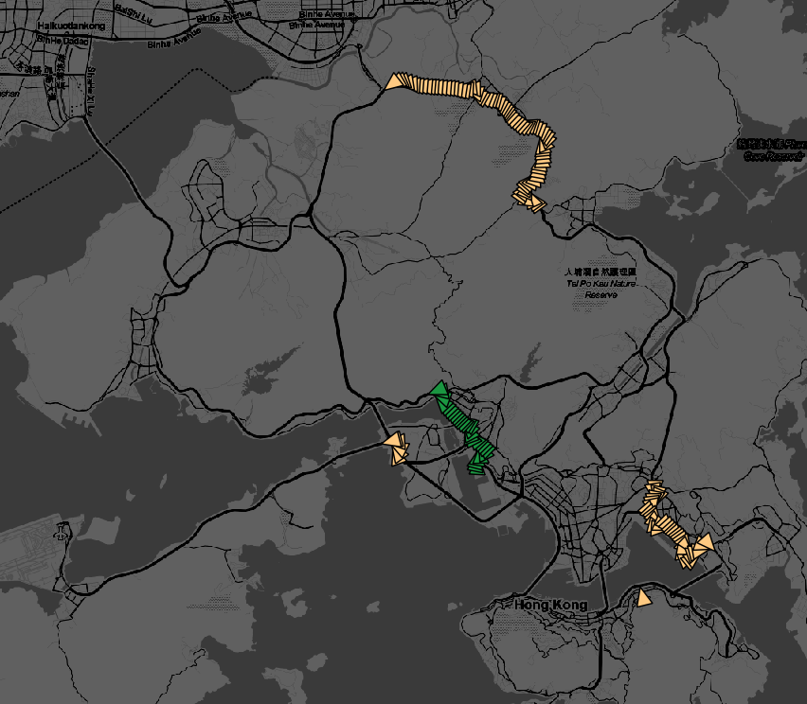

Results – initial project – only GPS
AUC average 0.3

Slide 10
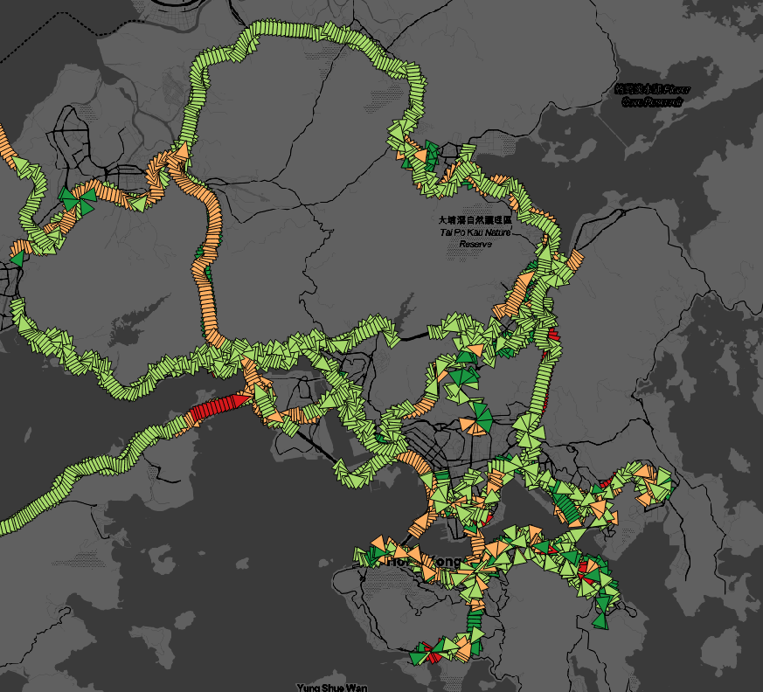
Results – redesigned project – only GPS
AUC average 0.5714
Best performing 0.999
Not taking into account roadworks
Based on some Feature Filtering
0.62

Slide 11
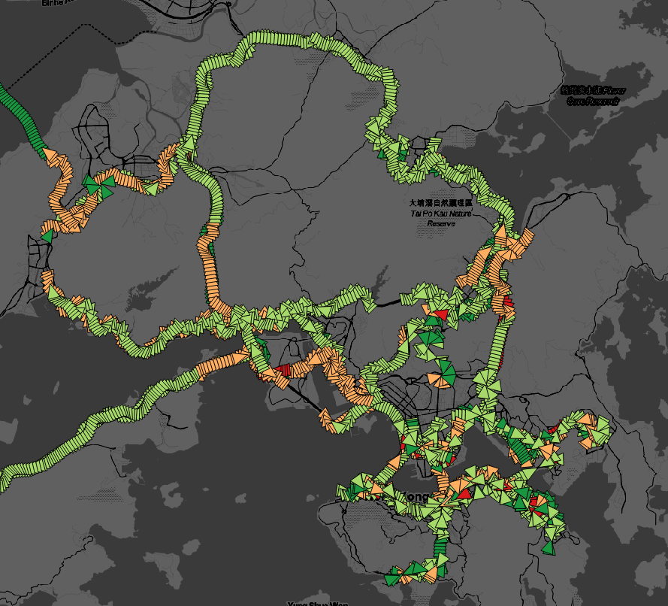
GPS + RS
AUC average 0.5749

Slide 12
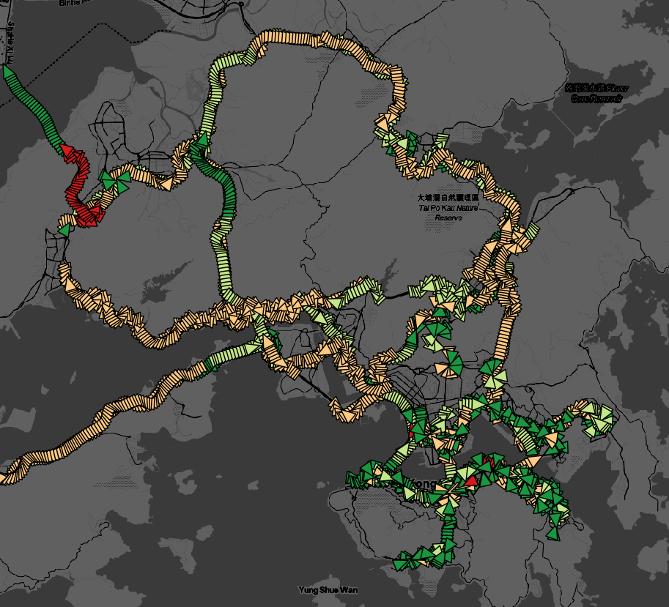

Comparison of AUC

Slide 13
Ideas To improve
Better Methodology for RS integration – No current literature has dealt with this problem. Designed my own rather simple logic.
Correlation between amount of data and AUC. Addition of new Road Sensors. Currently only 62 RS included. After 2013 600
Model improvement – Gaussians instead of Poissons, Assessment of model reliability in each segment based on some attributes
Include roadworks as ground truth like in Kinoshita et al. This is likely one reason for worse results.
Interactive: OSM allows many visualisation possibilities. Possibility to develop Human – AI system.

