Slide 1
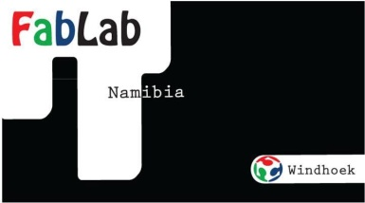
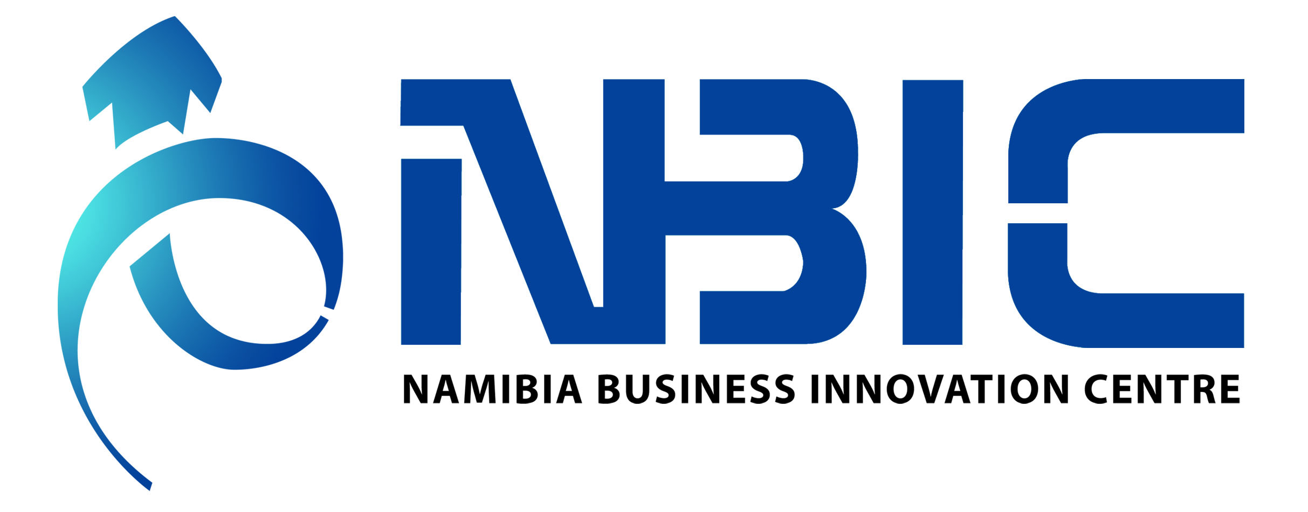
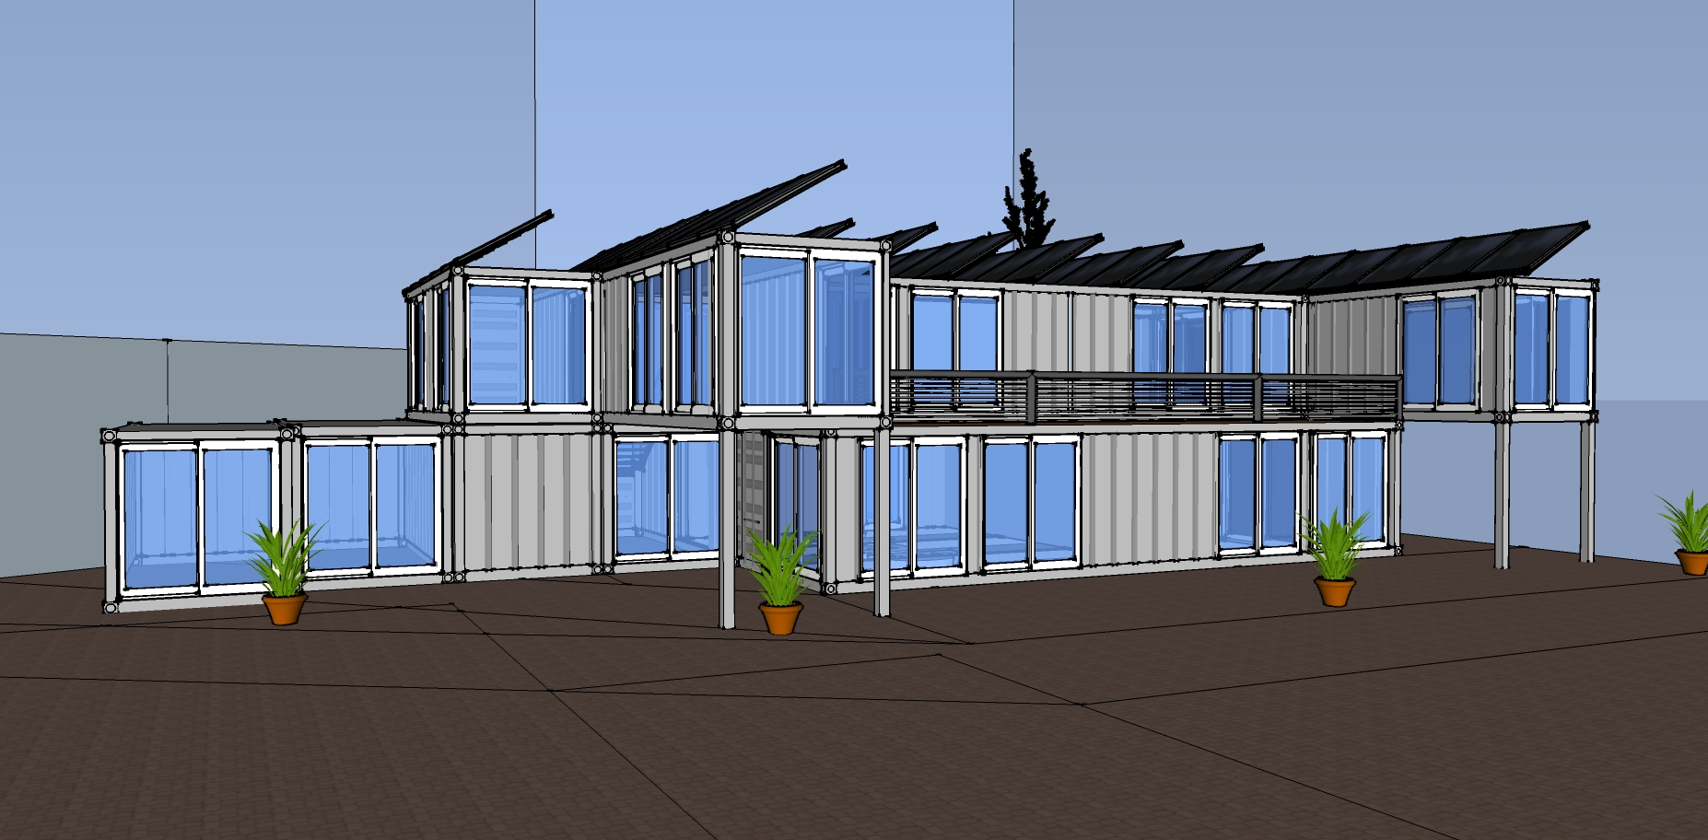

Our Building
Notes:
Our Building will be made from Containers as a sustainable way to teach the locals on how to create a sustainable building and a new method in modular Building Construction.
The building will be constructed in Phases
Phase 1- Actual Building
Phase 2- Solar Panels are added
Phase 3- Vertical Gardening all around the Building
Phase 4- Grey Water Recycling Schemes

Slide 2
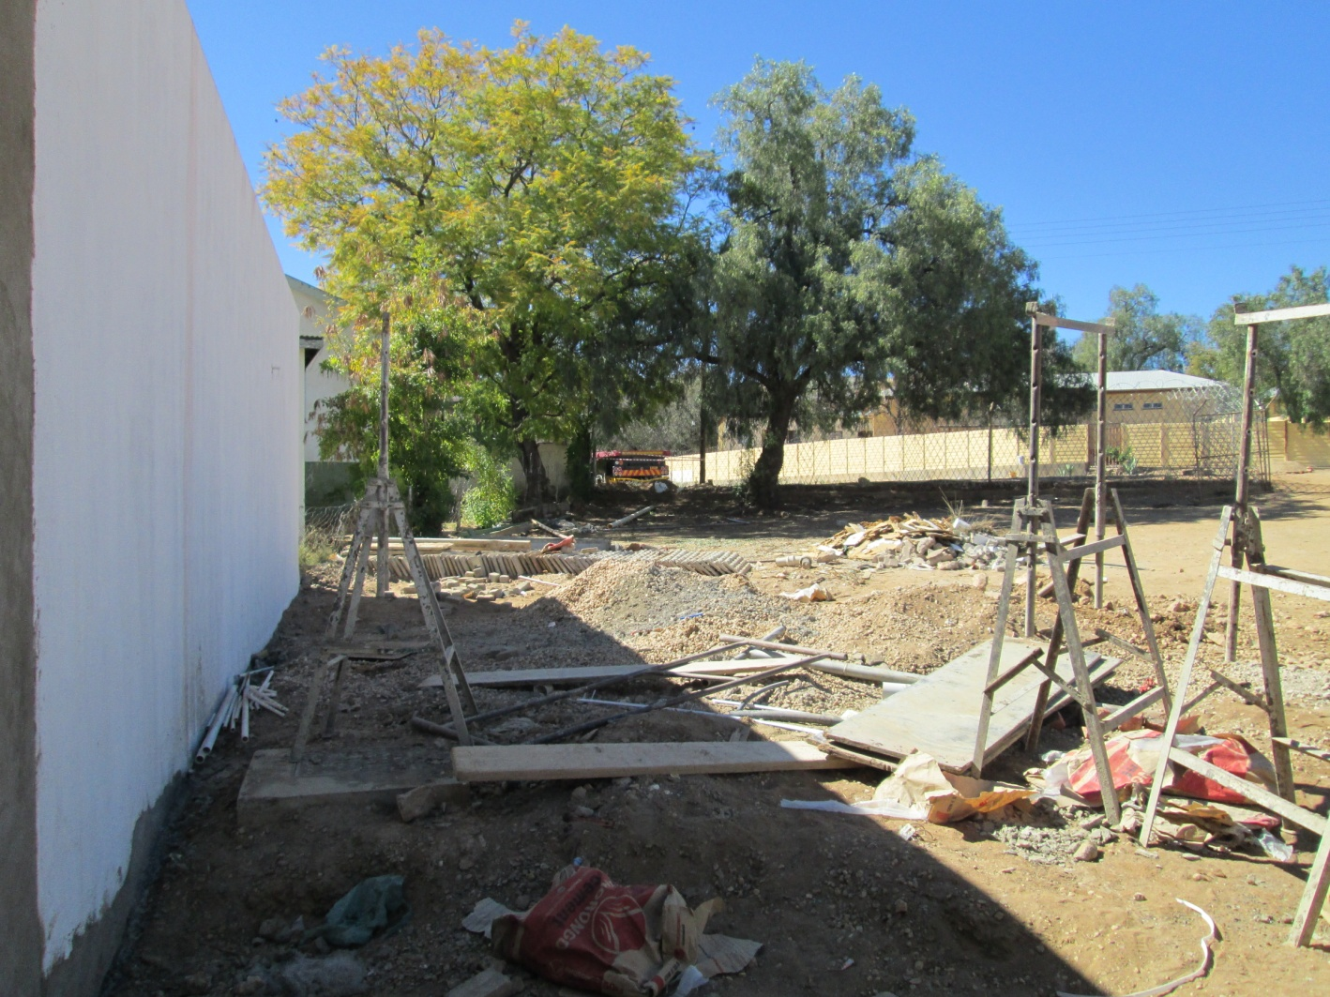
Our Land

Slide 3
Our Users
Notes:
Namibia has a large amount of SME’s/ Crafters who need Product Development in their Products they produce and sell.
We already have over 400 people who need our assistance in Product Development, Scaling in manufacture and quality assurance.
Our Host Institution in the Namibian Business Innovation Centre who serves entrepreneurs offering Business Planning, Bootcamps etc.

Slide 4
Our Machines
Prototyping Department
Laser Cutter
Shop-Bot, Drill Press and Scroll Saw
Electrical Workbench
Milling Machine
3D Scanner
Vinyl Cutter and Printer
3D Printer
Molding and Casting Station
Vacuum Former
Fashion Department
Sewing Machines
Embroidery Machines
Pattern Cutter
Notes:
Machines and stations that will be used most
Molding casting- e.g. Soap making
Modern Fashion and embroidery
Laser Cutter for Jewelry, buttons, Packaging etc.
Vinyl Cutter and Printer- Labels on Packaging
Shop-Bot and Vacuum Former – Packaging

Slide 5
Our Workshops
Labeling and Graphic Design- Currently running
Packaging Design
3D Cad Design for product Prototyping
Fashion Design
Furniture Design
Molding and Casting
Electrical Engineering
Robotics
Jewelry Manufacture (small scale)
All necessary prototyping for SME’s

Slide 6
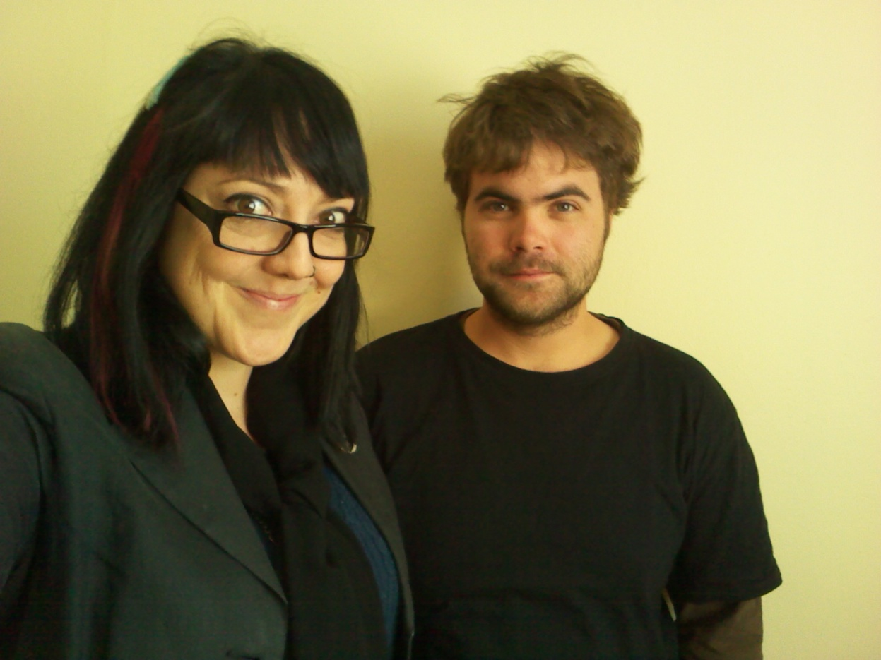
Us.

