Slide 1
Rain
Quick flow reservoir V₁
Quick flow reservoir V₂
Quick flow reservoir V₃
Effective rain (ER)
α ER
K_{q} V₁
K_{q} V₂
K_{q} V₃
ER
Q
Soil storage capacity
(1-α) ER
K_{s} V₄
Slow flow reservoir V₄

Slide 2
Rain
Effective rain
Quick flow reservoir
Total discharge
Soil
Slow flow reservoir

Slide 3
Rain
Effective rain (ER)
α ER
Quick flow reservoir V_{s}
K_{q} V_{q}
C
Q
Soil storage capacity
(1-α) ER
F(C)
K_{s} V_{s}
Slow flow reservoir V_{s}

Slide 4
Rain
Evaporation
Surface flow
Effective rain
Underground flow
River flow
Water stored in the soil

Slide 5
Rain
Evaporation
Surface flow
Effective rain
Water stored in the soil
Infiltration
Underground flow
River flow

Slide 6
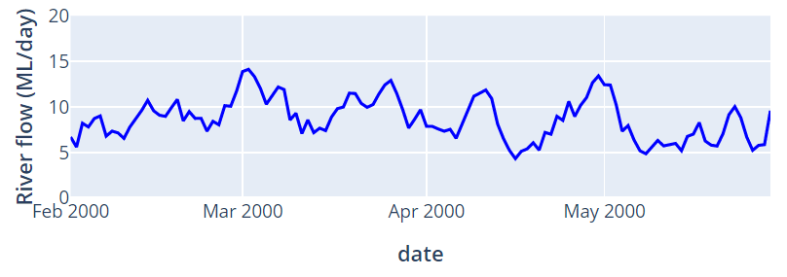
Rain
Evaporation
Surface flow
Effective rain
Water stored in the soil
Underground flow
Soil

Slide 7
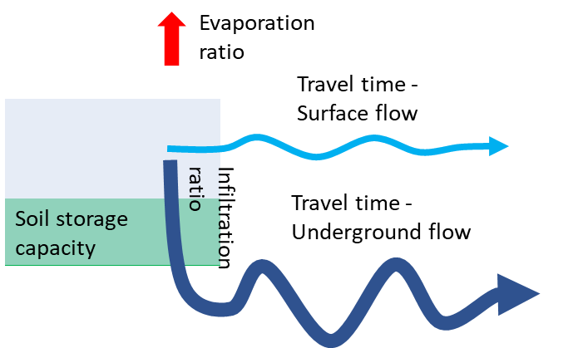
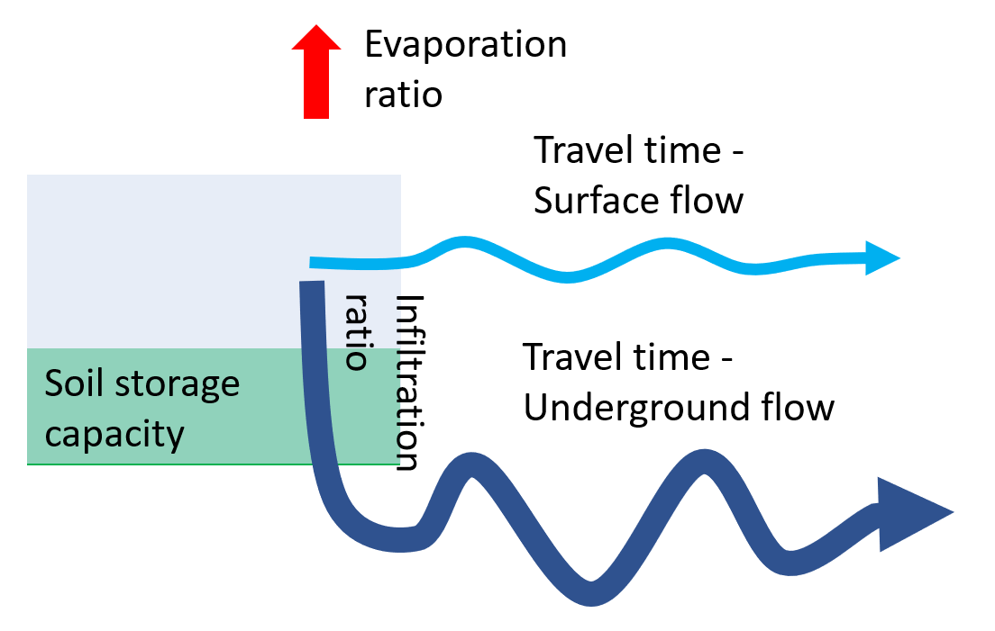
Evaporation ratio
Travel time - Surface flow
Soil storage capacity
Infiltration ratio
Travel time - Underground flow

Slide 8
Evaporation rate
Travel time - Surface flow
Soil storage capacity
Infiltration rate
Travel time - Underground flow

Slide 9
Evaporation rate
Travel time - Surface flow
Soil storage capacity
Infiltration rate
Travel time - Underground flow

Slide 10
Evaporation rate
Travel time - Surface flow
Soil storage capacity
Infiltration rate
Travel time - Underground flow

Slide 11
Evaporation rate
Travel time - Surface flow
Soil storage capacity
Infiltration rate
Travel time - Underground flow

Slide 12
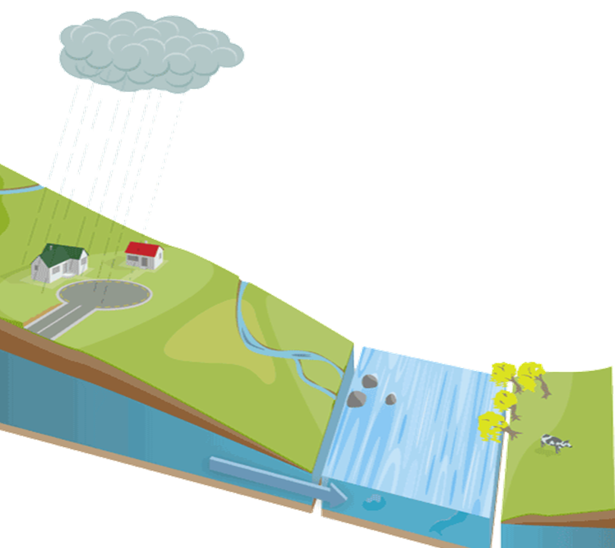
Rain
Evaporation
Soil
Surface flow
Groundwater
River
Underground flow

Slide 13
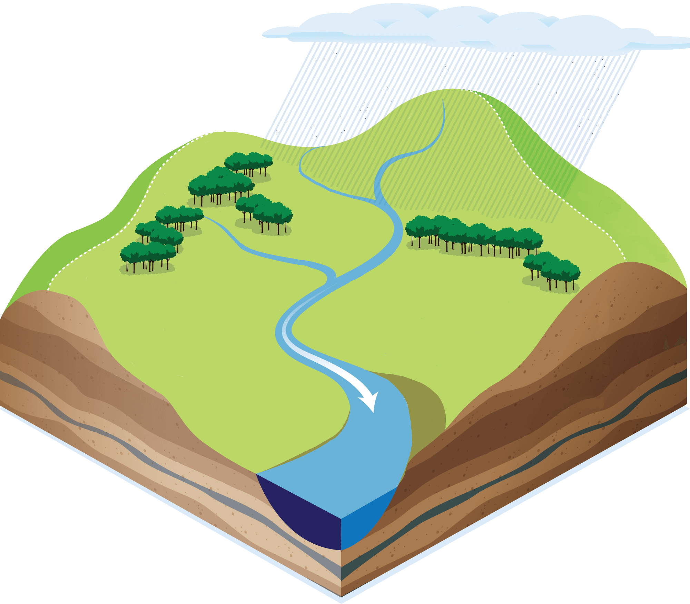
Rain
Surface flow
Evaporation
Soil
River
Underground flow

Slide 14
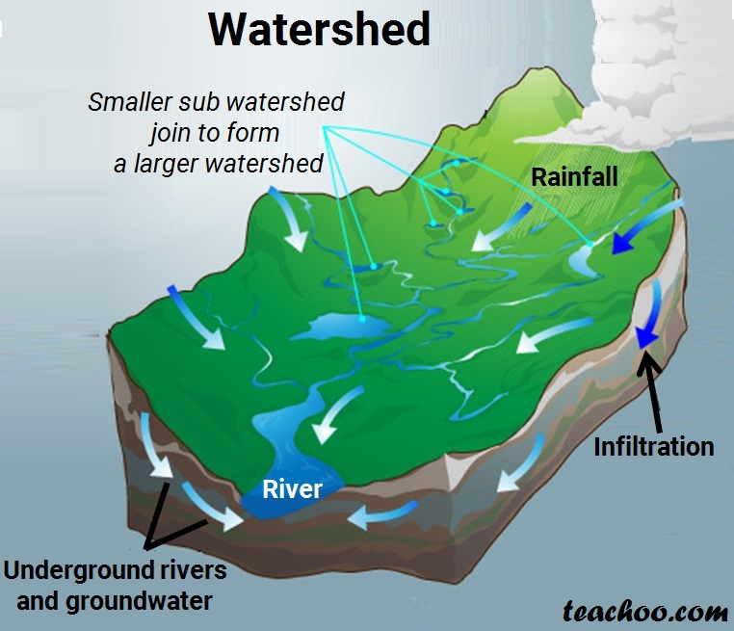

Slide 15
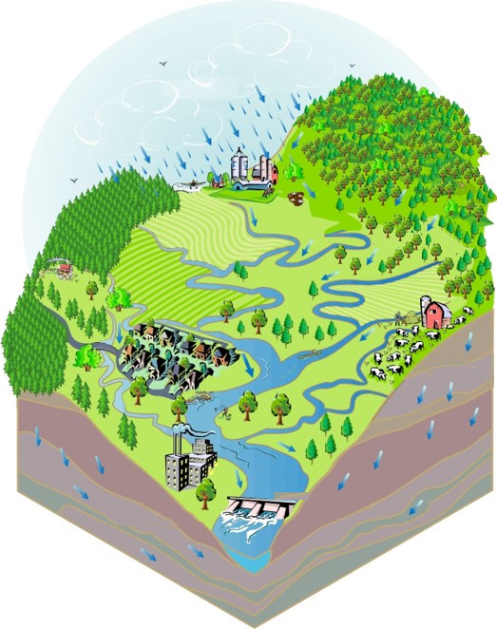
Rain
Surface flow
River
Underground flow
Underground flow

Slide 16
