Slide 1
Rain
Quick flow reservoir V₁
Quick flow reservoir V₂
Quick flow reservoir V₃
Effective rain (ER)
α ER
K_{q} V₁
K_{q} V₂
K_{q} V₃
ER
Q
Soil storage capacity
(1-α) ER
K_{s} V₄
Slow flow reservoir V₄

Slide 2
Rain
Effective rain
Quick flow reservoir
Total discharge
Soil
Slow flow reservoir

Slide 3
Rain
Effective rain (ER)
α ER
Quick flow reservoir V_{s}
K_{q} V_{q}
C
Q
Soil storage capacity
(1-α) ER
F(C)
K_{s} V_{s}
Slow flow reservoir V_{s}

Slide 4
Rain
Evaporation
Surface flow
Effective rain
Underground flow
River flow
Water stored in the soil

Slide 5
Rain
Evaporation
Surface flow
Effective rain
Water stored in the soil
Infiltration
Underground flow
River flow

Slide 6
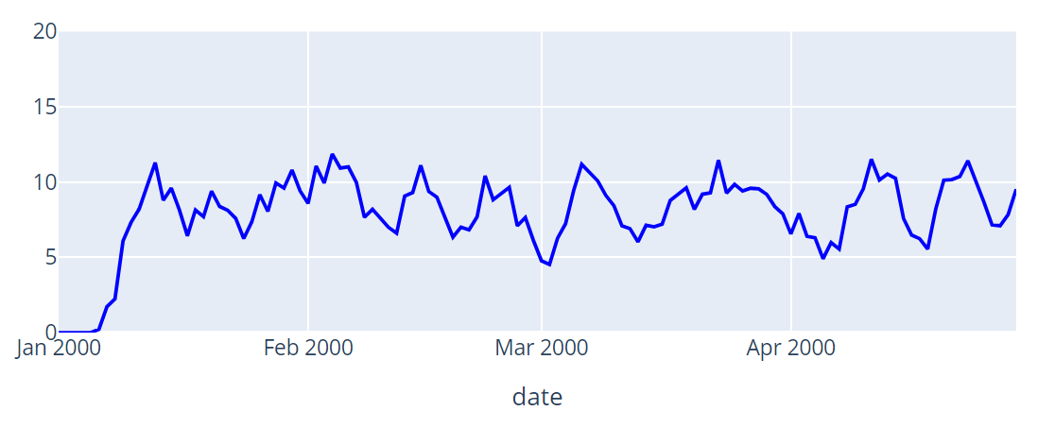
Rain
Evaporation
Surface flow
Effective rain
River flow
Water stored in the soil
Underground flow
Soil

Slide 7
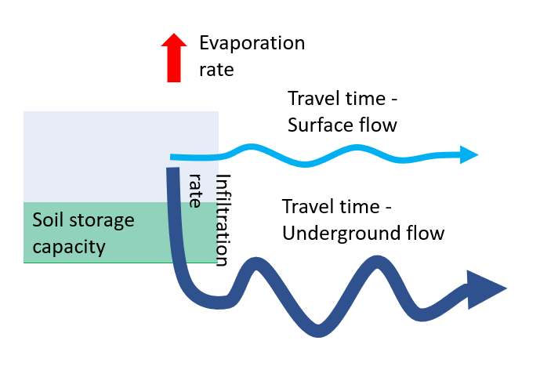
Evaporation rate
Travel time - Surface flow
Soil storage capacity
Infiltration rate
Travel time - Underground flow

Slide 8
Evaporation rate
Travel time - Surface flow
Soil storage capacity
Infiltration rate
Travel time - Underground flow

Slide 9
Evaporation rate
Travel time - Surface flow
Soil storage capacity
Infiltration rate
Travel time - Underground flow

Slide 10
Evaporation rate
Travel time - Surface flow
Soil storage capacity
Infiltration rate
Travel time - Underground flow

Slide 11
Evaporation rate
Travel time - Surface flow
Soil storage capacity
Infiltration rate
Travel time - Underground flow

Slide 12
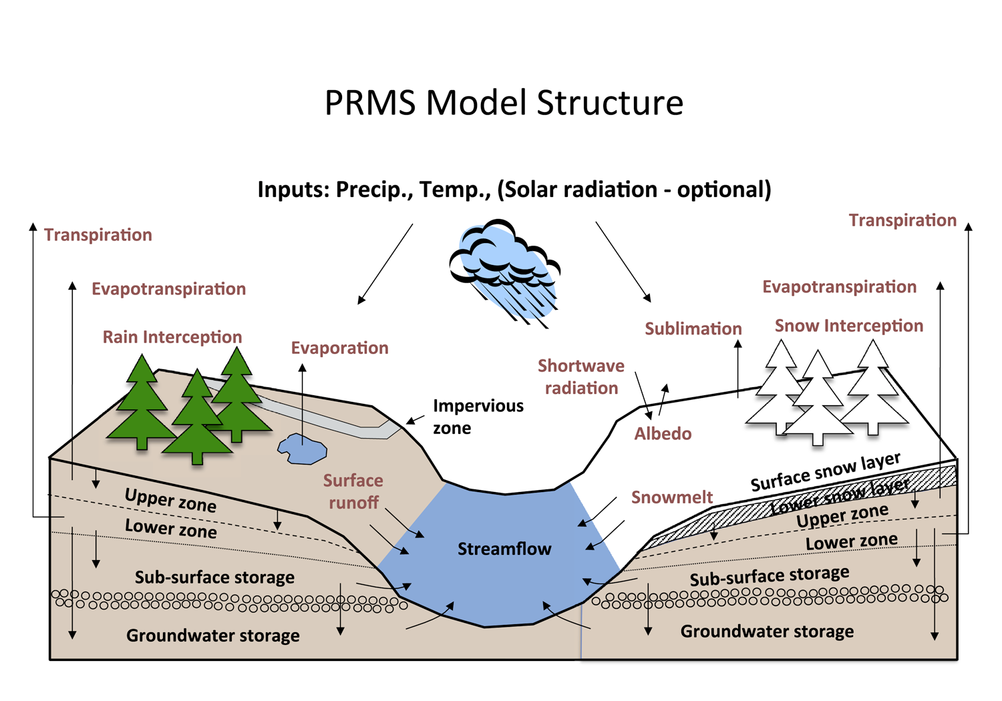
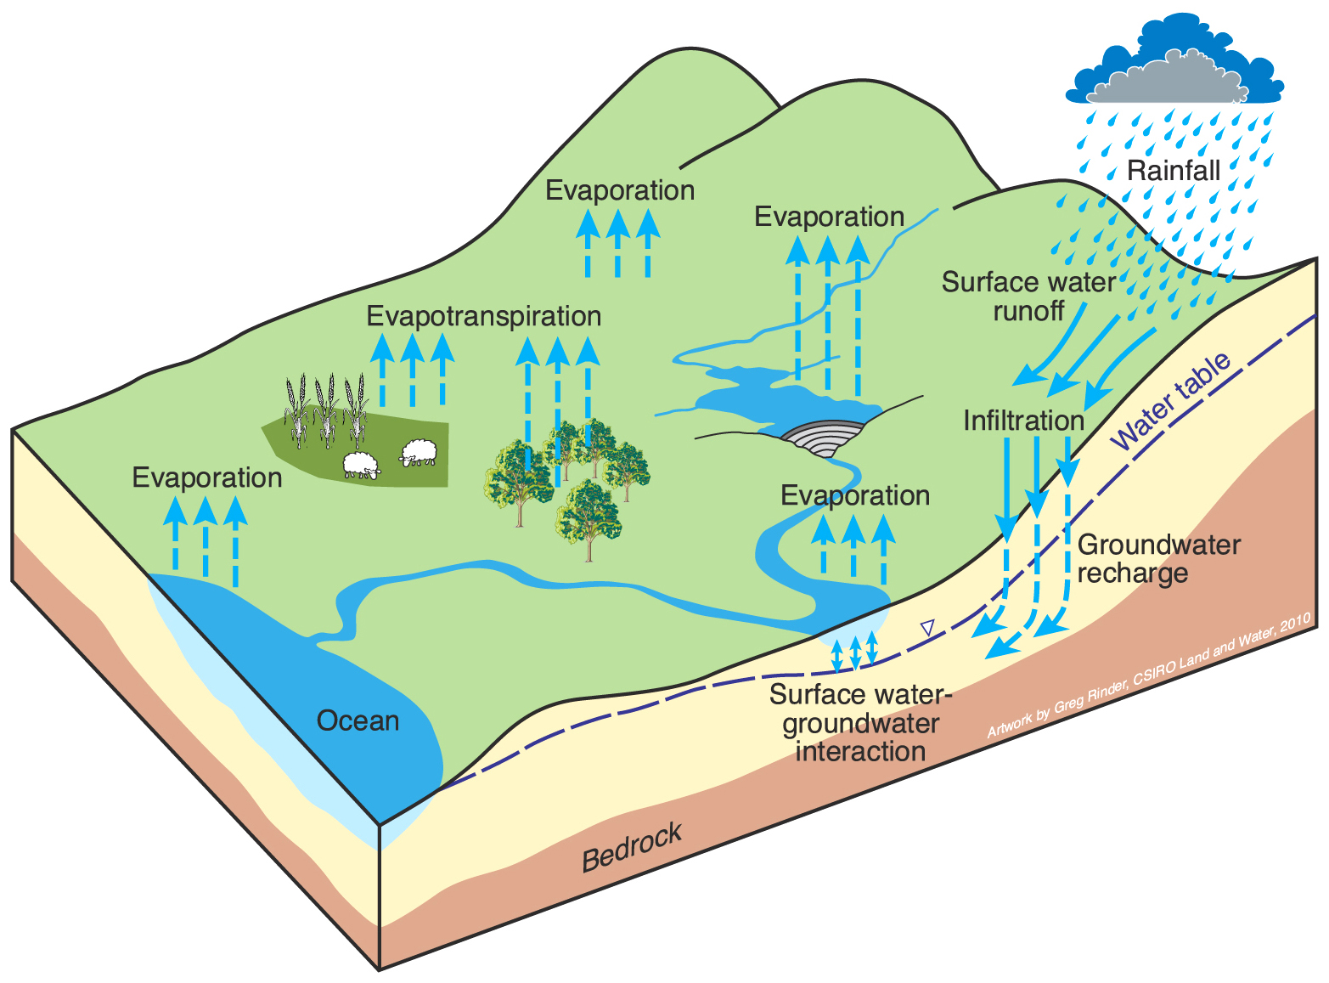

Slide 13
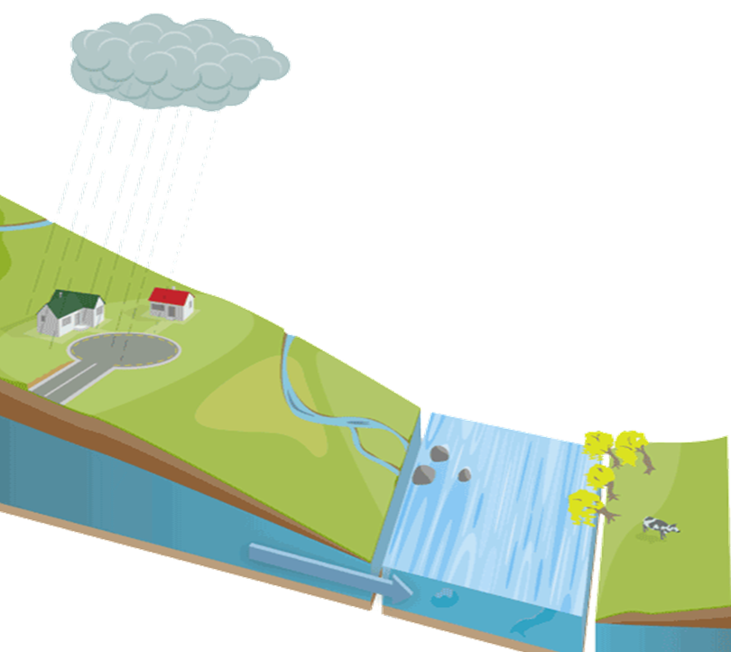
Rain
Evaporation
Soil
Surface flow
Groundwater
River
Underground flow

Slide 14
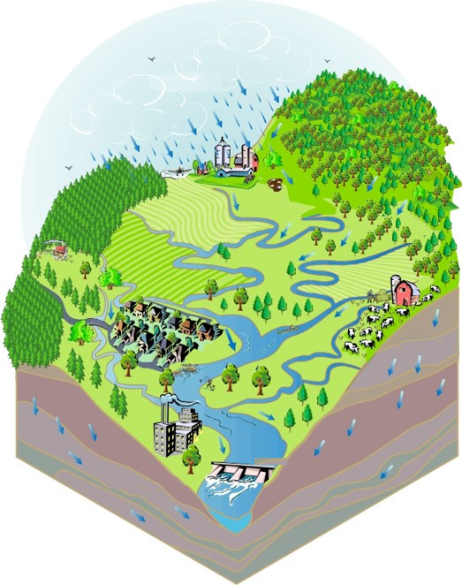
Rain
Surface flow
River
Underground flow
Underground flow

