Slide 1

Home Insurance Claim Probability Prediction
By Andrés Pitta

Slide 2





Problem Overview
Data
Model
Overview
Model
Performance
Next
Steps

Slide 3
Problem Overview

Slide 4
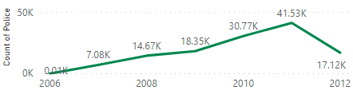
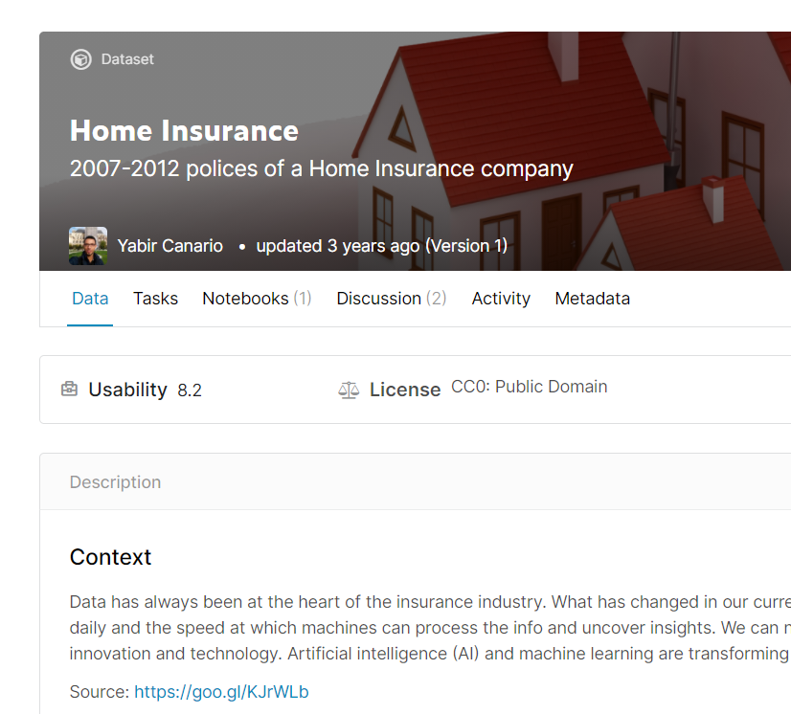
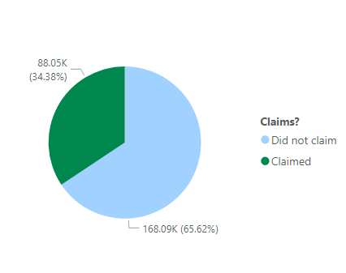
Problem Overview
256,142 Home owners policies issued between 2006 and 2012
Out of that number 88,050 policies have had a claim in the previous 3 years
Goal: Predict the probability of a policy having had a claim
Source: https://www.kaggle.com/ycanario/home-insurance?select=home_insurance.csv

Slide 5
Problem Overview
Goal: Predict the probability of a policy having had a claim
Identifying different types of clients according to their claim behaviour
Adjusting the premium accordingly
Creating risk prevention campaigns

Slide 6
Data

Slide 7
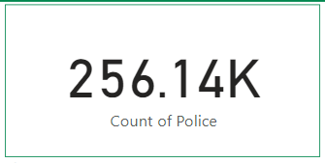
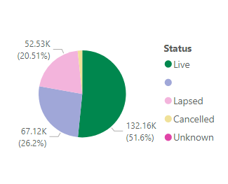
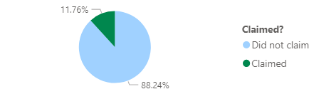
Data
Not all of them can be used for modeling
132,160 policies were used for this modeling exercise
For this group, 11,76% policies had a claim
53 variables: Client’s info, Home info, Policy info
30% Test – 14% Validation – 56% Train split

Slide 8
Model Overview

Slide 9
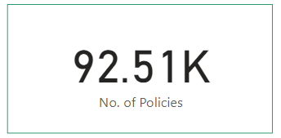
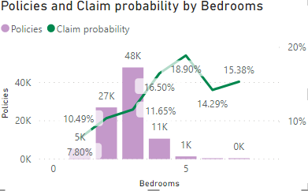
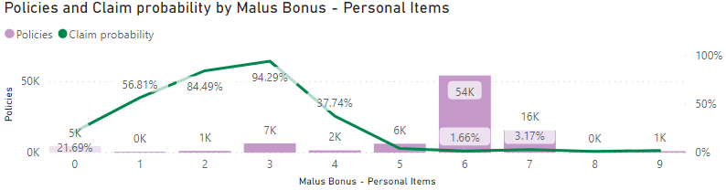
Model - EDA
This portion of the process helps understanding the data. For instance,
Are owners of bigger houses more likely to claim?
Does previous experience impact your probability of claiming?

Slide 10
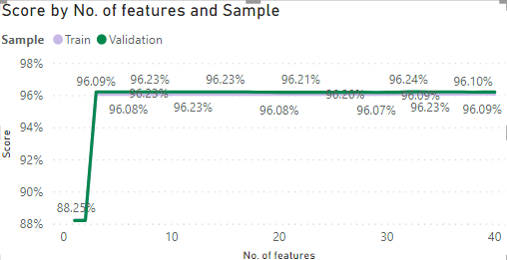
Model - Variables
Previous Claims – Content, Payment Method,
Content Covered
Clerical
No. Of Bedrooms
Logistic Regression with Recursive Feature Elimination (RFE)

Slide 11


Models
Models were assesed not only in terms of accuracy/recall/precision but also in terms of computational costs
Decision Tree
kNN
SVM
Logistic Regression
Random
Forest
XGBoost
LGBM
Dummy

Slide 12
Model Overview

Slide 13


Model - Performance
How to address: Having a big precision
Client predicted as ”will claim” but in reality will not claim
Issue: Overprice
False Positive
How to address: Having a big recall
Client predicted as ”will not claim” but in reality will claim
Issue: Underprice
False Negative

Slide 14
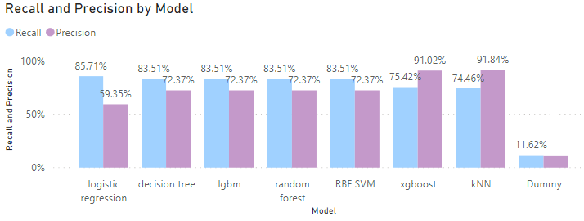
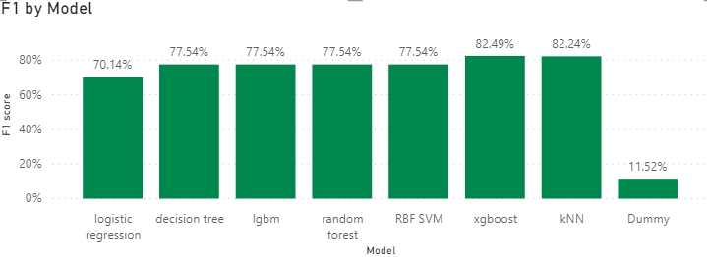
Model - Performance
70% recall - Kaggle
The best model for preventing overpriced clients is the kNN (593 overpriced clients)
The best model for preventing underpriced clients is the Logistic Regression (1376 underpriced clients)
Variables: Previous Claims – Content, Payment Method, Content Covered

Slide 15
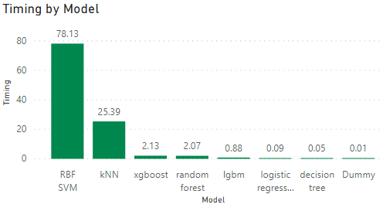
Model - Performance
Even though kNN is the best model, it is a bit slowing in the prediction stage.
I chose XGboost
Variables: Previous Claims – Content, Payment Method, Content Covered

Slide 16
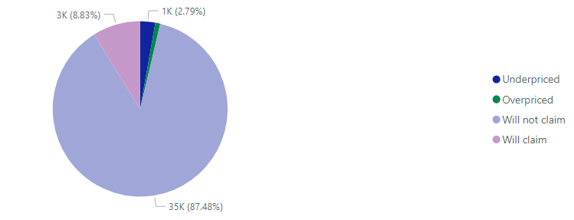
Final Test
Out of 39,648 clients on the test dataset, about 1,500 were misclassified
Variables: Previous Claims – Content, Payment Method, Content Covered

Slide 17
Next Steps

