Slide 1
Sentiment analysis
José Carlos Archundia Adriano 155150
Carlos Andrés Reyes Evangelista 157068
Erick Siordia Nagaya 157504

Slide 2
Sentiment analysis
Identify and classify the sentiment presented in a text
Classify terms and assigning them a sentiment value
Analyze opinions as being made towards an entity
“Sentiment analysis, also referred to as opinion mining, is an approach for analyzing people’s opinion, sentiment, attitude, evaluation and emotions towards an entity. (Rout, J. K., Choo, K.-K. R., et. Al, 2018)

Slide 3
Objective
Implement a proof of concept of sentiment analysis
Demonstrate a working sentiment analysis system by classifying an user provided review as positive, neutral or negative

Slide 4
Problem Description
Training of the sentiment analysis model.
Classify movie reviews in good or bad.

Slide 5
Algorithm
Bag of words (1 – gram)
Weights given by TF-IDF
Assign a value of positivity/negativity of a term
Logistic regression

Slide 6
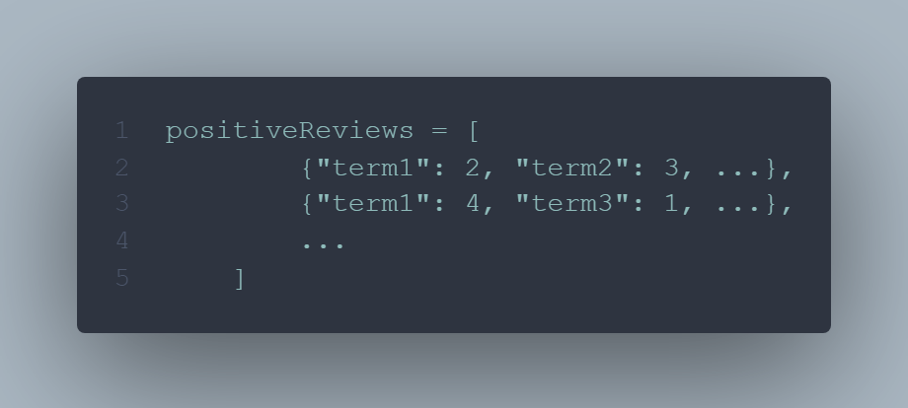
Algorithm – step 1
Get the Term Frequency of each term in each review

Slide 7
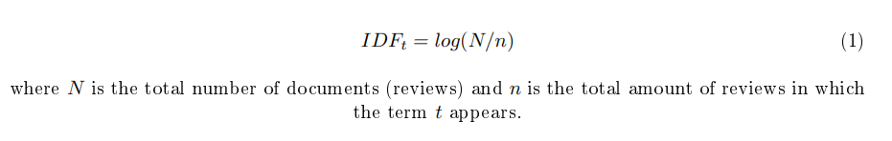
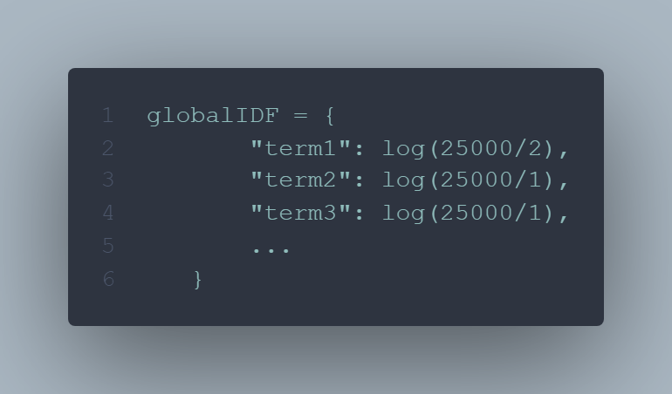
Algorithm – step 2
Get the IDF for all terms

Slide 8
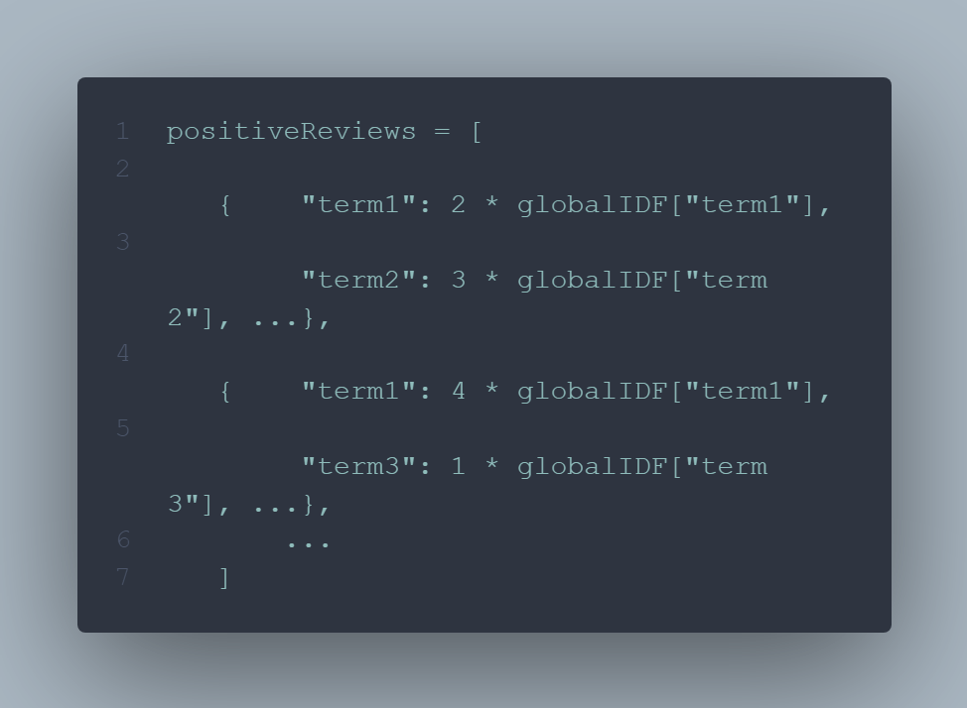
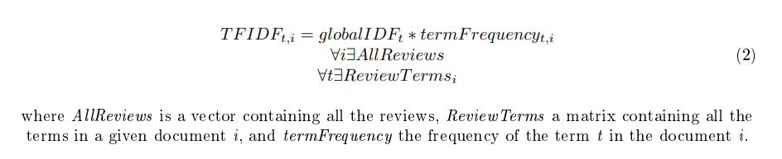
Algorithm – step 3
Get the TF-IDF for each term

Slide 9
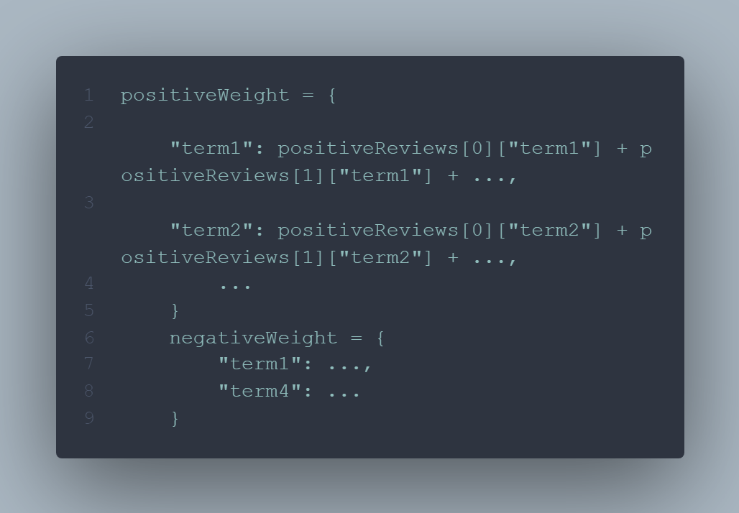
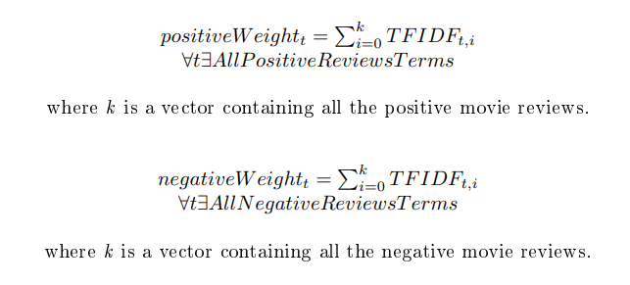
Algorithm – step 4
Get the positive and negative weight of each term

Slide 10
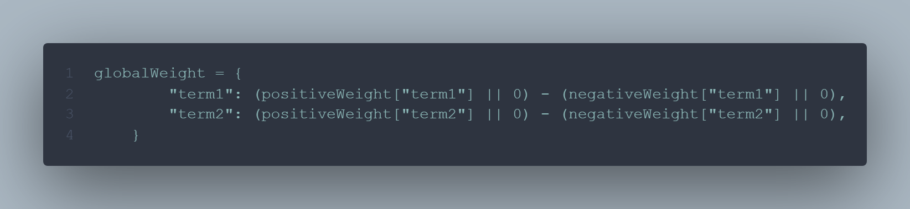

Algorithm – step 5
Neutralize the positive and negative value for each term

Slide 11
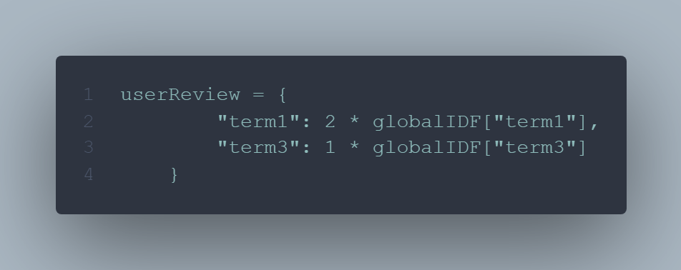
Algorithm – user provided review
Get TF-IDF and weight for the review given by the user

Slide 12
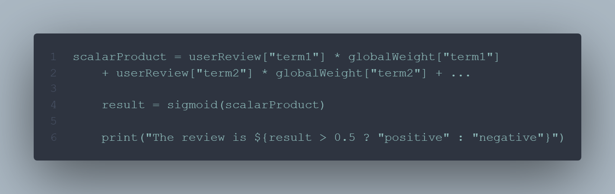
Algorithm – logistic regression

Slide 13
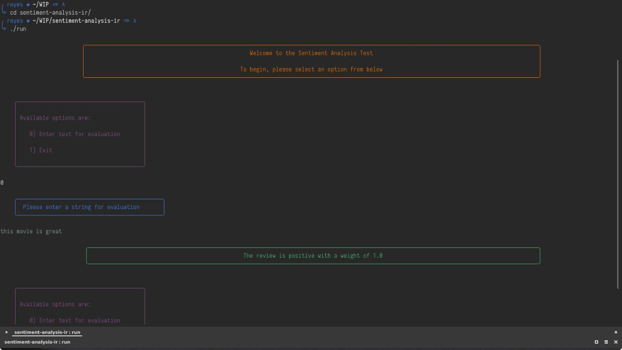
Results

Slide 14
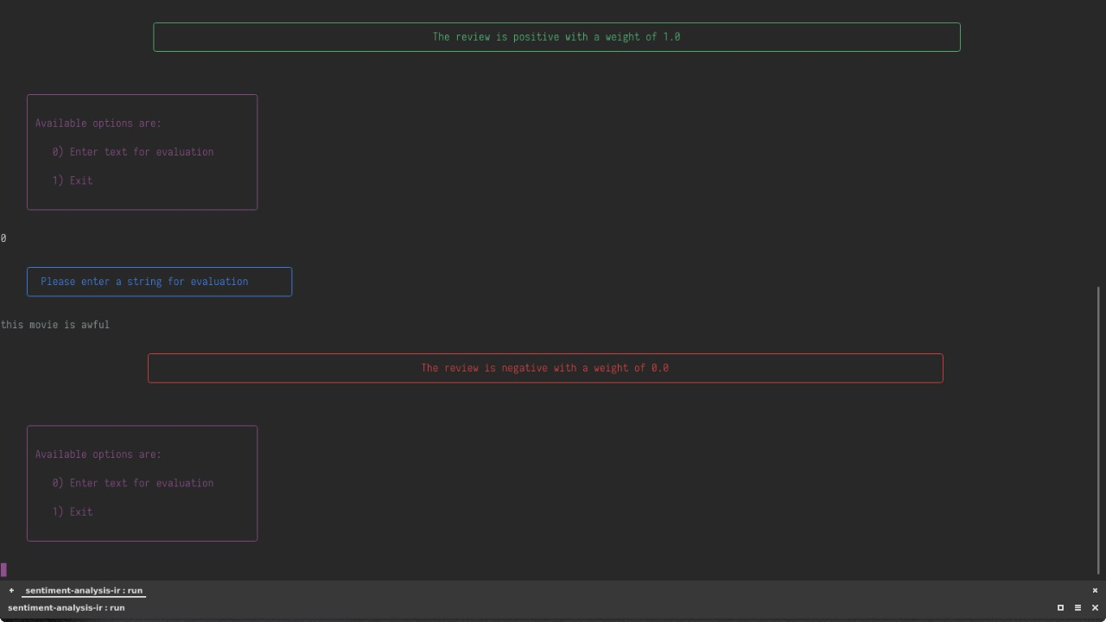

Slide 15
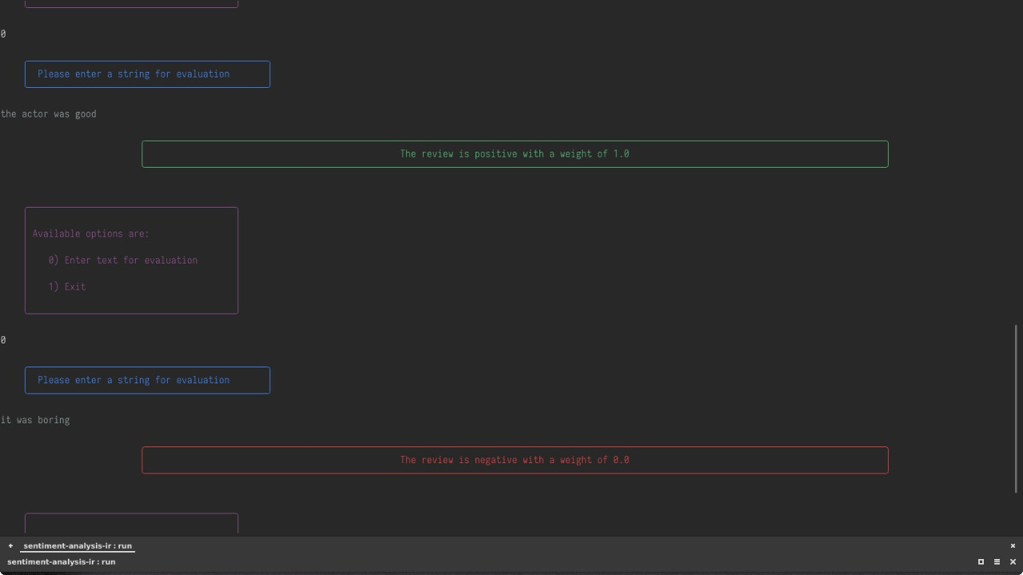

Slide 16
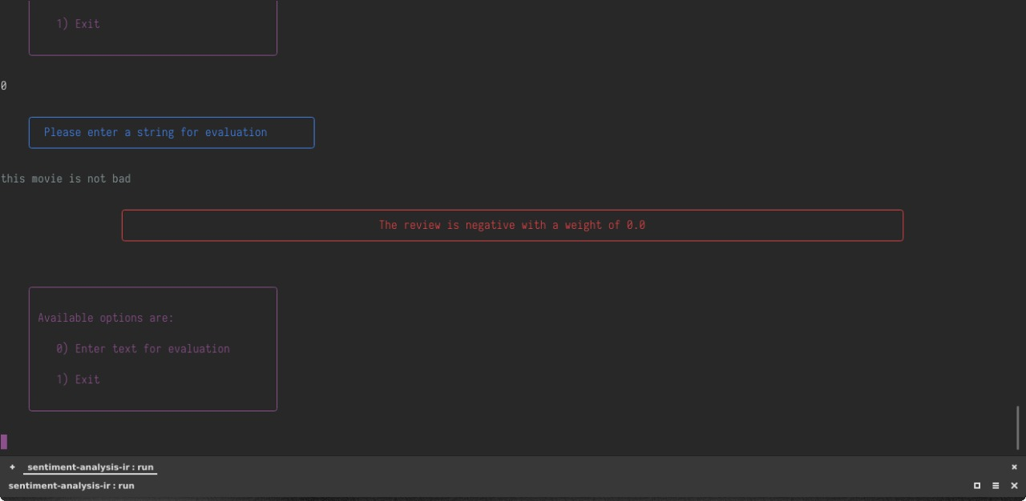

Slide 17
Conclusions
Satisfactory results
Further improvements:
N-gram
Bigger test collection
Stemming and lemmatization
Lessons:
Weighting terms can be useful for many applications
Sentiment analysis can be useful in many areas

