Slide 1
Detecting duplicates
155150 - 157068

Slide 2
Problem
Web crawling produces duplicates
Exact duplicates
Easy to check
Near duplicates
Hard to check
Web pages might have same text
content but different layout

Slide 3
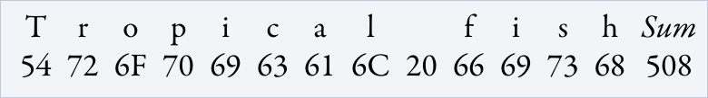
Solution
For exact duplicates:
Checksumming
Cyclic Redundancy Check

Slide 4
Solution
For near duplicates:
Fingerprinting techniques:
N-grams + hashing
Simhashing

Slide 5
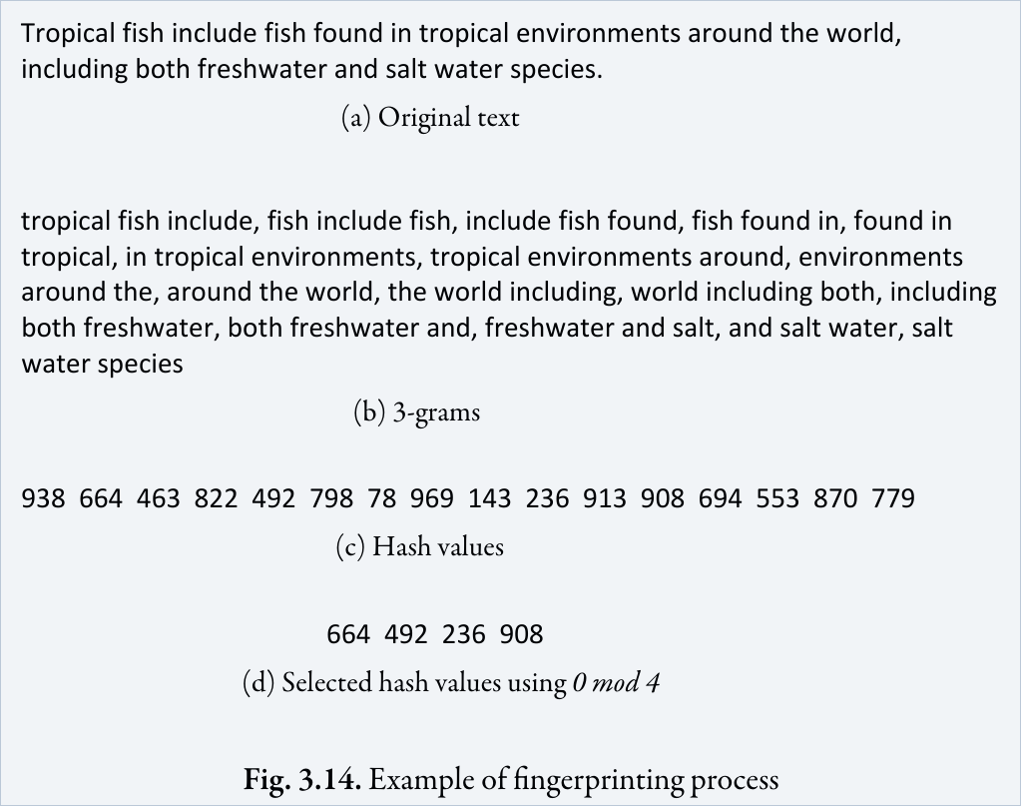
N-Hash

Slide 6
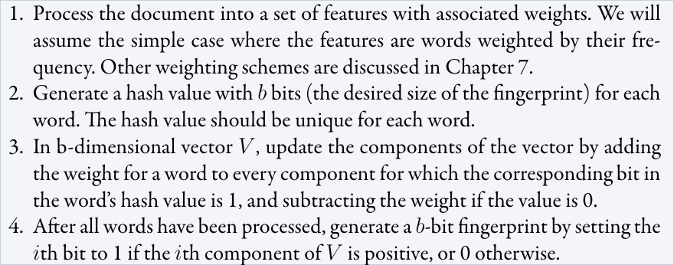
Simhash
Similar content produces a similar hash
A web page is defined as a near-duplicate of another page if the simhash fingerprints agree on more than 372 bits out of 384 bits

