Slide 1
Notes for OpenCL-implementation of Forward Backward Linear and Centered in Time Centered in Space numerical schemes for the SWEs
André R. Brodtkorb, 2016-05-30
Håvard H. Holm, 2018-10-17 (updates on one-kernel implementations)

Slide 2
Table of Content
This slide-set covers the following topics
Background / References
Original cell notation
Stencil for linear scheme
Stencil for non-linear scheme
One-kernel cell notation
Shared memory for linear scheme
Shared memory for non-linear scheme

Slide 3
Background / References
This set of slides includes a set or interpretations to make it easier to implement the different numerical schemes for the SWEs. It is based on the following reports:
L. P. Røed, Documentation of simple ocean models for use in ensemble predictions Part I: Theory and Part II: Benchmark cases, met.no report 5/2012
A. R. Brodtkorb, T. R. Hagen. L. P. Røed, One-Layer Shallow Water Models on the GPU, met.no report 27/2013

Slide 4
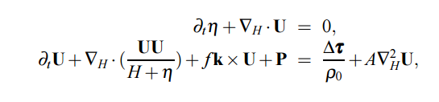
1-layer model
eta
H
h
u
Conservation of mass
Pressure
Bottom and wind stress
Eddy viscosity
Coriolis

Slide 5


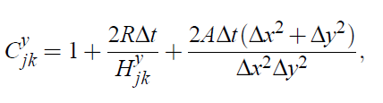
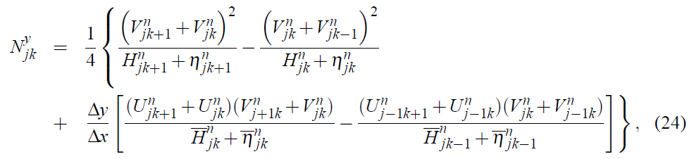

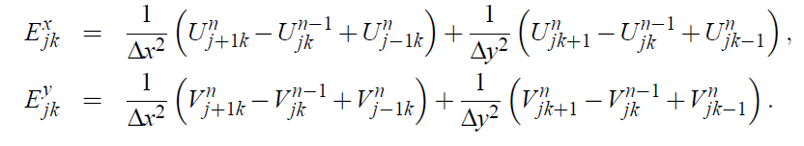
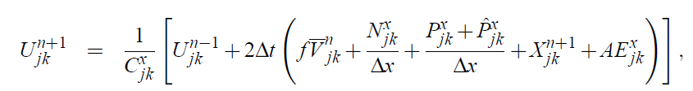
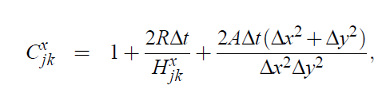
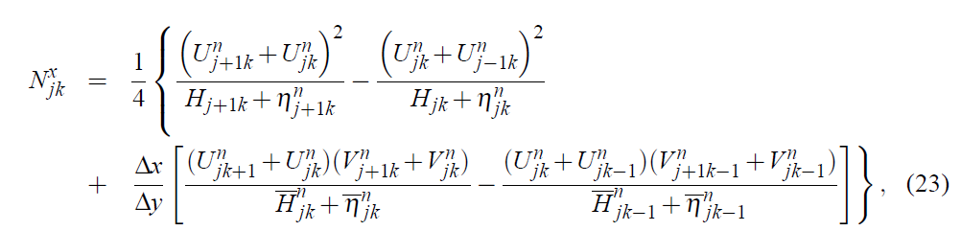
1 layer scheme, non-linear FD
2-layer non-linear scheme
eta1
H1
h1
u1
eta2
H2
h2
u2
1 layer model extendible to more layers
Ocean can be modeled as a stratisfied medium with multiple homogeneous layers
Multiple layers enables baroclinic response from model

Slide 6
Original Cell Notation

Slide 7
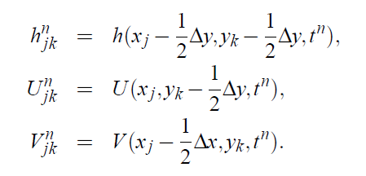
Cell notation
Eta / H / h
U
V
k+2
k+1
k
k-1
k-2
j-2
j-1
j
j+1
j+2

Slide 8
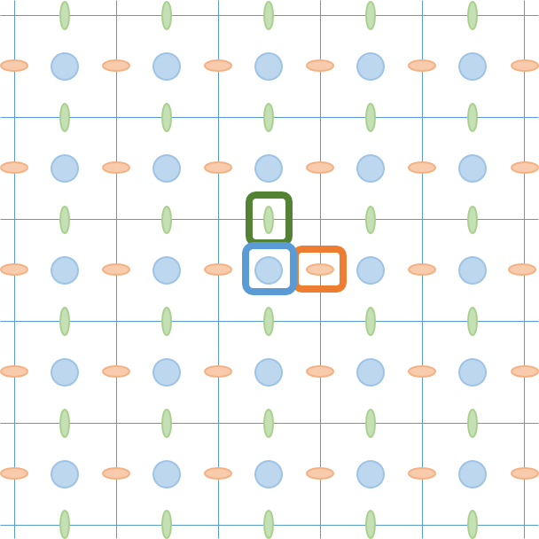
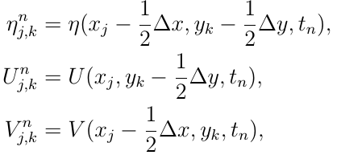
Cell notation
Eta / H / h
U
V
k+1
k
k-1
k-2
j-2
j-1
j
j+1

Slide 9
Cell notation
Eta / H / h
U
V
k+1
k
k-1
k-2
j-2
j-1
j
j+1

Slide 10
Cell notation
Eta / H / h
U
V
k+1
k
k-1
j-1
j
j+1

Slide 11



Cell notation (FIGURE)
Eta / H / h
U
V
k+1
$$η$$
k
$U$ or $hu$
$V$ or $hv$
k-1
j-1
j
j+1

Slide 12
Cell notation
Eta / H / h
U
V
k+1
k
k-1
j-1
j
j+1

Slide 13




Cell notation (FIGURE)
k+2
k+1
$$η$$
$U$ or $hu$
$V$ or $hv$
k
k-1
$η$, $hu$, and $hv$
k-2
j-2
j-1
j
j+1
j+2

Slide 14
FBL eta (FIGURE)
Eta / H / h
U
k+2
V
k+1
k
k-1
k-2
j-2
j-1
j
j+1
j+2

Slide 15
FBL U (FIGURE)
Eta / H / h
U
k+2
V
k+1
k
k-1
k-2
j-2
j-1
j
j+1
j+2

Slide 16
FBL V (FIGURE)
Eta / H / h
U
k+2
V
k+1
k
k-1
k-2
j-2
j-1
j
j+1
j+2

Slide 17
CTCS eta (FIGURE)
Eta / H / h
U
k+2
V
k+1
k
k-1
k-2
j-2
j-1
j
j+1
j+2

Slide 18
CTCS U (FIGURE)
Eta / H / h
U
k+2
V
k+1
k
k-1
k-2
j-2
j-1
j
j+1
j+2

Slide 19
CTCS V (FIGURE)
Eta / H / h
U
k+2
V
k+1
k
k-1
k-2
j-2
j-1
j
j+1
j+2

Slide 20
CTCS 2 eta
Eta / H / h
U
V
k+2
k+1
k
k-1
k-2
j-2
j-1
j
j+1
j+2

Slide 21
CTCS 2 V
Eta / H / h
U
V
k+2
k+1
k
k-1
k-2
j-2
j-1
j
j+1
j+2

Slide 22
CTCS 2 U
Eta / H / h
U
V
k+2
k+1
k
k-1
k-2
j-2
j-1
j
j+1
j+2

Slide 23
KP07 / CDKLM (FIGURE)
Eta / H / h
U
V
k+2
k+1
k
k-1
k-2
j-2
j-1
j
j+1
j+2

Slide 24

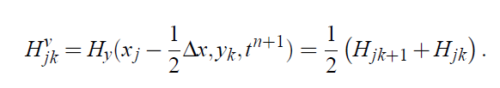
Cell notation
Eta / H / h
U
V
J, k+2
J, k+1
J-2, k
J-1, k
J, k
J+1, k
J+2, k
J, k-1
J, k-2

Slide 25
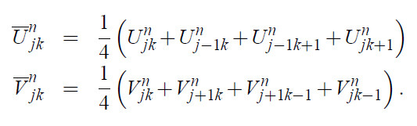
Cell notation
Eta / H / h
U
V
J, k+2
J, k+1
J-2, k
J-1, k
J, k
J+1, k
J+2, k
J, k-1
J, k-2

Slide 26
Cell notation
Eta / H / h
U
V
J, k+2
J, k+1
J-2, k
J-1, k
J, k
J+1, k
J+2, k
J, k-1
J, k-2

Slide 27

Cell notation
Eta / H / h
U
V
J, k+2
J, k+1
J-2, k
J-1, k
J, k
J+1, k
J+2, k
J, k-1
J, k-2

Slide 28
Boundary Conditions

Slide 29
Cell notation
Eta / H / h
U
V
k+2
k+1
k
k-1
k-2
j-2
j-1
j
j+1
j+2

Slide 30
Linear scheme

Slide 31
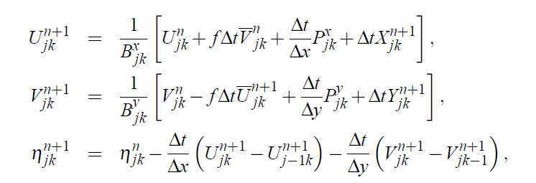
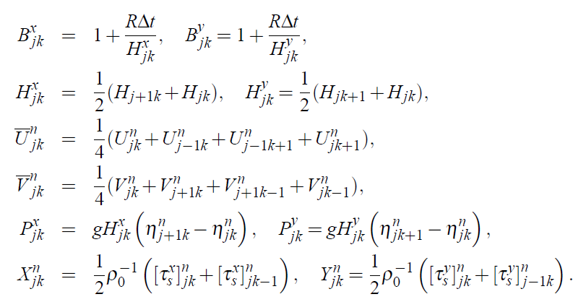
Eta
J, k+2
J, k+1
J-2, k
J-1, k
J, k
J+1, k
J+2, k
J, k-1
J, k-2

Slide 32
V
J, k+2
J, k+1
J-2, k
J-1, k
J, k
J+1, k
J+2, k
J, k-1
J, k-2

Slide 33
U
J, k+2
J, k+1
J-2, k
J-1, k
J, k
J+1, k
J+2, k
J, k-1
J, k-2

Slide 34
Nonlinear scheme

Slide 35
N
Nonlinear term

Slide 36

N^y 1/5
Eta / H / h
U
V
J, k+2
J, k+1
J-2, k
J-1, k
J, k
J+1, k
J+2, k
J, k-1
Error here: should be
H_j-1, k + eta_j-1, k
J, k-2

Slide 37
N^y 2/5
Eta / H / h
U
V
J, k+2
J, k+1
J-2, k
J-1, k
J, k
J+1, k
J+2, k
J, k-1
J, k-2

Slide 38
N^y 3/5
Eta / H / h
U
V
J, k+2
J, k+1
J-2, k
J-1, k
J, k
J+1, k
J+2, k
J, k-1
J, k-2

Slide 39
N^y 4/5
Eta / H / h
U
V
J, k+2
J, k+1
J-2, k
J-1, k
J, k
J+1, k
J+2, k
J, k-1
J, k-2

Slide 40
N^y 5/5
Eta / H / h
U
V
J, k+2
J, k+1
J-2, k
J-1, k
J, k
J+1, k
J+2, k
J, k-1
J, k-2

Slide 41
N^x 1/1
Eta / H / h
U
V
J, k+2
J, k+1
J-2, k
J-1, k
J, k
J+1, k
J+2, k
J, k-1
J, k-2

Slide 42
P
Pressure term

Slide 43
P 1/2
Eta / H / h
U
V
J, k+2
J, k+1
J-2, k
J-1, k
J, k
J+1, k
J+2, k
J, k-1
J, k-2
Wrong sign if pressure term!
Should not P hat also be dependent on g?

Slide 44


P 2/2
Eta / H / h
U
V
J, k+2
J, k+1
J-2, k
J-1, k
J, k
J+1, k
J+2, k
J, k-1
J, k-2

Slide 45
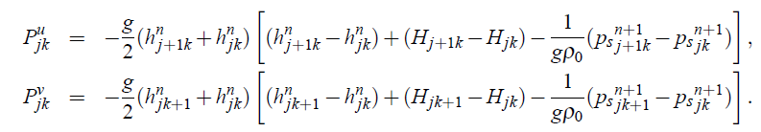
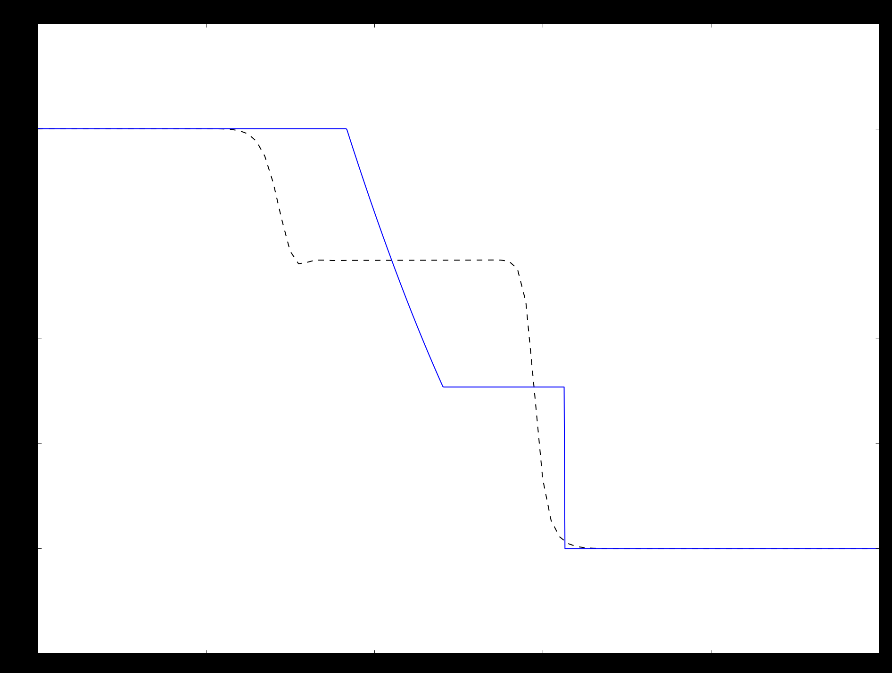
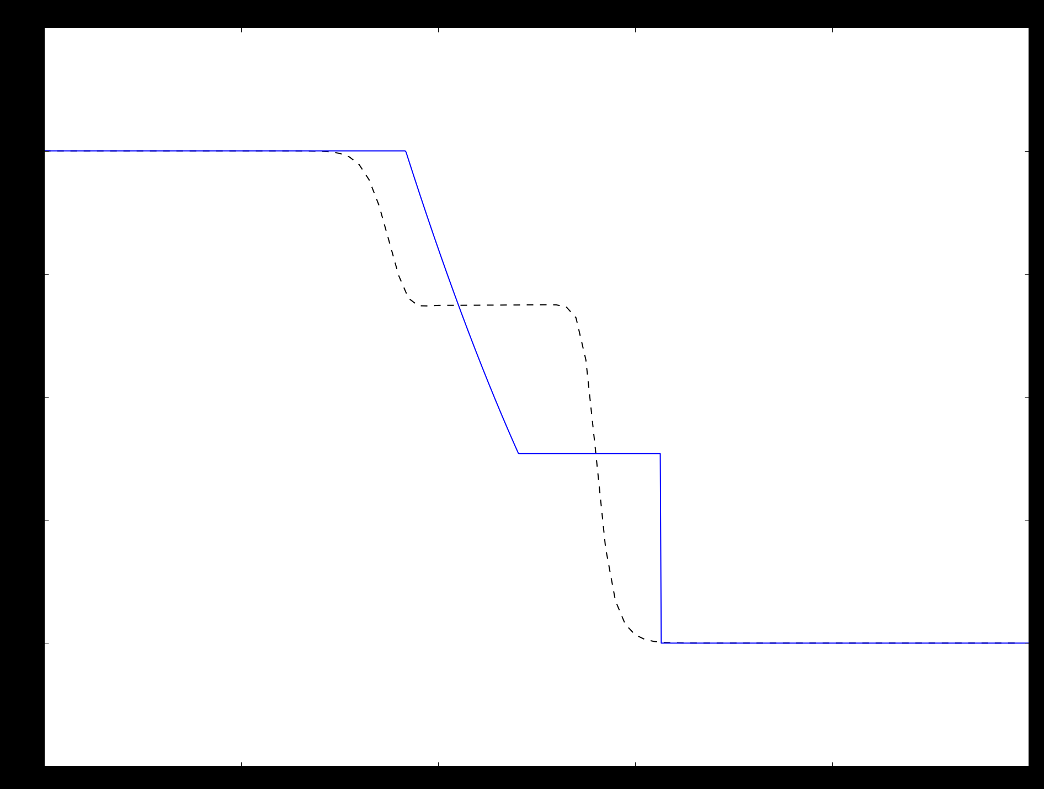
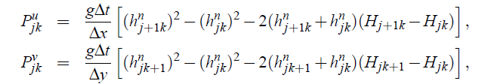



Pressure term
Atmospheric pressure = constant
Which pressure term is correct?

Slide 46
E
Eddy viscosity term

Slide 47
E 1/2
Eta / H / h
U
V
J, k+2
J, k+1
J-2, k
J-1, k
J, k
J+1, k
J+2, k
J, k-1
J, k-2
Note that center is from previous timestep (n-1)!

Slide 48
E 2/2
Eta / H / h
U
V
J, k+2
J, k+1
J-2, k
J-1, k
J, k
J+1, k
J+2, k
J, k-1
J, k-2
Note that center is from previous timestep (n-1)!

Slide 49
Eta
Difference from mean sea depth

Slide 50
Eta 1/1
Eta / H / h
U
V
J, k+2
J, k+1
J-2, k
J-1, k
J, k
J+1, k
J+2, k
J, k-1
J, k-2

Slide 51
V
Momentum along y-axis

Slide 52
V 1/7
Eta / H / h
U
V
J, k+2
J, k+1
J-2, k
J-1, k
J, k
J+1, k
J+2, k
J, k-1
J, k-2

Slide 53
V 2/7
Eta / H / h
U
V
J, k+2
J, k+1
J-2, k
J-1, k
J, k
J+1, k
J+2, k
J, k-1
J, k-2

Slide 54
V 3/7
Eta / H / h
U
V
J, k+2
J, k+1
J-2, k
J-1, k
J, k
J+1, k
J+2, k
J, k-1
J, k-2

Slide 55
V 4/7
Eta / H / h
U
V
J, k+2
J, k+1
J-2, k
J-1, k
J, k
J+1, k
J+2, k
J, k-1
J, k-2

Slide 56
V 5/7
Eta / H / h
U
V
J, k+2
J, k+1
J-2, k
J-1, k
J, k
J+1, k
J+2, k
J, k-1
J, k-2

Slide 57
V 6/7
Eta / H / h
U
V
J, k+2
J, k+1
J-2, k
J-1, k
J, k
J+1, k
J+2, k
J, k-1
J, k-2

Slide 58
V 7/7
Eta / H / h
U
V
J, k+2
J, k+1
J-2, k
J-1, k
J, k
J+1, k
J+2, k
J, k-1
J, k-2

Slide 59
U
Momentum along x-axis

Slide 60
U 1/1
Eta / H / h
U
V
J, k+2
J, k+1
J-2, k
J-1, k
J, k
J+1, k
J+2, k
J, k-1
J, k-2

Slide 61
Ghost cells

Slide 62
Local Ghost cells U (block level)
Eta / H / h
U
V
Block_width = 2
Block_height = 3
Eta: (nx)*(ny+2) cells incl ghost cells
U: (nx+1)*(ny+2) cells incl ghost cells
V: (nx)*(ny+1) cells incl ghost cells
0
1
2
3
4
0
1
2
3
4

Slide 63
Local Ghost cells V (block level)
Eta / H / h
U
V
Block_width = 3
Block_height = 2
Eta: (nx+2)*(ny) cells incl ghost cells
U: (nx+1)*(ny) cells incl ghost cells
V: (nx+2)*(ny+1) cells incl ghost cells
0
1
2
3
4
0
1
2
3
4

Slide 64
Ghost cells globally
Eta / H / h
U
V
Eta: compute for all internal cells - nx * ny
U: compute for all except last column - (nx-1) * ny
V: compute for all except last row - nx * (ny-1)
Eta: (nx+2)*(ny+2) cells incl ghost cells
U: (nx+1)*(ny+2) cells incl ghost cells
V: (nx+2)*(nx+1) cells incl ghost cells
0
1
2
3
4
0
1
2
3
4

Slide 65
One-kernel cell notation
Optimizing computational performance
Requires more ghost cells
Results in new cell notation
Investigate in terms of required shared memory
Goal: Each thread should write one value of eta, U and V
Global ghost cells determined by the requirement of shared memory ghost cells

Slide 66

One-kernel linear scheme
Data dependency:
$$U^{n+1}←F\left(η^{n}, V^{n}, U^{n}\right) \\ V^{n+1}←G\left(η^{n}, V^{n}, U^{n+1}\right) \\ η^{n+1}←H(η^{n}, V^{n+1}, U^{n+1})$$

Slide 67
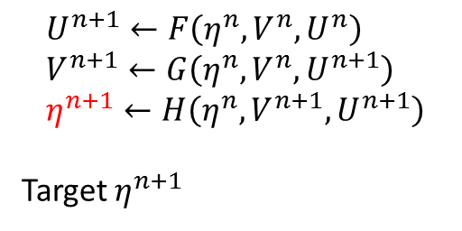
Data dependency – one-kernel FBL
Eta / H / h
U
V
$$U^{n+1}←F\left(η^{n}, V^{n}, U^{n}\right) \\ V^{n+1}←G\left(η^{n}, V^{n}, U^{n+1}\right) \\ η^{n+1}←H\left(η^{n}, V^{n+1}, U^{n+1}\right)$$
Target $η^{n+1}$

Slide 68
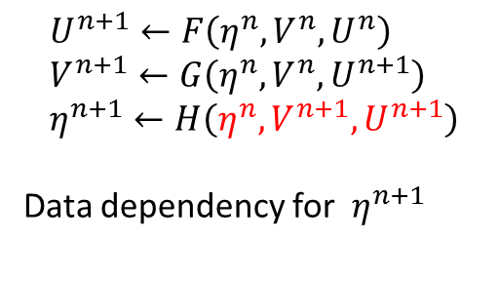
Data dependency – one-kernel FBL
Eta / H / h
U
V
$$U^{n+1}←F\left(η^{n}, V^{n}, U^{n}\right) \\ V^{n+1}←G\left(η^{n}, V^{n}, U^{n+1}\right) \\ η^{n+1}←H\left(η^{n}, V^{n+1}, U^{n+1}\right)$$
Data dependency for $η^{n+1}$

Slide 69
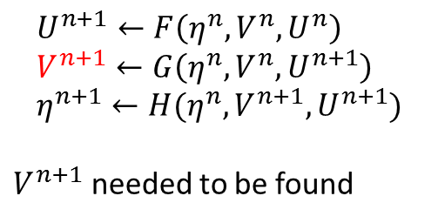
Data dependency – one-kernel FBL
Eta / H / h
U
V
$$U^{n+1}←F\left(η^{n}, V^{n}, U^{n}\right) \\ V^{n+1}←G\left(η^{n}, V^{n}, U^{n+1}\right) \\ η^{n+1}←H(η^{n}, V^{n+1}, U^{n+1})$$
$V^{n+1}$ needed to be found

Slide 70
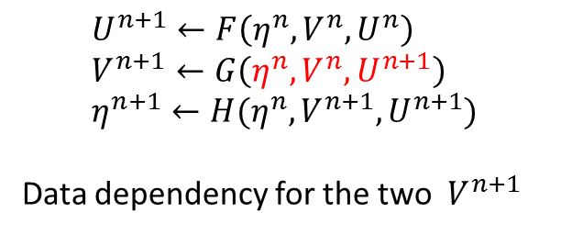
Data dependency – one-kernel FBL
Eta / H / h
U
V
$$U^{n+1}←F\left(η^{n}, V^{n}, U^{n}\right) \\ V^{n+1}←G\left(η^{n}, V^{n}, U^{n+1}\right) \\ η^{n+1}←H(η^{n}, V^{n+1}, U^{n+1})$$
Data dependency for the two $V^{n+1}$

Slide 71
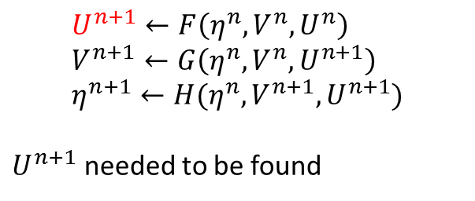
Data dependency – one-kernel FBL
Eta / H / h
U
V
$$U^{n+1}←F\left(η^{n}, V^{n}, U^{n}\right) \\ V^{n+1}←G\left(η^{n}, V^{n}, U^{n+1}\right) \\ η^{n+1}←H(η^{n}, V^{n+1}, U^{n+1})$$
$U^{n+1}$ needed to be found

Slide 72
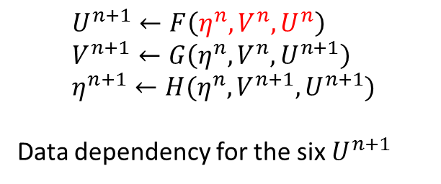
Data dependency – one-kernel FBL
Eta / H / h
U
V
$$U^{n+1}←F\left(η^{n}, V^{n}, U^{n}\right) \\ V^{n+1}←G\left(η^{n}, V^{n}, U^{n+1}\right) \\ η^{n+1}←H(η^{n}, V^{n+1}, U^{n+1})$$
Data dependency for the six $U^{n+1}$

Slide 73
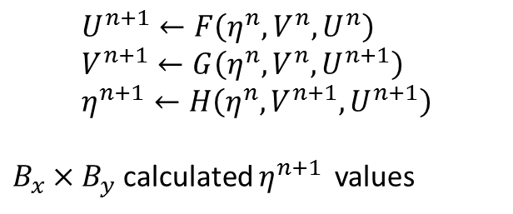
Data dependency – one-kernel FBL
Eta / H / h
U
V
$$U^{n+1}←F\left(η^{n}, V^{n}, U^{n}\right) \\ V^{n+1}←G\left(η^{n}, V^{n}, U^{n+1}\right) \\ η^{n+1}←H\left(η^{n}, V^{n+1}, U^{n+1}\right)$$
$B_{x}×B_{y}$ calculated $η^{n+1 }$ values

Slide 74
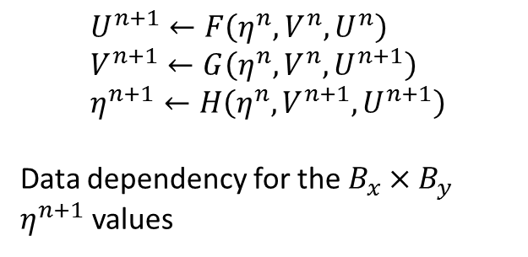
Data dependency – one-kernel FBL
Eta / H / h
U
V
$$U^{n+1}←F\left(η^{n}, V^{n}, U^{n}\right) \\ V^{n+1}←G\left(η^{n}, V^{n}, U^{n+1}\right) \\ η^{n+1}←H\left(η^{n}, V^{n+1}, U^{n+1}\right)$$
Data dependency for the $B_{x}×B_{y}$ $η^{n+1}$ values

Slide 75
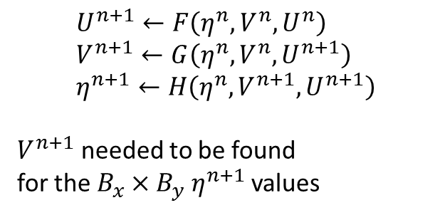
Data dependency – one-kernel FBL
Eta / H / h
U
V
$$U^{n+1}←F\left(η^{n}, V^{n}, U^{n}\right) \\ V^{n+1}←G\left(η^{n}, V^{n}, U^{n+1}\right) \\ η^{n+1}←H\left(η^{n}, V^{n+1}, U^{n+1}\right)$$
$V^{n+1}$ needed to be found
for the $B_{x}×B_{y}$ $η^{n+1}$ values

Slide 76
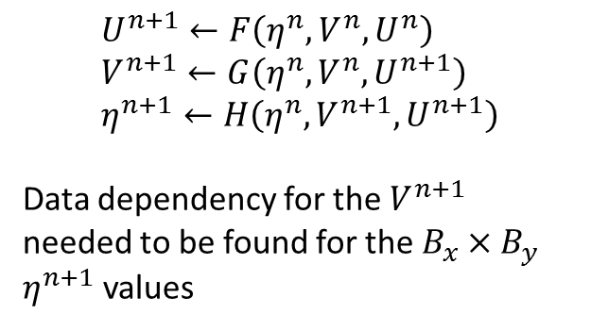
Data dependency – one-kernel FBL
Eta / H / h
U
V
$$U^{n+1}←F\left(η^{n}, V^{n}, U^{n}\right) \\ V^{n+1}←G\left(η^{n}, V^{n}, U^{n+1}\right) \\ η^{n+1}←H\left(η^{n}, V^{n+1}, U^{n+1}\right)$$
Data dependency for the $V^{n+1}$ needed to be found for the $B_{x}×B_{y}$ $η^{n+1}$ values

Slide 77
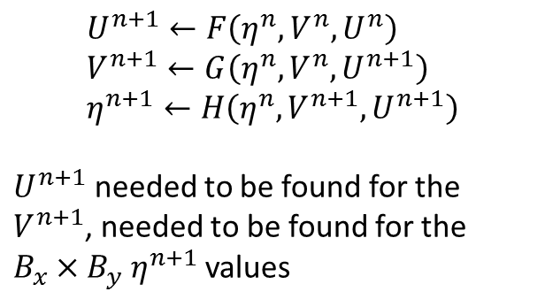
Data dependency – one-kernel FBL
Eta / H / h
U
V
$$U^{n+1}←F\left(η^{n}, V^{n}, U^{n}\right) \\ V^{n+1}←G\left(η^{n}, V^{n}, U^{n+1}\right) \\ η^{n+1}←H\left(η^{n}, V^{n+1}, U^{n+1}\right)$$
$U^{n+1}$ needed to be found for the $V^{n+1}$, needed to be found for the $B_{x}×B_{y}$ $η^{n+1}$ values

Slide 78
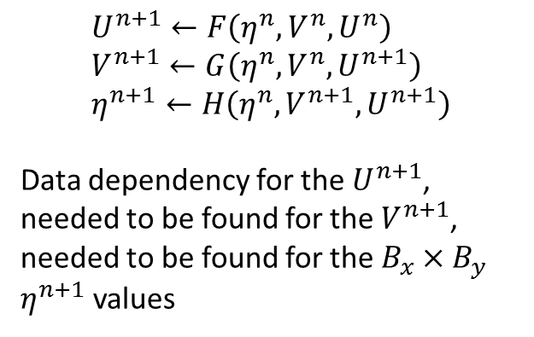
Data dependency – one-kernel FBL
Eta / H / h
U
V
$$U^{n+1}←F\left(η^{n}, V^{n}, U^{n}\right) \\ V^{n+1}←G\left(η^{n}, V^{n}, U^{n+1}\right) \\ η^{n+1}←H\left(η^{n}, V^{n+1}, U^{n+1}\right)$$
Data dependency for the $U^{n+1}$, needed to be found for the $V^{n+1}$, needed to be found for the $B_{x}×B_{y}$ $η^{n+1}$ values

Slide 79
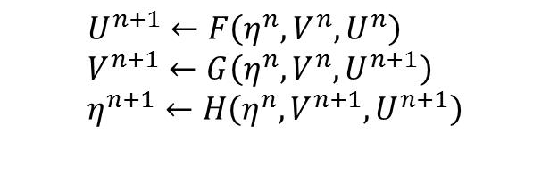

Data dependency – one-kernel FBL
Eta / H / h
U
V
$$U^{n+1}←F\left(η^{n}, V^{n}, U^{n}\right) \\ V^{n+1}←G\left(η^{n}, V^{n}, U^{n+1}\right) \\ η^{n+1}←H\left(η^{n}, V^{n+1}, U^{n+1}\right)$$
$(η^{n}, V^{n}, U^{n})$ points read by the block

Slide 80
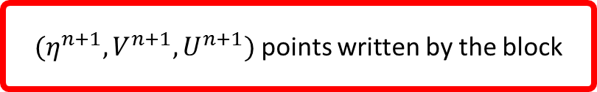
Data dependency – one-kernel FBL
Eta / H / h
U
V
$$U^{n+1}←F\left(η^{n}, V^{n}, U^{n}\right) \\ V^{n+1}←G\left(η^{n}, V^{n}, U^{n+1}\right) \\ η^{n+1}←H\left(η^{n}, V^{n+1}, U^{n+1}\right)$$
$(η^{n}, V^{n}, U^{n})$ points read by the block
$(η^{n+1}, V^{n+1}, U^{n+1})$ points written by the block

Slide 81
Data dependency – one-kernel FBL
Eta / H / h
U
by + 2
V
by + 1
by + 1
by
$$U^{n+1}←F\left(η^{n}, V^{n}, U^{n}\right) \\ V^{n+1}←G\left(η^{n}, V^{n}, U^{n+1}\right) \\ η^{n+1}←H\left(η^{n}, V^{n+1}, U^{n+1}\right)$$
by
…
…
$(η^{n}, V^{n}, U^{n})$ points read by the block
2
2
1
$(η^{n+1}, V^{n+1}, U^{n+1})$ points written by the block
1
0
0
0
1
…
bx - 1
bx
bx + 1
← Local thread indices within the block
0
1
…
bx - 1
bx

Slide 82
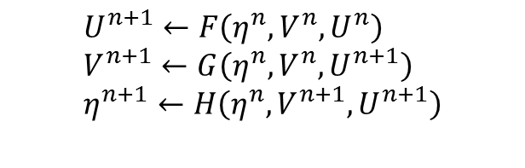


Data dependency – one-kernel FBL
Eta / H / h
U
by + 2
V
by + 1
by + 1
$$U^{n+1}←F\left(η^{n}, V^{n}, U^{n}\right) \\ V^{n+1}←G\left(η^{n}, V^{n}, U^{n+1}\right) \\ η^{n+1}←H\left(η^{n}, V^{n+1}, U^{n+1}\right)$$
by
by
…
$(η^{n}, V^{n}, U^{n})$ points read by the block
…
2
$(η^{n+1}, V^{n+1}, U^{n+1})$ points written by the block
2
1
1
Points with the same indices
0
0
Points read and written
0
1
…
bx - 1
bx
bx + 1
0
1
…
bx - 1
bx
Points read only

Slide 83
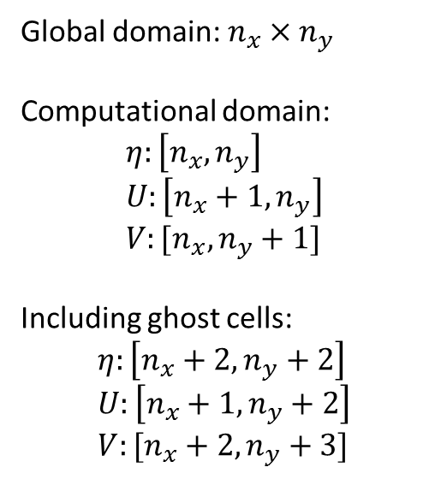
Data dependency – one-kernel FBL
Eta / H / h
U
ny + 2
V
ny + 1
Global domain: $n_{x}×n_{y}$
Computational domain:
$$η:\left[n_{x}, n_{y}\right] \\ U:\left[n_{x}+1, n_{y}\right] \\ V:[n_{x}, n_{y}+1]$$
Including ghost cells: $$η:\left[n_{x}+2, n_{y}+2\right] \\ U:\left[n_{x}+1, n_{y}+2\right] \\ V:[n_{x}+2, n_{y}+3]$$
ny + 1
ny
ny
…
…
2
2
1
1
0
0
0
1
…
nx - 1
nx
nx + 1
← Global thread indices
0
1
…
nx - 1
nx

Slide 84

One-kernel non-linear scheme
No blocking data dependency:
$$U^{n+1}←F\left(η^{n}, V^{n}, U^{n}\right) \\ V^{n+1}←G\left(η^{n}, V^{n}, U^{n}\right) \\ η^{n+1}←H(η^{n}, V^{n}, U^{n})$$

Slide 85

One-kernel CTCS
Eta / H / h
U
V
$η$-stencil

Slide 86

One-kernel CTCS
Eta / H / h
U
V
$η$-stencil
$U$-stencil

Slide 87

One-kernel CTCS
Eta / H / h
U
V
$η$-stencil
$U$-stencil
$V$-stencil

Slide 88
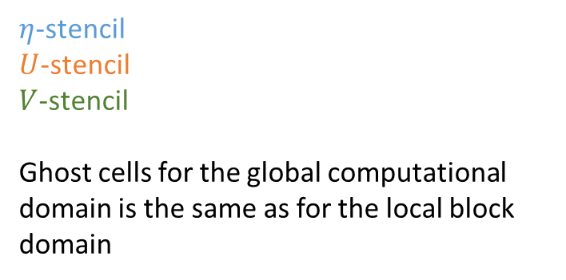
One-kernel CTCS
Eta / H / h
U
ny + 2
V
ny + 1
ny + 1
$η$-stencil
$U$-stencil
$V$-stencil
Ghost cells for the global computational domain is the same as for the local block domain
ny
ny
…
…
2
2
1
1
0
0
0
1
2
…
nx
nx + 1
nx + 2
0
1
2
…
nx
nx + 1

Slide 89
One-kernel CTCS
Eta / H / h
U
ny + 2
V
ny + 1
ny + 1
$η$-stencil
$U$-stencil
$V$-stencil
Ghost cells for the global computational domain is the same as for the local block domain
ny
ny
…
…
2
2
1
1
Points with the same indices
0
0
0
1
2
…
nx
nx + 1
nx + 2
0
1
2
…
nx
nx + 1

