Slide 1

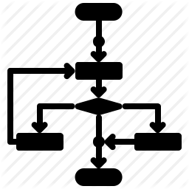
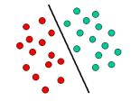
Deployment
Training
(Supervised Learning)
Labelled
Training Data
Operational Data
Vectors
Trained Classifier
Feature
Extraction
ML
Algorithm
Malicious / Benign

Slide 2







Benign
Malicious
Seeds
Benign
Sources
Found Evasive?
Malicious PDF
Benign PDFs
Variants
✓
✓
✗
✓
Select
Variants
01011001101
Clone
Mutate

Slide 3
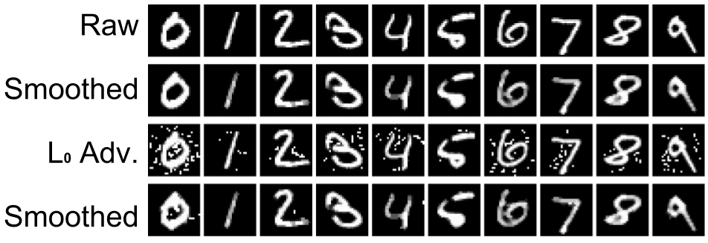
Squeeze Features

Slide 4

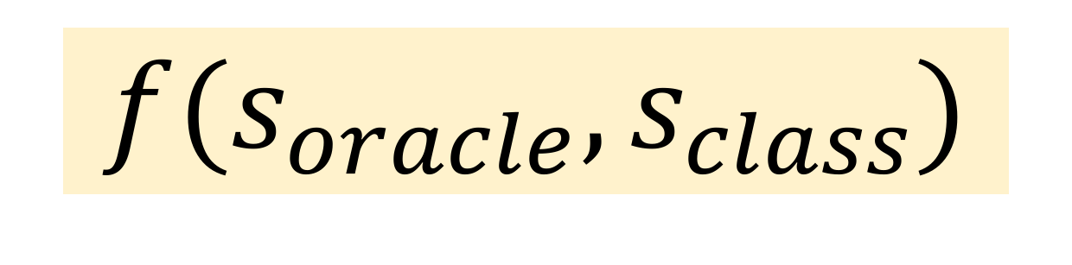
Selecting Promising Variants
Malicious
Benign PDFs
Benign PDFs
/Catalog
Malicious PDF
Malicious PDF
/Pages
Found Evasive?
Oracle
Generated Variants
Fitness Function
Malicious PDF
Benign PDFs
Oracle
Variants
Variants
128
$f(s_{oracle}, s_{class})$
/Root
Variant
0
Variants
Variants
01011001101
01011001101
/JavaScript
✓
✓
✗
✓
Variants
01011001101
eval(‘…’);
Score
Clone
Clone
Candidate Variant
Select
Variants
Clone
Mutation
Target Classifier
Variants

Slide 5
Classifier Performance
 | PDFrate | Hidost
Accuracy | 0.9976 | 0.9996
False Negative Rate | 0.0000 | 0.0056
False Negative Rate against Adversary | 1.0000 | 1.0000

Slide 6
PDFRate
Seeds Evaded
(out of 500)
Hidost
Number of Mutations

Slide 7
PDFRate
Simple transformations often worked
Seeds Evaded
(out of 500)
Hidost
Number of Mutations

Slide 8
PDFRate
(insert, /Root/Pages/Kids, 3:/Root/Pages/Kids/4/Kids/5/)
Seeds Evaded
(out of 500)
Works on 162/500 seeds
Number of Mutations

Slide 9
PDFRate
Some seeds required complex transformations
Seeds Evaded
(out of 500)
Hidost
Number of Mutations

Slide 10
Insert: Threads, ViewerPreferences/Direction, Metadata, Metadata/Length, Metadata/Subtype, Metadata/Type, OpenAction/Contents, OpenAction/Contents/Filter, OpenAction/Contents/Length, Pages/MediaBox
Delete: AcroForm, Names/JavaSCript/Names/S,
AcroForm/DR/Encoding/PDFDocEncoding,
AcroForm/DR/Encoding/PDFDocEncoding/Differences,
AcroForm/DR/Encoding/PDFDocEncoding/Type, Pages/Rotate,
AcroForm/Fields, AcroForm/DA, Outlines/Type, Outlines,
Outlines/Count, Pages/Resources/ProcSet, Pages/Resources
85-step mutation trace evading Hidost
Effective for 198/500 seeds

Slide 11
Execution Cost
Mutation
Classifier
Oracle
Hours to find all 500 variants on one desktop PC

Slide 12
Possible Defenses

Slide 13
Possible Defense: Adjust Threshold
Charles Smutz, Angelos Stavrou. When a Tree Falls: Using Diversity in Ensemble Classifiers to Identify Evasion in Malware Detectors. NDSS 2016.

Slide 14
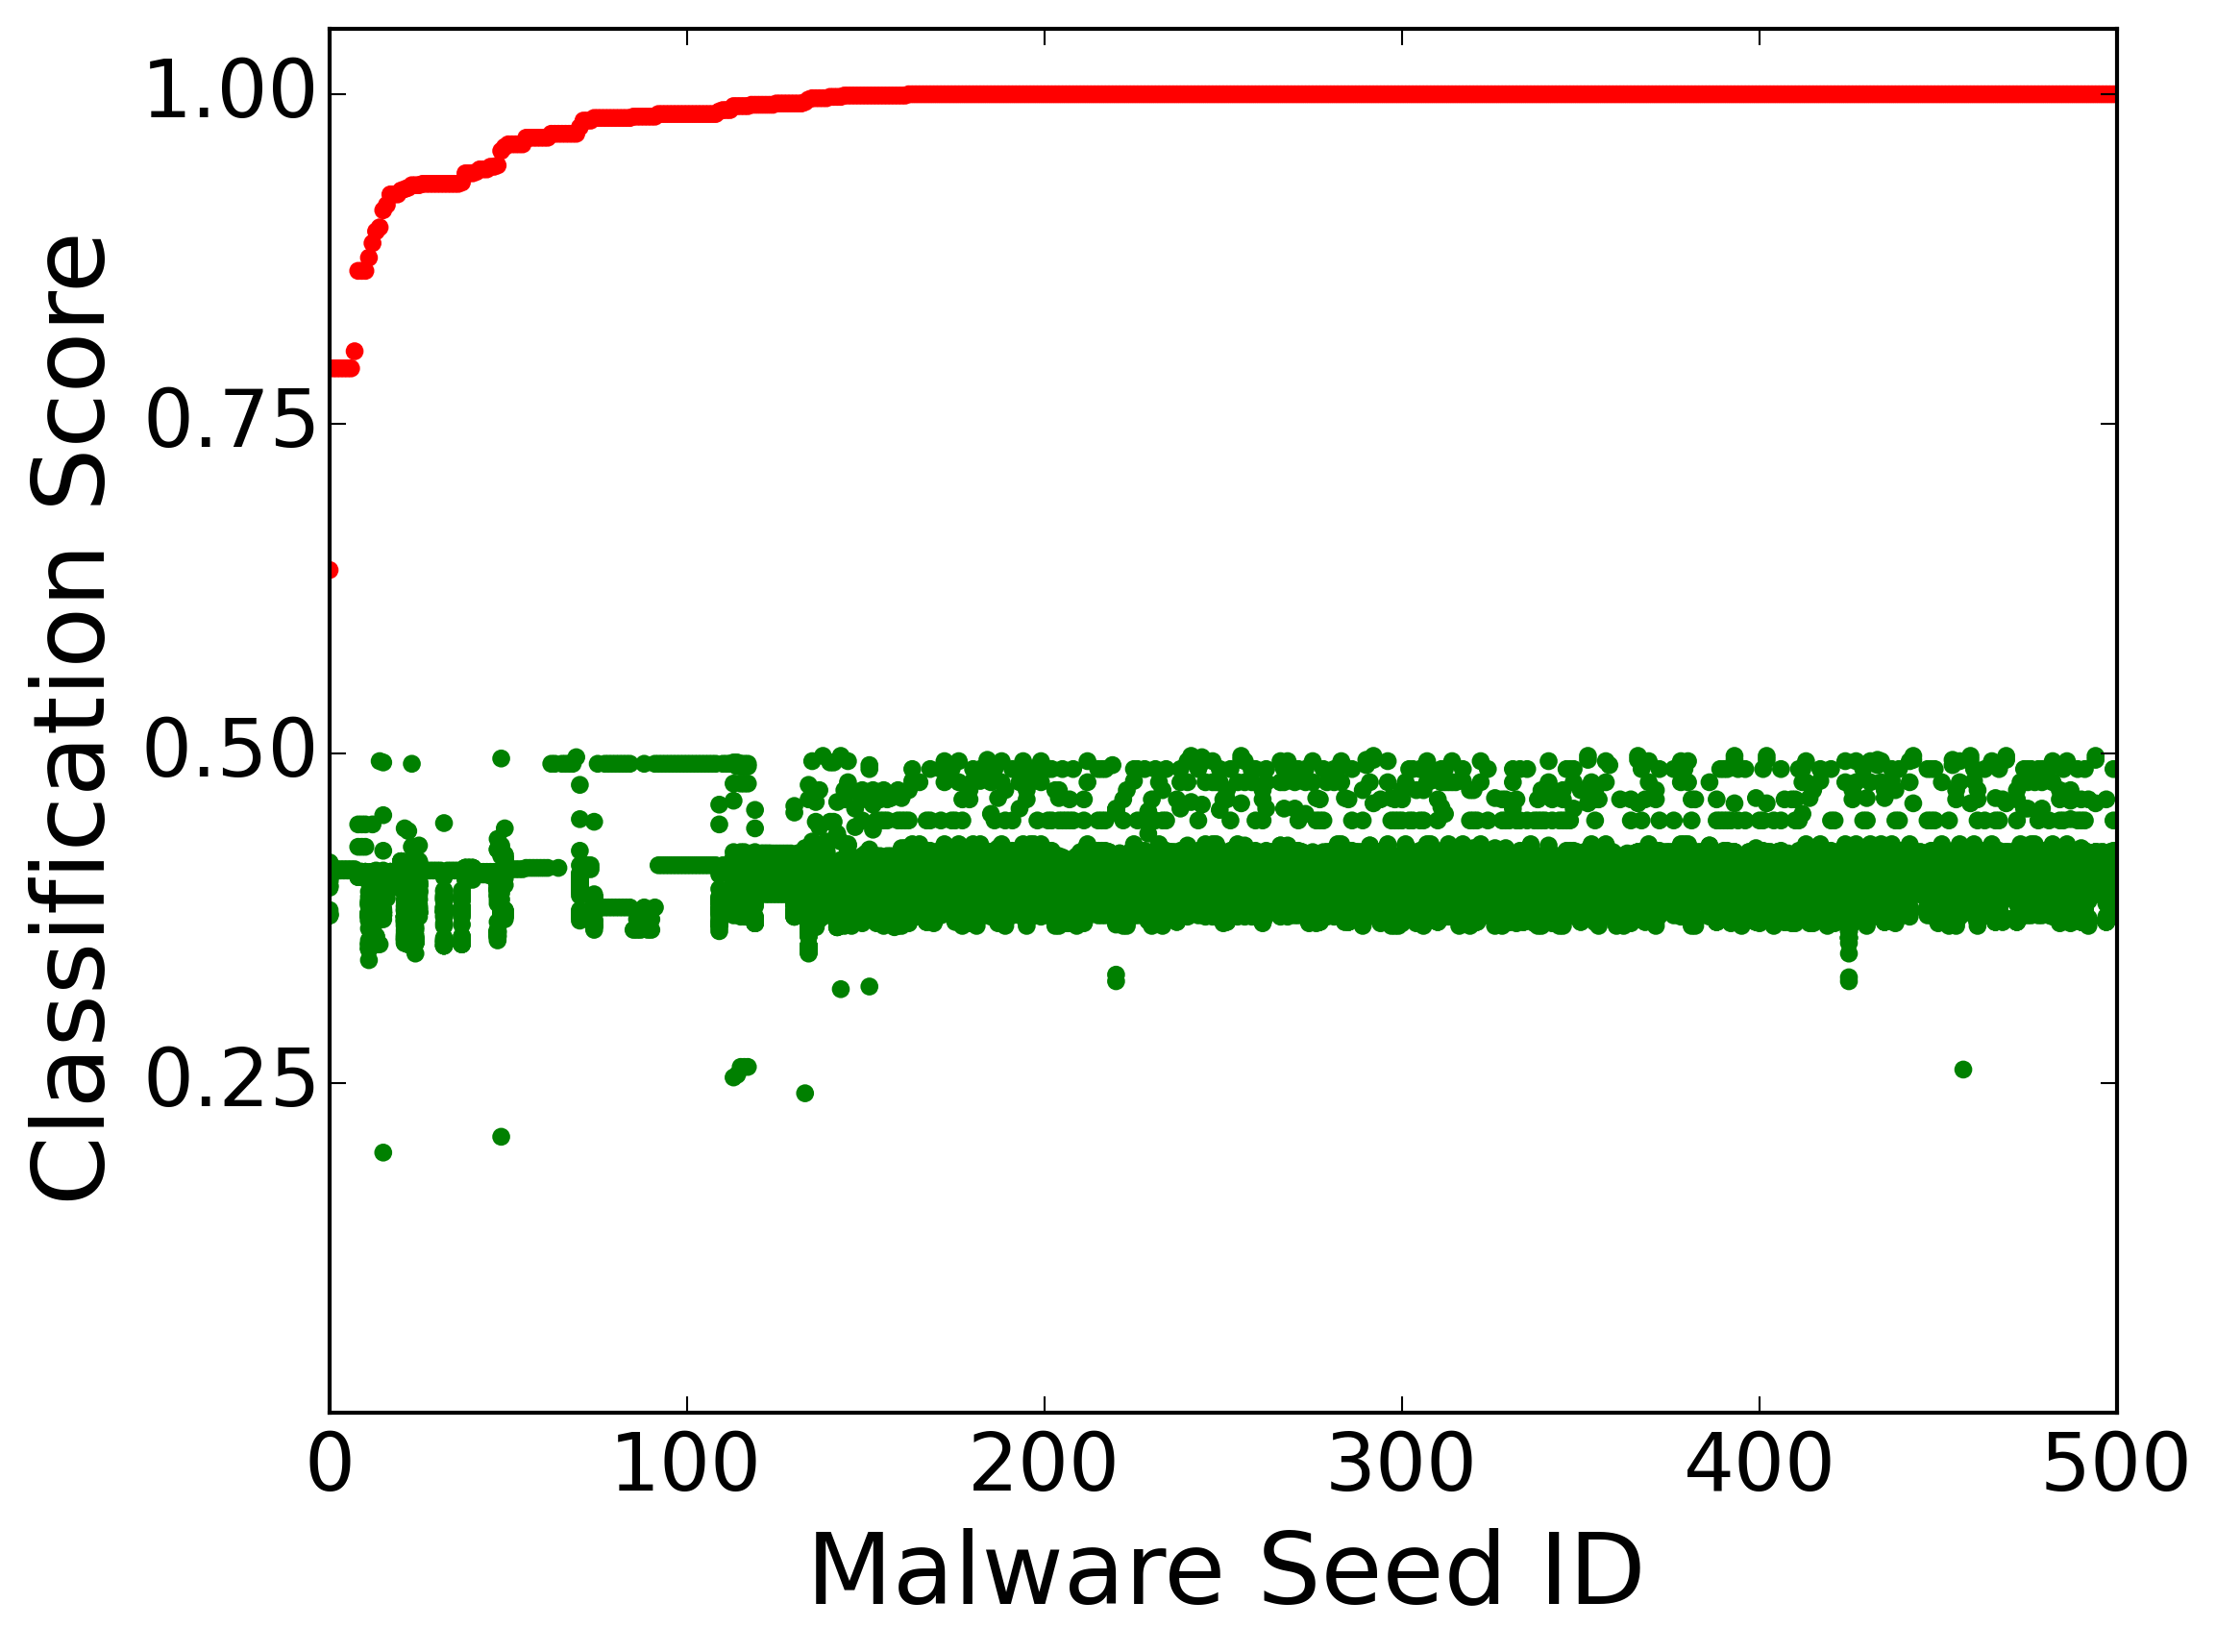
Evading PDFrate
Original Malicious Seeds
Malicious Label Threshold

Slide 15
Adjust threshold?
Discovered Evasive Variants

Slide 16
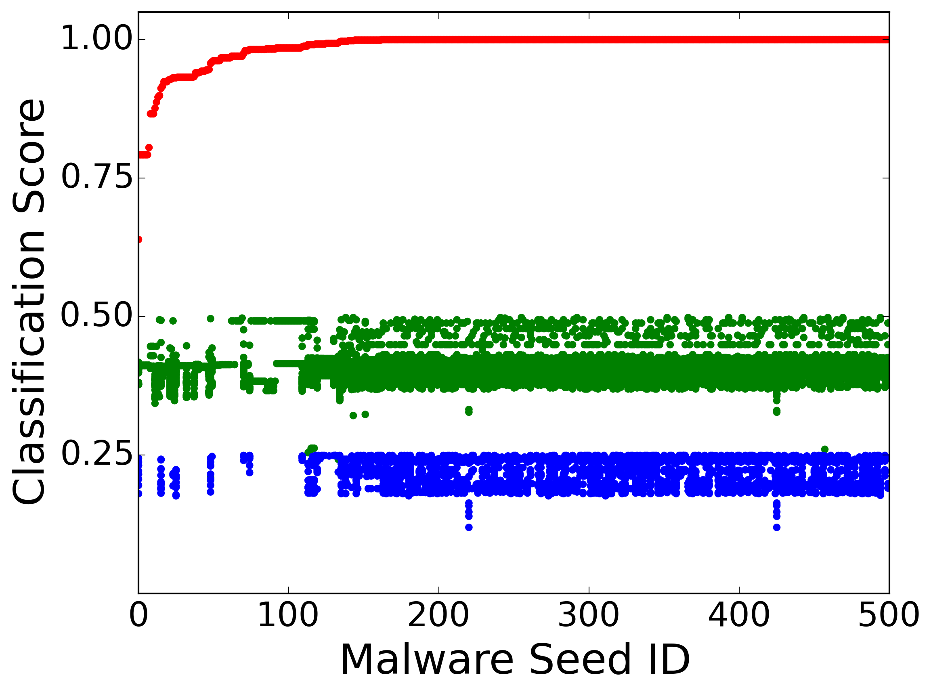
Adjust threshold?
Variants found with threshold = 0.50
Variants found with threshold = 0.25

Slide 17
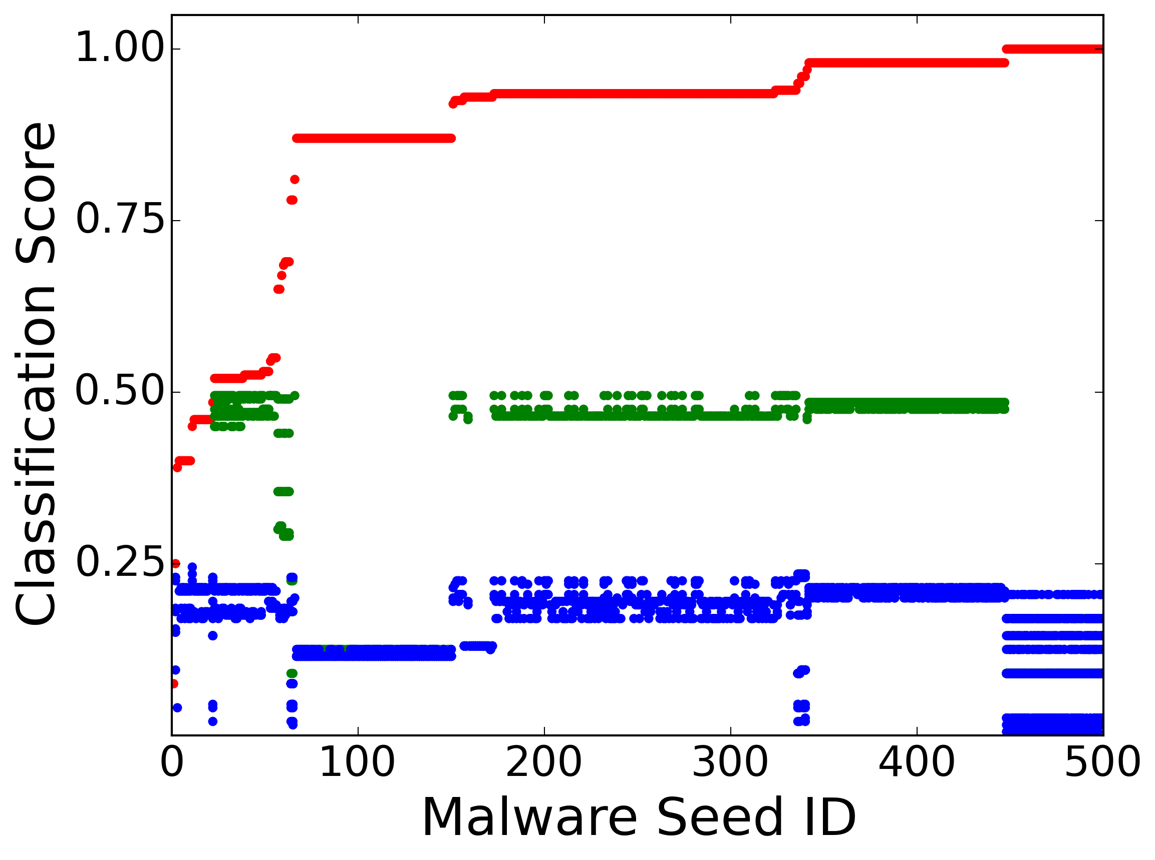
Hidost16
Variants found with threshold = 0.50
Variants found with threshold = 0.25

Slide 18
EvadeML
Training
(Supervised Learning)
01011001101
Clone
Vectors
Labelled
Training Data
Feature
Extraction
ML
Algorithm
Deployment

Slide 19
Hidost16
Original classifier:
Takes 614 generations to evade all seeds
Seeds Evaded (out of 500)
Generations

Slide 20
Hidost16
Seeds Evaded (out of 500)
HidostR1
Generations

Slide 21
Hidost16
Seeds Evaded (out of 500)
HidostR2
HidostR1
Generations

Slide 22
Hidost16
Seeds Evaded (out of 500)
HidostR2
HidostR1
Generations

Slide 23

Hidost16
False Positive Rates
 | Genome | Contagio Benign
Hidost16 | 0.00 | 0.00
HidostR1 | 0.78 | 0.30
HidostR2 | 0.85 | 0.53
Seeds Evaded (out of 500)
HidostR1
HidostR2
Generations

Slide 24

Hidost16
False Positive Rates
 | Genome | Contagio Benign
Hidost16 | 0.00 | 0.00
HidostR1 | 0.78 | 0.30
HidostR2 | 0.85 | 0.53
Seeds Evaded (out of 500)
HidostR1
HidostR2
Generations

Slide 25
Retrained using evasive variants and all benign samples available to adversary
.11 Evasion Rate
.07 False Positive
Generations

