Slide 1
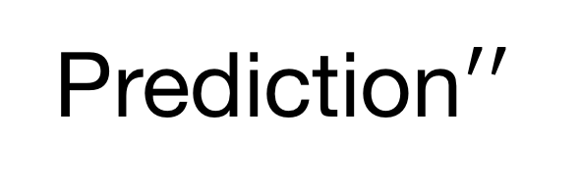
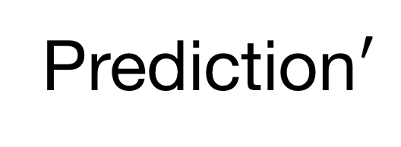
Model
Prediction
Compare Predictions
Ok
Model
Prediction$′$
Filter 1
Prediction
Input
Difference exceeds threshold
Model
Filter 2
Reject
Prediction$′′$

