Slide 1
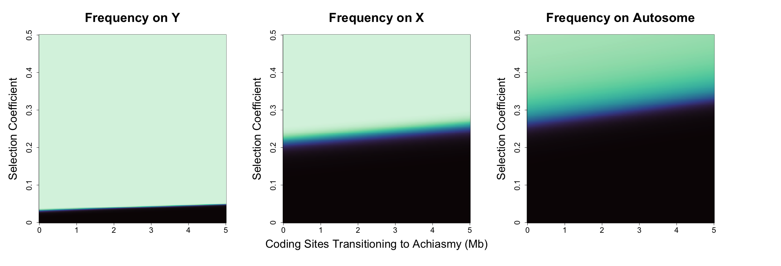
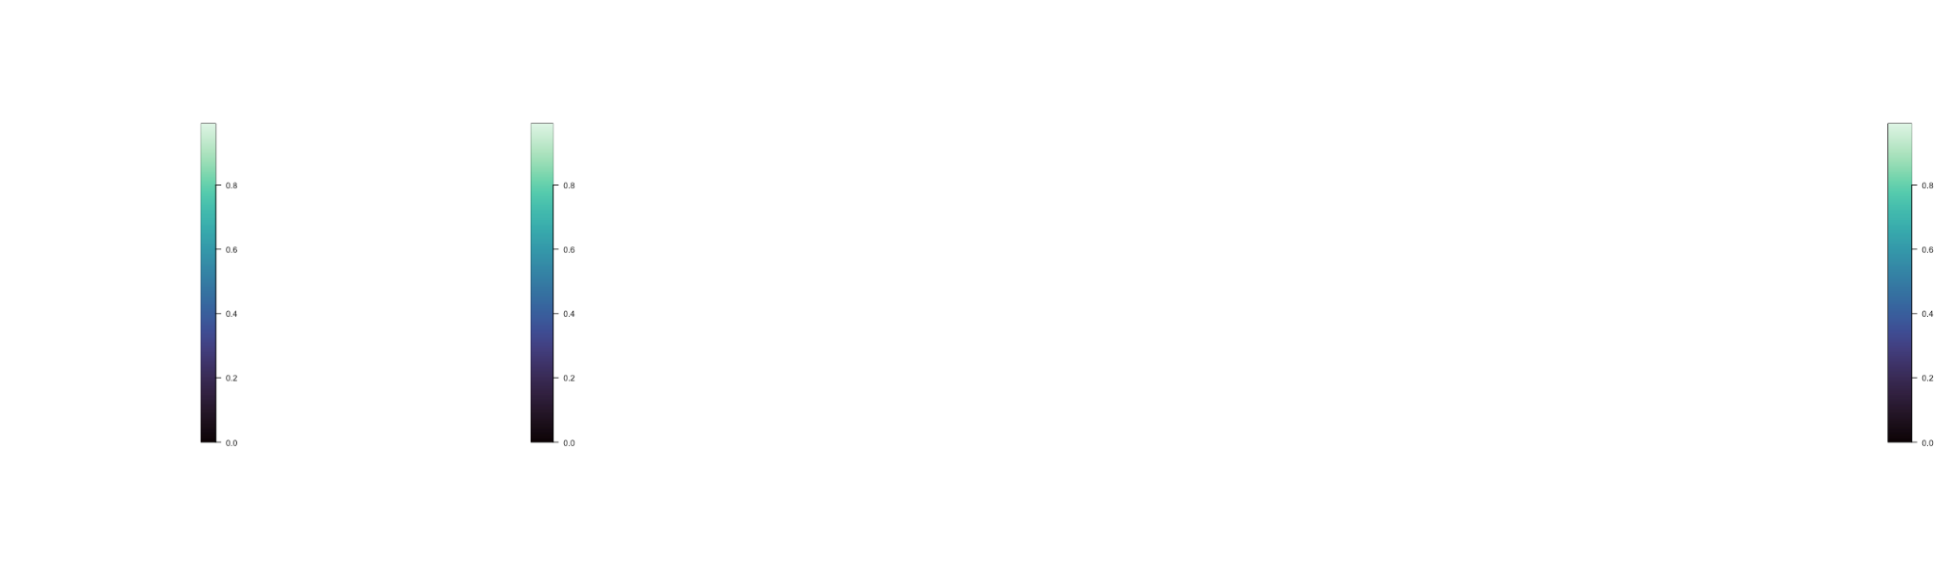
1.0
0.5
0.0
Achiasmy Allele Frequency
Notes:
SexAnt. With h=1, me = 0.3%, u=10⁻⁸, 1000 generations

Slide 2
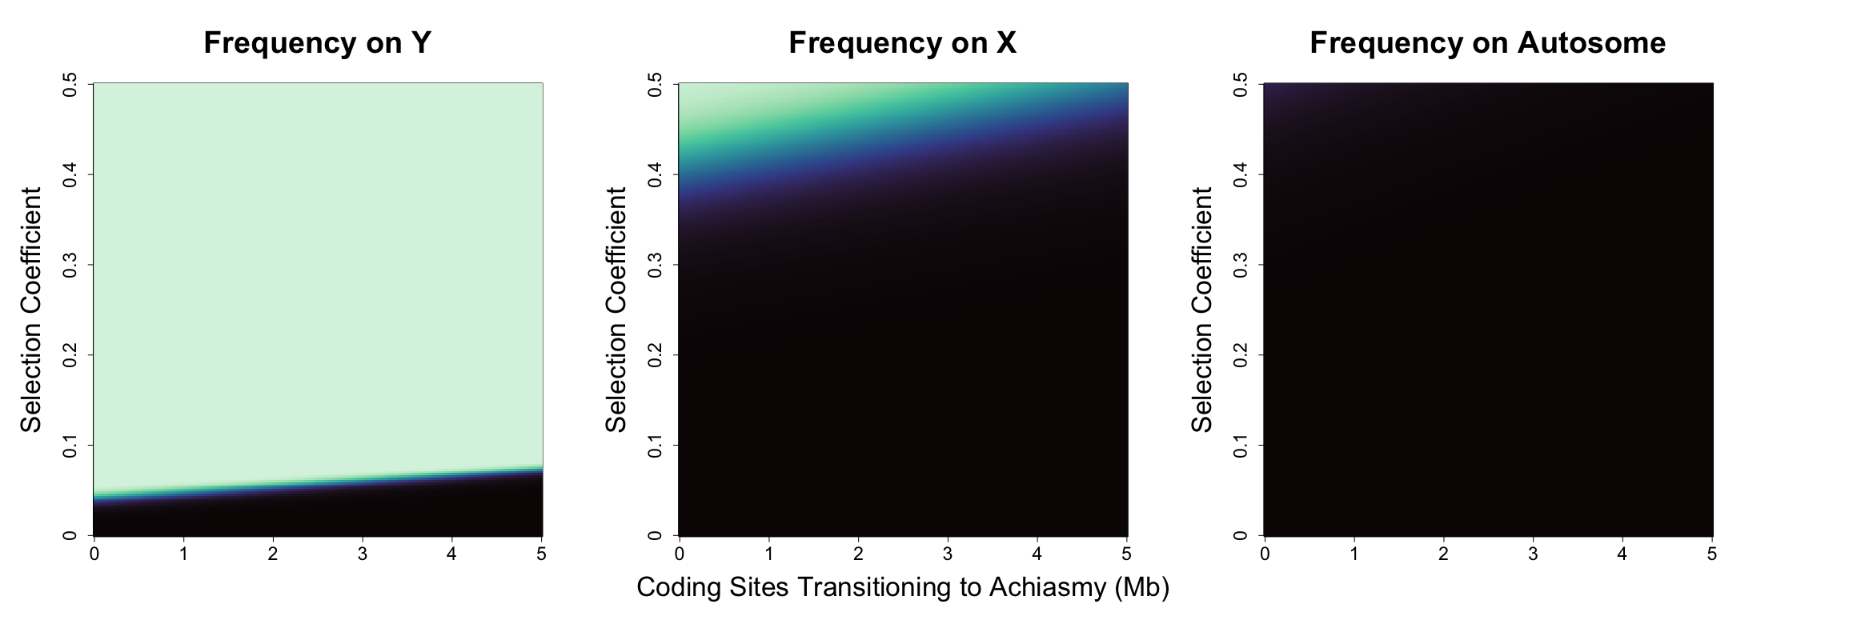
1.0
0.5
0.0
Achiasmy Allele Frequency
Notes:
SexAnt. With h=0.5, me = 0.3%, u=10⁻⁸, 1000 generations

Slide 3
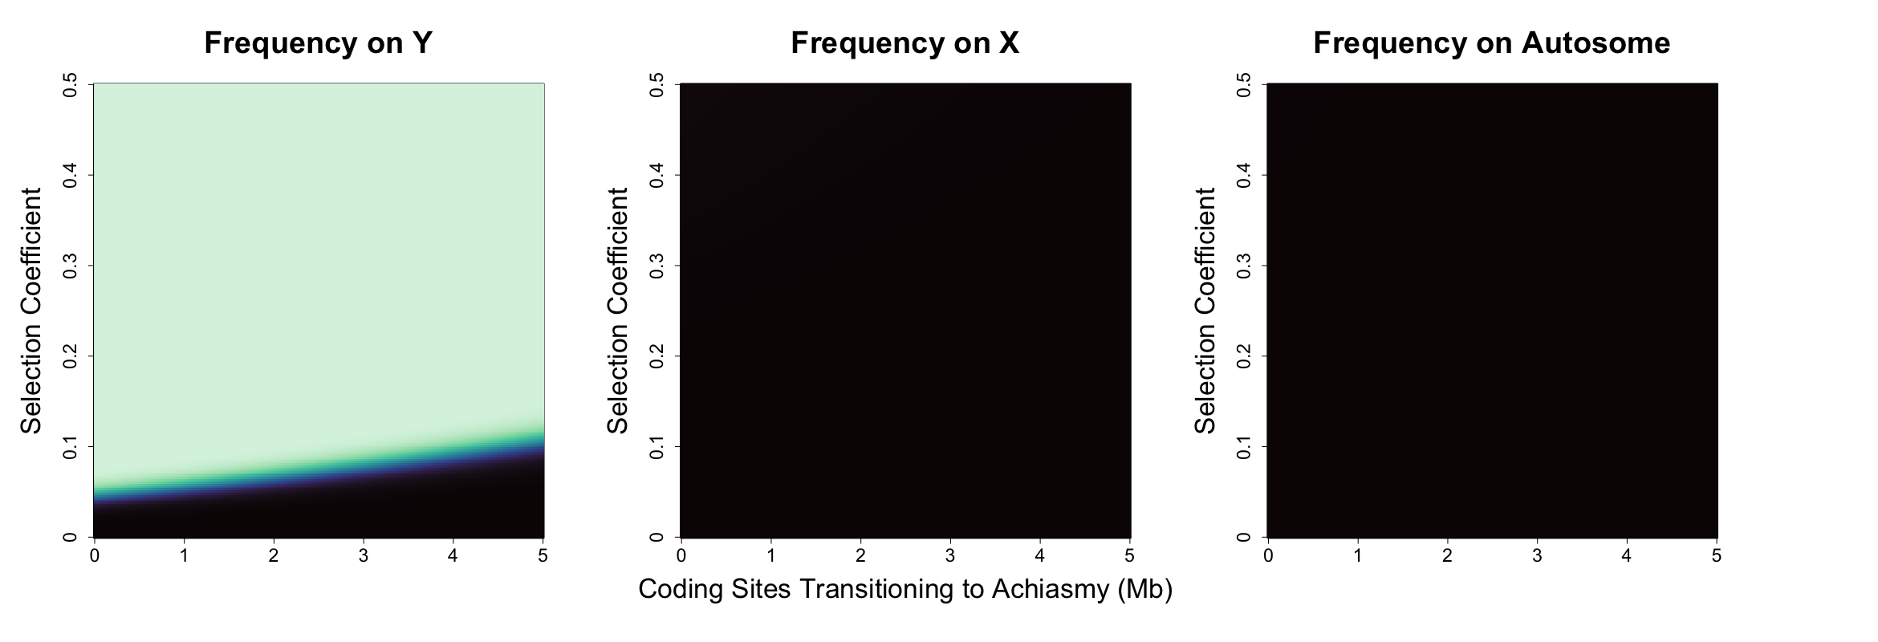
1.0
0.5
0.0
Achiasmy Allele Frequency
Notes:
SexAnt. With h=0, me = 0.3%, u=10⁻⁸, 1000 generations

Slide 4
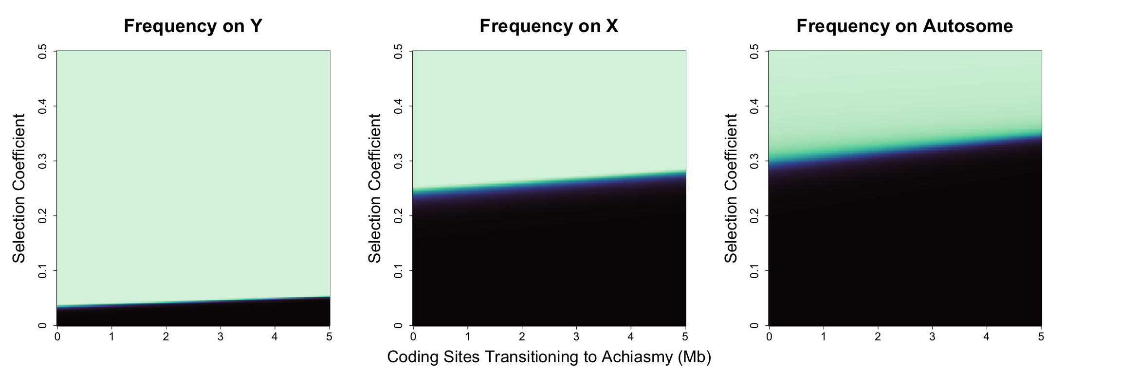
1.0
0.5
0.0
Achiasmy Allele Frequency
Notes:
SA. With r1 = 0.3, h=1, me = 0.3%, u=10⁻⁸, 1000 generations

Slide 5
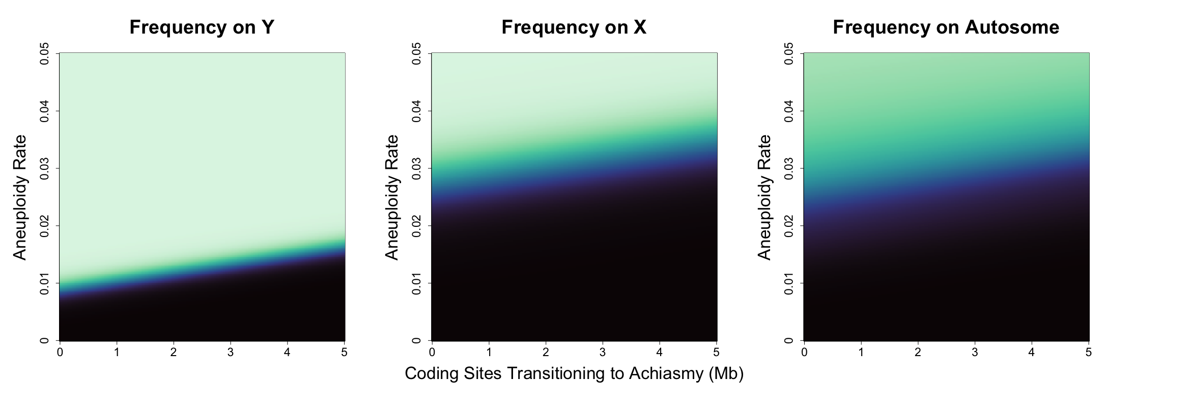
1.0
0.5
0.0
Achiasmy Allele Frequency
Notes:
HDA. With me = 0.3%, u=10⁻⁸, 1000 generations

Slide 6
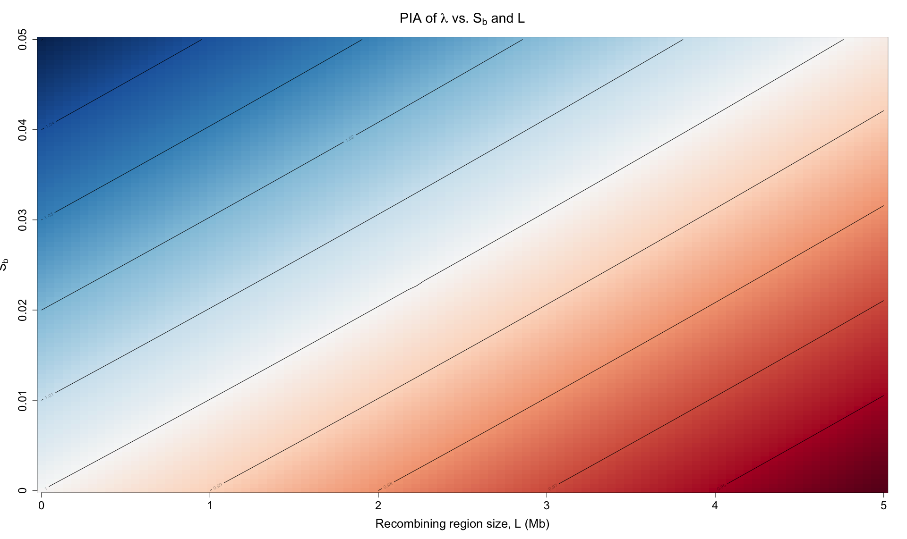
Notes:
Pairwise Invasibility Analysis

