Slide 1
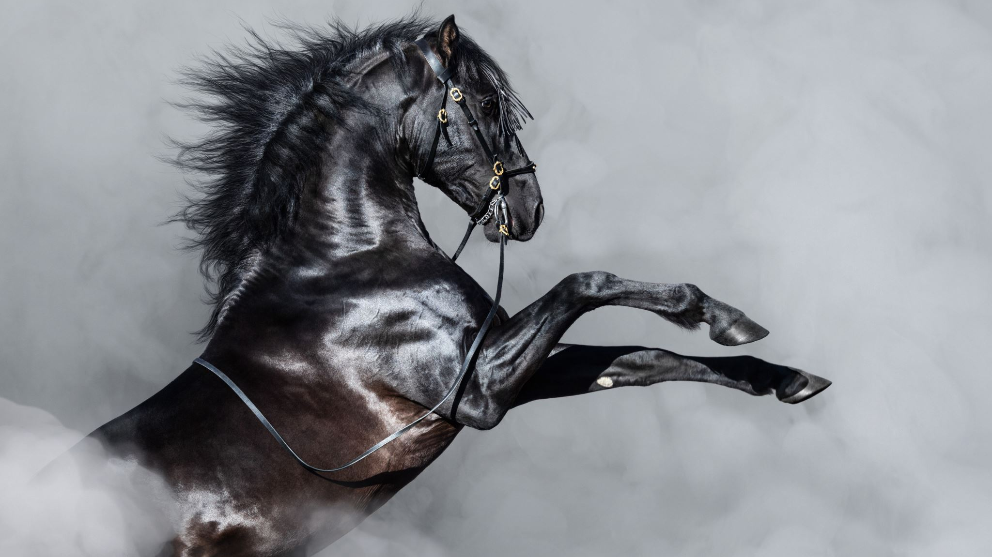
Hoof IMU
By
Elena Montalvo
Jonathan Hanbali
Josue Diaz
Kevin Brannan
Kyle Garcia
Matthew Wagaman

Slide 2
Timeline
Define outcomes
Order components
Sensor Hub
Battery management system
Create a PCB
Visualization of Data
Protective shell

Slide 3
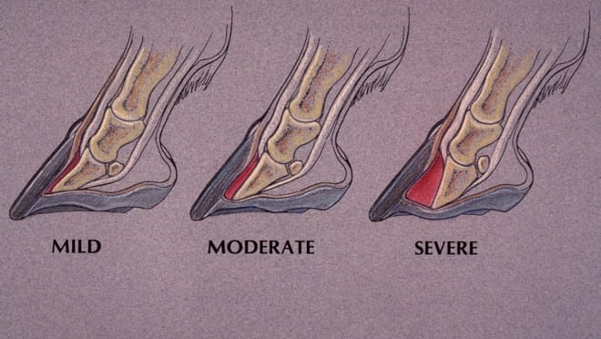
Laminitis Horse
Laminitis is commonly divided into three phases: mild, moderate, and severe. The hoof of a horse with laminitis shows displacement of the coffin bone.

Slide 4
Signs of acute laminitis:
A "sawhorse" stance in which the horse will rock back on its haunches and place its front feet stretched out in front of them to alleviate pressure on the toes.
Shifting lameness when standing and lameness when the horse is turned in a circle.
Heat in the foot and increased digital pulses (palpable on either side of the sesamoid bones at the level of the fetlock).
Pain in the toe region when pressure is applied.
Reluctance to walk and a very stiff/hesitant gait.

Slide 5
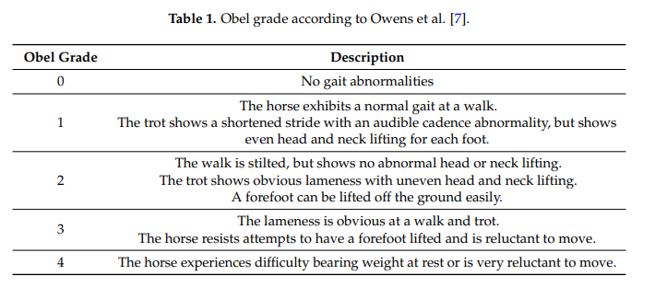
Horse with laminitis
The Obel grading system is a simple descriptive scale developed to evaluate equine lameness; it is the most widely accepted method for describing the severity of laminitis by equine practitioners . The clinical assessment of the Obel grade includes the observation of the horse walking and trotting in a straight line on a hard surface, away from and towards the assessor.

Slide 6
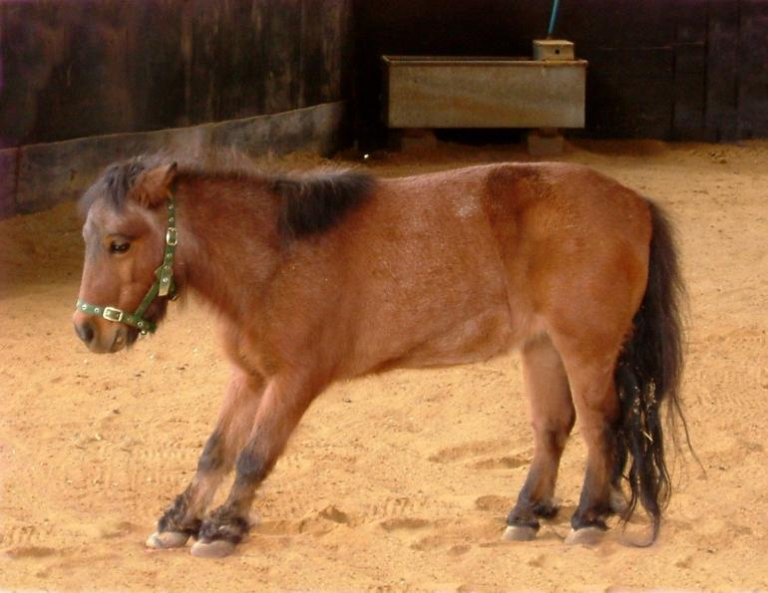
“Sawhorse” Stands
The weight is shift to the heel

Slide 7
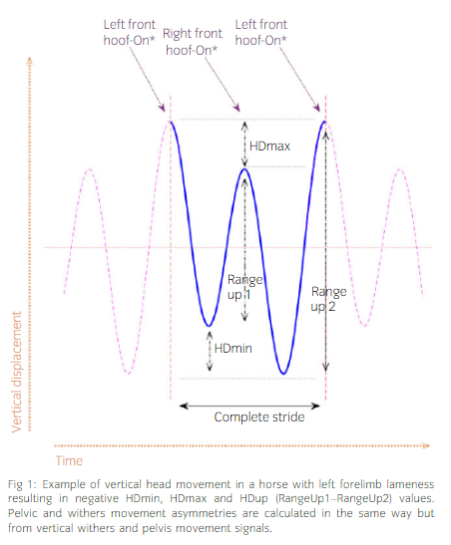
Lameness horse
Lameness can be described as an abnormal walk, usually noted by an asymmetry in movement.
significant difference, the limb exhibiting the lower ground reactive force

Slide 8
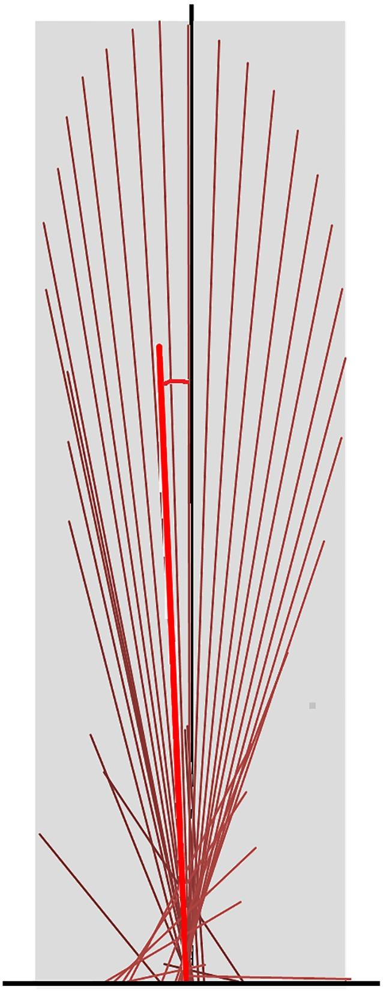
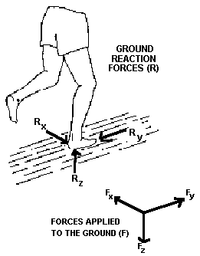
Low Ground Reactive force

Slide 9
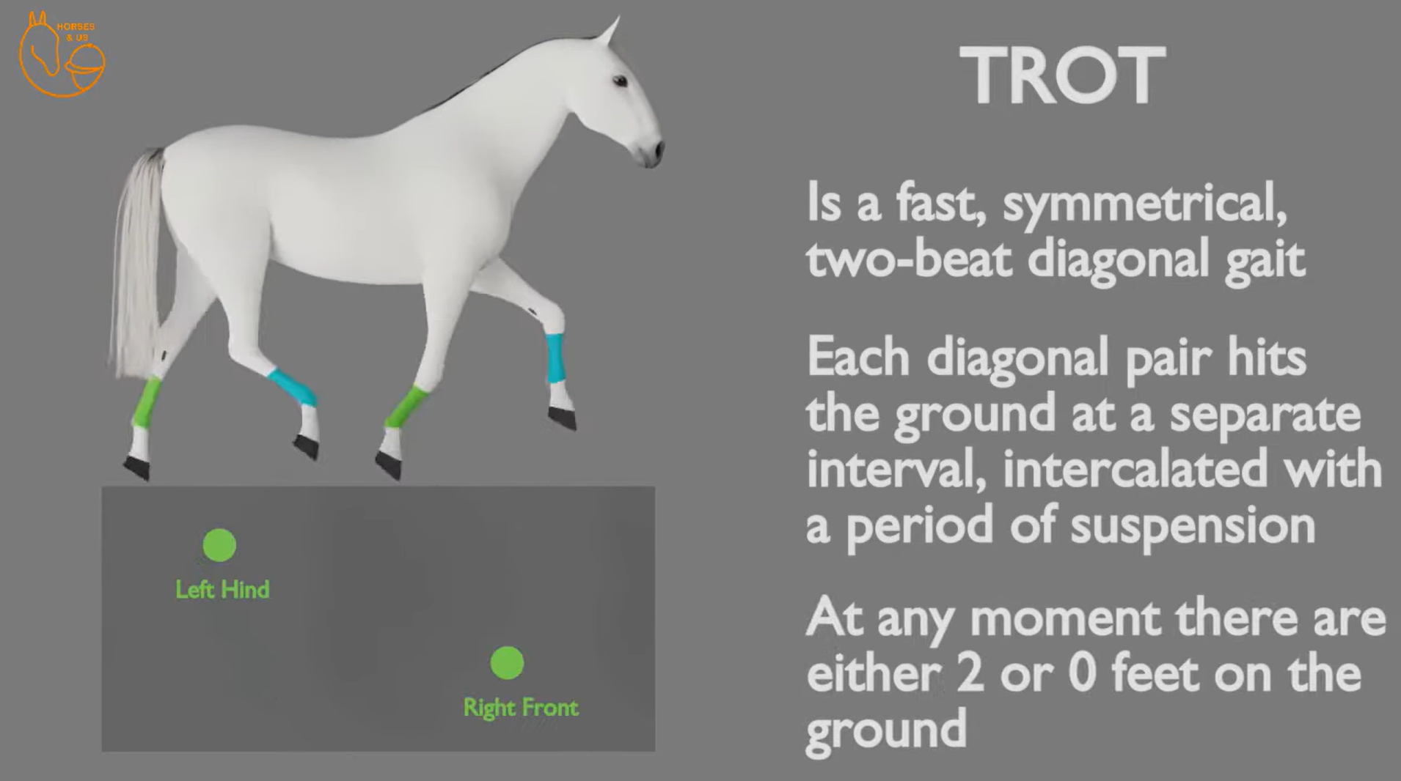
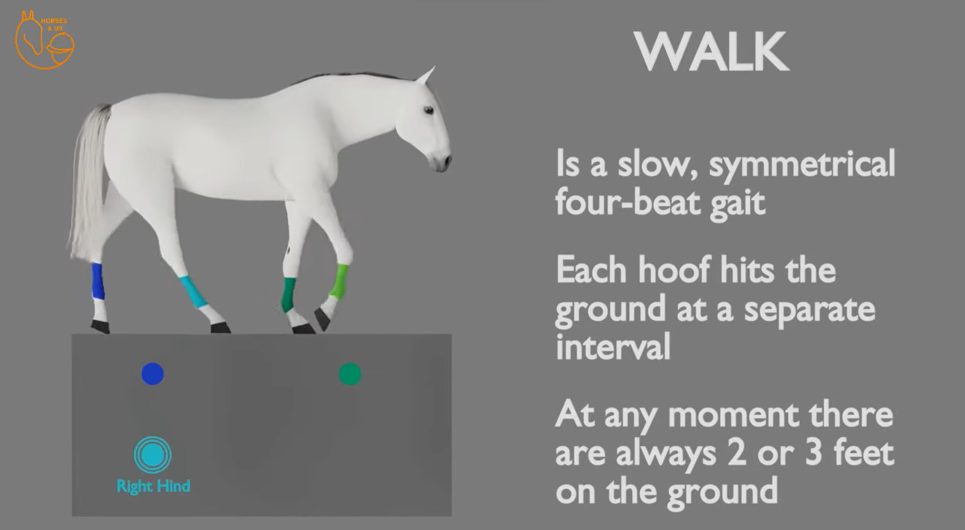
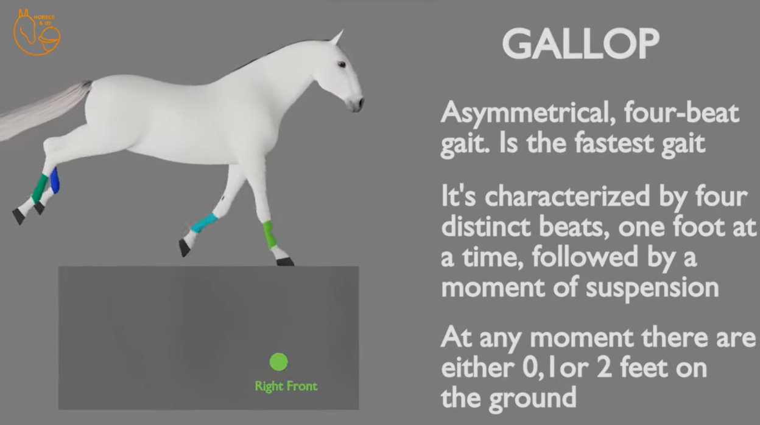
Horse Gait

Slide 10
Horse Gait Cont.
(F) and the anteroposterior (F_{X}), vertical (F_{Y}) and mediolateral (F_{Z}) components of the ground reaction force at one point in the single-support phase of the right leg. (When walking straight forward, the mediolateral component is normally very small resulting in little side-to-side movement of the body)

Slide 11
Timeline
Define outcome
Order components
Sensor Hub
Battery management system
Create a PCB
Protective shell
Visualization of Data

Slide 12

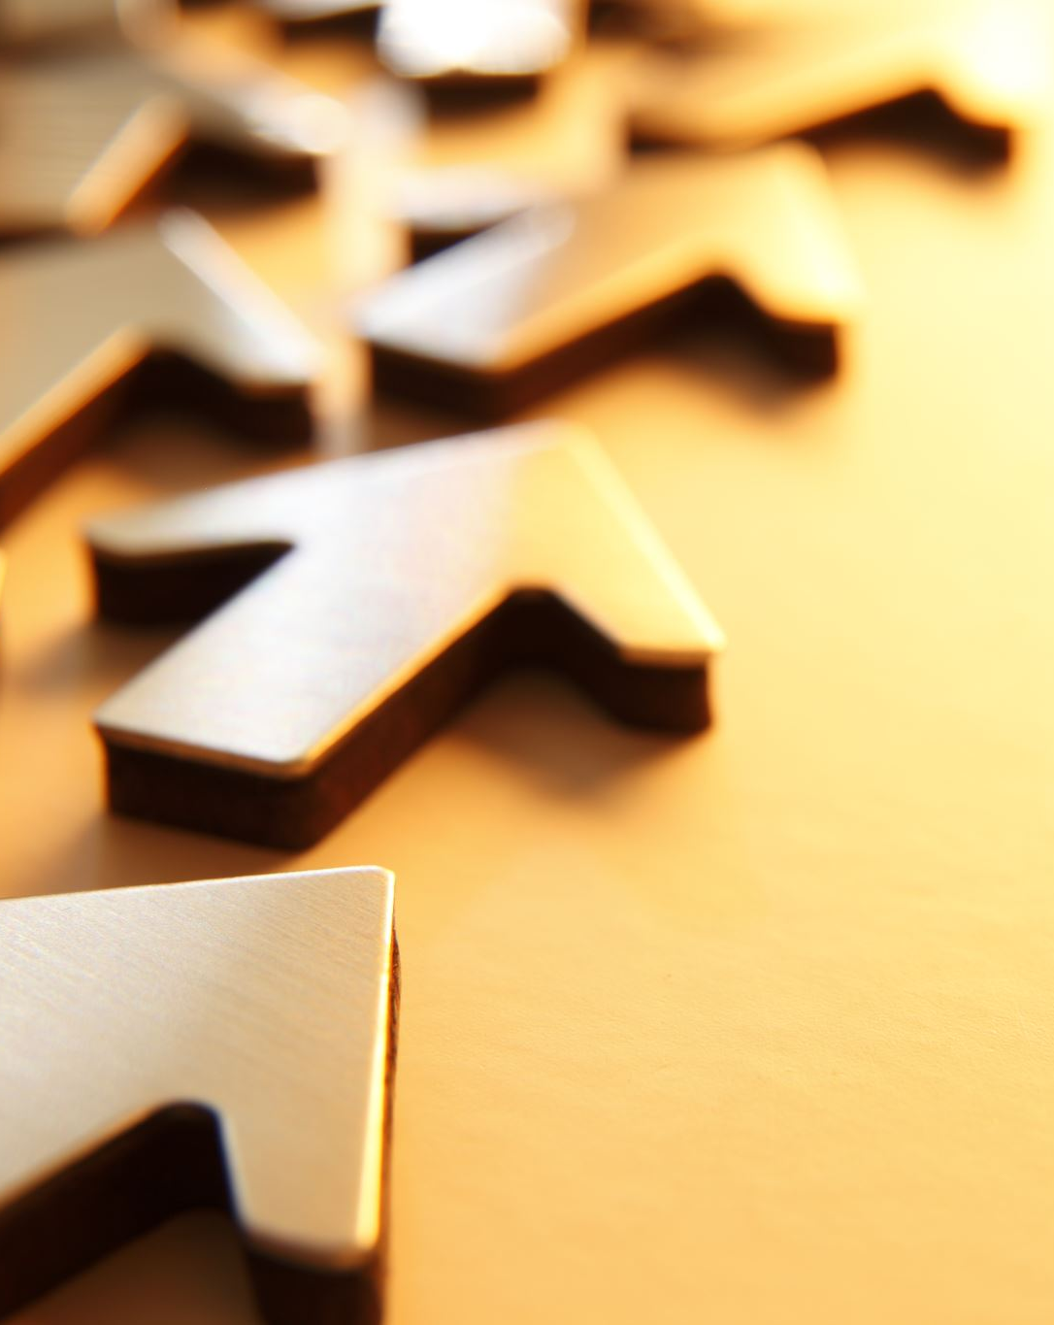
Progress

Slide 13
Sensor Device & Hub
The sensor device currently contains the following chips:
Seeeduino nrf52840 Sense
3-Axis Magnetometer (MMC5983MA)
3-Axis High-g Accelerometer (H3LIS331DL)
Low power 3D accelerometer with range of ±100/±200/±400 g.
6-Axis IMU (LSM6DS3)
3D accelerometer with range of ±2/±4/±8/±16 g. The 3D gyroscope angular rate range of ±125/±250/±500/±1000/±2000/±4000 dps.​
Bluetooth Low Energy (BLE) is being used to transmit the data packets from the sensor devices to the sensor hub using Adafruit’s Bluefruit library.
An addition that is being considered is adding Real-Time Clocks (RTC) so that the data can be organized by their precise times of collection.

Slide 14
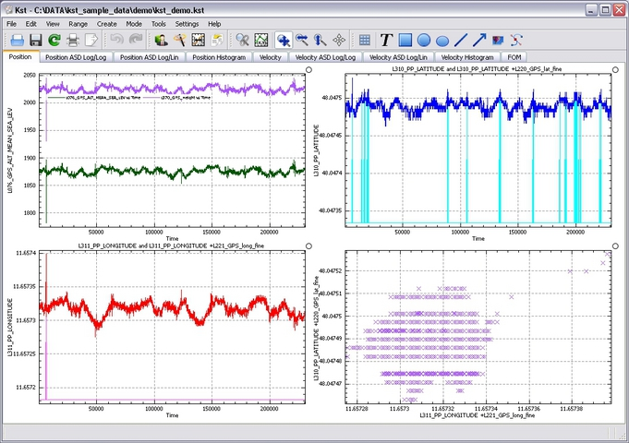
Data Saving and Post Processing
Currently, the Sensor Hub receives data from the sensor devices and sends it through a COM port to a host computer to save the data as a local .csv file using a MATLAB script.
The data from the .csv is read through a real-time data viewing software called “Kst”, where the .csv is then formatted and plotted to a real-time graph.
Post-processing will likely take place in MATLAB due to its extensive libraries of Sensor Fusion algorithms.
Image: Real-time plotting example using Kst

Slide 15
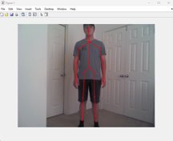
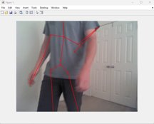
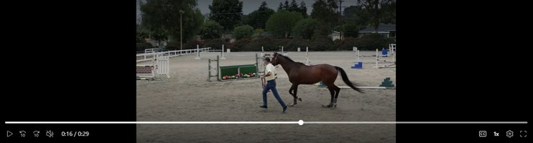
MATLAB Body Skeleton
Current status: Use MATLAB code with Kinect for Windows Sensor to take photo and map a skeleton figure on to the image. ​
Goal: To map a body skeleton onto horses captured in video. Detect movements specific to horses with laminitis.

Slide 16
Battery Management System
For the sensor device to collect data wirelessly, it will need a rechargeable battery and a battery management system to allow repeated use.
Currently, data is being collected on all the power requirements of each device.
Power used at the maximum transmission range will be collected to better understand the maximum operating time.
The sensor hub will not require any batteries or power systems since it will obtain power through the serial connection to the host computer.

Slide 17
PCB Design
While the Sensor Device is being finalized, the Eagle part files are being collected for specific chips used in the sensor device and sensor hub.
The purpose of creating a PCB is to create a smaller form factor so that it may go on a horse’s hoof without its notice.
The creation of a PCB will also allow better power optimization by reducing unnecessary features provided by other chips.
As of now the current iteration is too large to fit on the hooves of a horse without notice.

Slide 18
Protective Shell
The electronics will need some sort of case to protect the electronics from the elements without causing any interference on the BLE communications. A few design choices have been discussed:
A custom 3D printed electronics enclosure made of ASA, which boasts chemical, UV, temperature, and heat resistance.
White silicone to provide a water-tight interior for the electronics.
The design will be created once the sensor hub has been fully completed.

Slide 19
Questions?

