Slide 1

Hoof IMU
By
Elena Montalvo
Jonathan Hanbali
Josue Diaz
Kevin Brannan
Kyle Garcia
Matthew Wagaman

Slide 2
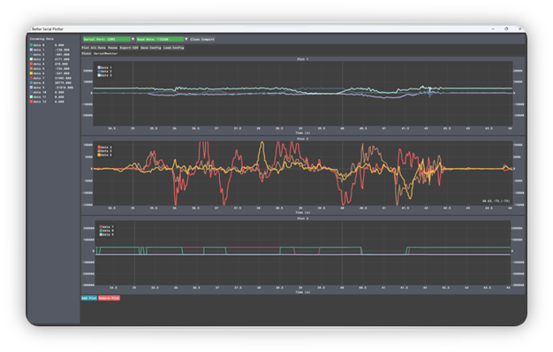
Data Saving and Post Processing
KST proved to not be capable of plotting the data in real-time using .csv files. As a result, BetterSerialPlotter is being used to plot data real-time, and is capable of exporting the results as a .csv file afterwards for post-processing.​
Alternatively, a Python script may be utilized for sorting data per device and exporting each to their own .csv file for individual device processing.

Slide 3
Important factors to consider for BMS
Voltage Monitoring
Current Monitoring
Temperature Monitoring
Cell Balancing
State of Charge (SOC) Estimation
State of Health (SOH) Estimation
Overcurrent and Overvoltage Protection
Cell Protection

Slide 4
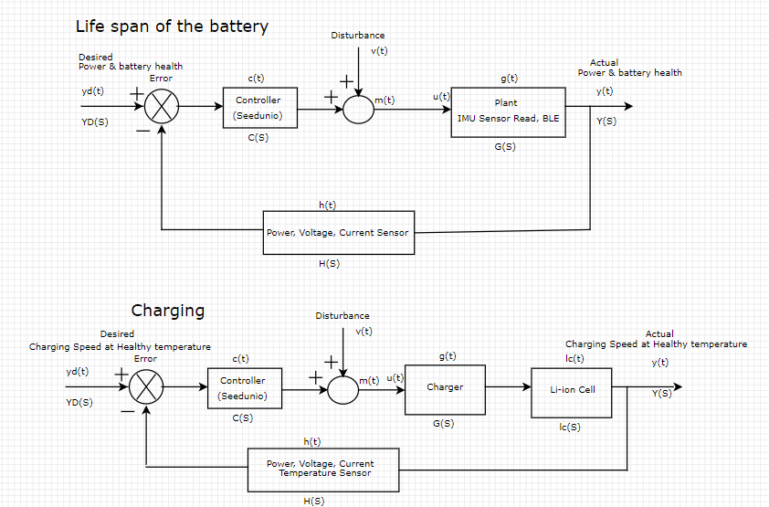
Proportional Integral Derivative (PID)

Slide 5
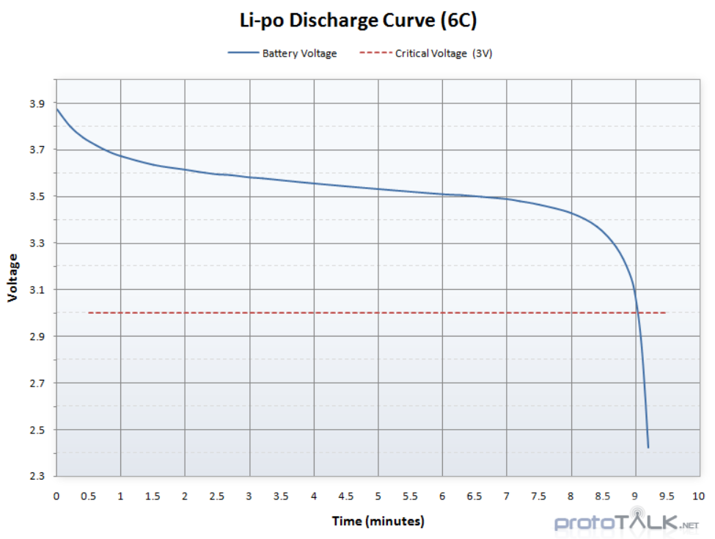
BATERRY
Voltage = 3.7 v capacity = 650mAh capacity = 1500mAh An individual LiPo cell has a nominal voltage of 3.7V. When fully charged you will see nearly 4.3V on the cell but it will quickly drop to 3.7V under normal use. When depleted, the cell will be around 3V. This means your project will need to handle various voltages if you are running directly from a cell

Slide 6
Hardware to for BMS
The Battery Babysitter features a pair of Texas Instruments LiPo-management ICs: a BQ24075 battery charger and a BQ27441-G1A fuel gauge.
INA219 High Side DC Current Sensor Breakout - 26V ±3.2A Max - STEMMA QT

Slide 7
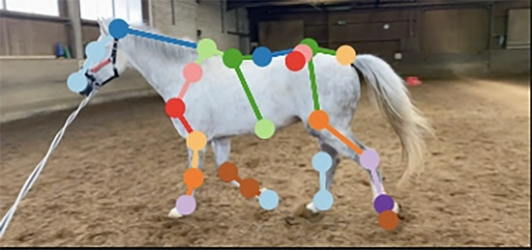
Computer Vision
By using machine learning, we're aiming to create a skeletal body over a recorded video of the horse movement
Currently exploring options on using already build libraries and models to help us in detecting the skeleton and movements

Slide 8
Questions?

