Slide 1
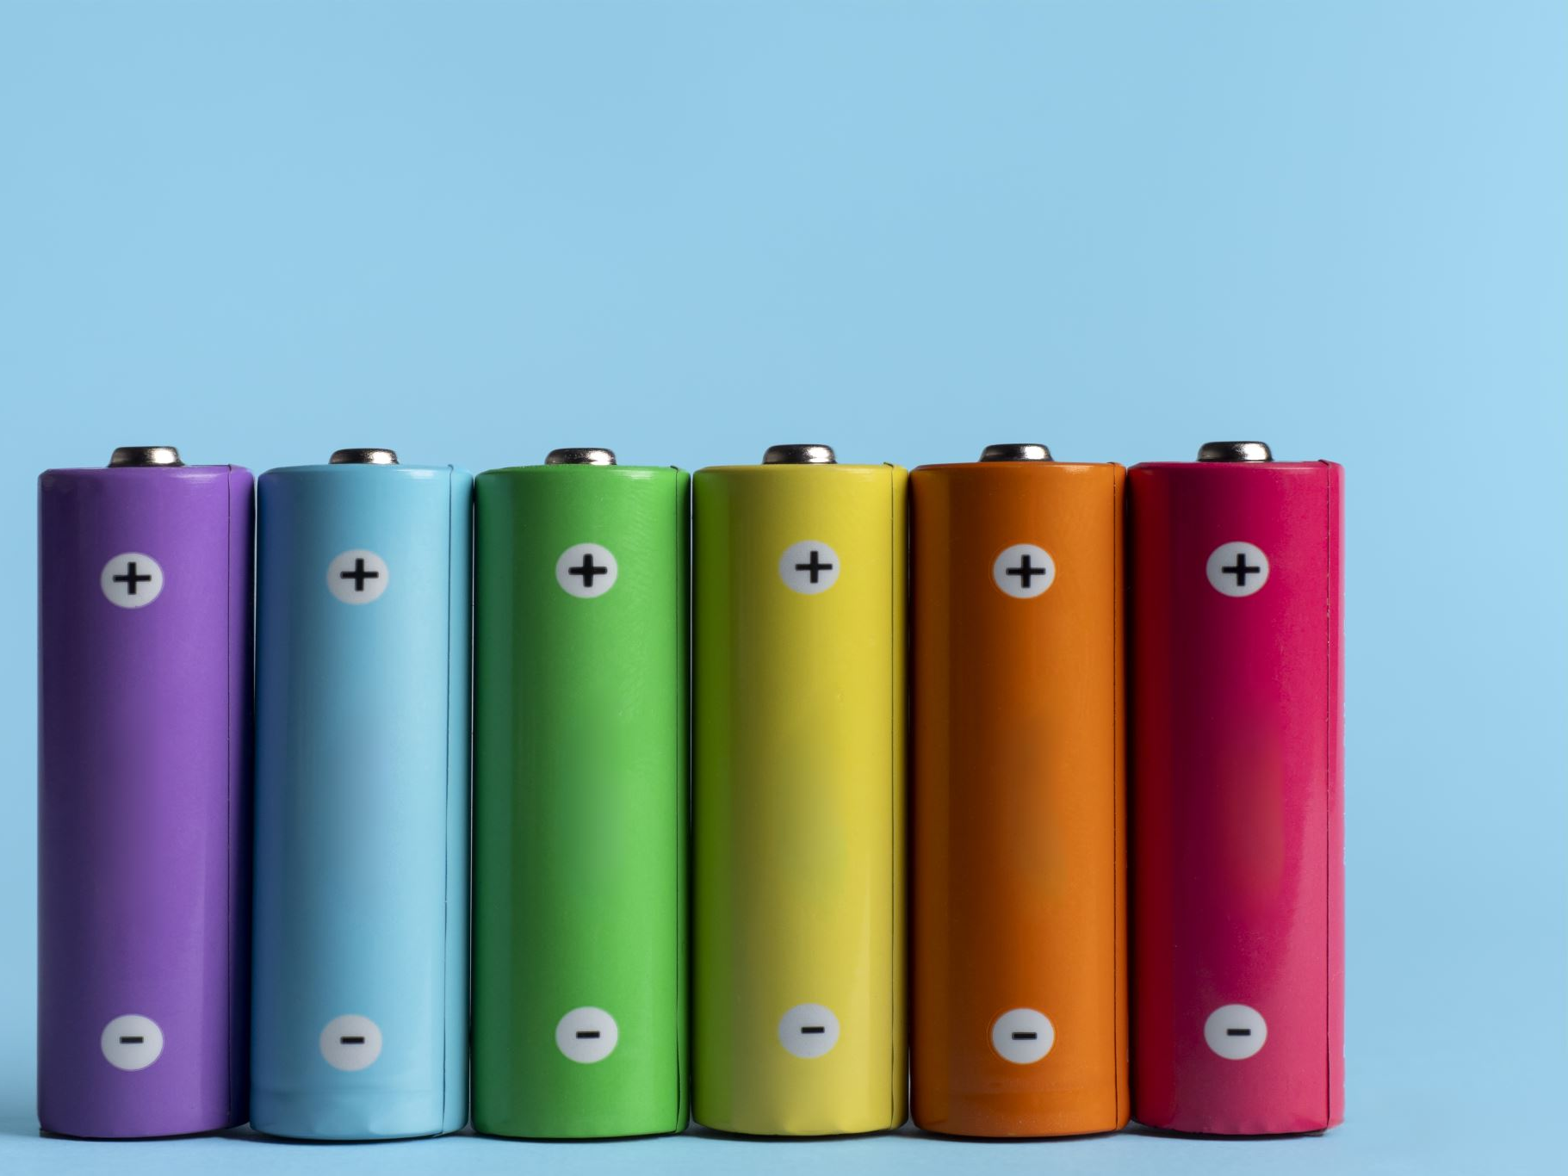
BATTERY

Slide 2
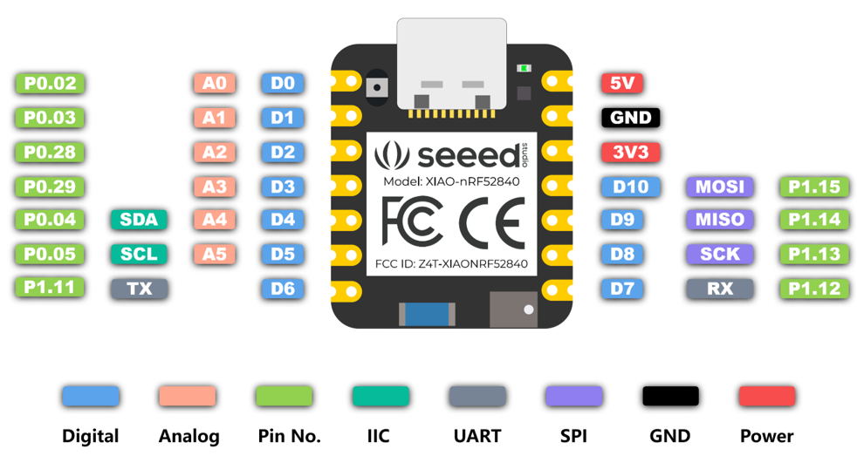
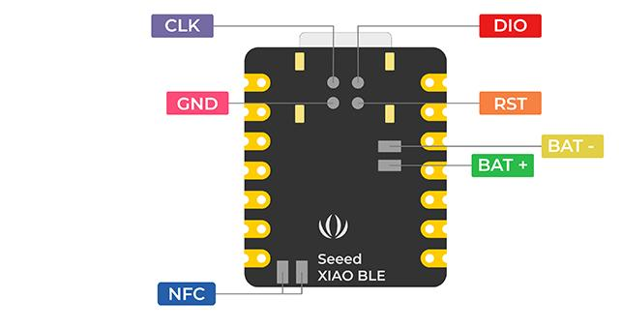

Slide 3

POWER MANAGEMENT UNIT (PMU)
The PMU automatically detects which power and clock resources are required by the different components in the system at any given time. It will then start/stop and choose operation modes in supply regulators and clock sources, without user interaction, to achieve the lowest power consumption possible.

Slide 4
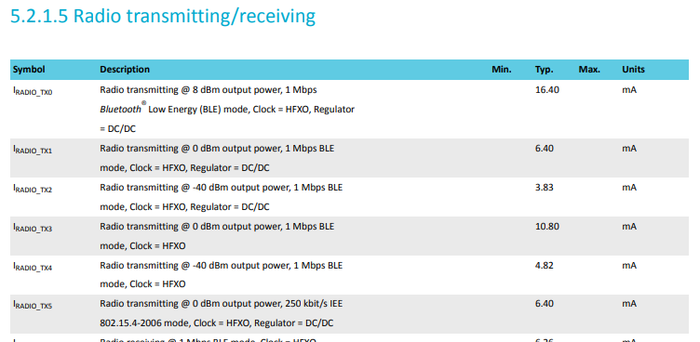

Slide 5
POWER REQUIREMENT & CONSUMPTION
Seeed Studio XIAO nRF52840 (Sense) |  | ISM330DHCX | MMC5983MA | MicroSD card breakout board+ | H3LIS331DL
Voltage | Current | Current | Current | Current | Current
3.3v | 50mA or 100mA | 1.5mA | 50mA or 100mA | 150mA | 7 μA
Total | ~351.5mA

Slide 6
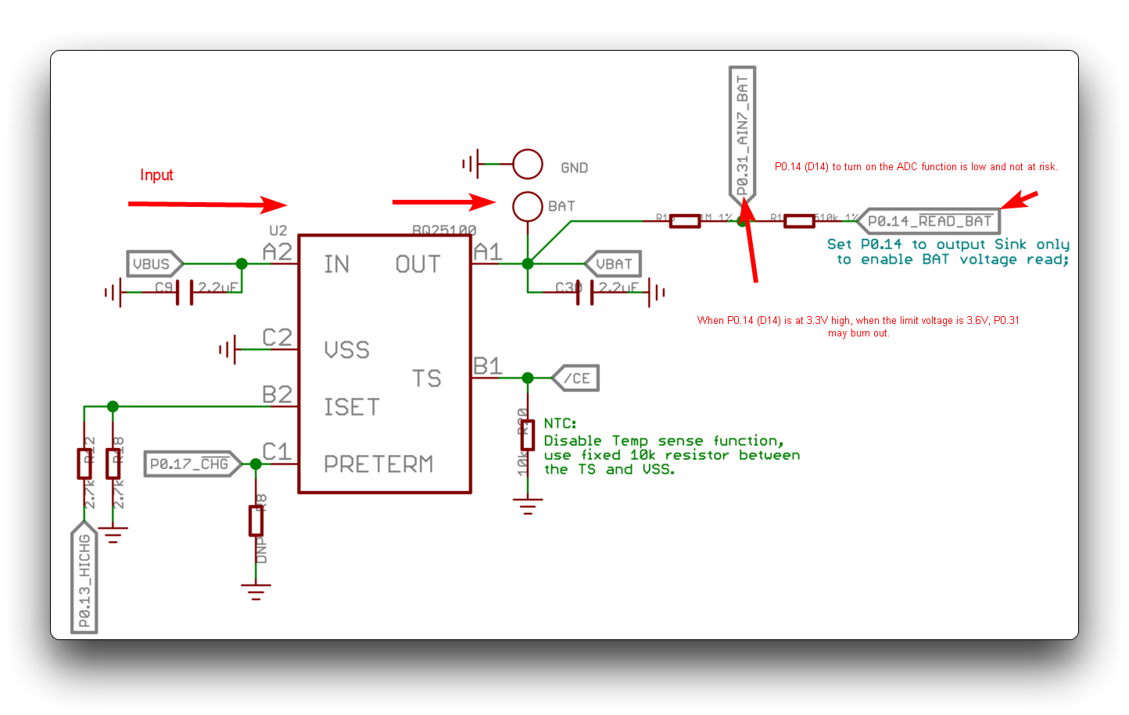
POWER REQUIREMENTS
When P0.14 (D14) turns off the ADC function at a high level of 3.3V, P0.31 will be at the input voltage limit of 3.6V. There is a risk of burning out the P0.31 pin.

Slide 7
Battery babysitter

