Slide 1

Lab Book 0.1. ModeSolver
Student: Andrés Sanchez-Toril

Slide 2
Instructions
General
SCRIPTS
From GitHub →
  Fork the repo: https://github.com/cccanvas-upv/pic-upv-lab0.git
  Clone the repo using VSCode
Run the Jupyter Notebook:
  010_MODESOLVER_Student.ipynb
INSTRUCTIONS
We are going to work with different Cross-Sections. In general, we will need: Materials definitions and the Geometrical parameters of each Cross-section.
W (width)
W (width)
Core
Core
h_core
h
(height)
Cladding
Cladding
Slab
XY Cross-section
h_slab
deep waveguide
shallow waveguide

Slide 3
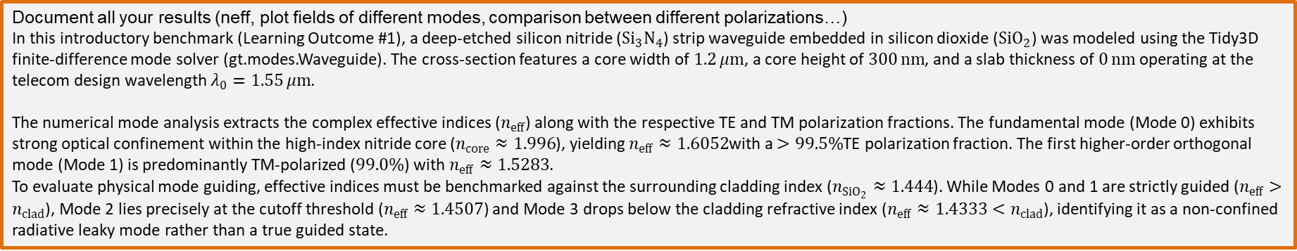
Learning outcome #1 – Effective index of a waveguide
INSTRUCTOR:
Present Python and GDSFactory: materials, output, results.
Explain how to run a simulation for a particular cross-section.
Showcase how to change between shallow and deep waveguide.
Describe how to change the wavelength and width for the waveguide analysis.
Describe the outputs.
ALL EXAMPLE #1: waveguide width 1.2 µm, deep wvg, wavelength start and end same 1.55 µm → all ”Run”
ALL: Follow instructor, that will show how to 1) plot mode, 2) explore the results (neff …)
Document all your results (neff, plot fields of different modes, comparison between different polarizations…)
In this introductory benchmark (Learning Outcome #1), a deep-etched silicon nitride (${Si}_{3}N_{4}$) strip waveguide embedded in silicon dioxide (${SiO}_{2}$) was modeled using the Tidy3D finite-difference mode solver (gt.modes.Waveguide). The cross-section features a core width of $1.2 μm$, a core height of $300 nm$, and a slab thickness of $0 nm$operating at the telecom design wavelength $λ_{0}=1.55 μm$.
The numerical mode analysis extracts the complex effective indices ($n_{eff}$) along with the respective TE and TM polarization fractions. The fundamental mode (Mode 0) exhibits strong optical confinement within the high-index nitride core ($n_{core}≈1.996$), yielding $n_{eff}≈1.6052$with a $>99.5\%$TE polarization fraction. The first higher-order orthogonal mode (Mode 1) is predominantly TM-polarized ($99.0\%$) with $n_{eff}≈1.5283$.
To evaluate physical mode guiding, effective indices must be benchmarked against the surrounding cladding index ($n_{{SiO}_{2}}≈1.444$). While Modes 0 and 1 are strictly guided ($n_{eff}>n_{clad}$), Mode 2 lies precisely at the cutoff threshold ($n_{eff}≈1.4507$) and Mode 3 drops below the cladding refractive index ($n_{eff}≈1.4333<n_{clad}$), identifying it as a non-confined radiative leaky mode rather than a true guided state.

Slide 4
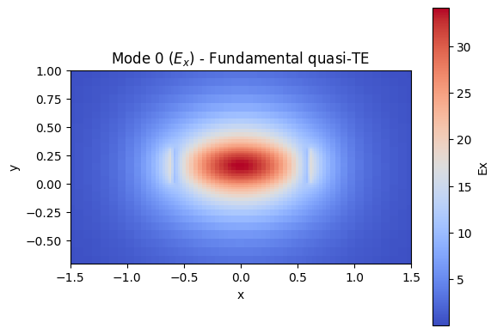
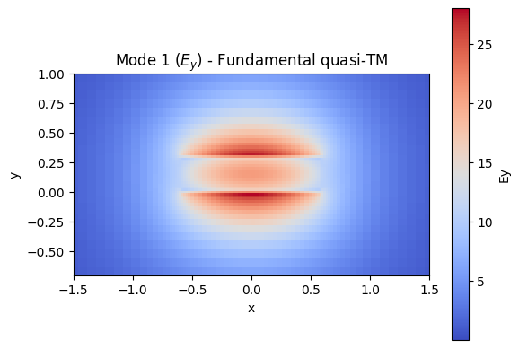
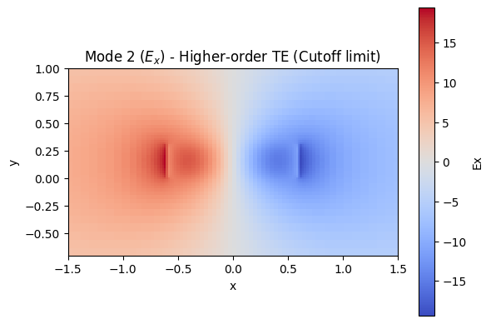
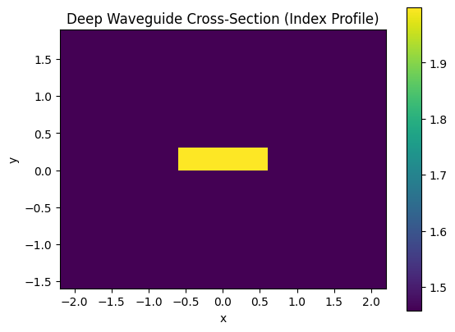
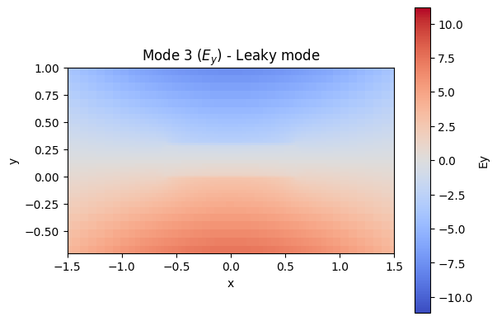

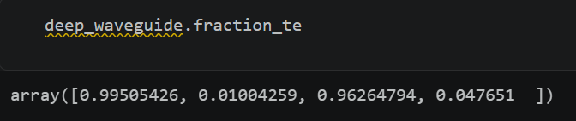
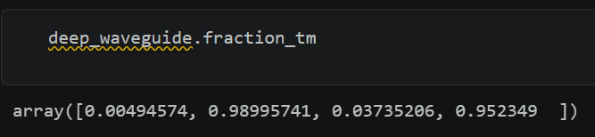

Slide 5
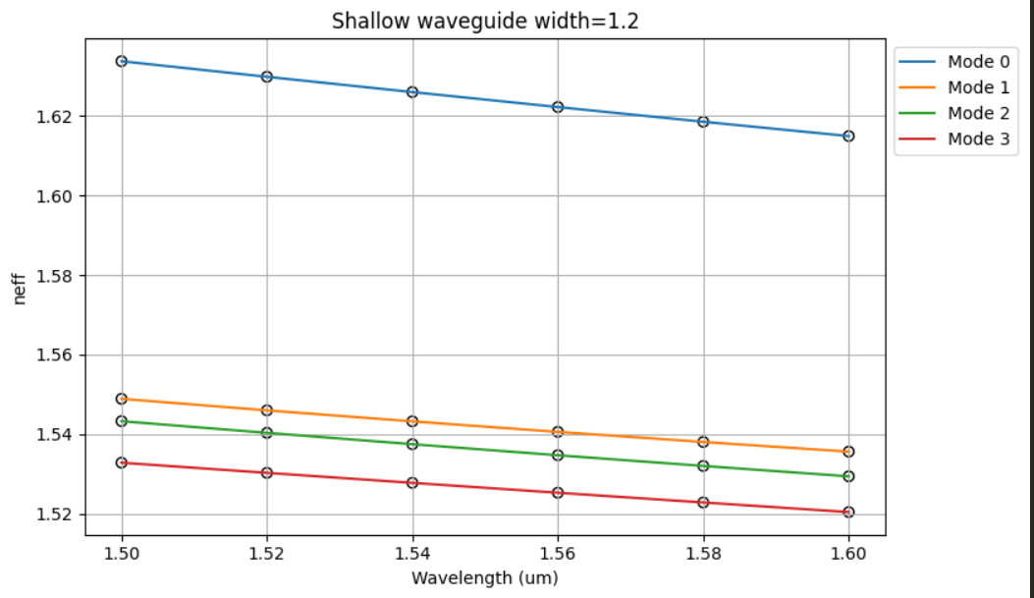
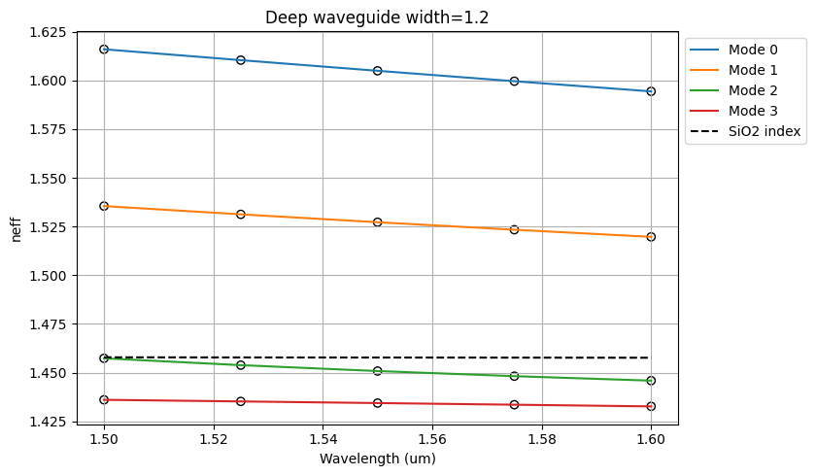
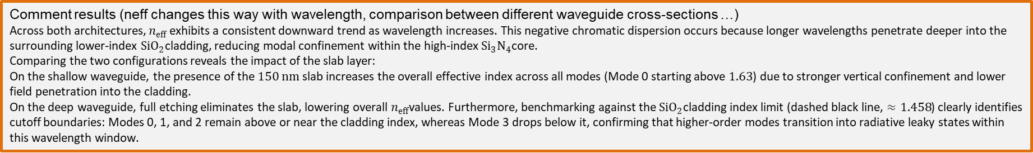
Learning outcome #2 – Wavelength behavior
Wavelength 1.5-1.6 µm (step 0.02 µm) – width 1.2 µm
shallow waveguide
Paste plot here
Plot neff vs lambda
deep waveguide
Paste plot here
Plot neff vs lambda
slab = 150nm
Comment results (neff changes this way with wavelength, comparison between different waveguide cross-sections …)
Across both architectures, $n_{eff}$ exhibits a consistent downward trend as wavelength increases. This negative chromatic dispersion occurs because longer wavelengths penetrate deeper into the surrounding lower-index ${SiO}_{2}$cladding, reducing modal confinement within the high-index ${Si}_{3}N_{4}$core.
Comparing the two configurations reveals the impact of the slab layer:
On the shallow waveguide, the presence of the $150 nm$ slab increases the overall effective index across all modes (Mode 0 starting above $1.63$) due to stronger vertical confinement and lower field penetration into the cladding.
On the deep waveguide, full etching eliminates the slab, lowering overall $n_{eff}$values. Furthermore, benchmarking against the ${SiO}_{2}$cladding index limit (dashed black line, $≈1.458$) clearly identifies cutoff boundaries: Modes 0, 1, and 2 remain above or near the cladding index, whereas Mode 3 drops below it, confirming that higher-order modes transition into radiative leaky states within this wavelength window.

Slide 6

Thank you

