Slide 1

Lab Book 0.2. Couplers
Student: Andrés Sanchez-Toril

Slide 2
Instructions
General
SCRIPTS
From GitHub →
  Fork the repo: https://github.com/cccanvas-upv/pic-upv-lab0.git
  Clone the repo using VSCode
Run the Jupyter Notebook:
  020_COUPLERS_Student.ipynb
Cross-Sections to be studied:
w (width)
w (width)
h
(height)
Core
Core
h
(height)
MMI Body
g
(gap)
Cladding
Cladding
Directional coupler (DC)
Multimode Interference (MMI) coupler

Slide 3
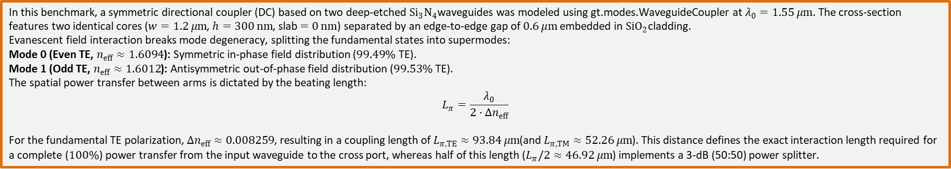

Learning outcome #1 – Directional coupler cross-section in GDSFactory
INSTRUCTOR:
Present Python and GDSFactory implementation of DC cross-section
Describe how to obtain the beating length $L_{π}$
Describe the outputs.
ALL EXAMPLE #1: waveguide width 1.2 µm, gap between waveguides 0.6 µm, deep wvg, wavelength start and end same 1.55 µm → all ”Run”
ALL: Follow instructor, that will show how to 1) plot mode, 2) explore the results (neff …)
In this benchmark, a symmetric directional coupler (DC) based on two deep-etched ${Si}_{3}N_{4}$waveguides was modeled using gt.modes.WaveguideCoupler at $λ_{0}=1.55 μm$. The cross-section features two identical cores ($w=1.2 μm$, $h=300 nm$, slab $=0 nm$) separated by an edge-to-edge gap of $0.6 μm$embedded in ${SiO}_{2}$cladding.
Evanescent field interaction breaks mode degeneracy, splitting the fundamental states into supermodes:
Mode 0 (Even TE, $n_{eff}≈1.6094$): Symmetric in-phase field distribution ($99.49\%$ TE).
Mode 1 (Odd TE, $n_{eff}≈1.6012$): Antisymmetric out-of-phase field distribution ($99.53\%$ TE).
The spatial power transfer between arms is dictated by the beating length:
$$L_{π}=\frac{λ_{0}}{2⋅Δn_{eff}}$$
For the fundamental TE polarization, $Δn_{eff}≈0.008259$, resulting in a coupling length of $L_{π,TE}≈93.84 μm$(and $L_{π,TM}≈52.26 μm$). This distance defines the exact interaction length required for a complete ($100\%$) power transfer from the input waveguide to the cross port, whereas half of this length ($L_{π}/2≈46.92 μm$) implements a 3-dB (50:50) power splitter.

Slide 4
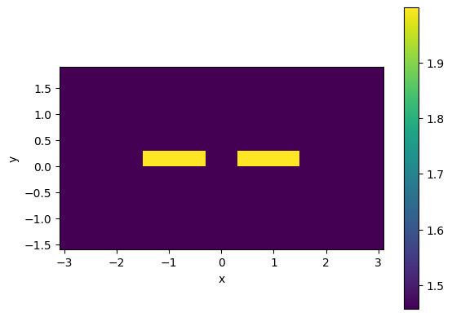
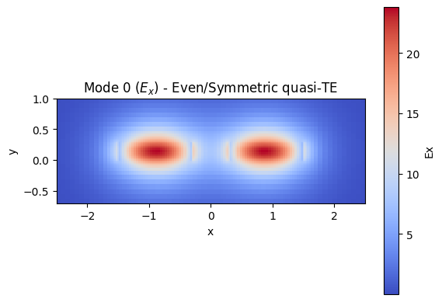
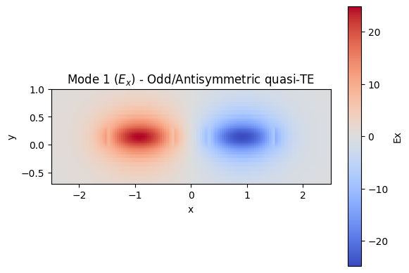
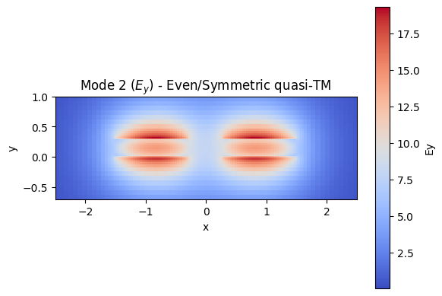
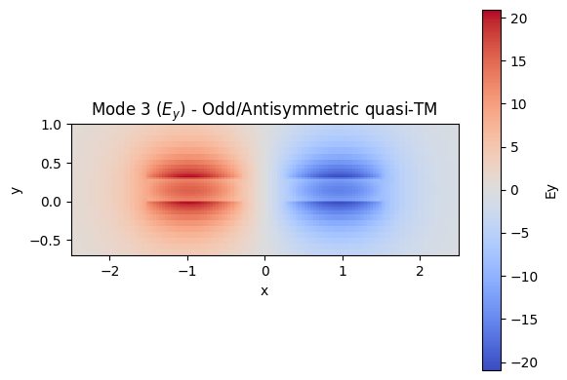
Directional coupler

Slide 5
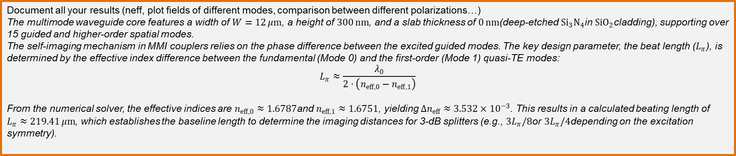

Learning outcome #2 – Multimode Interference (MMI) Coupler cross-section
INSTRUCTOR:
Present Python and GDSFactory implementation of DC cross-section
Describe how to obtain the beating length $L_{π}$
Describe the outputs.
ALL EXAMPLE #2: waveguide width 12 µm, gap between waveguides 0.6 µm, deep wvg, wavelength start and end same 1.55 µm → all ”Run”
ALL: Follow instructor, that will show how to 1) plot mode, 2) explore the results (neff …)
Document all your results (neff, plot fields of different modes, comparison between different polarizations…)
The multimode waveguide core features a width of $W=12 μm$, a height of $300 nm$, and a slab thickness of $0 nm$(deep-etched ${Si}_{3}N_{4}$in ${SiO}_{2}$cladding), supporting over 15 guided and higher-order spatial modes.
The self-imaging mechanism in MMI couplers relies on the phase difference between the excited guided modes. The key design parameter, the beat length ($L_{π}$), is determined by the effective index difference between the fundamental (Mode 0) and the first-order (Mode 1) quasi-TE modes:
$$L_{π}≈\frac{λ_{0}}{2⋅\left(n_{eff,0}−n_{eff,1}\right)}$$
From the numerical solver, the effective indices are $n_{eff,0}≈1.6787$and $n_{eff,1}≈1.6751$, yielding $Δn_{eff}≈3.532×{10}^{−3}$. This results in a calculated beating length of $L_{π}≈219.41 μm$, which establishes the baseline length to determine the imaging distances for 3-dB splitters (e.g., $3L_{π}/8$or $3L_{π}/4$depending on the excitation symmetry).

Slide 6
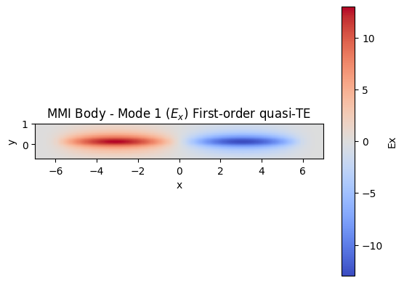
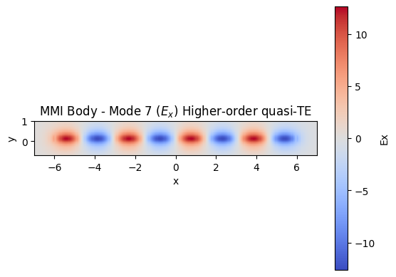
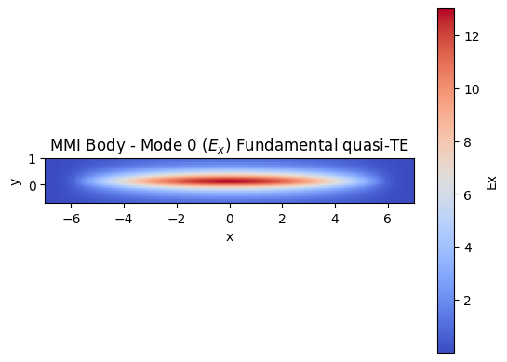
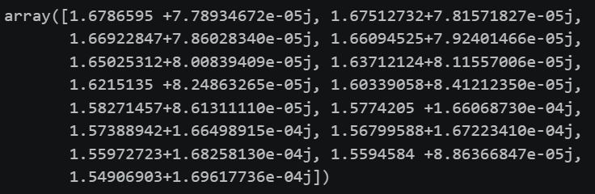

MMI
$L_{π}=$ 219,411

Slide 7
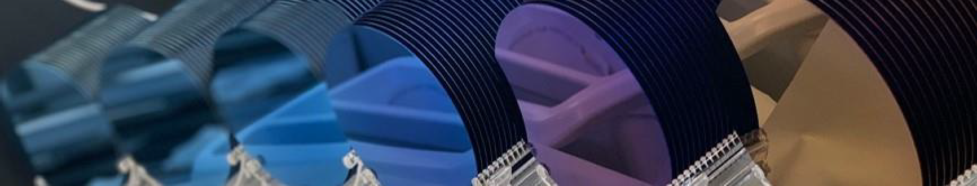
Thank you

