Slide 1

Lab Book 3. Interferometers I – MZI
Student: Andrés Sánchez-Toril Bastrygina

Slide 2




Instructions
General
SOFTWARE
Python notebook supplied by instructors
SCRIPTS
From Poliformat → download the 030_INTERFEROMETERS_v2025_Student_UPDATE2.ipynb
https://github.com/cccanvas-upv/pic-upv-lab3.git
COMPONENT to be studied: Mach-Zendher Interferometer (MZI)
$β_{u}$, $L_{u}$
In2
Out2
$$k_{a}$$
$$k_{b}$$
In1
Out1
$β_{d}$, $L_{d}$

Slide 3

ASSESSMENT #1 – Recap from theory – MZI configurations
Provide one example of implementation for each one of the configurations studied during MZI lecture:
  1. Balanced configuration
  2. Unbalanced configuration:
  2.1. Phase difference
  2.2. Delay imbalance
Compute also some examples with $α≠0$ and $γ≠0$

Slide 4
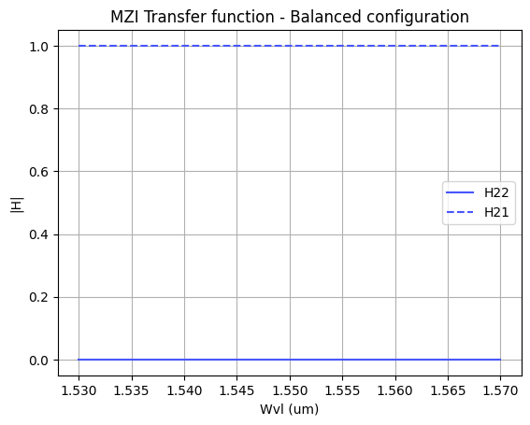
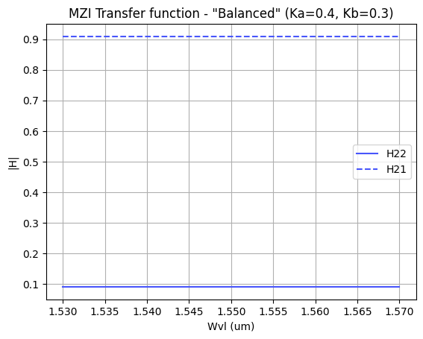
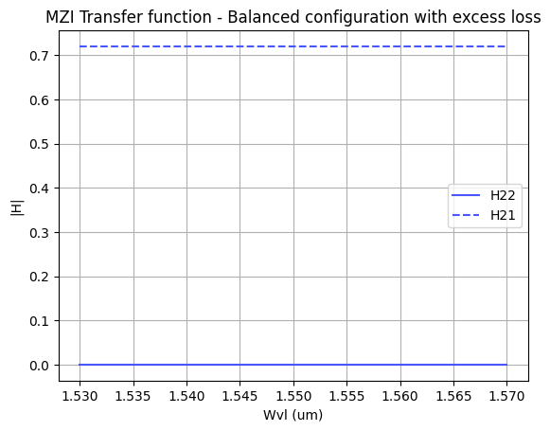
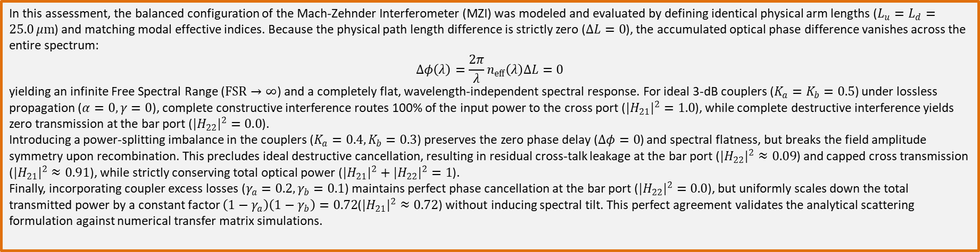
ASSESSMENT #1 – Balanced – MZI configurations
In this assessment, the balanced configuration of the Mach-Zehnder Interferometer (MZI) was modeled and evaluated by defining identical physical arm lengths ($L_{u}=L_{d}=25.0 μm$) and matching modal effective indices. Because the physical path length difference is strictly zero ($ΔL=0$), the accumulated optical phase difference vanishes across the entire spectrum:
$$Δφ\left(λ\right)=\frac{2π}{λ}n_{eff}\left(λ\right)ΔL=0$$
yielding an infinite Free Spectral Range ($FSR→∞$) and a completely flat, wavelength-independent spectral response. For ideal 3-dB couplers ($K_{a}=K_{b}=0.5$) under lossless propagation ($α=0,γ=0$), complete constructive interference routes 100% of the input power to the cross port ($|H_{21}|​^{2}=1.0$), while complete destructive interference yields zero transmission at the bar port ($|H_{22}|​^{2}=0.0$).
Introducing a power-splitting imbalance in the couplers ($K_{a}=0.4,K_{b}=0.3$) preserves the zero phase delay ($Δφ=0$) and spectral flatness, but breaks the field amplitude symmetry upon recombination. This precludes ideal destructive cancellation, resulting in residual cross-talk leakage at the bar port ($|H_{22}|​^{2}≈0.09$) and capped cross transmission ($|H_{21}|​^{2}≈0.91$), while strictly conserving total optical power ($|H_{21}|​^{2}+|H_{22}|​^{2}=1$).
Finally, incorporating coupler excess losses ($γ_{a}=0.2,γ_{b}=0.1$) maintains perfect phase cancellation at the bar port ($|H_{22}|​^{2}=0.0$), but uniformly scales down the total transmitted power by a constant factor $\left(1−γ_{a}\right)\left(1−γ_{b}\right)=0.72$($|H_{21}|​^{2}≈0.72$) without inducing spectral tilt. This perfect agreement validates the analytical scattering formulation against numerical transfer matrix simulations.

Slide 5
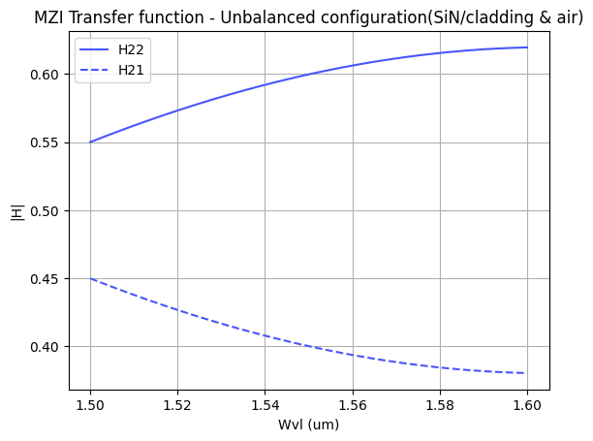
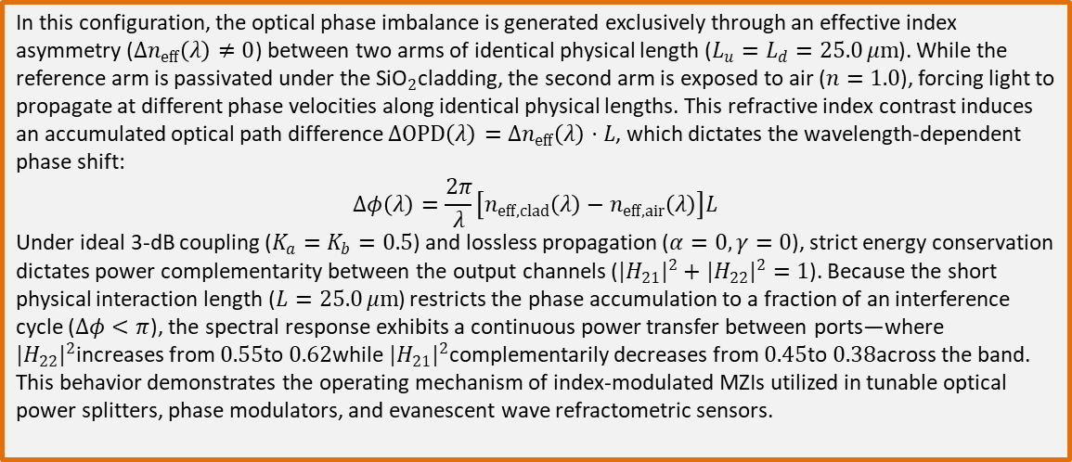
ASSESSMENT #1 – Unbalanced: Phase difference – MZI configurations
In this configuration, the optical phase imbalance is generated exclusively through an effective index asymmetry ($Δn_{eff}\left(λ\right)≠0$) between two arms of identical physical length ($L_{u}=L_{d}=25.0 μm$). While the reference arm is passivated under the ${\text{SiO}}_{2}$cladding, the second arm is exposed to air ($n=1.0$), forcing light to propagate at different phase velocities along identical physical lengths. This refractive index contrast induces an accumulated optical path difference $ΔOPD\left(λ\right)=Δn_{eff}\left(λ\right)⋅L$, which dictates the wavelength-dependent phase shift:
$$Δφ\left(λ\right)=\frac{2π}{λ}\left[n_{eff,clad}\left(λ\right)−n_{eff,air}\left(λ\right)\right]L$$
Under ideal 3-dB coupling ($K_{a}=K_{b}=0.5$) and lossless propagation ($α=0,γ=0$), strict energy conservation dictates power complementarity between the output channels ($|H_{21}|​^{2}+|H_{22}|​^{2}=1$). Because the short physical interaction length ($L=25.0 μm$) restricts the phase accumulation to a fraction of an interference cycle ($Δφ<π$), the spectral response exhibits a continuous power transfer between ports—where $|H_{22}|​^{2}$increases from $0.55$to $0.62$while $|H_{21}|​^{2}$complementarily decreases from $0.45$to $0.38$across the band. This behavior demonstrates the operating mechanism of index-modulated MZIs utilized in tunable optical power splitters, phase modulators, and evanescent wave refractometric sensors.

Slide 6
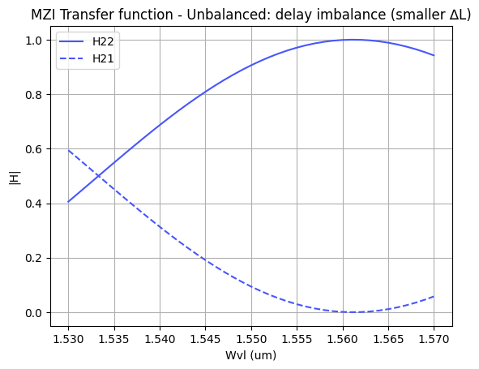
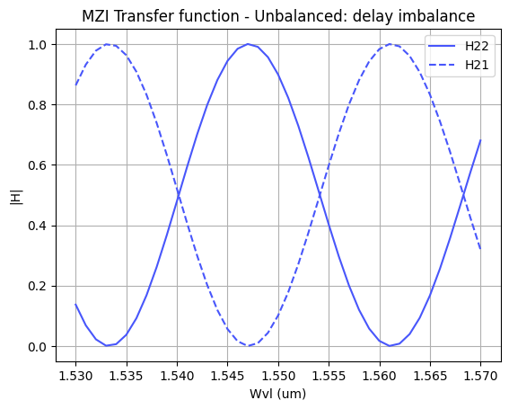
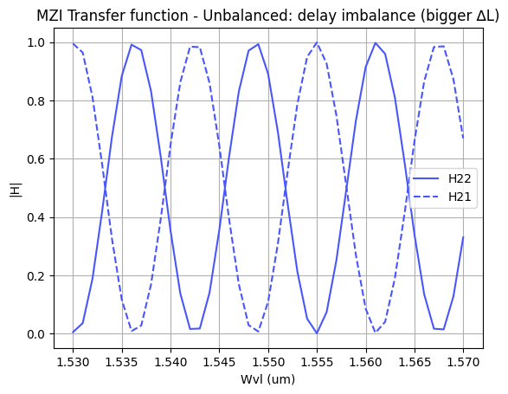
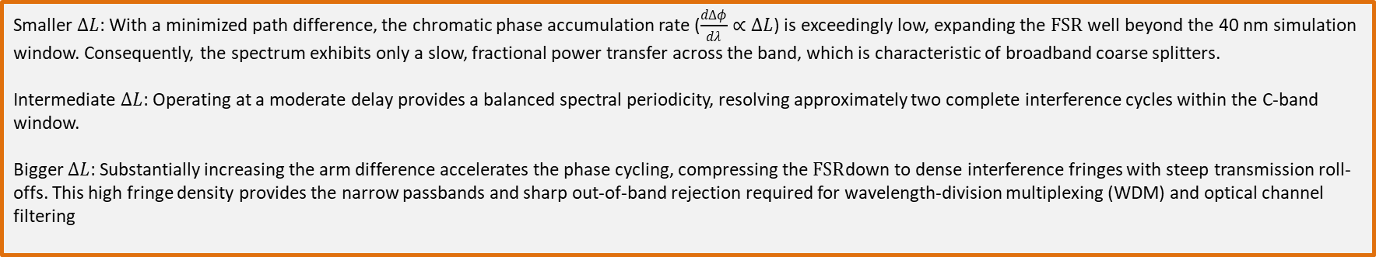
ASSESSMENT #1 – Unbalanced: Delay imbalance– MZI configurations
Smaller $ΔL$: With a minimized path difference, the chromatic phase accumulation rate ($\frac{dΔφ}{dλ}∝ΔL$) is exceedingly low, expanding the $FSR$ well beyond the 40 nm simulation window. Consequently, the spectrum exhibits only a slow, fractional power transfer across the band, which is characteristic of broadband coarse splitters.
Intermediate $ΔL$: Operating at a moderate delay provides a balanced spectral periodicity, resolving approximately two complete interference cycles within the C-band window.
Bigger $ΔL$: Substantially increasing the arm difference accelerates the phase cycling, compressing the $FSR$down to dense interference fringes with steep transmission roll-offs. This high fringe density provides the narrow passbands and sharp out-of-band rejection required for wavelength-division multiplexing (WDM) and optical channel filtering

Slide 7
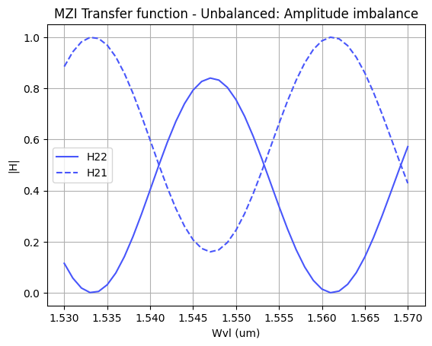
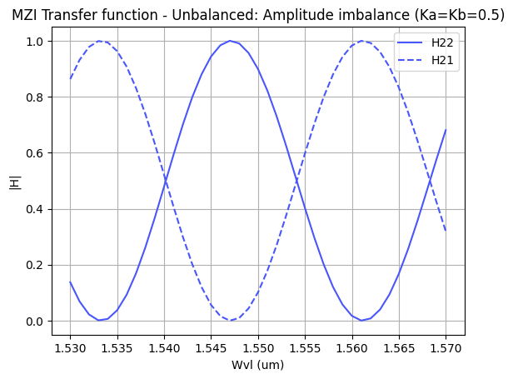
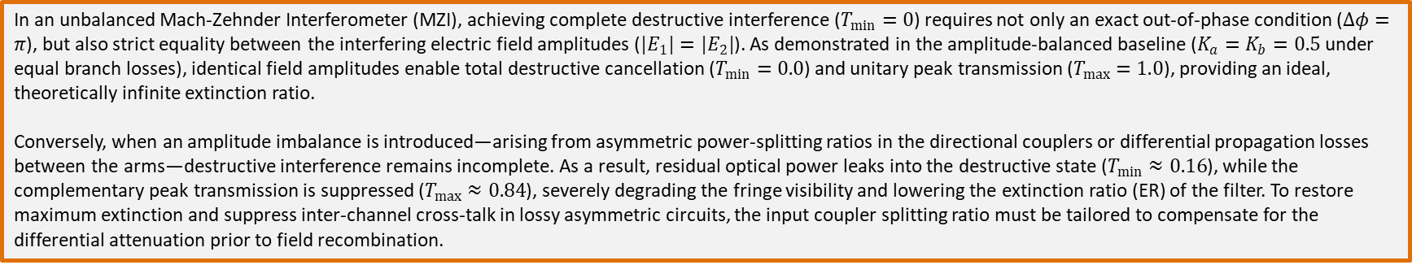
ASSESSMENT #1 – Unbalanced: Amplitude imbalance– MZI configurations
In an unbalanced Mach-Zehnder Interferometer (MZI), achieving complete destructive interference ($T_{min}=0$) requires not only an exact out-of-phase condition ($Δφ=π$), but also strict equality between the interfering electric field amplitudes ($|E_{1}|=|E_{2}|$). As demonstrated in the amplitude-balanced baseline ($K_{a}=K_{b}=0.5$ under equal branch losses), identical field amplitudes enable total destructive cancellation ($T_{min}=0.0$) and unitary peak transmission ($T_{max}=1.0$), providing an ideal, theoretically infinite extinction ratio.
Conversely, when an amplitude imbalance is introduced—arising from asymmetric power-splitting ratios in the directional couplers or differential propagation losses between the arms—destructive interference remains incomplete. As a result, residual optical power leaks into the destructive state ($T_{min}≈0.16$), while the complementary peak transmission is suppressed ($T_{max}≈0.84$), severely degrading the fringe visibility and lowering the extinction ratio (ER) of the filter. To restore maximum extinction and suppress inter-channel cross-talk in lossy asymmetric circuits, the input coupler splitting ratio must be tailored to compensate for the differential attenuation prior to field recombination.

Slide 8
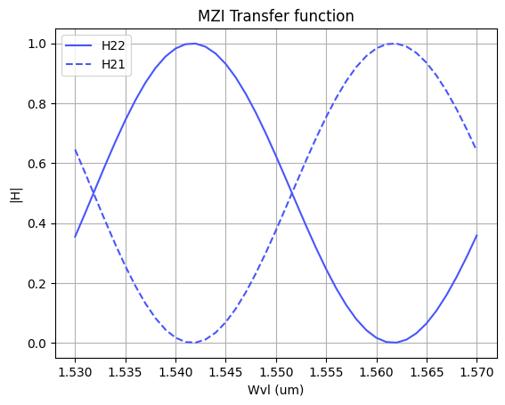


ASSESSMENT #2 – Recap from theory – Calculation of $ΔL$
Considering the n_{eff} values for the SOI cross-section, what would be the path difference ($ΔL= L_{u} −L_{d}$) needed to obtain a Free Spectral Range of 40 nm? Introduce the obtained value in the model to check the MZI response.
Hint: We assume 1550 nm as the central design wavelength ($λ_{0}=$1550 nm).
Document all your results (copy here the code employed to obtain the corresponding value)
In an unbalanced Mach-Zehnder Interferometer (MZI), the Free Spectral Range is governed by the optical group index ($n_{g}$) rather than the modal effective index ($n_{\text{eff}}$) due to strong chromatic waveguide dispersion in high-contrast SOI waveguides:
$$\text{FSR}=\frac{λ_{0}^{2}}{n_{g}⋅ΔL}⟹ΔL=\frac{λ_{0}^{2}}{n_{g}⋅\text{FSR}}$$
For a central design wavelength $λ_{0}=1.55 μm$, a target $\text{FSR}=40 nm$($0.040 μm$), and evaluating the fundamental quasi-TE mode group index of the standard SOI strip waveguide ($450×220 nm$, $n_{g}≈4.2933$):
$$ΔL=\frac{{\left(1.55 μm\right)}^{2}}{4.2933×0.040 μm}≈13.9899 μm$$
Enforcing this path delay guarantees an exact spectral period of $40 nm$around $1550 nm$, with an integer interference order $m=\text{round}\left(\frac{n_{\text{eff}}ΔL}{λ_{0}}\right)=21$

Slide 9
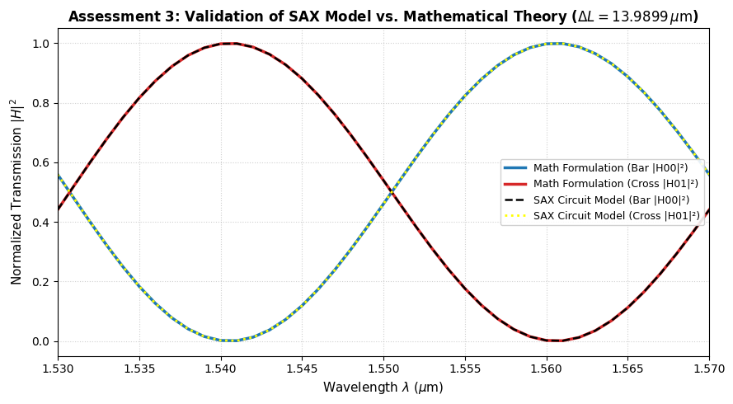
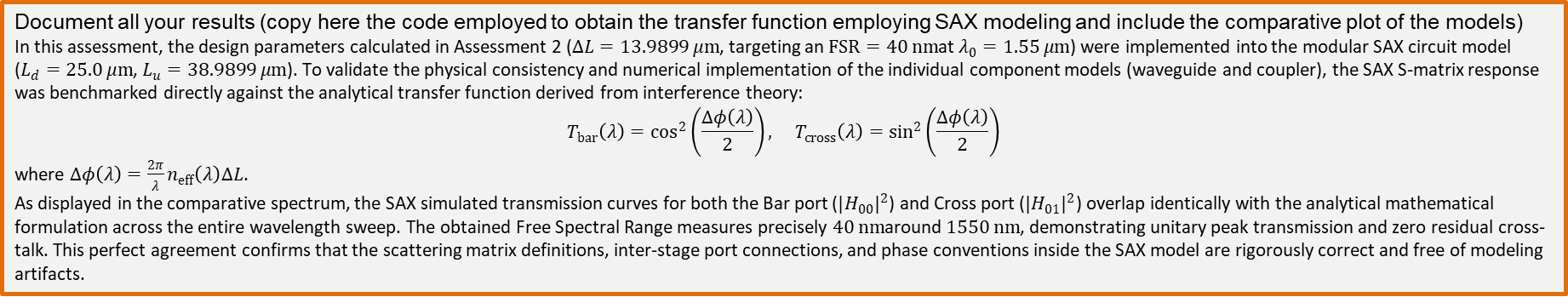
ASSESSMENT #3 – SAX implementation
Now, we are going to implement the design parameters in the MZI model developed in SAX and compare the response obtained with the one simulated by mathematical formulation. This will help us to identify any error in the definition of the SAX model single components.
In order to implement the SAX model, take as example the following lines:
    mzi_test = mzi(wl=wl,
    coup_a = ...
    wvg_d={"length": l_d, "neff": ...},
    wvg_u={"length": l_u, "neff": ...},
    coup_b = ... )
    H00 = mzi_test["in0", "out0"]
Document all your results (copy here the code employed to obtain the transfer function employing SAX modeling and include the comparative plot of the models)
In this assessment, the design parameters calculated in Assessment 2 ($ΔL=13.9899 μm$, targeting an $FSR=40 nm$at $λ_{0}=1.55 μm$) were implemented into the modular SAX circuit model ($L_{d}=25.0 μm$, $L_{u}=38.9899 μm$). To validate the physical consistency and numerical implementation of the individual component models (waveguide and coupler), the SAX S-matrix response was benchmarked directly against the analytical transfer function derived from interference theory:
$$T_{bar}\left(λ\right)=\cos^{2}\left(\frac{Δφ\left(λ\right)}{2}\right), T_{cross}\left(λ\right)=\sin^{2}\left(\frac{Δφ\left(λ\right)}{2}\right)$$
where $Δφ\left(λ\right)=\frac{2π}{λ}n_{eff}\left(λ\right)ΔL$.
As displayed in the comparative spectrum, the SAX simulated transmission curves for both the Bar port ($|H_{00}|​^{2}$) and Cross port ($|H_{01}|​^{2}$) overlap identically with the analytical mathematical formulation across the entire wavelength sweep. The obtained Free Spectral Range measures precisely $40 nm$around $1550 nm$, demonstrating unitary peak transmission and zero residual cross-talk. This perfect agreement confirms that the scattering matrix definitions, inter-stage port connections, and phase conventions inside the SAX model are rigorously correct and free of modeling artifacts.

Slide 10
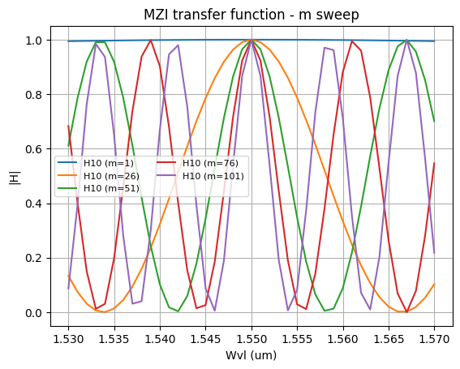
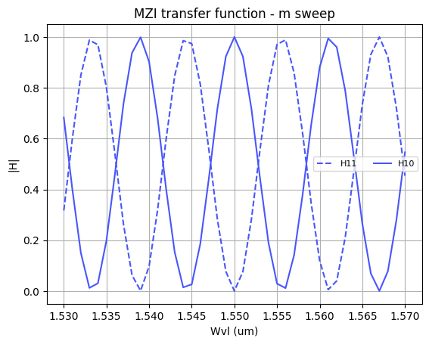

Extra assessments
Assessment 4. Design an MZI for filtering at a specific wavelength. Calculate and adjust the arm lengths to configure the MZI to have a maximum transmission at 1550 nm.
Document all your results
To configure the unbalanced Mach-Zehnder Interferometer for maximum transmission at the target design wavelength ($λ_{0}=1.55 μm$), the accumulated differential phase shift must satisfy the constructive interference condition $Δφ\left(λ_{0}\right)=2πm$, where $m∈ℤ^{+}$denotes the interference order. The required physical path difference is analytically determined by:
$$ΔL=L_{u}−L_{d}=m⋅\frac{λ_{0}}{n_{\text{eff}}\left(λ_{0}\right)}$$
Evaluating the fundamental quasi-TE mode effective index ($n_{\text{eff}}\left(1.55 μm\right)≈2.4411$) confirms that any positive integer $m$locks a transmission peak ($|H_{10}|​^{2}=1.0$) precisely at $1550 nm$.
As demonstrated in the order sweep ($m∈\left\{1,26,51,76,101\right\}$), increasing $m$linearly expands $ΔL$, which inversely scales and compresses the Free Spectral Range ($FSR≈\frac{λ_{0}^{2}}{n_{g}ΔL}$). Lower orders ($m=1$) exhibit an excessively wide FSR with negligible wavelength selectivity. Selecting $m=76$establishes a physical path difference $ΔL≈48.27 μm$($L_{d}=25.0 μm$, $L_{u}=73.27 μm$), providing a periodic passband filter with $FSR≈11.6 nm$, unitary peak throughput ($|H_{10}|​^{2}=1.0$) at $1.55 μm$, and complete out-of-band rejection ($|H_{11}|​^{2}=0.0$).

Slide 11
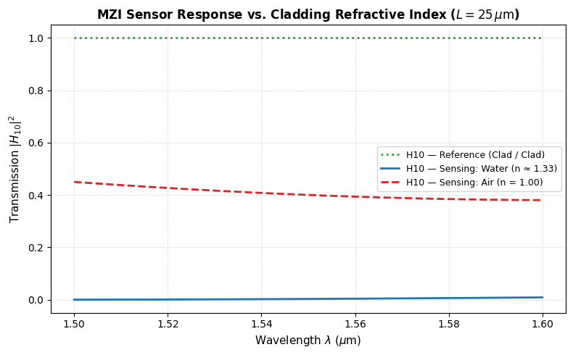

Extra assessments
Assessment 5. Let's see how the response of the MZI varies with the effective index. Vary the effective index of one of the arms and analyze how the spectrum shifts. To do this, you can use the data provided in the .txt files entitled ‘SiN’. Can you give an example of an application where this configuration is used?
Document all your results
In this configuration, the MZI operates as an asymmetric evanescent field sensor where the upper arm remains passivated under a protective ${\text{SiO}}_{2}$cladding ($n_{\text{clad}}≈1.44$) while the lower sensing arm is exposed to external media of varying refractive indices ($n_{\text{medium}}$: ${\text{SiO}}_{2}$, water, and air). Because the optical mode possesses an evanescent tail extending into the surrounding upper half-space, reducing the external index from $n_{\text{clad}}→n_{\text{water}}→n_{\text{air}}$diminishes the effective index of the lower arm ($n_{\text{eff, d}}<n_{\text{eff, u}}$).
This effective index contrast induces a net optical phase shift:
$$Δφ\left(λ\right)=\frac{2π}{λ}\left[n_{\text{eff, clad}}\left(λ\right)−n_{\text{eff, sample}}\left(λ\right)\right]L_{\text{sense}}$$
In a balanced physical length configuration ($L_{u}=L_{d}=25 μm$), the reference state (${\text{SiO}}_{2}/{\text{SiO}}_{2}$) yields $Δφ=0$, directing 100% of the input power to the cross port ($|H_{10}|​^{2}=1.0$). Exposing the sensing window to water and air induces a progressive phase delay that detunes the constructive interference condition, causing a significant downward transmission shift at $λ_{0}=1.55 μm$($|H_{10}|​^{2}→0.75$ for water and $→0.38$for air). In longer sensing channels ($L≥150 μm$), this phase perturbation manifests as a rigid spectral blue-shift of the periodic transmission fringes
This exact asymmetric MZI topology is widely implemented in integrated biophotonics for label-free real-time detection of biomolecules, pathogens, and chemical concentrations.
When a target analyte (such as viral antigens or specific proteins) binds to the surface receptors, it alters the local refractive index within the evanescent field decay depth ($∼100−200 nm$ from the waveguide surface). This index change ($Δn$) modifies $n_{\text{eff}}$, which the interferometer converts into a measurable optical intensity variation or a spectral wavelength shift ($Δλ$).

Slide 12
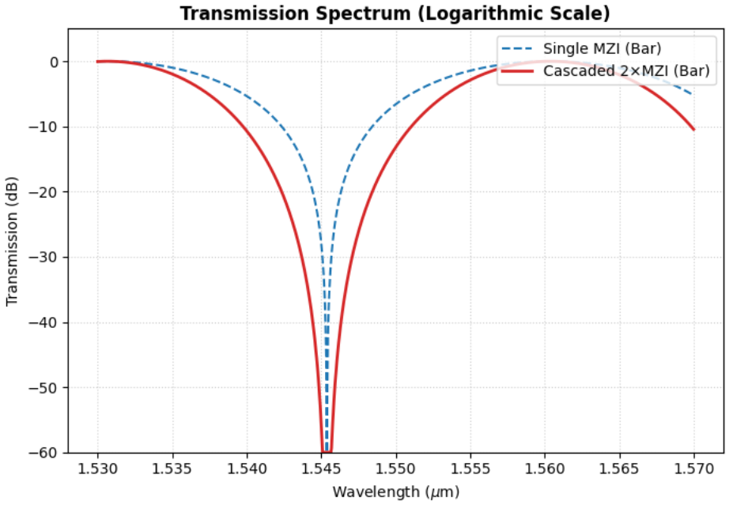
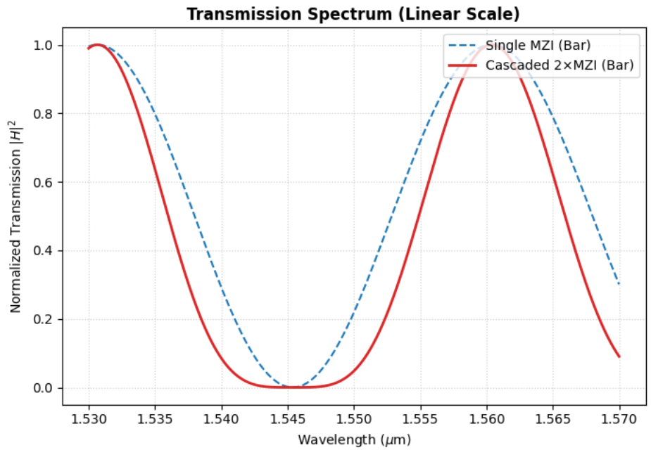

Extra assessments
Advanced level assessment. Explore how cascading two MZIs affects the transmission spectrum. To do so, design a system in which two MZIs are cascaded. Simulate and observe the spectrum, explaining how the transmission peaks behave.
Document all your results
Cascading two identical, uncoupled Mach-Zehnder Interferometers (MZIs) in series yields an overall complex field transfer function given by the product of the individual stages, $H_{cascaded}\left(λ\right)=H_{1}\left(λ\right)⋅H_{2}\left(λ\right)$. In terms of power transmission, this results in the squaring of the individual spectral response:
$$T_{cascaded}\left(λ\right)=|H_{1}\left(λ\right)|​^{2}⋅|H_{2}\left(λ\right)|​^{2}=\cos^{4}\left(\frac{Δφ\left(λ\right)}{2}\right)$$
As observed in the linear spectrum, squaring the sinusoidal transmission does not alter the peak wavelength positions ($λ_{0}≈1.531 μm$ and $1.561 μm$) nor the Free Spectral Range ($FSR≈30 nm$), since both stages maintain identical optical path differences ($ΔL_{1}=ΔL_{2}$).
However, the geometric profile of the transmission peaks undergoes two distinct modifications. Near resonance, because fractional power values below unity decrease quadratically ($T^{2}<T$ for $T<1$), the 3-dB passband bandwidth (Full Width at Half Maximum, FWHM) noticeably narrows, resulting in sharper, more selective transmission peaks. Concurrently, near the destructive interference state ($λ≈1.545 μm$), squaring near-zero values flattens the bottom of the transmission valley in linear scale.
In logarithmic scale (dB), this cascading doubles the roll-off steepness from the passband to the stopband ($T_{dB,cascaded}=2×T_{dB,single}$). Consequently, out-of-band rejection and inter-channel isolation are doubled across the entire spectrum, providing significantly steeper filter skirts and suppressing adjacent channel cross-talk without increasing the physical complexity of the individual delay arms.

Slide 13

Thank you

