Slide 1
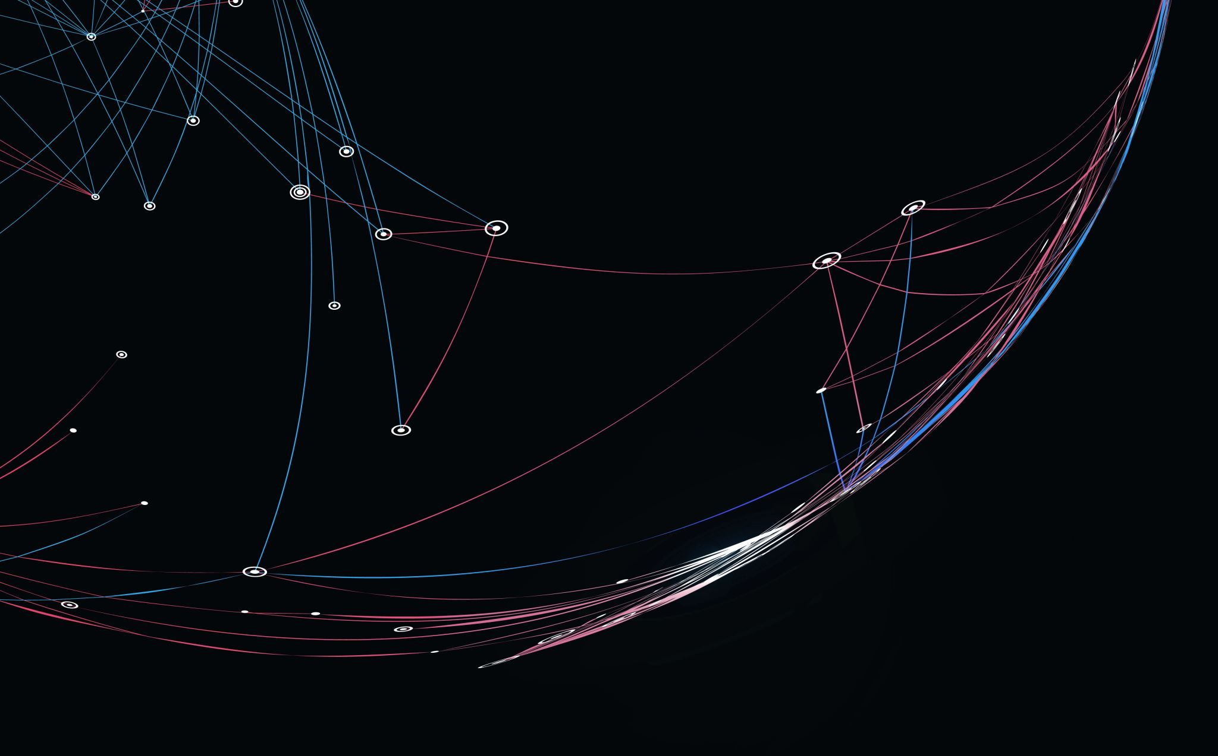
THE WAY OF THE FIST
By: urMove Developers
Team members: Andres Yance, Elijah Friedrich, Isaac Nouansacksy

Slide 2

Project Game Introduction
The way of the fist is a turn based fighting game. The hero (the player) fights the enemy (AI) to win and acquire experience and money to become more powerful. If the hero wins 2 of 3 rounds. The user will win the match. As Result the hero will gain a certain amount of money and experience. Which will allow the user to purchase more abilities and increase their power.

Slide 3
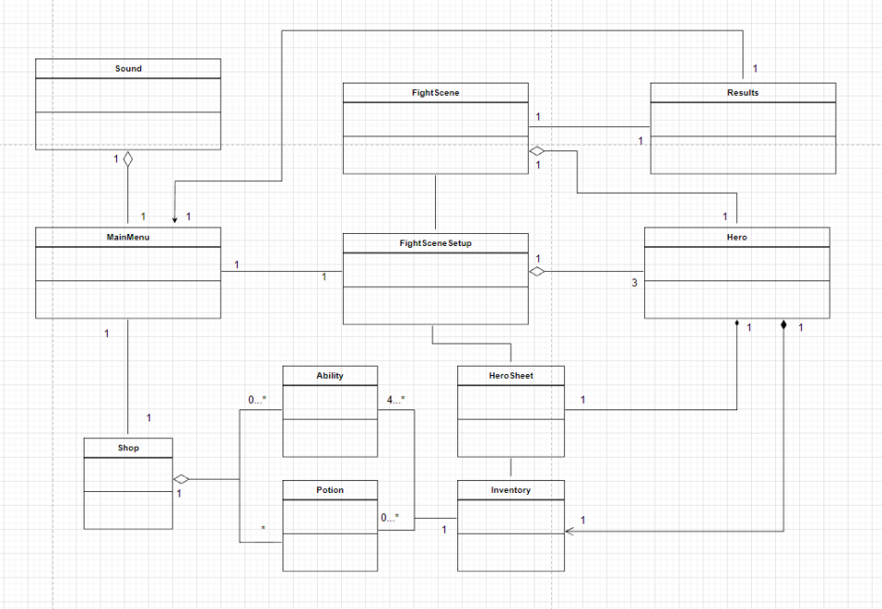
Initial Class Diagram

Slide 4
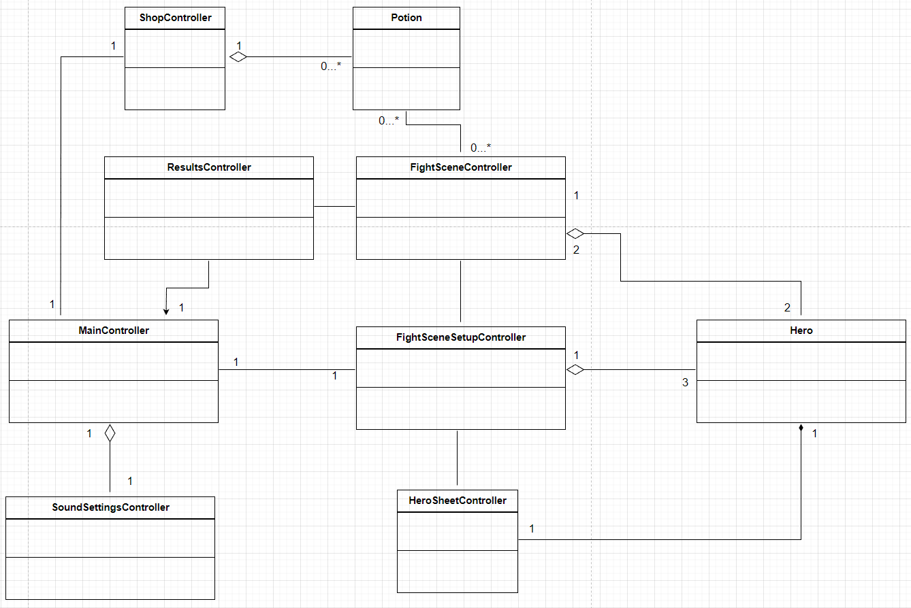
New Class Diagram

Slide 5
Project Current Status What we implemented:
- JavaFX controllers.
- FXML scenes.
- Scene Navigation.
- Hero class – Contains the player data.
- HeroSheetController – Visually displays data, spend experience.
- FightSceneSetupController – Choose settings for fight.
- FightSceneController - Fight an AI enemy, earn reward.
- ResultController – Visually display results.
- ShopController – Buy potions.

Slide 6
Live demonstration of what we implemented

Slide 7
Project Current Status What we have not implemented:
- Executable JAR file
- Abilities (we only have attack but we wanted 4 ability buttons that are changeable via shop purchases)
- Best of 3 rounds per fight.
- Background color changes (FightSceneSetup)
- Hero Animations (FightScene)
- Hero custom names.
- Positional combat mechanics (For dynamic combos)
- Inventory usage in the FightScene.
- Sounds / sound settings.
- Information pop-ups (on the HeroSheetController)
//----- anything more?? If you do add any of these, swap them over to the other slide

Slide 8
Lessons learned from the project:
Biggest take aways:
Andres: Working with a new GUI as JavaFX can be tedious. However, I learn a lot of stuff related to graphical interfaces and they work.
Elijah: Learning a new GUI platform is difficult.
Isaac: Learning JavaFX was a learning curve. Should have started programming sooner.

