Slide 1


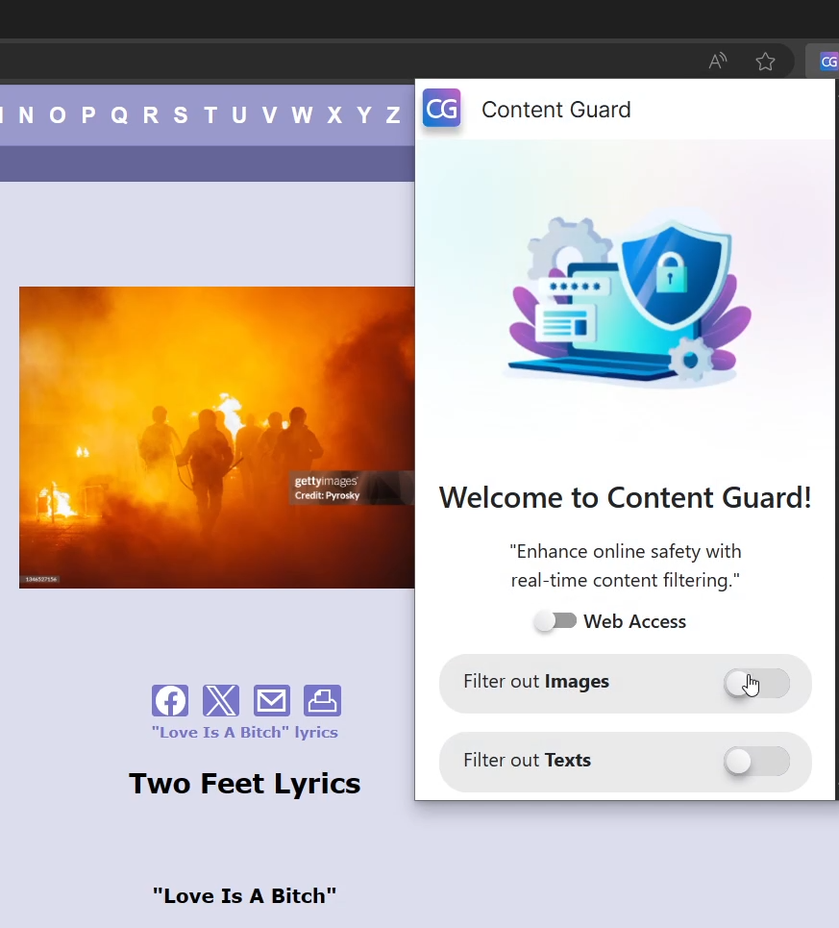
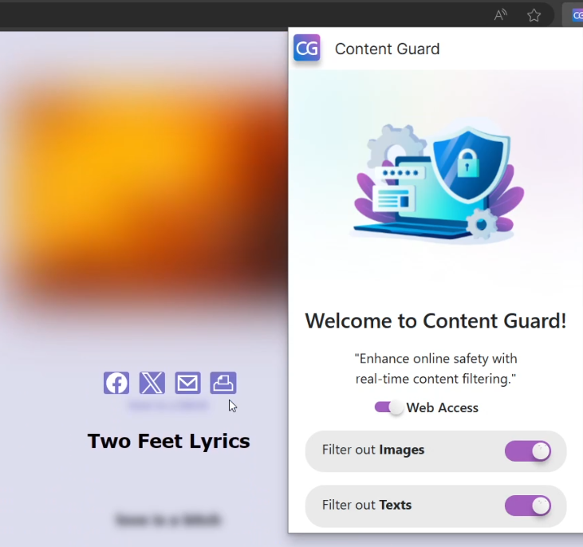
Content Guard By: Andrew Adel, Mariz Erian, Monica Sameh, Mehrael Ashraf, Veronica Emad, Filobateer Essam
Supervised by: Prof. Dr. Donia Gamal ElDin, TA. Lamis Hassan
Faculty of Computer and Information Sciences - Ain Shams University
Introduction
Results
The internet has become an indispensable tool in our daily lives, offering a wealth of information and resources. However, it also exposes users to harmful content, including cyberbullying, hate speech, violence, and inappropriate material. This exposure is particularly concerning for vulnerable individuals, such as children and adolescents, who may inadvertently encounter such content. To address this issue, our project focuses on developing a real-time content filtering extension that utilizes machine learning techniques to classify both text and images, creating a safer online environment.
Figure 1 Shows web page before activating Content Guard extension
Methods
Figure 2 Shows web page after activating Content Guard extension
1. Text Classification: Identifies and filters harmful text content such as cyberbullying, hate speech, and offensive language. This is achieved by utilizing the DistilBERT model, a transformer-based model known for its efficiency in natural language processing tasks. The model is trained on a diverse dataset of text examples, enabling it to learn patterns and nuances associated with harmful language.
2. Binary Image Classification: Distinguishes between violent and non-violent images. This classification is performed using the MobileNetV3 model, a lightweight convolutional neural network designed for mobile and embedded vision applications. The model is trained on a dataset of images labeled as either violent or non-violent, allowing it to recognize visual cues indicative of violence.
3. Multiclass Image Classification: Categorizes images into specific classes, including fire, accidents, damaged buildings, and normal content. This task is accomplished using the EfficientNetV2B2 model, another convolutional neural network known for its efficiency and accuracy. The model is trained on a dataset of images belonging to these different classes, enabling it to differentiate between them based on visual features.
Table I: Results of content guard models.
Model | Number of epochs | Train Accuracy | Validation Accuracy | Test Accuracy | Type of Data
DistilBERT | 3 | 97.9% | 96.97% | 96.89% | Text
MobileNetV3 | 10 | 98.78% | 98.87% | 98.55% | Image (Binary classification)
EfficientNetV2B2 | 19 | 98% | 96.7% | 96.85% | Image (Multi-Class classification)
Conclusions
The Content Guard extension effectively filters harmful content in real time, enhancing the safety and inclusivity of the online environment. By proactively identifying and mitigating the risks associated with harmful content, this project contributes to fostering a positive and secure digital space for all users.
Bibliography
Adel, Hadeer, Abdelghani Dahou, Alhassan Mabrouk, Mohamed Abd Elaziz, Mohammed Kayed, Ibrahim Mahmoud El-Henawy, Samah Alshathri, and Abdelmgeid Amin Ali. "Improving crisis events detection using distilbert with hunger games search algorithm." Mathematics 10, no. 3 (2022): 447
.Koonce, Brett, and Brett Koonce. "MobileNetV3." Convolutional Neural Networks with Swift for Tensorflow: Image Recognition and Dataset Categorization (2021): 125-144.
Tan, Mingxing, and Q. V. Le. "Efficientnetv2: Smaller models and faster training. arXiv 2021." arXiv preprint arXiv:2104.00298.

