Slide 1
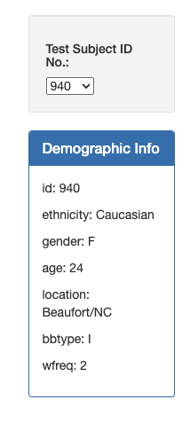
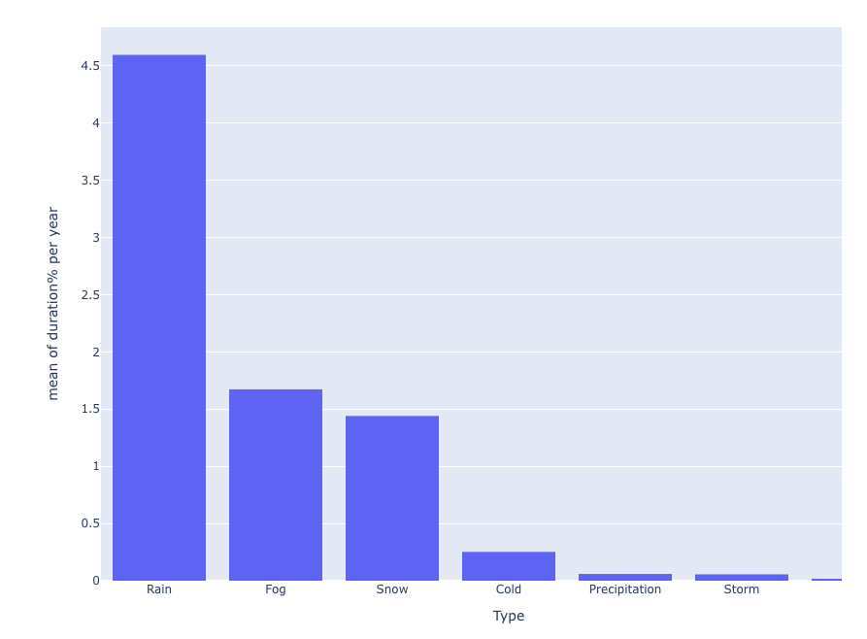
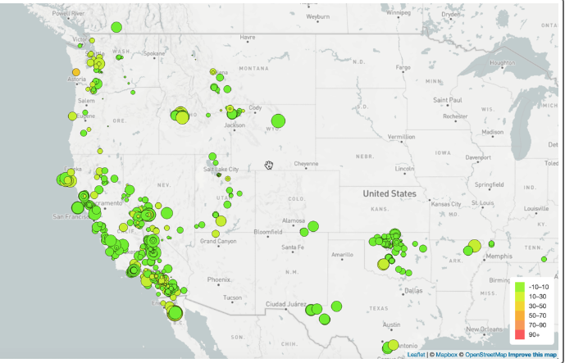
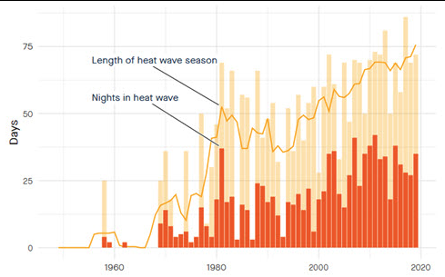
Group 4: Project 3 – US Weather Events (2016-2022) Contributors: Robert Pearce Roberto Gutierrez Spencer Bowman Andrew Bourgeois Data Source: https://www.kaggle.com/datasets/sobhanmoosavi/us-weather-events/data The aim of our project is to uncover trends in weather patterns recorded at airport weather stations from 2016-2022. We will examine relationships between types of weather events, severity, times of year they occurred, duration, and if they tend to recur at the same time year-after-year forming an annual or multi-year cyclic pattern for the nation as a whole and/or separate geographical locations. Findings will be displayed on an interactive dashboard with multiple views. GitHub Repository: https://github.com/Andrew-Bourgeois/Project-3_WeatherEvents_JAN2016-DEC2022
Project 3 – Weather Events Contributors: One, Two, Three, Four
Inspiring Screen Shots:

