Slide 1







Technology Industry Trends Analysis
Andrew Carlson
12/01/2022

Slide 2



OUTLINE
Executive Summary
Introduction
Methodology
Results
Visualization – Charts
Dashboard
Discussion
Findings & Implications
Conclusion
Future Analysis
Appendix

Slide 3

EXECUTIVE SUMMARY
2019 Stack Overflow Developer Survey:
Currently most popular:
Language: JavaScript
Database: MySQL
Web Framework: jQuery
Cloud Service: AWS
Platform: Linux
Most desired to learn by developers:
Language: JavaScript
Database: PostgreSQL
Web Framework: Angular
Cloud Service: AWS
Platform: Docker
Respondents of survey are primarily men in the United States with a Bachelor’s or Master’s degree

Slide 4

INTRODUCTION
Purpose
Analyze current trends and possible future trends in the technology industry
Questions
Which technologies are the most popular?
Which technologies do employees in the industry have a desire to learn?
What are the demographics that make up the technology industry?

Slide 5

METHODOLOGY
Data Sources (provided by IBM Skills Network)
2019 Stack Overflow Developer Survey – csv file formats
2019 Stack Overflow Developer Survey– SQLite file format
How Data was Used
Performed exploratory/statistical analysis
Created Python visualizations
Created an IBM Cognos Dashboard to visualize industry trends

Slide 6
Technologies Used
Programming/Querying Languages:
Python
SQL
Tools/Software:
Jupyter Notebook
IBM Cognos
Microsoft Excel (See Appendix)
Python Modules:
Pandas
MatPlotLib
Seaborn
Sqlite3
Requests (See Appendix)
Openpyxl (See Appendix)
Web Frameworks:
Flask (See Appendix)

Slide 7
RESULTS
Data Organization
Preliminary exploratory data analysis was performed on csv data using Python
SQLite file was read in as a Pandas dataframe using DB-API connection
csv data was imported into IBM Cognos to create Dashboard
Analysis
Pandas dataframes were used to perform exploratory data analysis and to create visualizations using Pandas, MatPlotLib, and Seaborn libraries.
IBM Cognos Dashboard was made to visualize current/future trends and demographics trends according to the Stack Overflow developer survey

Slide 8
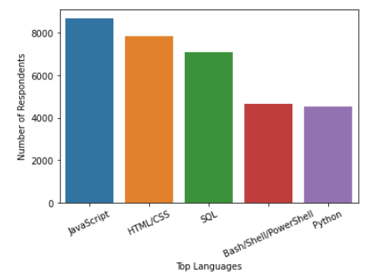
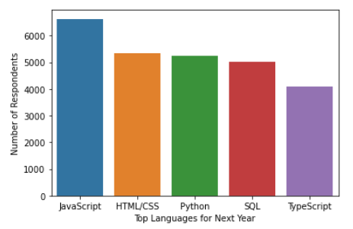
PROGRAMMING LANGUAGE TRENDS
Current Year
Next Year

Slide 9
PROGRAMMING LANGUAGE TRENDS: FINDINGS & IMPLICATIONS
Findings
JavaScript is the most popular language
JavaScript is the language that developers desire to learn most
Python is the 3rd most desired language to learn
SQL is the most popular querying language
TypeScript is a language that many developers want to learn, but is not amongst the top 5 most used languages
Implications
Since JavaScript, HTML, and CSS are the most popular languages, then many of the respondents in the survey do front-end development
Many respondents also want to learn front-end development since JavaScript, HTML, and CSS are the most desired to learn
TypeScript is a language that may be increasingly sought after in the technology industry

Slide 10
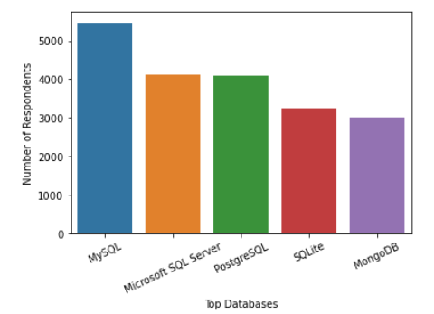
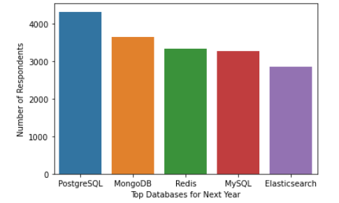
DATABASE TRENDS
Current Year
Next Year

Slide 11
DATABASE TRENDS: FINDINGS & IMPLICATIONS
Findings
MySQL is the most used database
PostgreSQL is the database that respondents desire to learn most
MongoDB is the most used and desired document-based database
More respondents are wanting to learn document-based (NoSQL) databases like Redis and Elasticsearch
Implications
PostgreSQL may become a more popular database of choice in the future versus MySQL and Microsoft SQL Server
NoSQL databases may be increasing in popularity
MongoDB may be the NoSQL database that is increasing in popularity most

Slide 12

DASHBOARD
Link to IBM Cognos Dashboard:
Click here to view

Slide 13
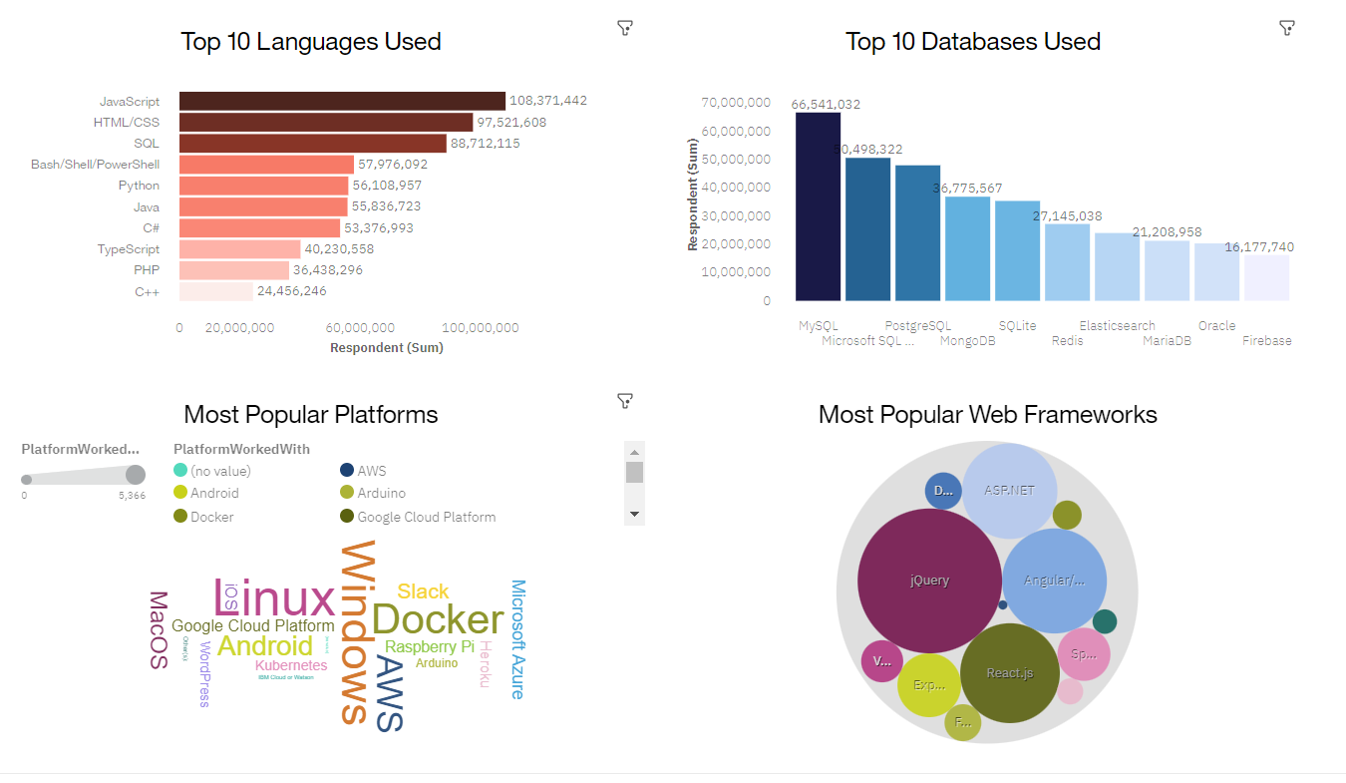
DASHBOARD TAB 1

Slide 14
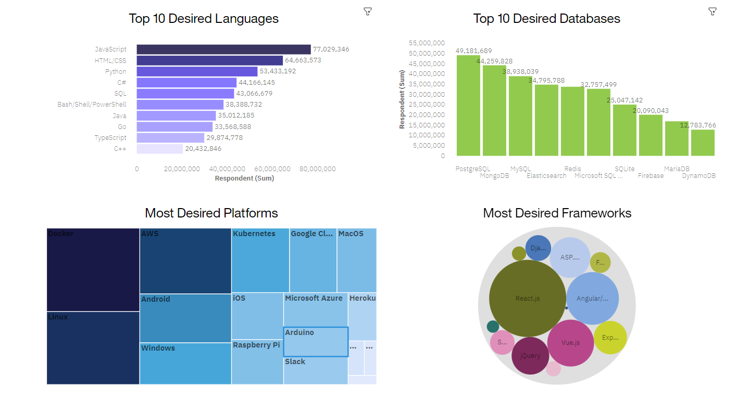
DASHBOARD TAB 2

Slide 15
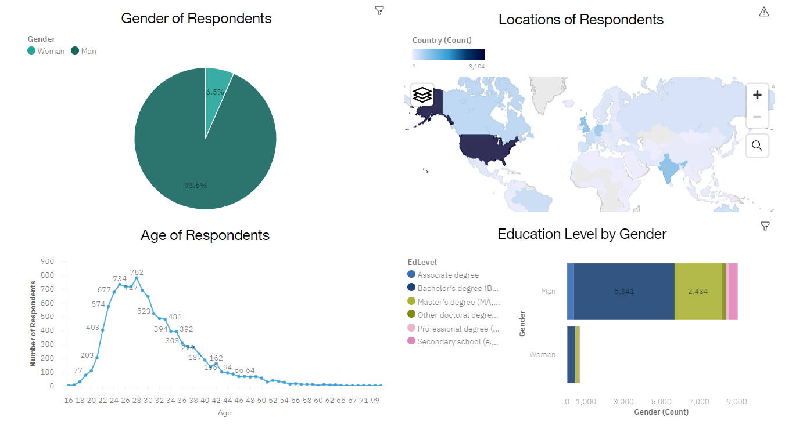
DASHBOARD TAB 3

Slide 16
DISCUSSION
As a developer, it may be important to learn to incorporate the following technologies according to this survey:
JavaScript
React.js
PostgreSQL
AWS
Docker

Slide 17
OVERALL FINDINGS & IMPLICATIONS
Findings
Currently most popular:
Language: JavaScript
Database: MySQL
Web Framework: jQuery
Cloud Service: AWS
Platform: Linux
Most desired to learn by developers:
Language: JavaScript
Database: PostgreSQL
Web Framework: Angular
Cloud Service: AWS
Platform: Docker
Demographics: Respondents are primarily men in the United States with a Bachelor’s or Master’s degree
Implications
JavaScript is a popular language with a high potential to continue this trend in the future
Linux is the most used platform since it is an open-source, light-weight, and high-speed operating system
Docker is a platform that many survey respondents want to learn indicating the rise in popularity of DevOps and containers/microservice architectures
Most employees in the tech industry are males who have at least a bachelor’s degree

Slide 18

CONCLUSION
JavaScript, React.js, PostgreSQL, Linux, AWS, and Docker technologies have a high potential to become more popular in the future
JavaScript, jQuery, Linux, and MySQL are reliable technologies that are frequently used today
The technology industry is dominated by a disproportionate number of males versus females

Slide 19
Future Analysis
The following additional information can provide further insight:
Which technologies are most popular in certain regions
Which programming languages do developers find to be the most readable/versatile/performant
Detailed comparison between popular cloud services

Slide 20

APPENDIX
Additional Analysis
Data Sources
Naukri.com Kaggle Jobs Dataset – json format
IBM Webpage with Programming Language Data – HTML
How Data was Used
Created an API and used API to store Kaggle data in an excel spreadsheet using Python
Performed web scraping on IBM Webpage and store scraped data in csv file

Slide 21
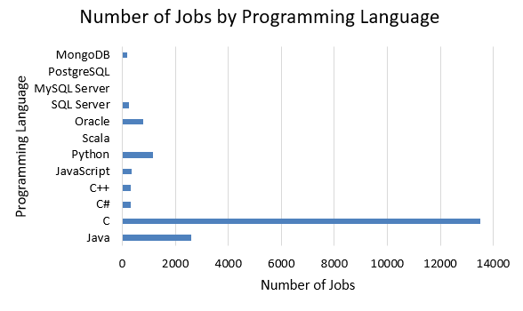
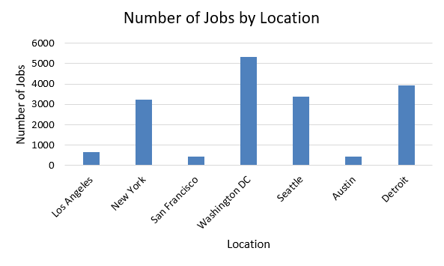
JOB POSTINGS

Slide 22
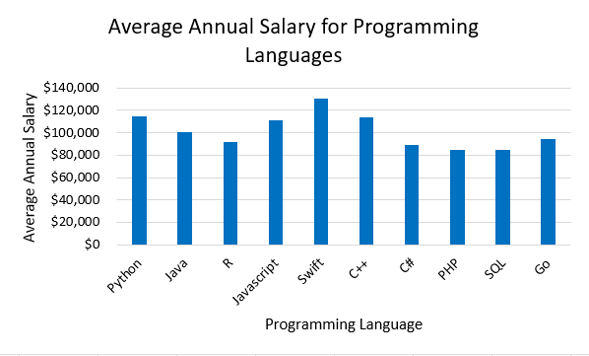
POPULAR LANGUAGES

