Slide 1
Representation Learning for Efficient Recommendation Retrieval
Dung D. Le

Slide 2

Outline
Overview
Personalized Recommendation
Matrix Factorization for Recommendation
What Recommendation Retrieval?
Why Efficient Recommendation Retrieval?
How Efficient Recommendation Retrieval?
Q and A

Slide 3

CHOICES

Slide 4
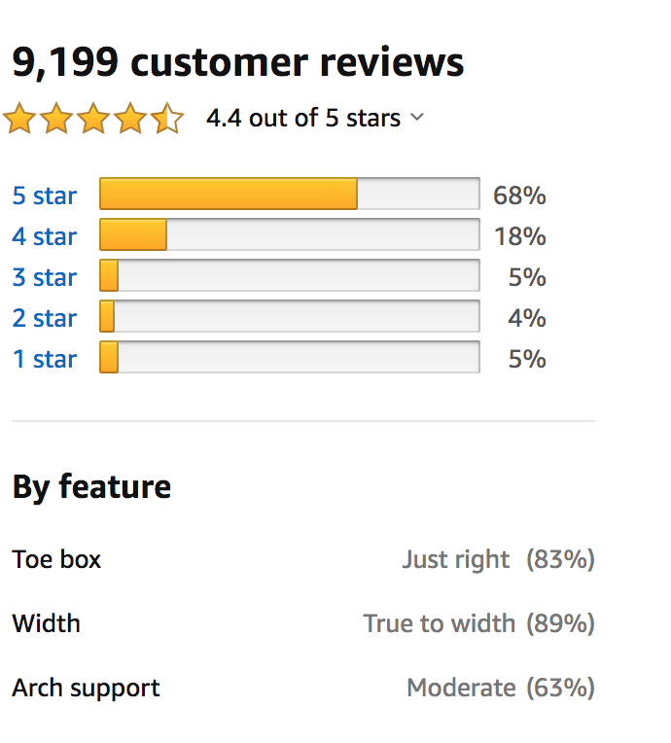

Preference Signals
Personal Preference

Slide 5

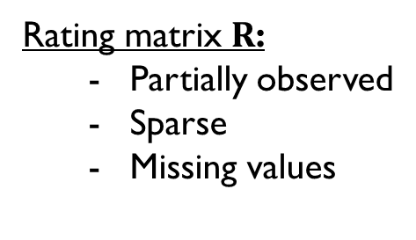

Preference Signals
$$n items$$
R
Rating matrix $R$:
Partially observed
Sparse
Missing values
$$m users$$
“estimate missing ratings and recommend most likely preferred items”

Slide 6
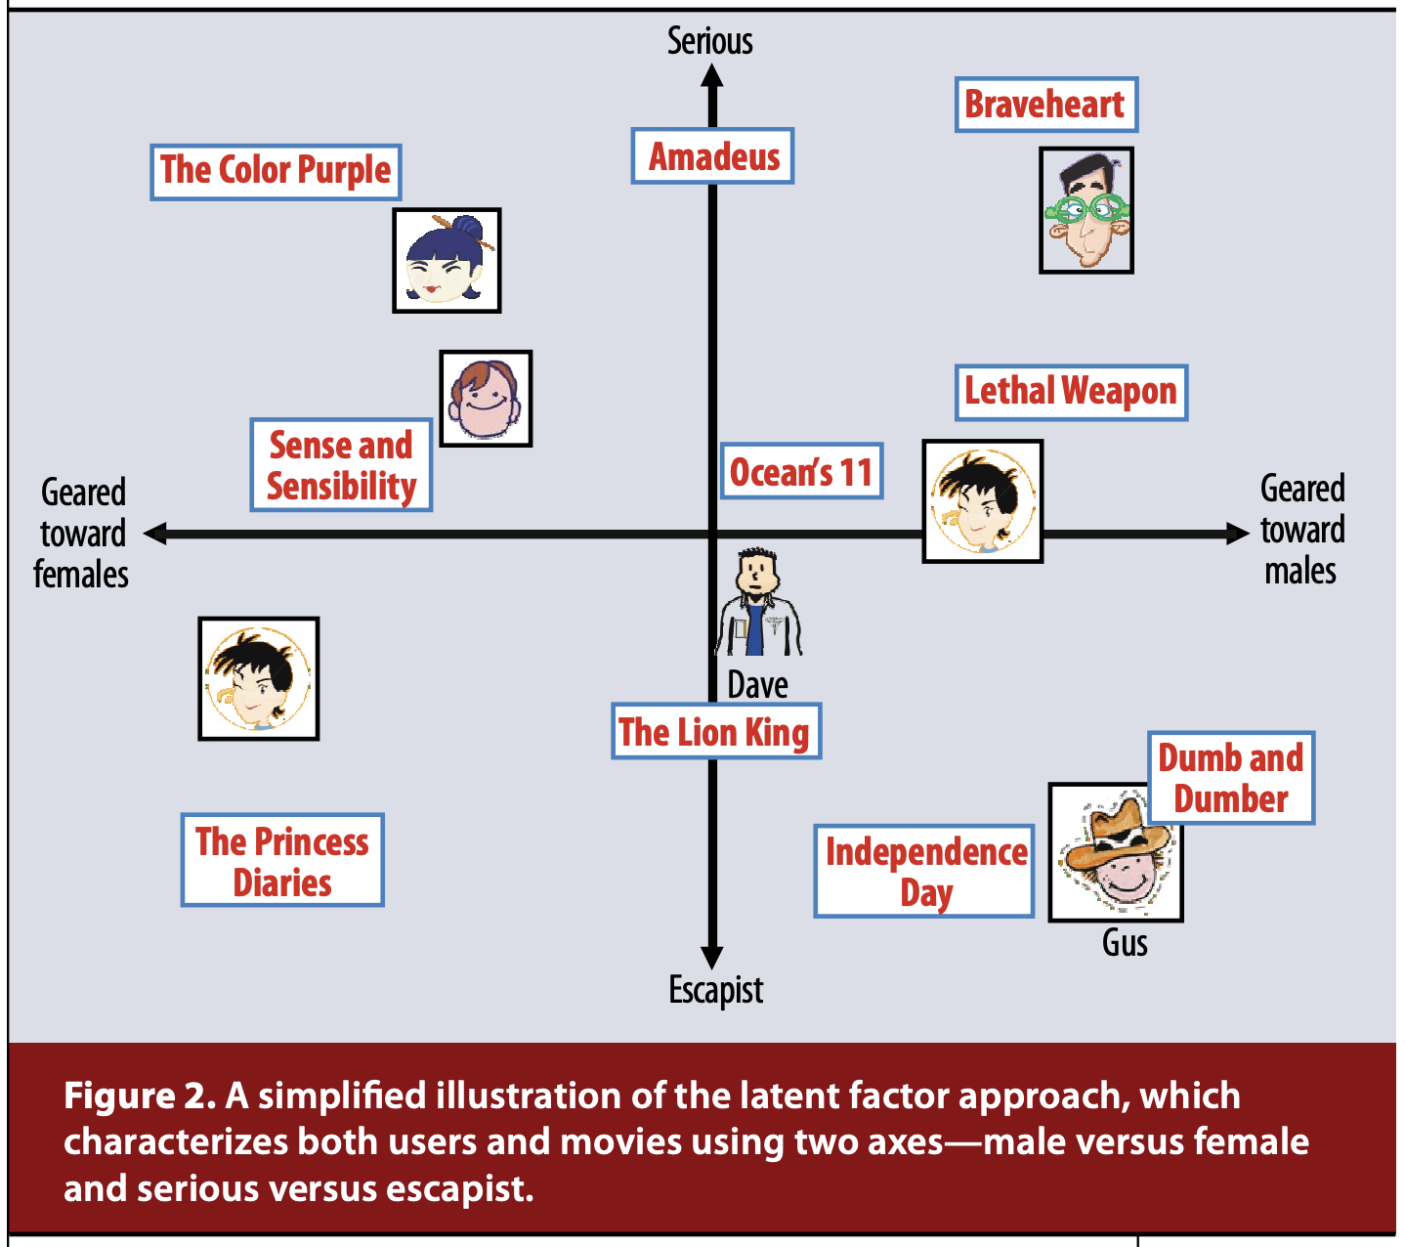
Matrix Factorization
Koren, Bell, Volinsky, "Matrix Factorization Techniques for Recommender Systems”, Computer 2009.

Slide 7








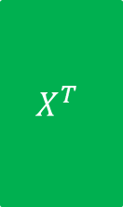



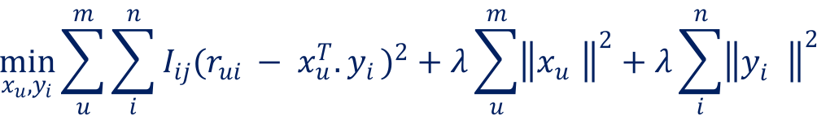
Matrix Factorization: Learning
Ruslan Salakhutdinov, Andriy Mnih, “Probabilistic Matrix Factorization”,
NeurIPS 2007
$$n$$
$$d$$
$$n$$
$$R$$
$$X^{T}$$
$$Y$$
$$m$$
$$≈$$
$$m$$
$$×$$
$$d$$
Prediction
$${pref}_{u}\left(i\right)∝x_{u}^{T}{.y}_{i}$$
$$\min_{x_{u}, y_{i}}{\sum_{u}^{m}{\sum_{i}^{n}{I_{ij}{(r_{ui} − x_{u}^{T}{.y}_{i})}^{2}}+λ\sum_{u}^{m}{{\left\|x_{u}^{}\right\|}^{2}}+λ\sum_{i}^{n}{{\left\|y_{i}^{}\right\|}^{2}}}}{}$$
Objective:

Slide 8
















Matrix Factorization: Top-K Recommendation Retrieval
$$n$$
$$pref_{u}\left(i\right)∝x_{u}^{T}{.y}_{i}$$
$$d$$
$$Y$$
$$n$$
$$×$$
$$=$$
$$1$$
$$x_{u}$$
$$d$$
$$1$$
$$pref_{u}$$
$$n$$
Top-K items
$$1$$
Sorted $pref_{u}$
Maximum Inner Product Search
$$\underset{i}{argmax}{{(x}_{u}^{T}{.y}_{i})}{}$$

Slide 9







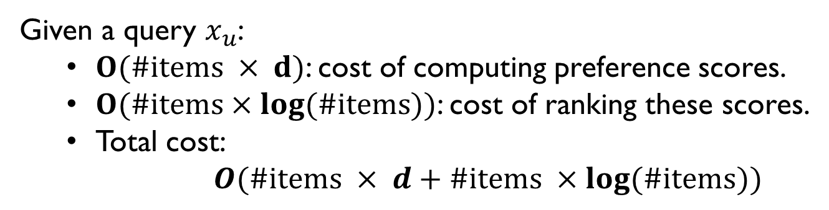








Complexity of Brute Force Search
$$n$$
$$pref_{u}\left(i\right)=x_{u}^{T}{.y}_{i}$$
$$d$$
$$Y$$
$$n$$
$$×$$
$$=$$
$$1$$
$$x_{u}$$
$$d$$
$$1$$
$$pref_{u}$$
Retrieval
phase
Brute Force Approach is not Scalable
A faster Alternative is Desirable
$$n$$
Top-K items
$$1$$
Sorted $pref_{u}$
Given a query $x_{u}$:
$O(\#items × d)$: cost of computing preference scores.
$O(\#items×\log{(\#items)})$: cost of ranking these scores.
Total cost:
$O(\#items × d+\#items ×\log{(\#items)})$

Slide 10















Indexing as a Faster Alternative
User Vector
$$1$$
$$2$$
$$…$$
$$d$$
$x_{u}^{T}$:
Index
Builder
Index
$$y_{1}$$
$$y_{2}$$
$$y_{n}$$
$$…$$
$$1$$
$$…$$
Item Matrix
$$Y:$$
$$2$$
$$…$$
$$…$$
$$…$$
$$…$$
$$d$$
$$C_{u}$$
Candidate Set
Most indexing methods are designed for
Nearest Neighbor Search
or
Maximum Cosine Search

Slide 11
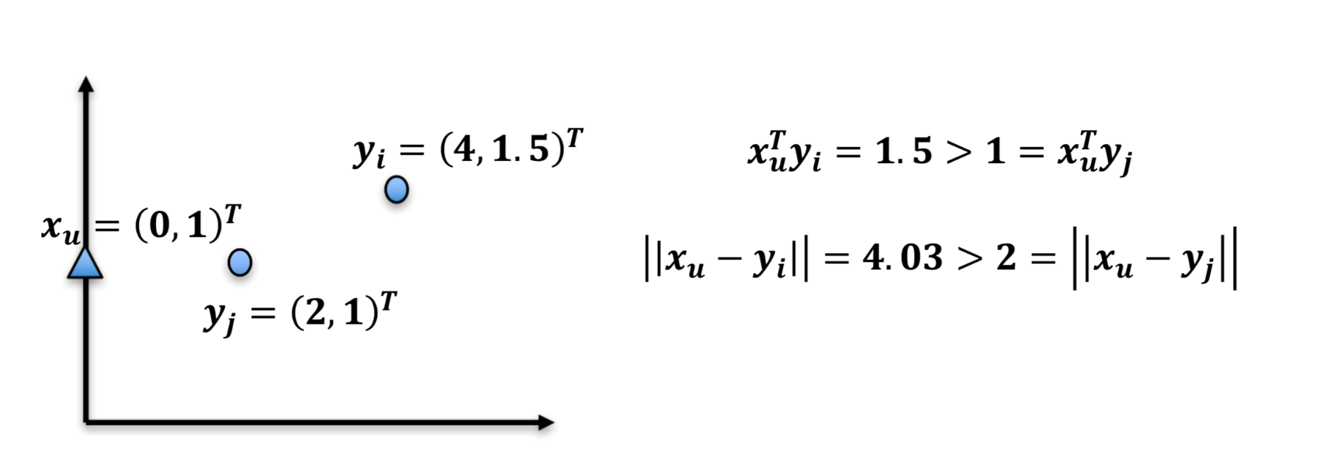


MIPS is not Nearest Neighbor Search
Maximum Inner Product Search (MIPS)
$$\underset{i}{argmax}{{(x}_{u}^{T}{.y}_{i})}{}$$
Nearest Neighbor Search (NNS)
$$\underset{i}{argmax}{{\left\|x_{u}−y_{i}\right\|}^{2}}$$

Slide 12
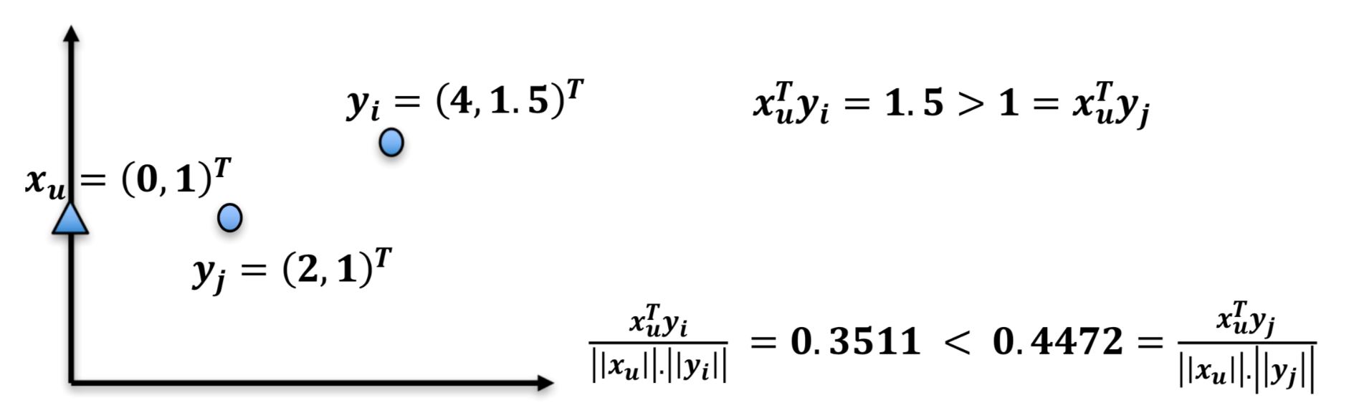


MIPS is not Max Cosine Similarity Search
Maximum Inner Product Search (MIPS)
$$\underset{i}{argmax}{{(x}_{u}^{T}{.y}_{i})}{}$$
Maximum Cosine Similarity Search (MCSS)
$$\underset{i}{argmax}{\frac{x_{u}^{T}{.y}_{i}}{\left\|x_{u}\right\| \left\|y_{i}\right\|}}$$

Slide 13
Approaches
# Strategy 1:
MIPS to NNS/MCSS Reduction
# Strategy 1I:
Indexable Representation
Learning

Slide 14


Slide 15


MIPS-to-NNS/MCSS Reduction
Pre-Processing
$$\left|\left|y_{i}\right|\right|≤M, ∀y_{i}∈Y$$
$$P\left(y_{i}\right)=\left[y_{i},\sqrt{M^{2}−{\left|\left|y_{i}\right|\right|}^{2}}\right]$$
$$Q\left(x_{u}\right)=\left[x_{u},0\right]$$
Item Vectors
User Vectors
Reducing MIPS to NNS/MCSS
$$\arg{\max_{1≤i≤n }{x_{u}^{T}y_{i}=\arg{\min_{1≤i≤n }\left|\left|Q\left(x_{u}\right)−P\left(y_{i}\right)\right|\right|= \arg{\max_{1≤i≤n }{\frac{Q{\left(x_{u}\right)}^{T}P\left(y_{i}\right)}{\left|\left|Q\left(x_{u}\right)\right|\right|.\left|\left|P\left(y_{i}\right)\right|\right|}}}}}}$$
MIPS
NNS
MCSS
[1] Bachrach, Y., et al. Speeding up the Xbox recommender system using a euclidean transformation for
inner-product spaces. RecSys 2014.
[2] Neyshabur and Srebro, "On Symmetric and Asymmetric LSHs for Inner Product Search", ICML 2015.

Slide 16














Indexing as a Faster Alternative
User Vector
$$1$$
$$2$$
$$…$$
$$d$$
MIPS to NNS/MCSS
Reduction
$x_{u}^{T}$:
$$y_{1}$$
$$y_{2}$$
$$y_{n}$$
Index
$$…$$
Index
Builder
$$1$$
$$…$$
Item Matrix
$$Y:$$
$$2$$
$$…$$
$$…$$
$$…$$
$$…$$
$$d$$
$$C_{u}$$
Candidate Set

Slide 17
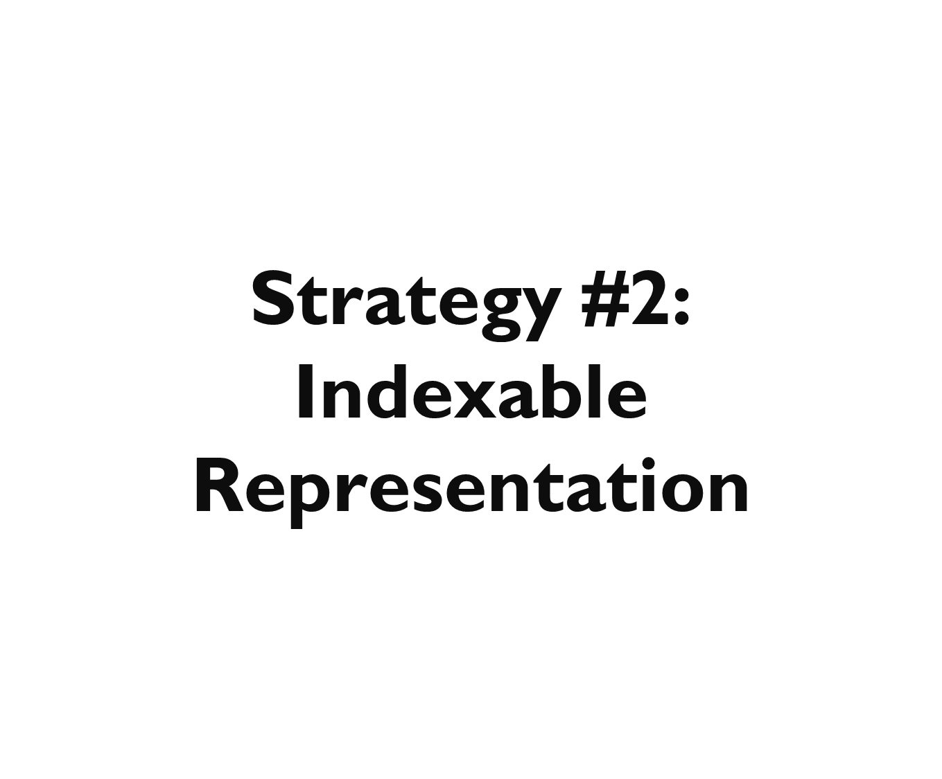

Slide 18
Indexable Representation Learning
Metric Learning
Change inner-product formulation to one based on Euclidean distance.
Compatible with spatial trees, LSH.

Slide 19
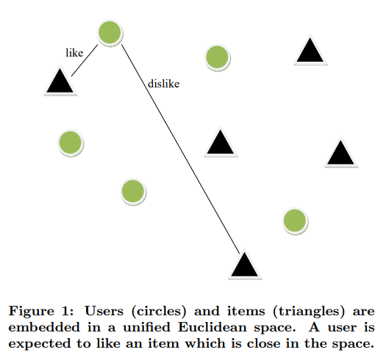
Metric Learning
Khoshneshin and Street, "Collaborative Filtering via Euclidean Embedding”, RecSys 2010.

Slide 20
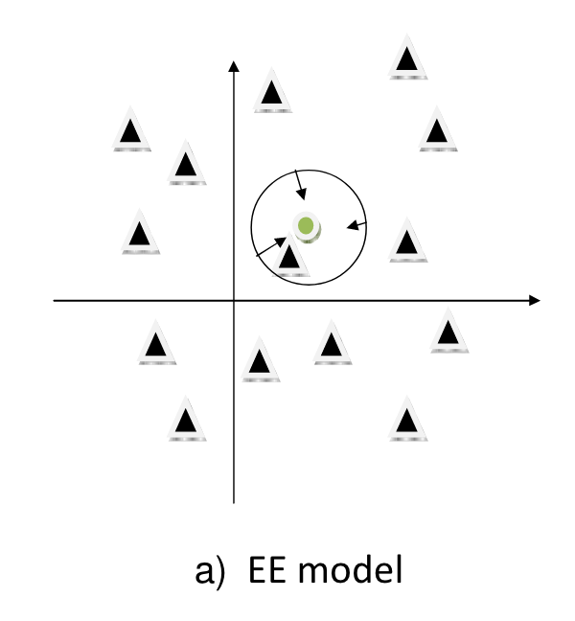
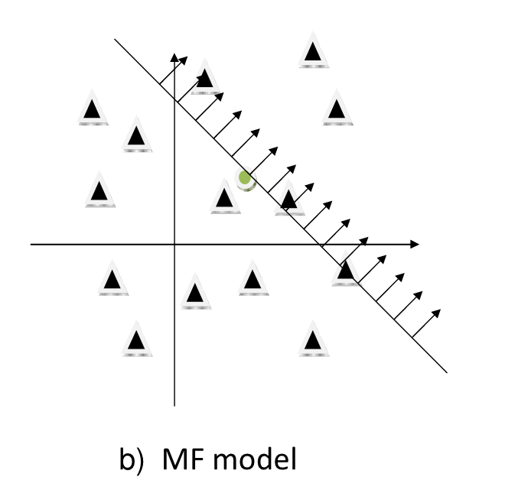


Metric Learning
Khoshneshin and Street, "Collaborative Filtering via Euclidean Embedding”, RecSys 2010.
Euclidean Embedding
Matrix Factorization
$${\hat{r}}_{ui}=μ+b_{u}+b_{i} −{\left|\left|x_{u} −y_{i}\right|\right|}^{2}$$
$${\hat{r}}_{ui}=μ+b_{u}+b_{i}+x_{u}^{T}y_{i}$$

Slide 21
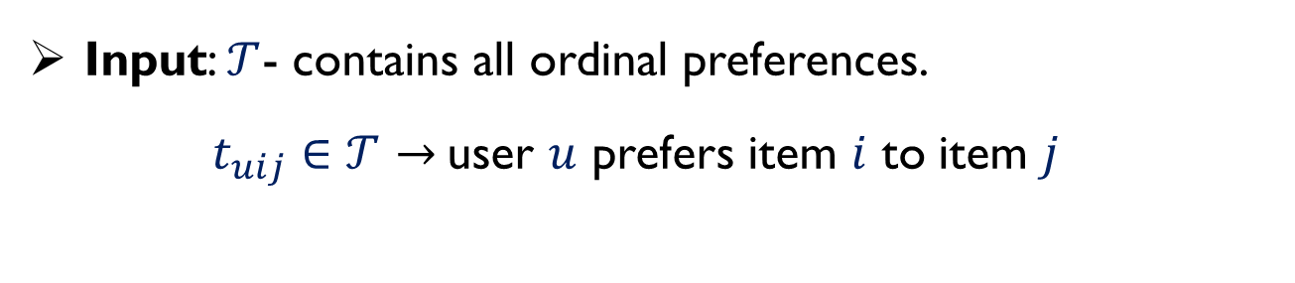
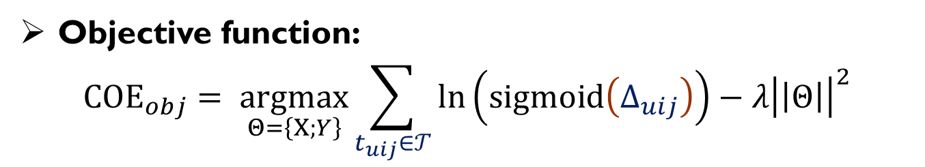

Metric Learning for Ordinal Triples
Le and Lauw, "Euclidean Co-Embedding of Ordinal Data for Multi-Type Visualization",
SDM 2016.
Input: $𝒯$- contains all ordinal preferences.
$t_{uij}∈𝒯→$user $u$ prefers item $i$ to item $j$
Objective function:
$${COE}_{obj}= \underset{Θ=\left\{X;Y\right\}}{argmax}{\sum_{t_{uij}∈𝒯}{\ln\left(sigmoid\left(Δ_{uij}\right)\right)−λ{\left|\left|Θ\right|\right|}^{2}}}$$
$$Δ_{uij}=\left|\left|x_{u}−y_{j}\right|\right|−\left|\left|x_{u}−y_{i}\right|\right|$$
Benefits:
Recommendation retrieval becomes nearest neighbor search.
Euclidean coordinates are useful for visualization.

Slide 22
Indexable Representation Learning
Indexable MF
Keep inner-product formulation, but ensure native indexability by removing the effect of vector magnitudes.
Compatible with spatial trees, L2LSH, SRP-LSH, inverted index.

Slide 23

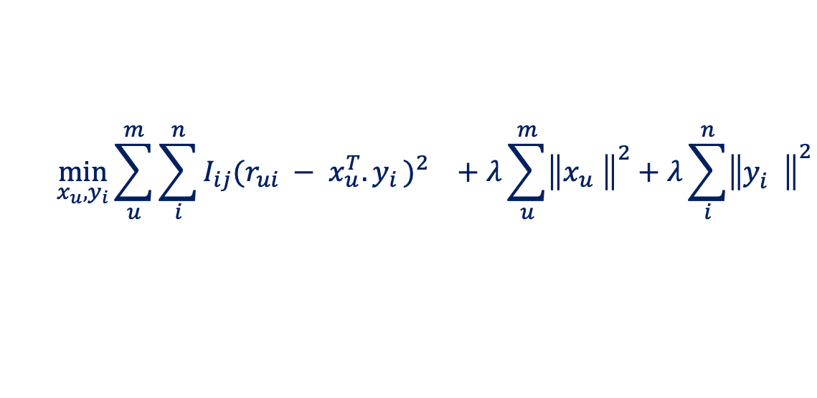

Indexable MF for Rating Prediction
Fraccaro, Paquet, and Winther, "Indexable Probabilistic Matrix Factorization for Maximum
Inner Product Search", AAAI 2016.
$$n$$
$$d$$
$$n$$
$$R$$
$$X^{T}$$
$$Y$$
$$m$$
$$≈$$
$$m$$
$$×$$
$$d$$
Prediction
$${pref}_{u}\left(i\right)=x_{u}^{T}{.y}_{i}$$
Learning Objective
$$\min_{x_{u}, y_{i}}{\sum_{u}^{m}{\sum_{i}^{n}{I_{ij}{{(r_{ui} − x_{u}^{T}{.y}_{i})}^{2}}_{}}+λ\sum_{u}^{m}{{\left\|x_{u}^{}\right\|}^{2}}+λ\sum_{i}^{n}{{\left\|y_{i}^{}\right\|}^{2}}}}{}$$
Constraint
$$s.t. \left|\left|y_{i}\right|\right|=c ∀ 1≤i≤n.$$

Slide 24
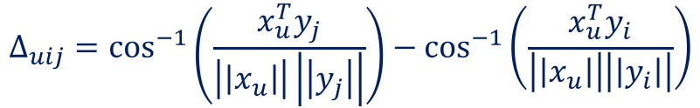

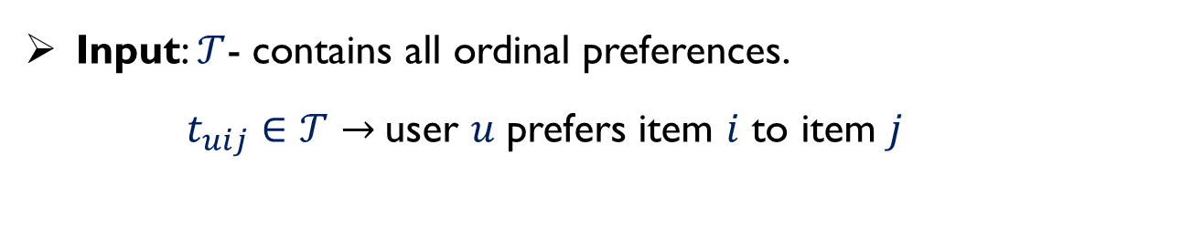
Indexable MF for Ordinal Triples
Le and Lauw, "Indexable Bayesian Personalized Ranking for Efficient Top-k Recommendation",
CIKM 2017.
Input: $𝒯$- contains all ordinal preferences.
$t_{uij}∈𝒯→$user $u$ prefers item $i$ to item $j$
Indexable Bayesian Personalized Ranking (IBPR)
$${IBPR}_{obj}= \underset{Θ=\left\{X;Y\right\}}{argmax}{\sum_{t_{uij}∈𝒯}{\ln\left(sigmoid\left(Δ_{uij}\right)\right)−λ{\left|\left|Θ\right|\right|}^{2}}}$$
$$Δ_{uij}=\cos^{−1}\left(\frac{x_{u}^{T}y_{j}}{\left|\left|x_{u}\right|\right|\left|\left|y_{j}\right|\right|}\right){− cos}^{−1}\left(\frac{x_{u}^{T}y_{i}}{\left|\left|x_{u}\right|\right|\left|\left|y_{i}\right|\right|}\right)$$
Benefits:
Recommendation retrieval becomes max cosine similarity search.
Compatible with LSH and Spatial Tree indexing structures.

Slide 25
































Indexable Representation Learning
$$n$$
$$R$$
Indexable Learning
Model
User Matrix
$$X:$$
Item Matrix
$$Y:$$
$$x_{1}$$
$$x_{2}$$
$$…$$
$$x_{m}$$
$$y_{1}$$
$$y_{2}$$
$$y_{n}$$
$$1$$
$$…$$
$$m$$
$$…$$
$$1$$
$$…$$
$$2$$
$$…$$
$$2$$
$$…$$
$$…$$
$$…$$
$$…$$
$$…$$
$$…$$
$$…$$
$$d$$
$$d$$
$$y_{1}$$
$$y_{2}$$
$$y_{n}$$
Index
Builder
$$…$$
$$1$$
$$…$$
Item Matrix
$$Y:$$
$$2$$
$$…$$
$$…$$
$$…$$
$$…$$
$$d$$
Index
User Vector
$$1$$
$$2$$
$$…$$
$$d$$
$x_{u}^{T}$:
$$C_{u}$$
Candidate Set

Slide 26
Conclusion
Learn user and item representations that are natively compatible with indexing in the first place
Metric Learning
Indexable MF
Change inner-product formulation to one based on Euclidean distance
Compatible with spatial index and L2LSH
Keep inner-product formulation, but ensure native indexability
Compatible with spatial index, L2LSH, SRP-LSH, inverted index
https://code.preferred.ai/recommendation-retrieval (tutorial)
or
https://cerebro.preferred.ai
(library for recommendation retrieval)

Slide 27


Slide 28
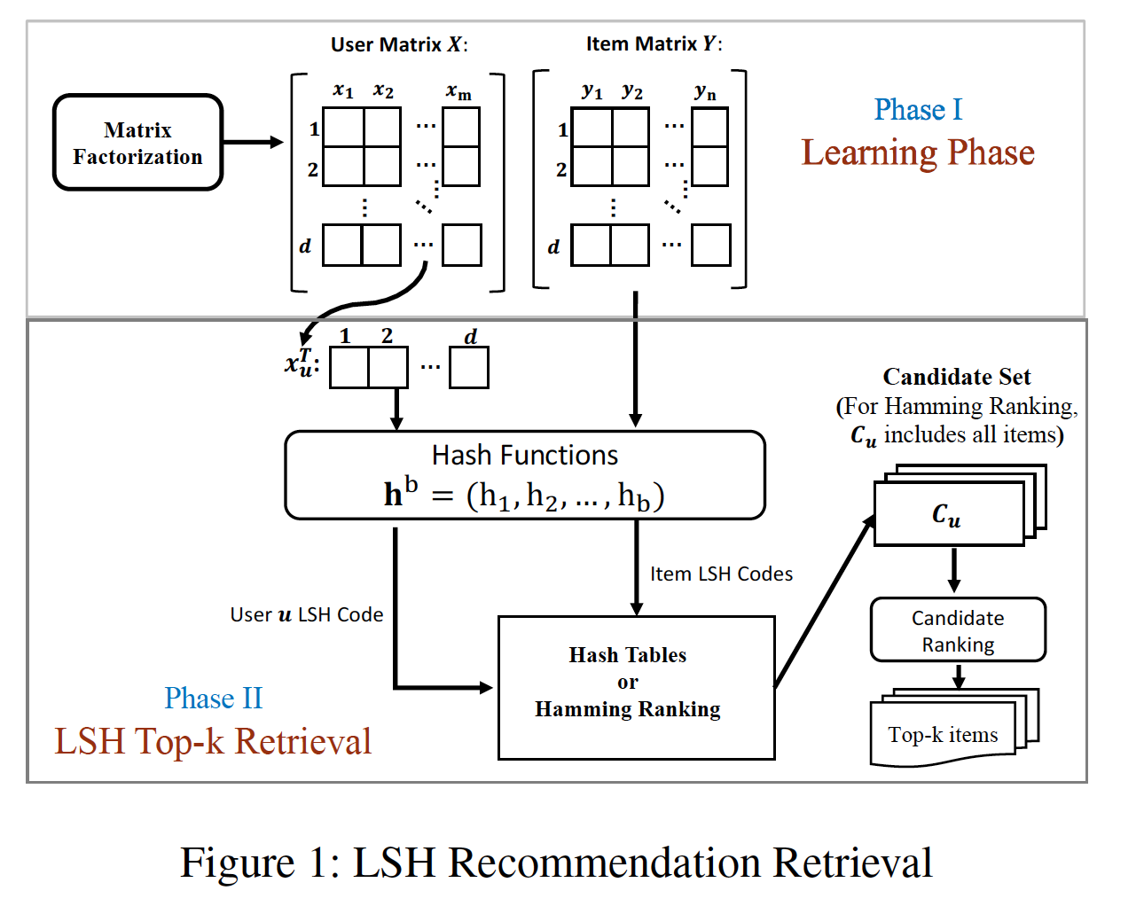
LSH-based Recommendation Retrieval
Le and Lauw, " Stochastically Robust Personalized Ranking for LSH Recommendation Retrieval ", AAAI 2020.

