Slide 1
Deep learning segmentation and quantification method for assessing epicardial adipose tissue in CT calcium score scans
Ammar Hoori1 , Tao Hu1 , Juhwan Lee1 , et al.
Nature portfolio
(2022) 12:2276
Presented By:
Prerna Singh
Andrew Dupuis
Roshan Sivakumar

Slide 2
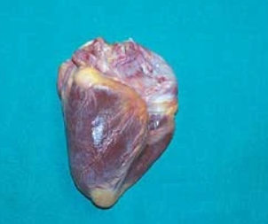
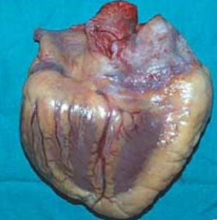
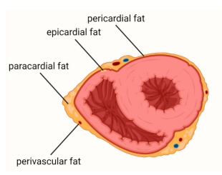
Epicardial adipose tissue (EAT) - Has structural and functional interactions with Heart
Fig 1:Left: Normal heart (200g), Right: hypertrophic heart (900g)
Fig 2: Classification of adipose tissue around the heart
In normal heart, fat distribution limited to major coronary branches
Hypertrophy is mainly on the right-hand side—the adipose tissue fills the epicardial spaces
EAT has biochemical, mechanical and thermogenic cardioprotective properties – Myocardial homeostasis
No anatomical barrier between EAT and myocardium – Can interact locally

Slide 3
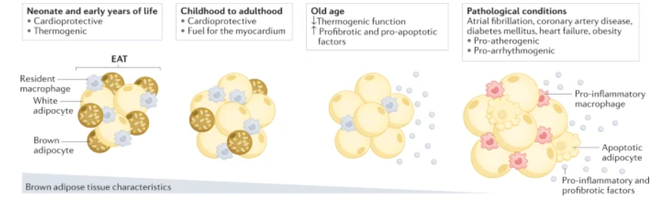
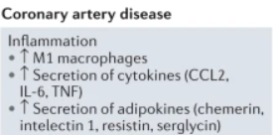
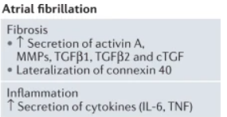
Adverse cardiac diseases and events linked to EAT
Fig 3: EAT changes with age and in pathological conditions
Under pathological cases, EAT affects heart and coronary arteries via Vasocrine/Pancrine secretion of Cytokines
For conditions like coronary artery disease, diabetes mellitus, heart failure and atrial fibrillation, in EAT:
Thermogenic function decreases
increases in the expression of genes encoding profibrotic and pro-apoptotic factors
EAT can be a therapeutic target

Slide 4
Methods to Assess EAT Volume
Method | Advantages | Challenges
MRI |  | - Large cohorts are less available - Not readily available, high cost
Non-contrast CT calcium score images | Large cohorts available, since primary screening exam for cardiovascular health | - Slices are thick - No contrast agent for fat boundary definition
High resolution CT angiography (CTA) | Overcomes disadvantages on Non-contrast CT for calcium score | - Large cohorts are less available - Not a screening exam

Slide 5
Manual and Automatic EAT segmentation on CT
Manual Analysis
Time-consuming, requires skilled expertise, prone to inter- and intra-observer variability
Difficult to distinguish thin layer of pericardium tissue in CT scans w/ low contrast
Automatic Methods
Floor of the log clustering algorithm and a set of morphological operations
2D Dense U-Net for automatically segmenting epicardium
3D deep attention U-Net for segmenting the EAT
Dual U-Net framework on 2D images slices
2 CNNs to segment EAT and thoracic adipose tissue (error on top and bottom slices)
Deep Fat Method introduced which overcomes the errors when using 2CNNs to segment EAT

Slide 6
Objective and Metrics
Develop an accurate, fully-automated EAT segmentation from CT calcium score images
Evaluation Metrics
Dice coeff/F1 score and Intersection over union score
Accuracy
Scatter and Bland–Altman plots (R and p-values)

Slide 7
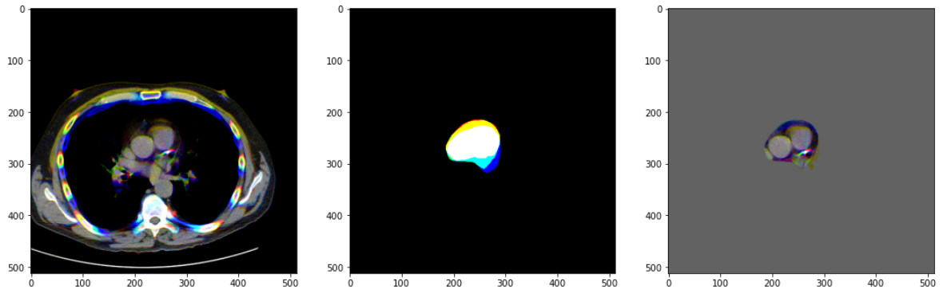
Data and Pre-processing
Fig 3: window/leveled and masked image of the RGB data
CT scans:
93 non-contrast cardiac CT images
2D slice dimensions : 512x512, axial thickness : 2.5mm
Pre-processing training and testing data:
Hu attention window with a window/level of 350/40 HU

Slide 8
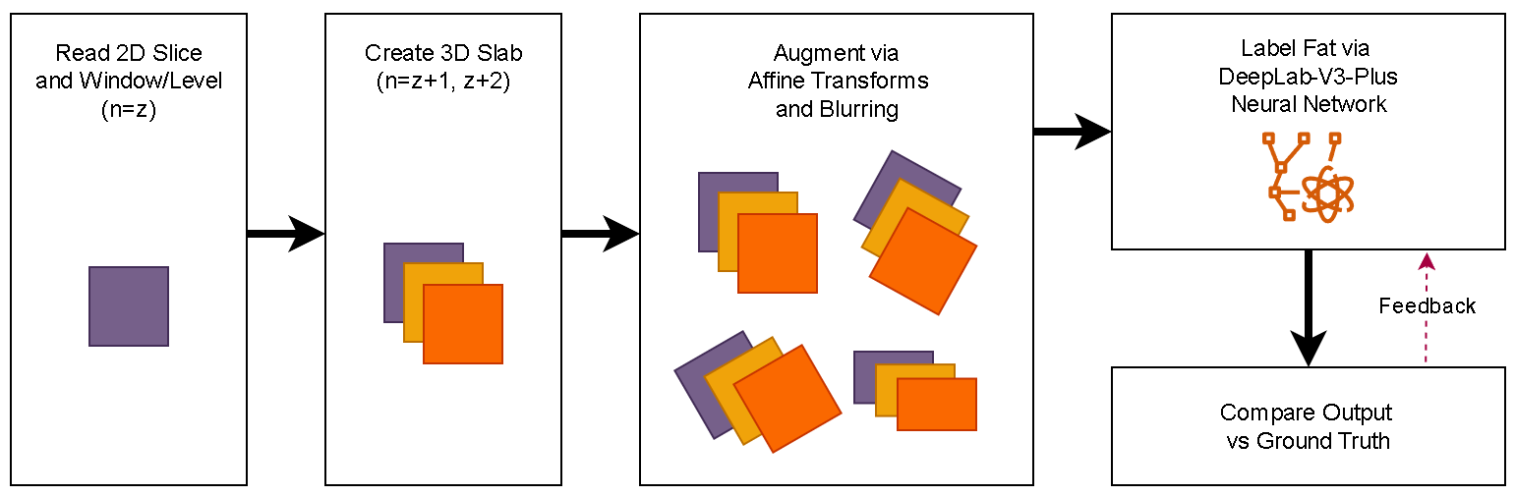
DeepFat Network – U-Net on 8-bit data
Fig 5 :Deep learning neural network
Data augmented
Network pre-trained on ImageNet dataset
Model Used…

Slide 9
Slides (Plots for results/evaluation) – 3/4

Slide 10
Key Takeaways and Future work
<Results>:
Things that can be done:
Review of automated results required to investigate errors identified (ex: outliers)
Manual correction of automated segmentation to improve performances

Slide 11
Relevance with course work

Slide 12
References (To be included)

Slide 13
Thank You
Questions?

