Slide 1
The Tool to convert a IOCDS file into an Excel Spreadsheet
Andrew Jan andrewj@tw.ibm.com
20170112

Slide 2
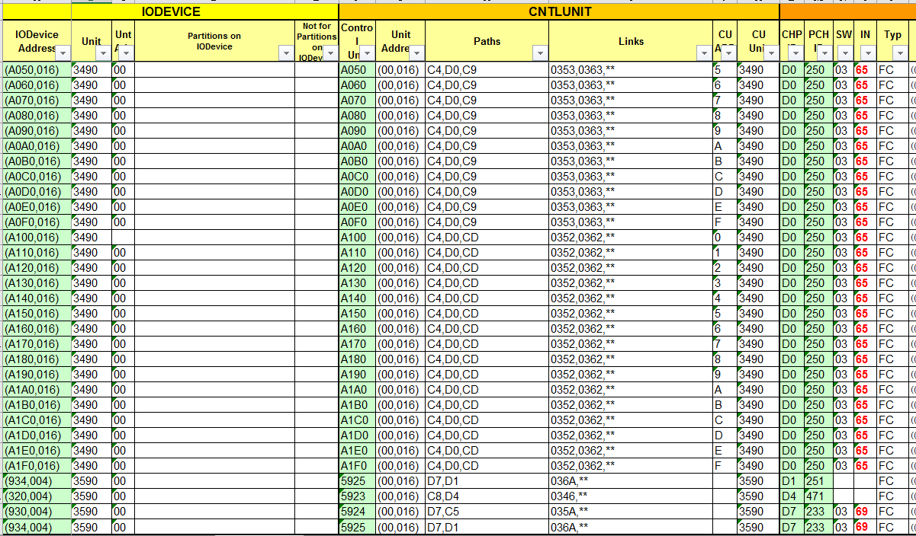
2499 ports (to device)
honoraria
2499 ports (from CPU)
CHP IDs

Slide 3
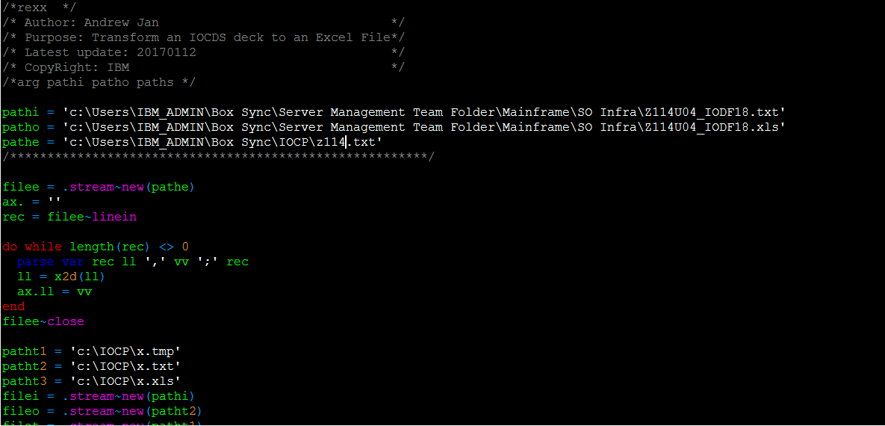
IOCDS text file
The 2499 input ports from the CPU
The excel file to produce
These are temporary files but make sure the folder does exist

Slide 4
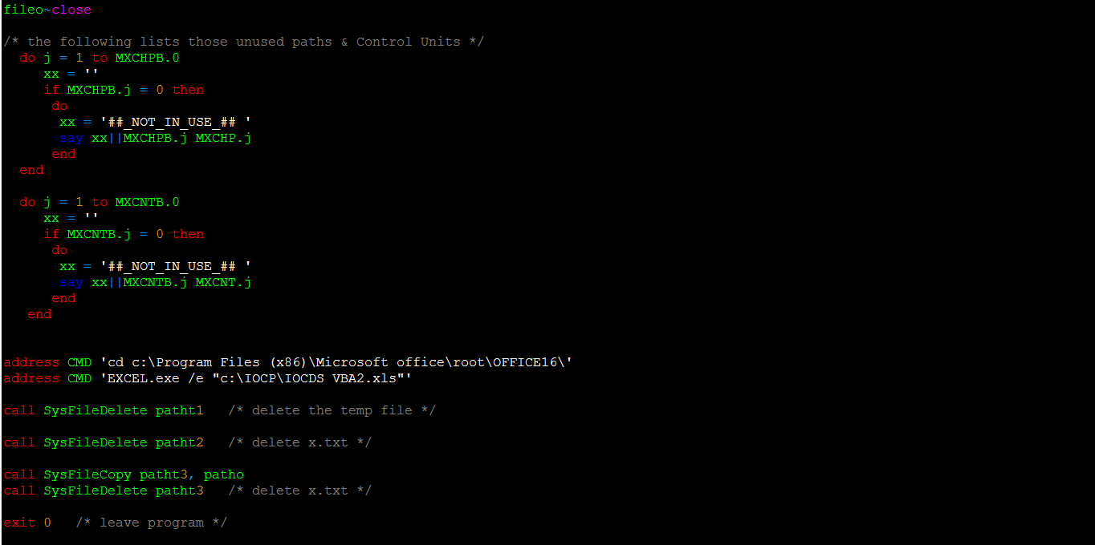
This is how the VBA script is executed. Make sure the fold is correct!

Slide 5
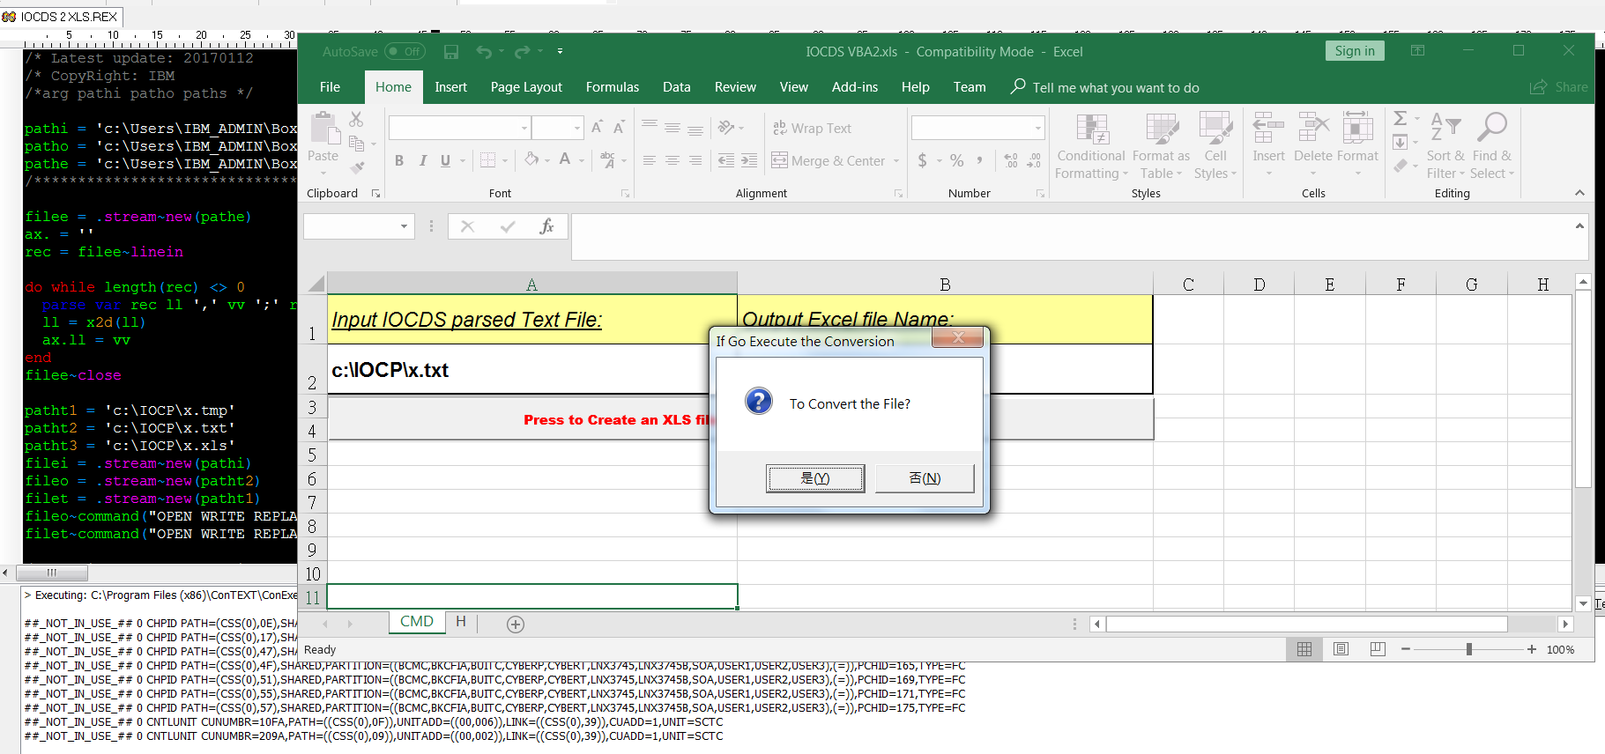
Press “Y” to execute the VBA script

Slide 6
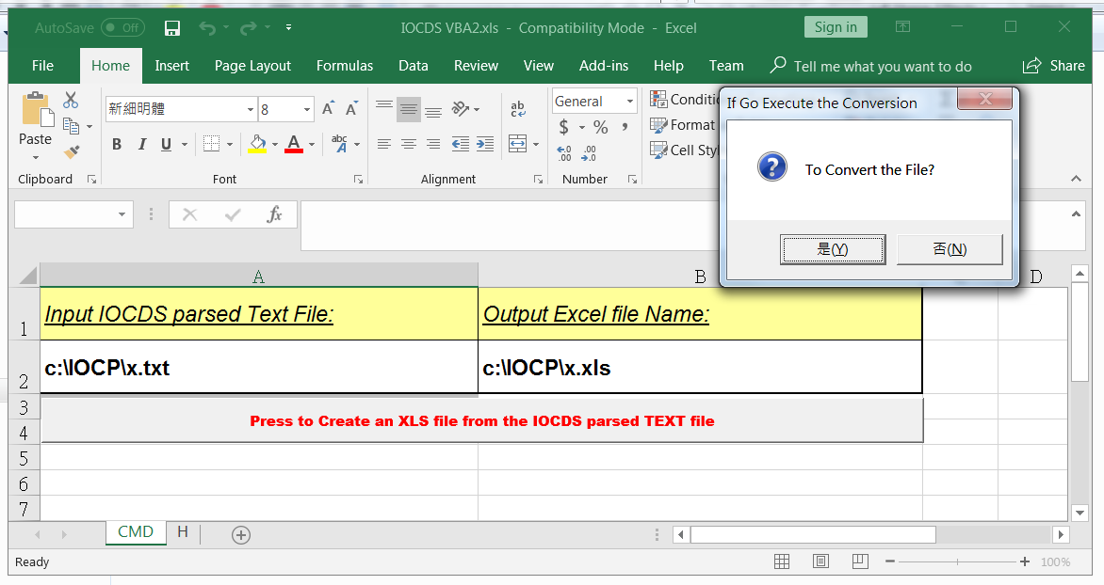
Press “N” when we want to update the VBA script logic

Slide 7
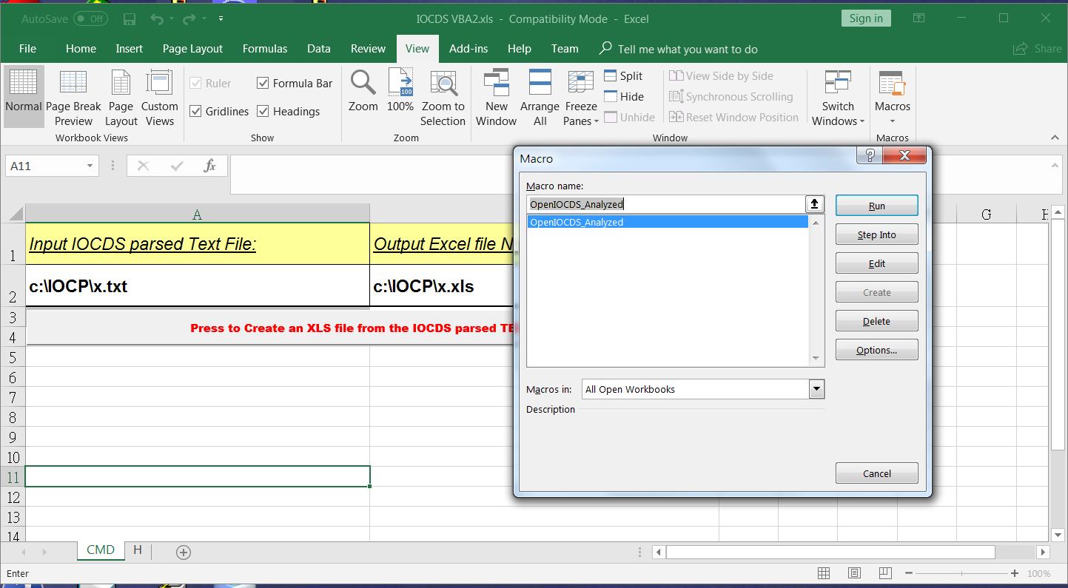
Choose “Edit” from “Macros” under “View”

Slide 8
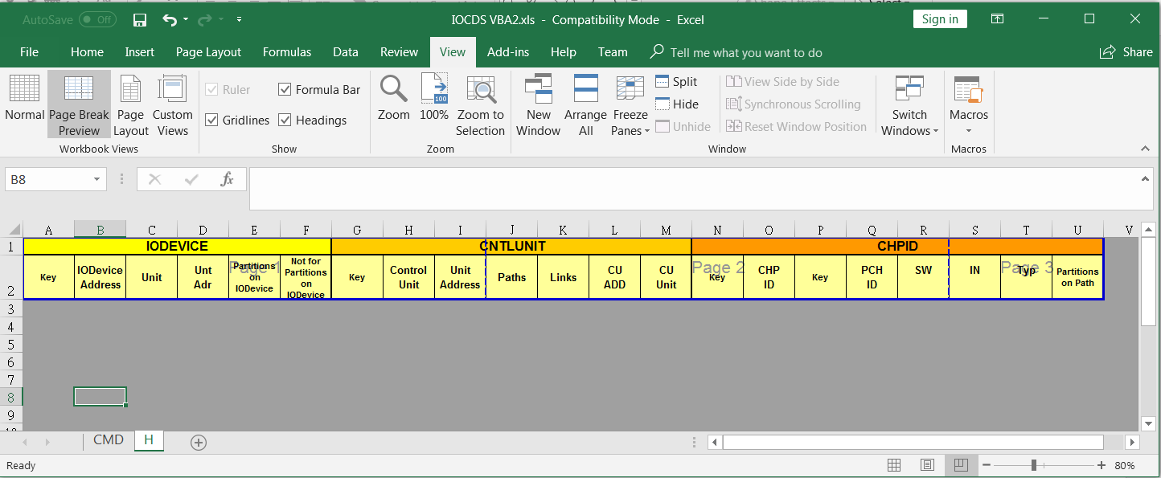
This is the template for the header of the resulted output excel file

Slide 9
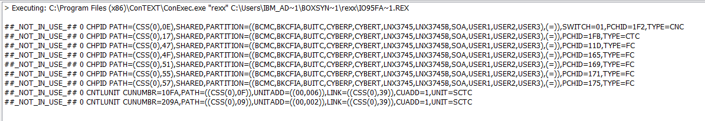
IOCDS2XLS collects only those PATHs and CNTLUNITs with IODEVICEs attached to them. However, some warnings will pop up to show what PATHs and CNTLUNITs exist in the IOCDS without having any IODEVICE.
Other IOCDS statements (like “ID”, “TOK”, “RESOURCE PARTITION” ) this are nothing to do with IODEVICEs will not display in the excel file either.

