Slide 1
HW 5
Aiqing Jiang
2017.11.7

Slide 2
Code
library(NLP)
library(tm)
library(SnowballC)
abs = Corpus(VectorSource(vec_abs))
abs_dtm = DocumentTermMatrix(abs, control = list(stemming = TRUE, stopwords = TRUE, minWordLength = 3,
removeNumbers = TRUE, removePunctuation = TRUE))
dim(abs_dtm)
inspect(abs_dtm)
findFreqTerms(abs_dtm, 3)
removeSparseTerms(abs_dtm, 0.5)
inspect(removeSparseTerms(abs_dtm, 0.5))
library(ggplot2)
library(wordcloud)
freq = colSums(as.matrix(abs_dtm))
wf = data.frame(word=names(freq), freq=freq)
plot = ggplot(subset(wf, freq>50), aes(word, freq))
plot = plot + geom_bar(stat="identity")
plot = plot + theme(axis.text.x=element_text(angle=45, hjust=1))
plot
freq = colSums(as.matrix(abs_dtm))
dark2 = brewer.pal(6, "Dark2")
wordcloud(names(freq), freq, max.words=100, rot.per=0.2, colors=dark2)
library(RCurl)
library(XML)
library(stringr)
url = paste("http://shakespeare.mit.edu/romeo_juliet/full.html")
#url = paste("http://shakespeare.mit.edu/julius_caesar/full.html")
#url = paste("http://shakespeare.mit.edu/hamlet/full.html")
abs = lapply(url, FUN = function(x) htmlParse(x, encoding = "ANSI"))
clean_txt = function(x) {
cleantxt = xpathApply(x, "//body//text()
[not(ancestor :: script)][ not(ancestor :: style)]
[not(ancestor :: noscript)] " ,xmlValue)
cleantxt = paste(cleantxt, collapse="\n")
cleantxt = str_replace_all(cleantxt, "\n", " ")
cleantxt = str_replace_all(cleantxt, "\r", "")
cleantxt = str_replace_all(cleantxt, "\t", "")
cleantxt = str_replace_all(cleantxt, "<br>", "")
return(cleantxt)
}
cleantxt = lapply(abs,clean_txt)
vec_abs = unlist(cleantxt)

Slide 3
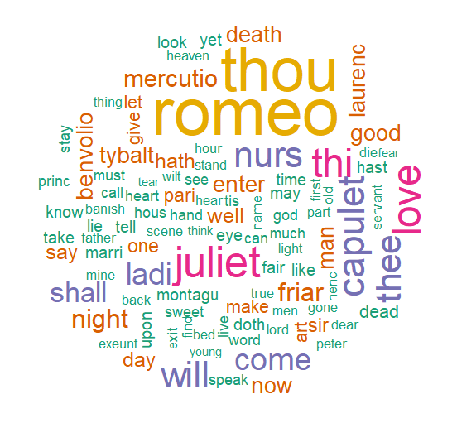
Q1 Romeo and Juliet

Slide 4
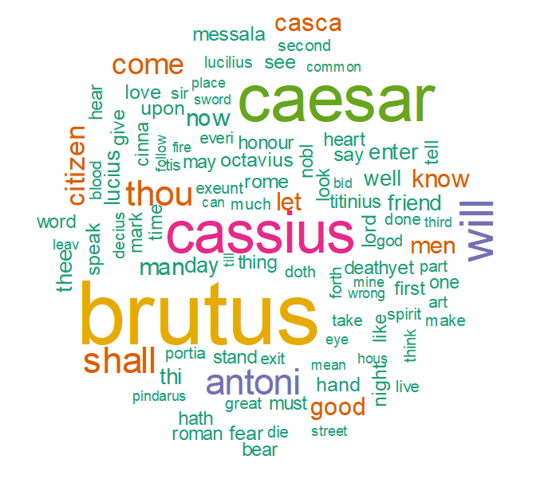
Q1 Julius Caesar

Slide 5
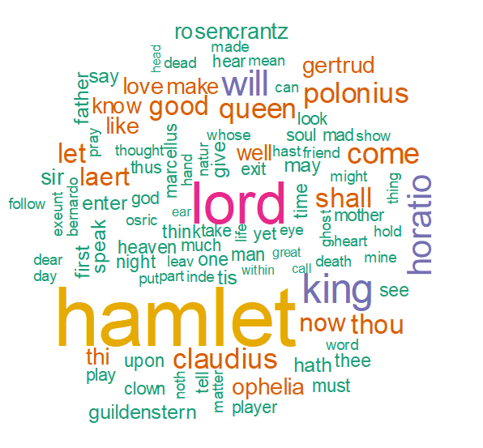
Q1 Hamlet

Slide 6
Q2 Romeo and Juliet

Slide 7
Q2 Julius Caesar

Slide 8
Q2 Hamlet

