Slide 1
Cash Flow Forecasting Model (Group 2)
ACS 362A: Database Systems Group Project
Instructor: Japheth Mursi, Ph.D.
Team: 22-2207 – Makau Andrew Nzyoki; 22-2203 – Wanjihia Serena Wairati; 22-2245 – Dorothy Vugutsa; 22-2337 – Lewis Kagia; 23-2189 – Kitavi Christoph

Slide 2
Agenda
Objective & Scope
Approach & Assumptions
Model Overview
Results & Scenarios
Sensitivities, Risks
Recommendations
Notes:
Keep to ~10–12 minutes; Q&A at the end.

Slide 3
Objective & Scope
24‑month cash forecast in KES
Revenue, margins, opex, working capital, CapEx
Base / Upside / Downside scenarios
Notes:
Why 24 months: shows seasonality; concise for class.

Slide 4
Approach (Model Architecture)
Driver‑based; centralized Assumptions
Schedules: Revenue, Opex, Working Capital, CapEx/Dep, Debt
Consolidated Cash Flow; scenario switcher
Notes:
No hardcoded numbers in formulas.

Slide 5
Key Assumptions (Base)
Growth: 1.5% monthly
COGS: 40% of revenue
DSO/DPO/InvDays: 45 / 30 / 60
Tax: 30%; Interest: 8% if debt

Slide 6
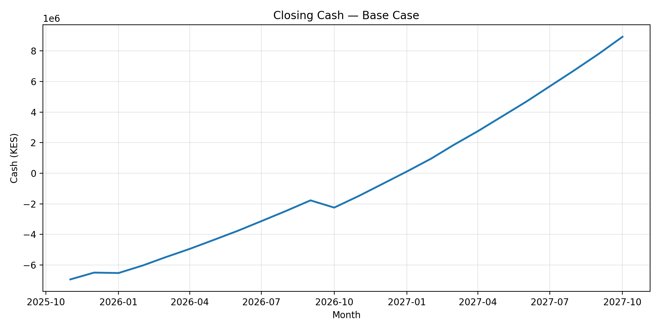
Results: Base Closing Cash

Slide 7
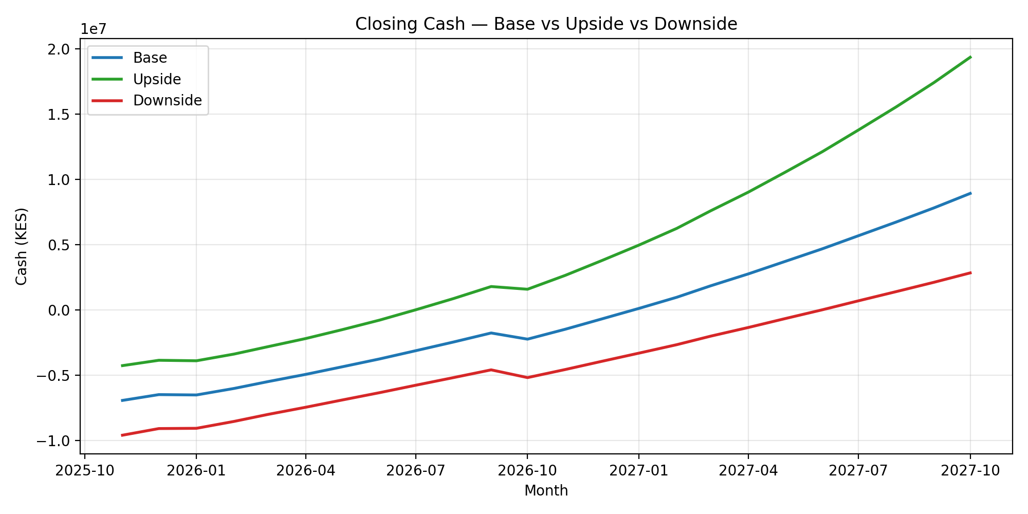
Scenario Comparison: Closing Cash

Slide 8
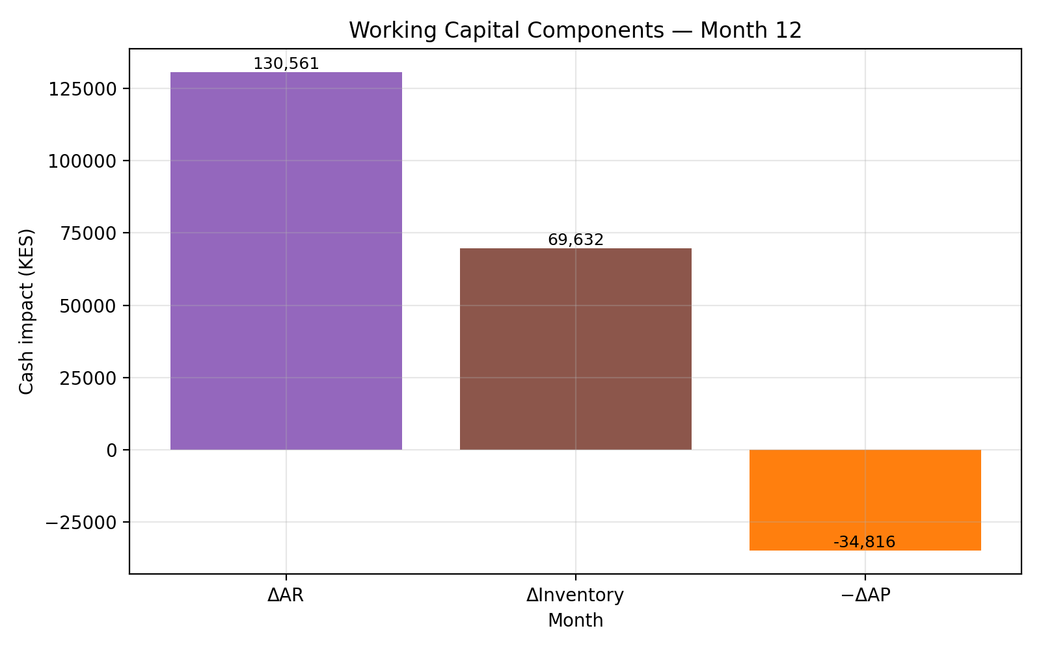
Working Capital Components

Slide 9
Recommendations
Reduce DSO; negotiate DPO
Phase CapEx after trough
Maintain buffer via revolving facility
Update actuals monthly; refresh scenarios quarterly

