Slide 1
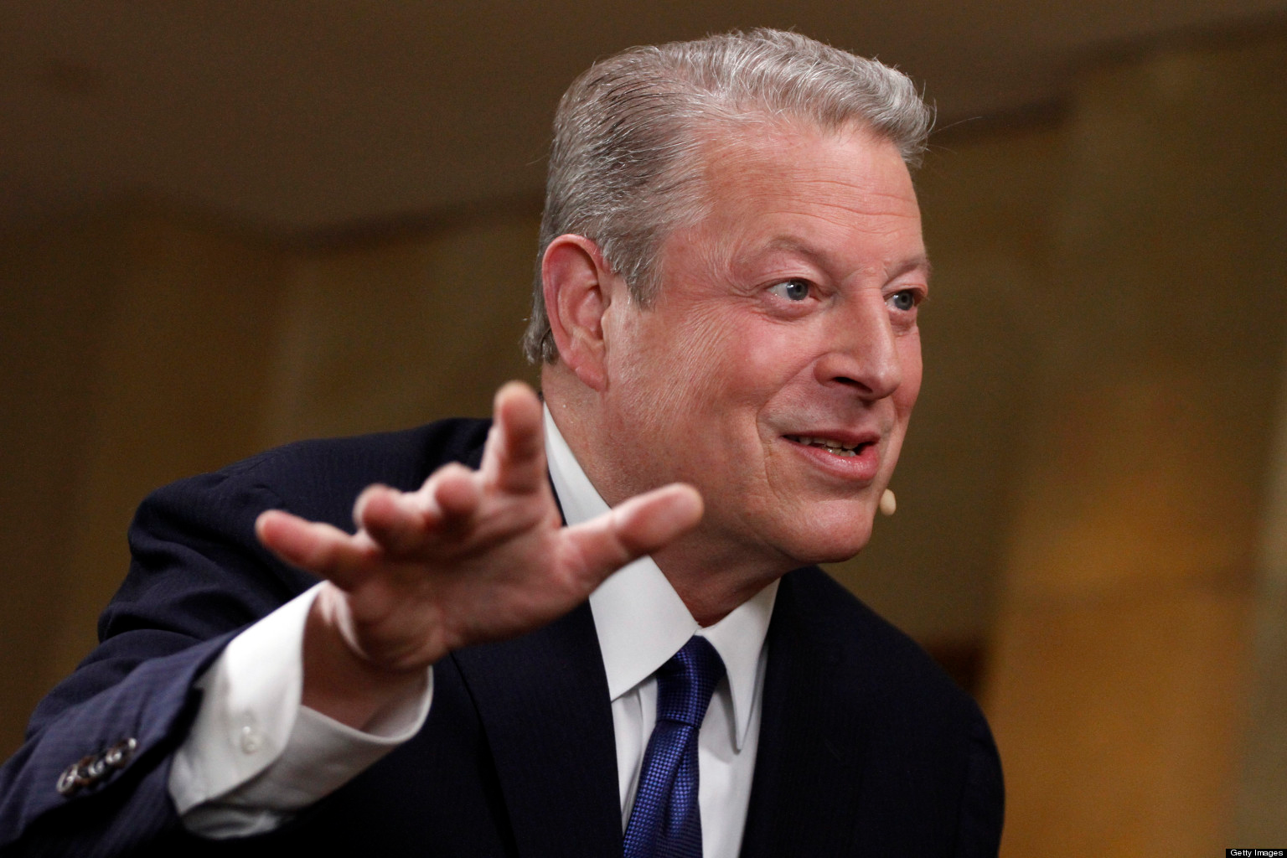
The Information Super Highway

Slide 2
What Is a website?
Any website you look at is more or less just a collection of html, css and javascript that is sent to your browser by some server.
Your browser is just a normal program that displays html documents, styles them with css and runs javascript code.
So what are html, css and javascript?

Slide 3
HTML
HTML stands for hypertext markup language
Hypertext is just a fancy word for text with links.
HTML is a set of computer readable rules you can add to text so a computer can format and add other content to that text.

Slide 4
css
HTML can be styled by using css or california style sheets
CSS allows you to set things like the size, shape, and background color of a box, and the font, size and color of text, as well as many many other things.
We'll see an example coming up

Slide 5
Javascript
Java script is a programming language and it is the only programming language that most browsers understand
The server that writes the html can be in any language but once that code gets sent to the browser, the only code that can still affect it is javascript that you sent with the html.

Slide 6

Let's check it out!

Slide 7
What does it mean to make a website?
Anyone with an internet connection can serve websites
The difficult part is a writing a program on that computer that can listen to formatted web requests(http requests), talk to a database to store and retrieve data, and create html and javascript based off the request that is sent back to the original computer as a website. That's what a web server is.

Slide 8
Where does all the html and css come from?
The websites you view are created by some server somewhere far away. Web servers are regular programs that can run on any computer. These programs figure out what html, css and javascript are needed to display a website to a user, and send it out to them.
Urls are essentially server addresses.
When you go to a url like google.com your computer translates google.com to an ip-address which is the address of some google server and sends a formatted request for the page google has at that location.
Google gets your request, does some processing, and then sends you back the html and javascript that you see as the google home page

Slide 9
Static vs Dynamic Content
Static Content
If your website has the same exact content for every user (think just a plain text document of a poem ) your webserver can just send a prewritten html document back to the user
Dynamic content
If your website needs to act differently for each user (think facebook, twitter, or our website) then your server needs to be a more complex program that can figure out what to serve, usually by running some code and talking to a database

Slide 10
How it basically works
Your Computer
Web Server
Web request
Web Page

Slide 11
But the reality is a little bit More Complicated
Complex modern web sites, don't serve html pages at all. Instead they serve whole javascript programs that create the HTML on the users browser on the fly. When you see something like gmail or facebook that has seemingly limitless content on one page, this is how they achieve it
Identified's website does the same thing with ember.js

Slide 12
API
For this setup, the server acts as what is known as an API.
Instead of serving html an API server only fetches data from the data base. The browser makes request to this API and then has to use it's javascript to figure out what to do with the data on it's own

Slide 13
API's in reality
Multiple clients
Can be open to the public or private

Slide 14
Another Example!

Slide 15
Basics of HTTP
Web requests use the HTTP protocol (Hyper Text Transfer Protocol ). HTTP is a strict format for sending messages between computers over the internet
We only need to understand three pieces of the http format to see how requests are sent and responded to
URL: website.com/something/something_else
Verb:
      GET : Just get some data from the resource specified from the url
      (Viewing your facebook hompage)
      POST: Add some data to the database for the specified resource
      (Writing a new comment or editing an existing comment on facebook)
      DELETE: Delete the resource specified by the URL
  (Deleting your facebook account )
POSTS/ PUTS/ DELETE also have Data: extra data necessary to complete the request
eg: ID = 1

Slide 16
Lets Practice REST
GET to /users
DELETE to bananas/1
POST to users/1/messages
GET to users/347

Slide 17
Lets Practice Rest – part deux
GET to ostriches/1/edit
PUT to ostriches/1
POST to /users/1/messages
DELETE to /users

Slide 18
Questions

