Slide 1
SchoolQA: An assignment-based alternative to Piazza
Andy Negrut

Slide 2
The Problem
Piazza lacks assignment text display.
Reference assignment part with LaTeX or screenshot.
Piazza not assigned by nature.
Bombardment of questions from multiple assignments.
Unorganized and confusing.
One page for all assignment Q's.
See Q’s next to assignment text?

Slide 3
SchoolQA Solution - condensed.
Each assignment, one separate page.
Displayed assignment text on the page.
Highlight pertinent text, type questions nearby.
Click Q, bar pops up right.
Bar appears over previous question area.
Thread with Q&A for clicked queries.
Instructors answer, students view on bar.
Exit bar and select new question.
Slide 7 shows the layout visualized.

Slide 4
Graphics made with available tools for demonstration.

Slide 5
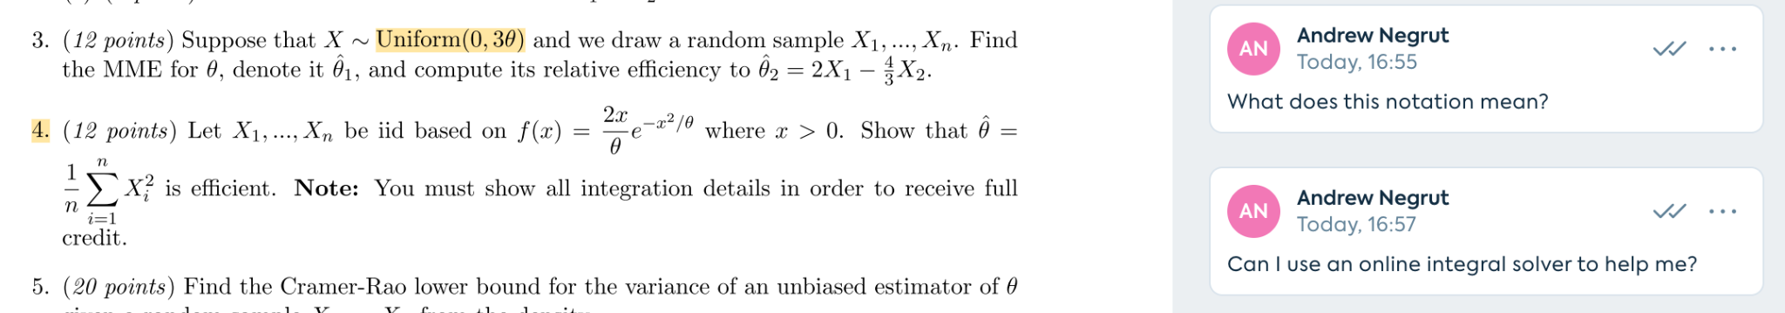
Question Examples
Inquire about a specific problem part.
Regarding the entire problem at hand.

Slide 6
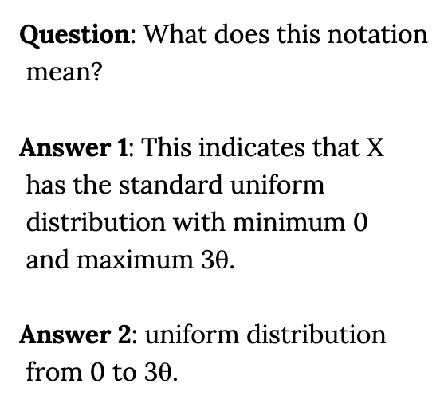
Answer Bar Example

Slide 7
Layout
Assignment Text
Assignment Text
Q2
-Answer
-Answer
-Answer
Q1
Q2
Q3
Viewing Questions
User Clicked on Q2

