Slide 1

Networking and Internet Services(Subnetting Lecture )
Presented by
Omid Panahi

Slide 2
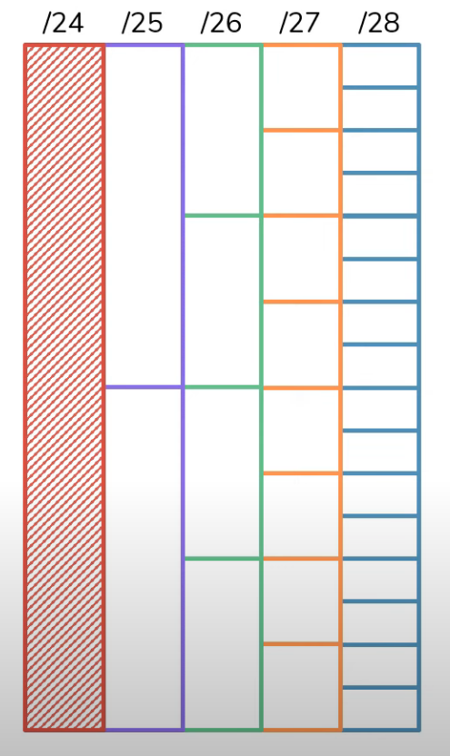
Subnetting divides a large network into small sub networks
Network segmentation helps break down network to small subnet for many reason like security, cost and segregation.

Slide 3
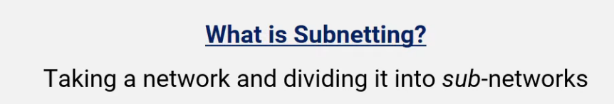
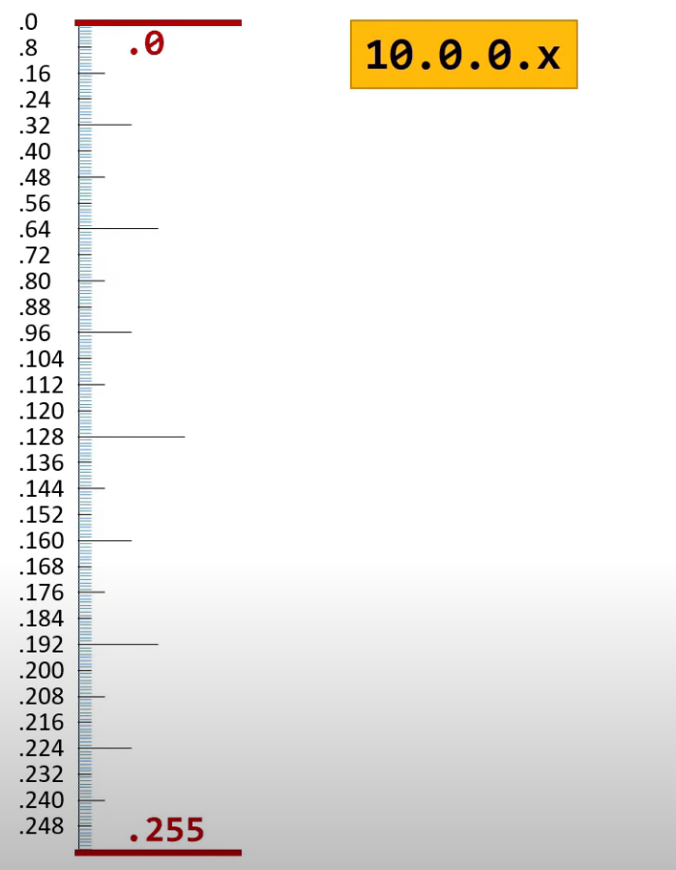
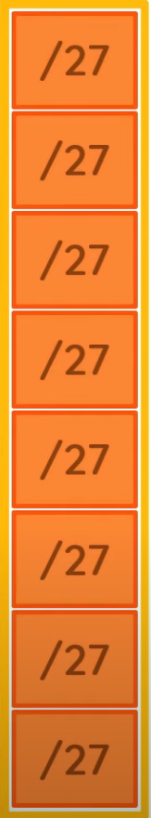
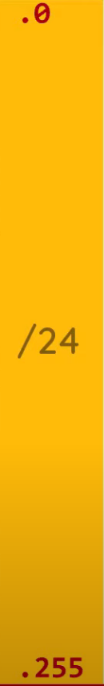
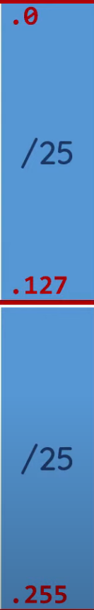
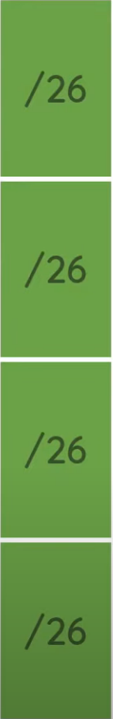
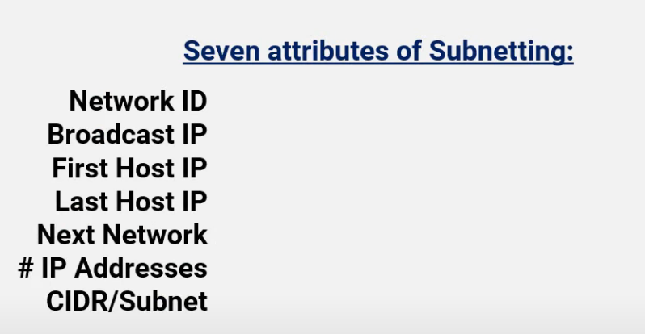
We need to resolve one or more of the following
items
Simply we can divide
Each block to 2.
Notes:
We

Slide 4
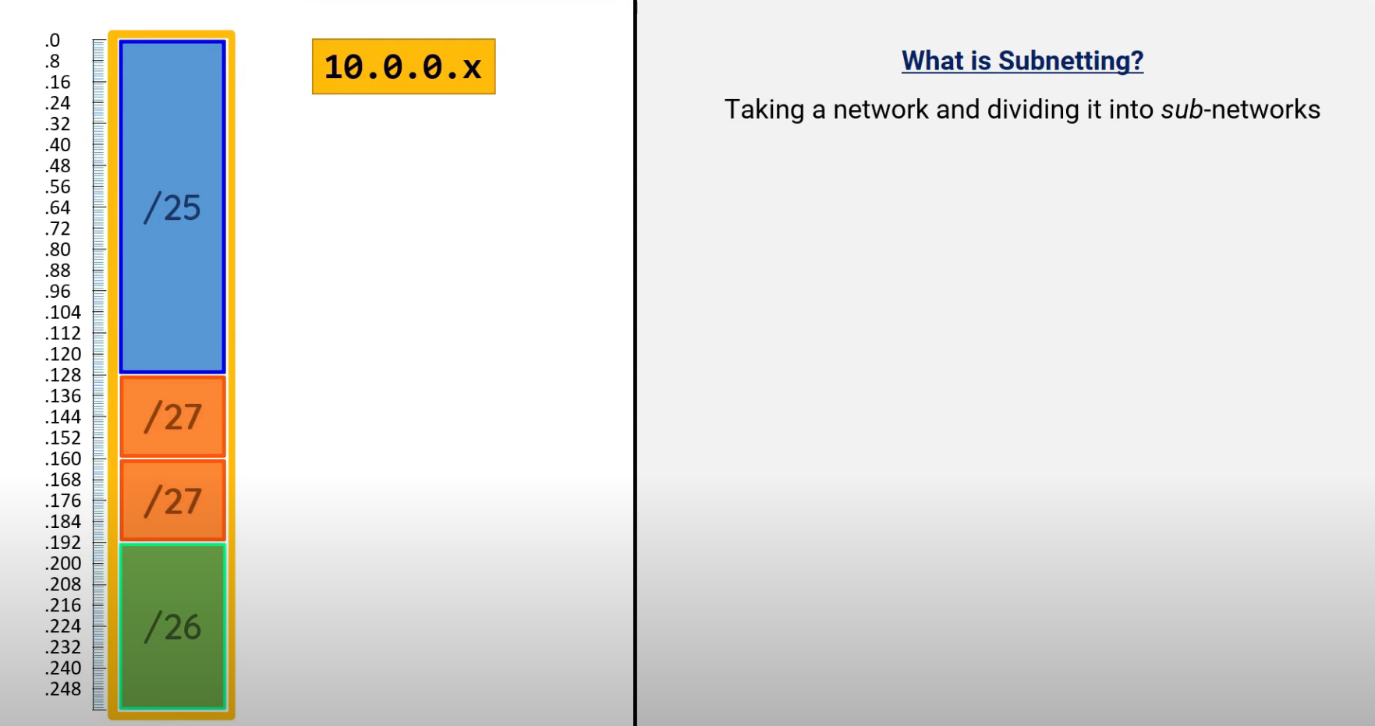
We need to resolve one or more of the following
items
We’ve taken the original /24 and broke it up into one /25 , two /27 and one /26

Slide 5
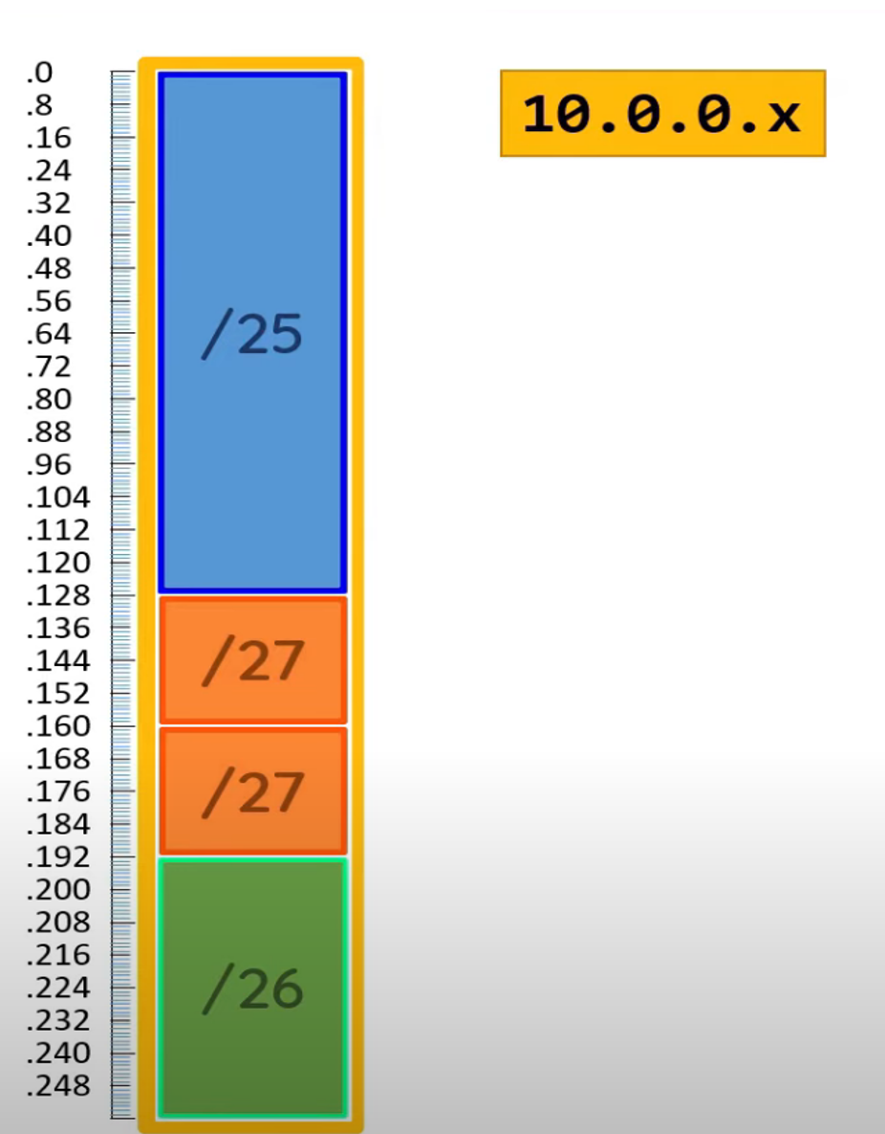
We cannot assign NetworkID and Broadcast IP to any device
Net ID: 10.0.0.0
BC IP: 10.0.0.127
First Host: 10.0.0.1 (Net ID+1)
Last IP: 10.0.0.126 (BC-1)
Next Net: 10.0.0.128 (BC +1)
#Ips= 2^(32-25)=128
Subnet: 255.255.255.128
(126 usable)
Seven attributes of Subnetting:
Network ID:
Broadcast IP:
First Host IP:
Last Host IP:
Next Network:
IP Addresses:
CIDR/Subnet:
Net ID: 10.0.0.128
BC IP: 10.0.0.159
First Host: 10.0.0.129 (Net ID+1)
Last Host : 10.0.0.158 (BC-1)
Next Net: 10.0.0.160 (BC +1)
#Ips= 2^(32-27)=32
Subnet: 255.255.255.224
First IP address in each Sub-Network
Last IP address in each Sub-Network
IP address immediately after Network ID (Net ID +1)
IP address before Broadcast IP (BC-1)
IP address after Broadcast IP (BC +1)
(30 usable)
Number of IP addresses in Sub-network(total number in each block)
Converting between CIDR/Subnet Mask
#Ips= 2^(32-26)=64
Subnet: 255.255.255.192

Slide 6
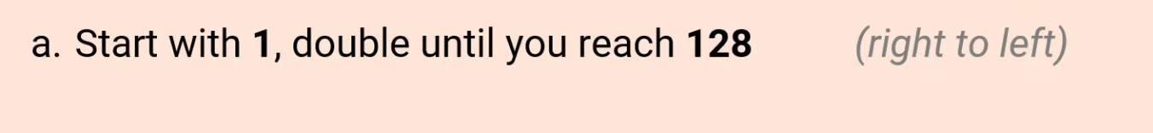

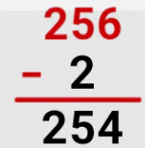
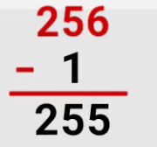
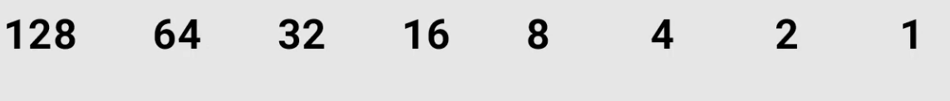
Drawing the table for subnetting

Slide 7
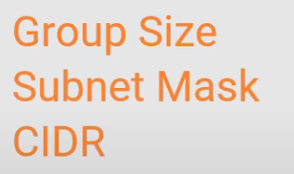
Drawing the table for subnetting

Slide 8
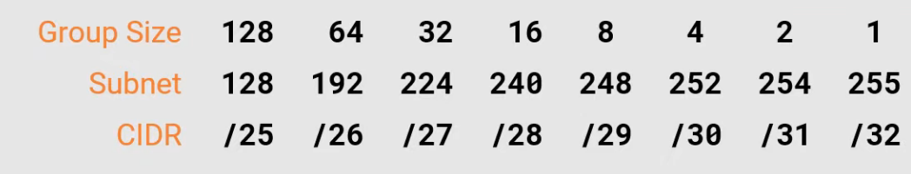
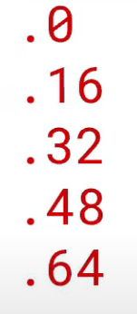
Steps-1: use table to find the right column
  CIDR/Subnet Mask map to each other
  Locate Group size
  Start at .0 in relevant Octet
  Increase by Group Size until you PASS target IP
Step-2: Number before target IP is Network ID
Step-3 : Number After Target IP is the Next Network
Step-4: IP address BEFORE next Network is Broadcast IP
Step-5: IP address after Network ID is the First Host
Step-6: IP address Before Broadcast IP is Last Host
Step-7: Group size is total # of IP addresses
10.1.1.55/28 Target IP
10.1.1.48
Network ID: First IP in each network:
Broadcast IP: Last IP address in each network:
First Host IP: IP address after the network ID:
Last Host IP: IP address before the Broadcast:
Next Network: IP address after Broadcast IP :
IP Addresses: Number of IP addresses in each network:
CIDR/Subnet: Converting between CIDR/Subnet Mask:
10.1.1.63
10.1.1.49
10.1.1.62
10.1.1.64
2^(32-CIDR)=2^(32-28)=2^4=16 (but this is total.
For usable will be 16-2=14
255.255.255.240

Slide 9
10.1.1.37/29
Let’s try this?
Network ID: First IP in each network:
Broadcast IP: Last IP address in each network:
First Host IP: IP address after the network ID:
Last Host IP: IP address before the Broadcast:
Next Network: IP address after Broadcast IP :
IP Addresses: Number of IP addresses in each network:
CIDR/Subnet: Converting between CIDR/Subnet Mask:

Slide 10
10.2.2.20/30
Let’s try this?
Network ID: First IP in each network:
Broadcast IP: Last IP address in each network:
First Host IP: IP address after the network ID:
Last Host IP: IP address before the Broadcast:
Next Network: IP address after Broadcast IP :
IP Addresses: Number of IP addresses in each network:
CIDR/Subnet: Converting between CIDR/Subnet Mask:

Slide 11
10.2.2.199/26
Let’s try this?
Network ID: First IP in each network:
Broadcast IP: Last IP address in each network:
First Host IP: IP address after the network ID:
Last Host IP: IP address before the Broadcast:
Next Network: IP address after Broadcast IP :
IP Addresses: Number of IP addresses in each network:
CIDR/Subnet: Converting between CIDR/Subnet Mask:
Notes:
10.2.2.0 (it will end to 256). It is passes the range 10.2.3.0 . If we need to continue

Slide 12
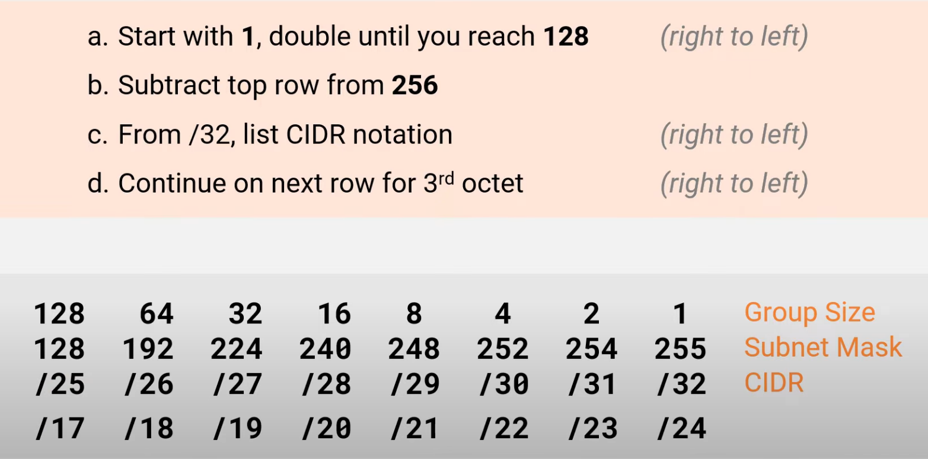
Drawing the table for subnetting for /17- /24 range(3rd octet)

Slide 13
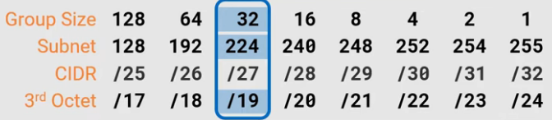
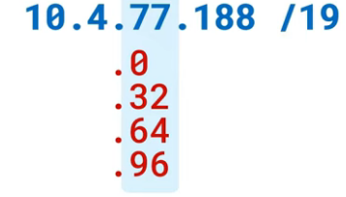
Remember: For subnet mask , you work with 3rd digit and not the last one
Also to find the target IP we will look at 3rd digit in our IP
Subnet Mask/CIDR : Class B : 255.255.224.0
Next Network: 10.4.96.0
Network ID : 10.4.64.0
Broadcast: 10.4.95.255
First Host: 10.4.64.1
Last Host: 10.4.95.254
IP range = 2 ^ (32-CIDR)=2 ^13=8192

Slide 14
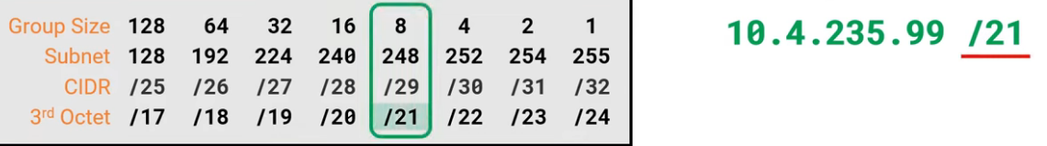
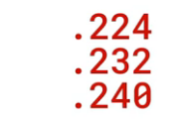


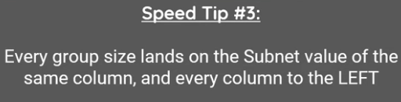
Subnet Mask/CIDR : 255.255.248.0
Next Network: 10.4.240.0
Network ID : 10.4.232.0
Broadcast: 10.4.239.255
First Host: 10.4.232.1
Last Host: 1.4.239.254
IP range = 2^(32-CIDR)=2^11=2048

Slide 15
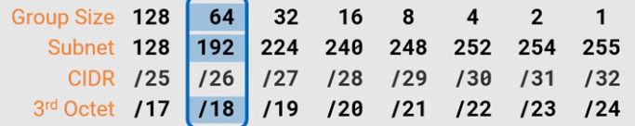

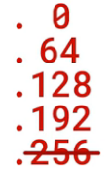
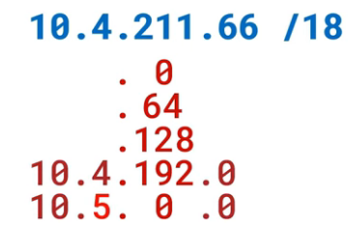
Subnet Mask/CIDR : 255.255.192.0
Next Network: 10.5.0.0
Network ID : 10.4.192.0
Broadcast: 10.4.255.255
First Host: 10.4.192.1
Last Host: 10.4.255.254
IP range = 2^(32-18)= 2^14=16384

Slide 16
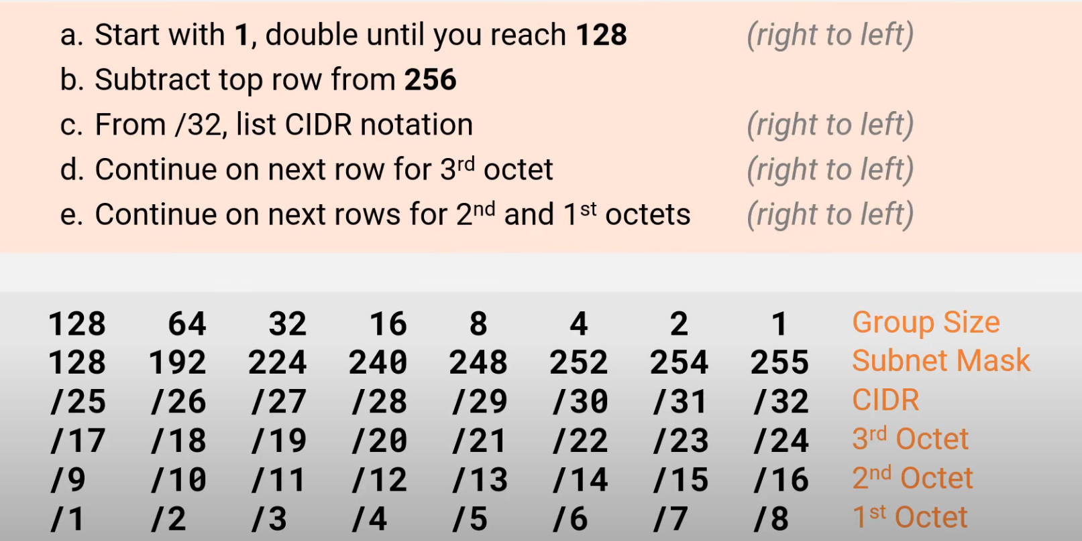

Slide 17
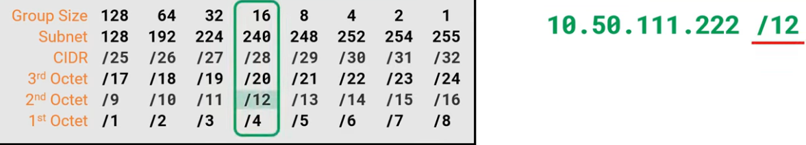
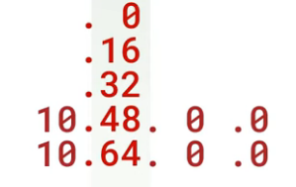
Subnet Mask/CIDR : 255.240.0.0
Next Network: 10.64.0.0
Network ID : 10.48.0.0
Broadcast: 10.63.255.255
First Host: 10.48.0.1
Last Host: 10.63.255.254
IP range = 2^(32-12)=2^20=1024*1024=1048576

Slide 18
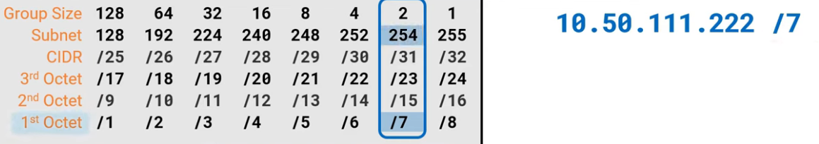
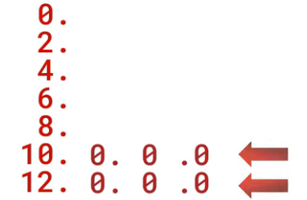
Subnet Mask/CIDR : 254.0.0
Next Network: 12.0.0.0
Network ID : 10.0.0.0
Broadcast: 11.255.255.255
First Host: 10.0.0.1
Last Host: 11.255.255.254
IP range: 2^(32-7)=2^25=33,554,432

Slide 19


