Slide 1

TCP-Protocol
Presented by
Omid Panahi

Slide 2
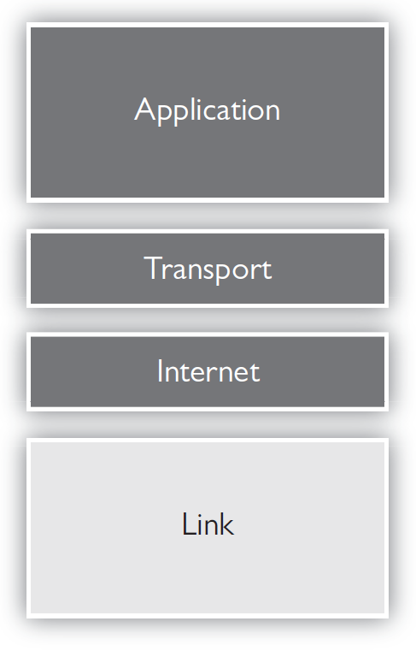
TCPIP Protocol Suite
We will look at the Internet step of the TCP suite
Recall the function of the Internet step (frame vs. packet, MAC vs. IP).

Slide 3
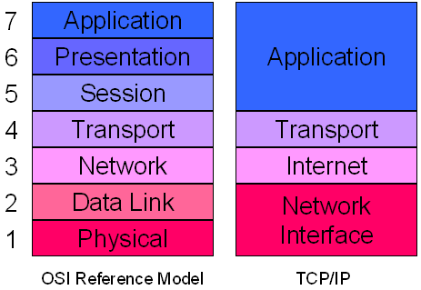
TCP/IP Model
TCPIP MODEL
Divided into 4 Layers
  Application
  Transport
  Internet
  Network Interface

Slide 4
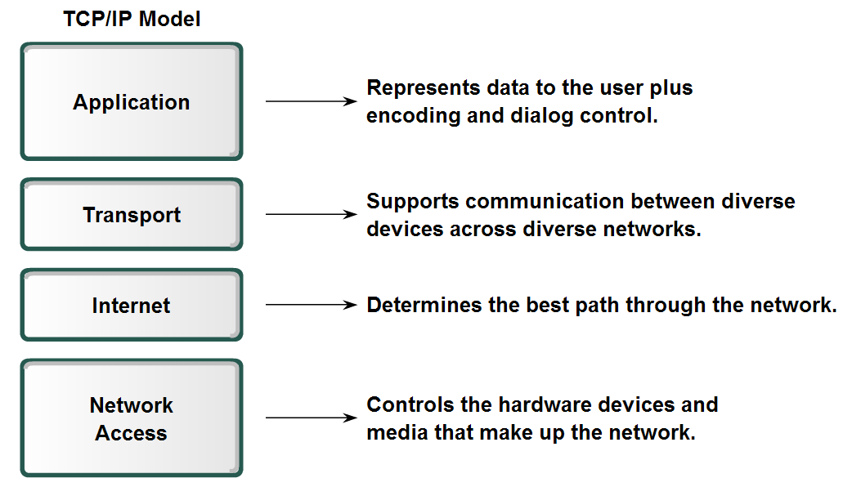
TCP-IP Model

Slide 5
TCP/IP Model Detail 1
Link Layer
  Consists mainly of OSI layers 1,2
  Also called Network Interface
  Not very important in the TCP/IP model
Internet Layer
  Mainly concerned with getting IP packets from source to destination.
  Doesn't care about contents of the packets.
  Doesn't care about ordering of packets.

Slide 6
TCP/IP Model Detail 2
Transport Layer
  Same as OSI transport.
Application Layer
  Uses port number (0-65535)
  Http = 80, 8080
  Same functionality as the OSI Session/Presentation/Application.

Slide 7
TCP/IP Model Detail 2
Transport Layer
  Same as OSI transport.
Application Layer
  Uses port number (0-65535)
  Http = 80, 8080
  Same functionality as the OSI Session/Presentation/Application.

Slide 8
TCP Features
Delivery Acknowledgements
Re transmission
Delays transmission when the network is congested
Easy Error detection

Slide 9
What is the TCP 3-Way Handshake?
The TCP 3-Way Handshake is a fundamental process used in the Transmission Control Protocol (TCP) to establish a reliable connection between a client and a server before data transmission begins. This handshake ensures that both parties are synchronized and ready for communication.

Slide 10
TCP 3-Way Handshake Process
The TCP 3-Way Handshake is a fundamental process that establishes a reliable connection between two devices over a TCP/IP network. It involves three steps:
SYN (Synchronize),
SYN-ACK (Synchronize-Acknowledge),
ACK (Acknowledge).
During the handshake, the client and server exchange initial sequence numbers and confirm the connection establishment.

Slide 11
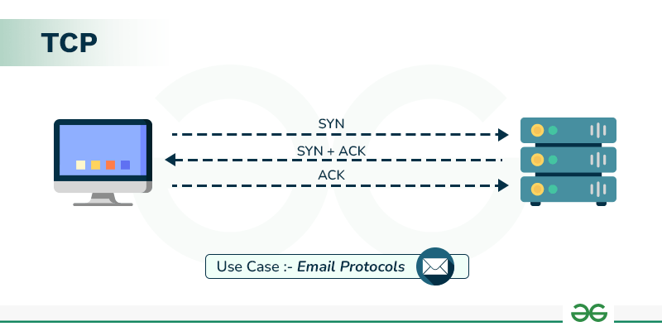
https://www.geeksforgeeks.org/computer-networks/what-is-transmission-control-protocol-tcp/

Slide 12
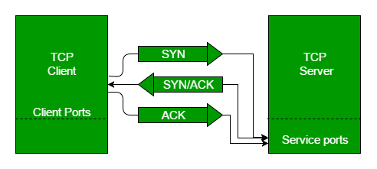

Slide 13
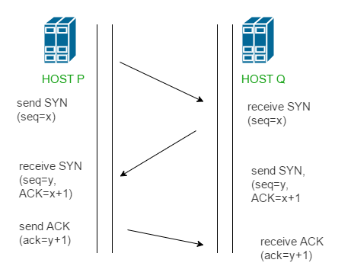
Step 1 (SYN): In the first step, the client wants to establish a connection with a server, so it sends a segment with SYN(Synchronize Sequence Number) which informs the server that the client is likely to start communication and with what sequence number it starts segments with
Step 2 (SYN + ACK): Server responds to the client request with SYN-ACK signal bits set. Acknowledgement(ACK) signifies the response of the segment it received and SYN signifies with what sequence number it is likely to start the segments with
Step 3 (ACK): In the final part client acknowledges the response of the server and they both establish a reliable connection with which they will start the actual data transfer

Slide 14
TCP Segment Structure
A TCP segment consists of data bytes to be sent and a header that is added to the data by TCP as shown:

Slide 15
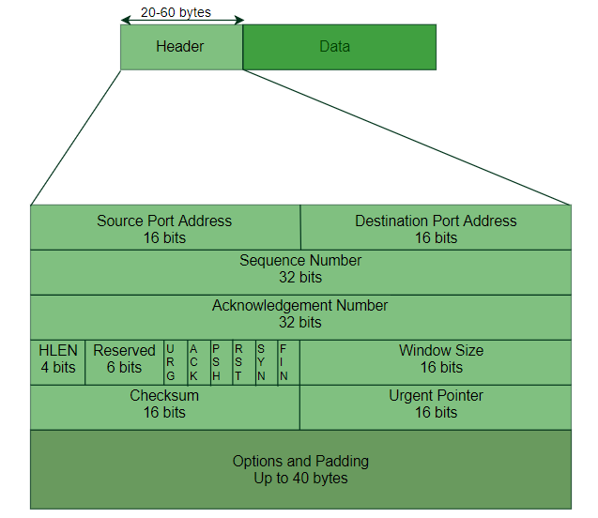

Slide 16
Header fields:
Source Port Address: A 16-bit field that holds the port address of the application that is sending the data segment.
Destination Port Address: A 16-bit field that holds the port address of the application in the host that is receiving the data segment.
Sequence Number: A 32-bit field that holds the sequence number , i.e, the byte number of the first byte that is sent in that particular segment. It is used to reassemble the message at the receiving end of the segments that are received out of order.

Slide 17
CONTINUE..
Acknowledgement Number: A 32-bit field that holds the acknowledgement number, i.e, the byte number that the receiver expects to receive next. It is an acknowledgement for the previous bytes being received successfully.

Slide 18
CONTINUE..
Header Length (HLEN): This is a 4-bit field that indicates the length of the TCP header by a number of 4-byte words in the header, i.e if the header is 20 bytes(min length of TCP header )

Slide 19
Control flags: These are 6 1-bit control bits that control connection establishment, connection termination, connection abortion, flow control, mode of transfer etc. Their function is:
URG: Urgent pointer is valid
ACK: Acknowledgement number is valid used in case of cumulative acknowledgement)
PSH: Request for push
RST: Reset the connection
SYN: Synchronize sequence numbers
FIN: Terminate the connection

Slide 20
Continue…
Window size: This field tells the window size of the sending TCP in bytes.
Checksum: This field holds the checksum for error control . It is mandatory in TCP as opposed to UDP.
Urgent pointer: This field (valid only if the URG control flag is set) is used to point to data that is urgently required that needs to reach the receiving process at the earliest. The value of this field is added to the sequence number to get the byte number of the last urgent byte.

Slide 21
Capture TCP handshake with Wireshark
You can use Wireshark app with filtering either source or destination ip address to see the TCP handshake.
We can look at TCP header and find out all these 3 packets
Also we can use Packet tracer
You can see them in next slides

Slide 22
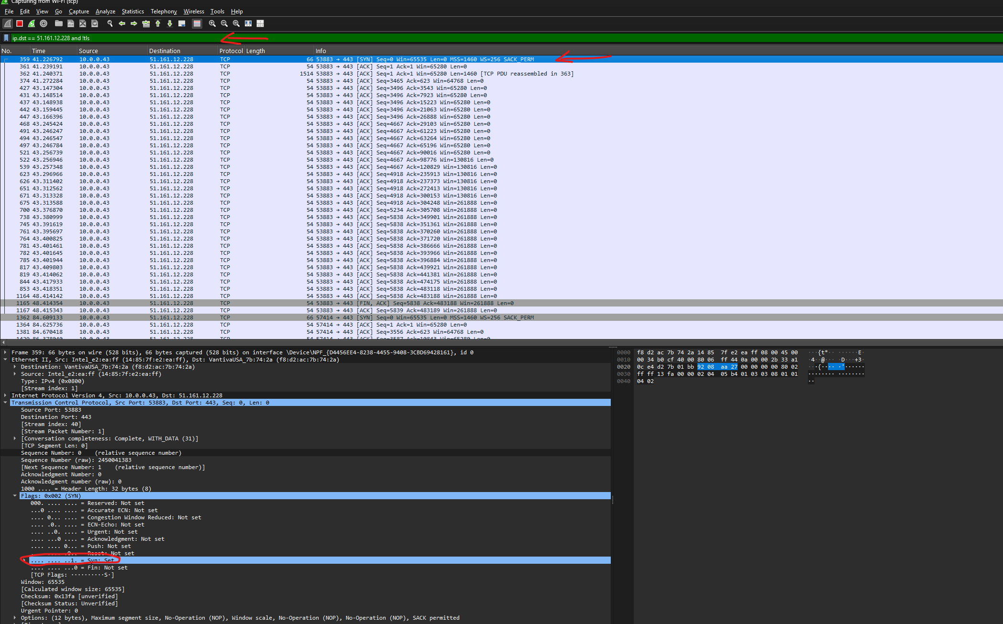
SYN flag

Slide 23
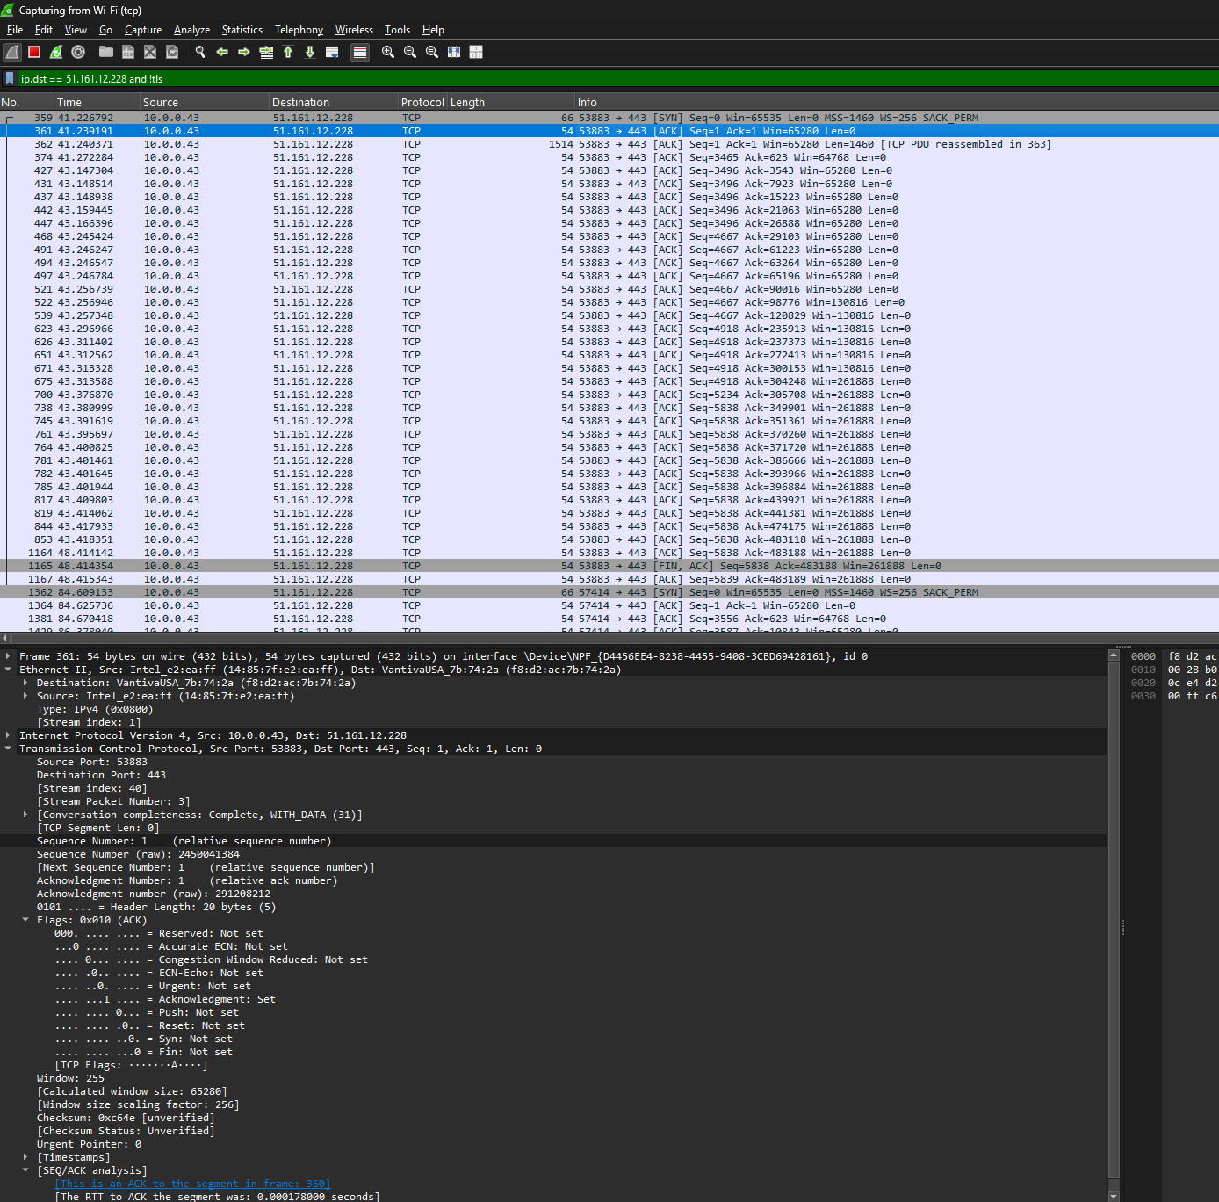
AKC Flag

Slide 24
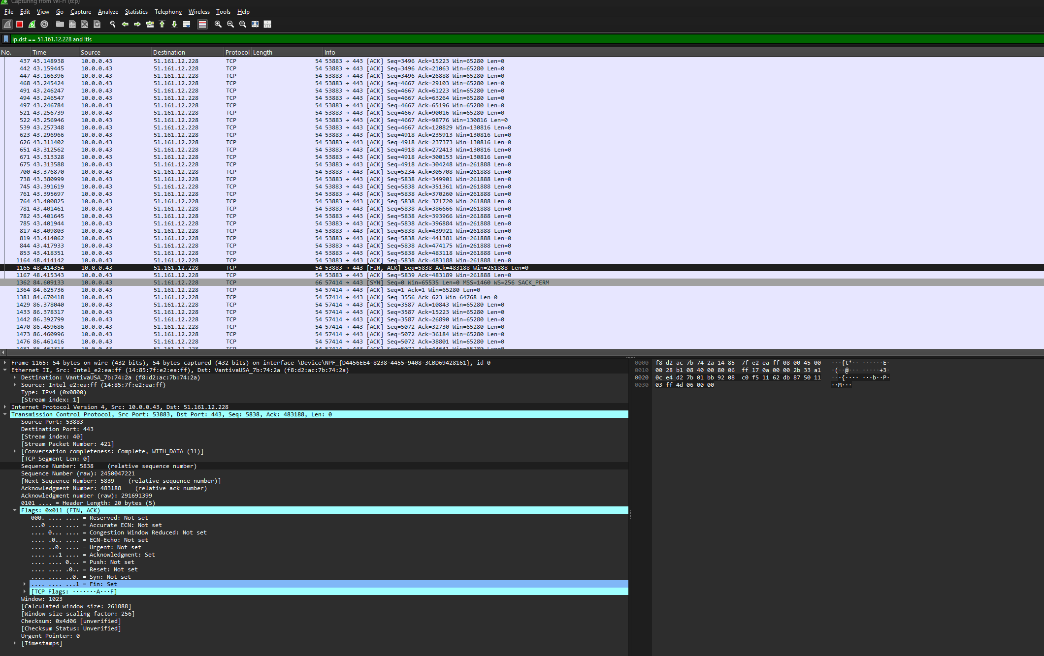
FIN flag

Slide 25
https://www.youtube.com/watch?v=F27PLin3TV0
Watch this video to understand better TCP handshake

Slide 26


