Slide 1
Graph-Based Change Point Detection in fMRI Data
By Andrew Olson Wayne State University M.A. Applied Mathematics April 2026
Advisor: Dr. Xiaoli Kong
MAT 7999 Final Project

Slide 2
Why Use fMRI Data for Graph-Based C-P Detection?
Each time point is a high-dimensional brain state
Graph methods compare observations by similarity
This lets us study changes in multivariate structure
Standard R methods are useful comparisons, but more limited

Slide 3
Experimental Design
20 subjects completed an fMRI neurofeedback experiment
The experiment targeted dynamic facial-expression processing
Subjects imagined different facial expressions
Runs included visual, auditory , and zero feedback
Task blocks give a reason to expect changes over time

Slide 4
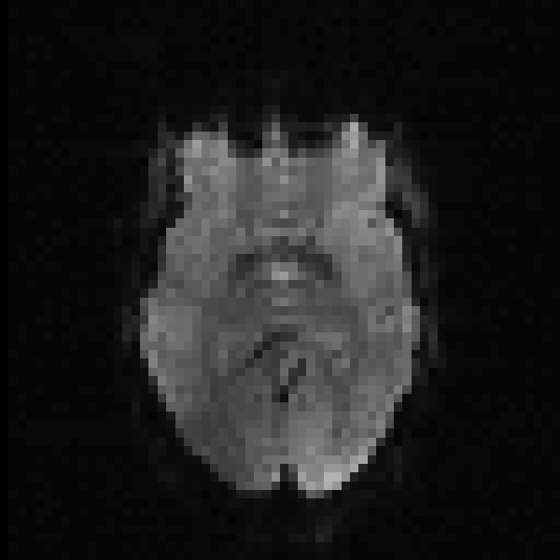
From fMRI Scans to a Time Series
Each run contains 300 brain scans
Each time point contains the collection of
BOLD signals
We perform masking to lose voxels with no contribution
PCA was used before applying change point methods

Slide 5
Data Construction
Load the subject’s BOLD scan from the NIfTY file
nii <- readNIfTI(bold_path, reorient = FALSE)
Extract the 4-dim image array
img <- nii@.Data, (64 x 64 x 33 x 300)
Remove background with masking
mask <- img[,,,1] != 0, (X: 133,056 x 300)
Reshape to time x voxels

Slide 6
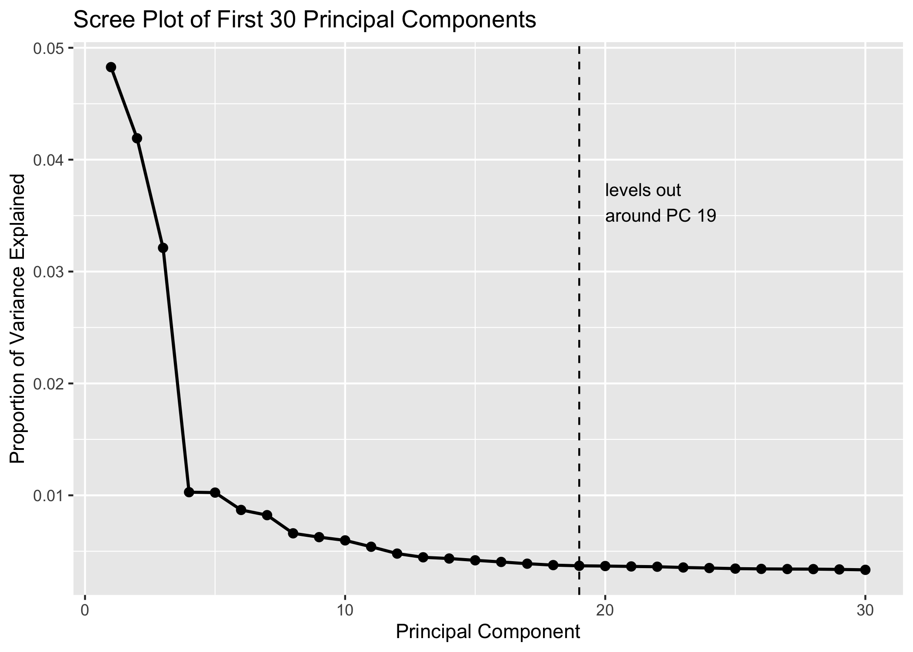
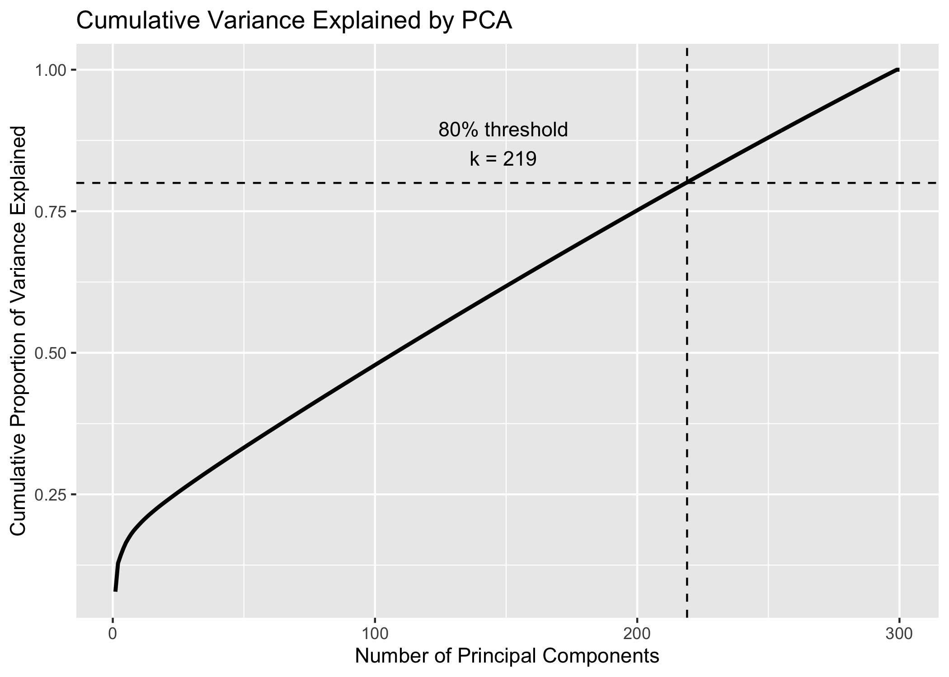
Why Use PCA Before Change Point Detection
Apply pca_fit <- prcomp(X, center = TRUE, scale. = TRUE)
Decided on k = 219 PCs (Z: 300 x 219)!!!

Slide 7
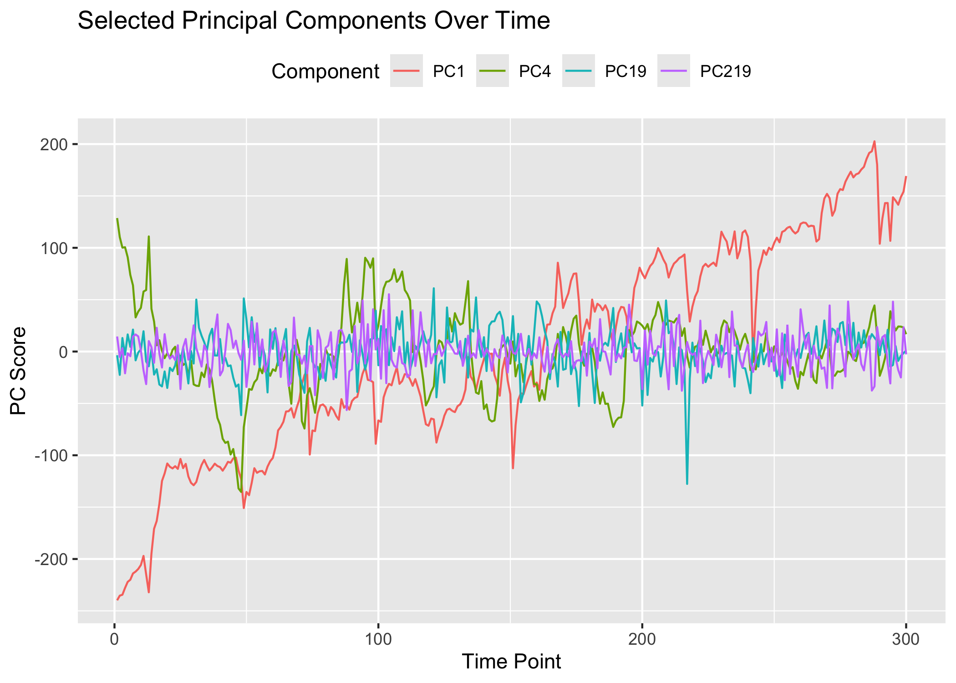
PCA Representation of the fMRI Time Series
Each column of Z is a PC over time
Each PC progressively explains less variance
By PC219, the variation is small and the signal is more stable over time

Slide 8
Comparison with Standard R Methods
Using: Subject 01, no-feedback, run 01
Possible agreement around the mid-160s
 | Method | Input | Result
1 | PELT | PC1 | 126 CPs
2 | BinSeg | PC1 | 15, 60, 162, 197, 249
3 | Energy | First 5 PCs | 31, 62, 92, 133, 163, 198, 242
4 | Kernel/MMD | First 5 PCs | 267

Slide 9
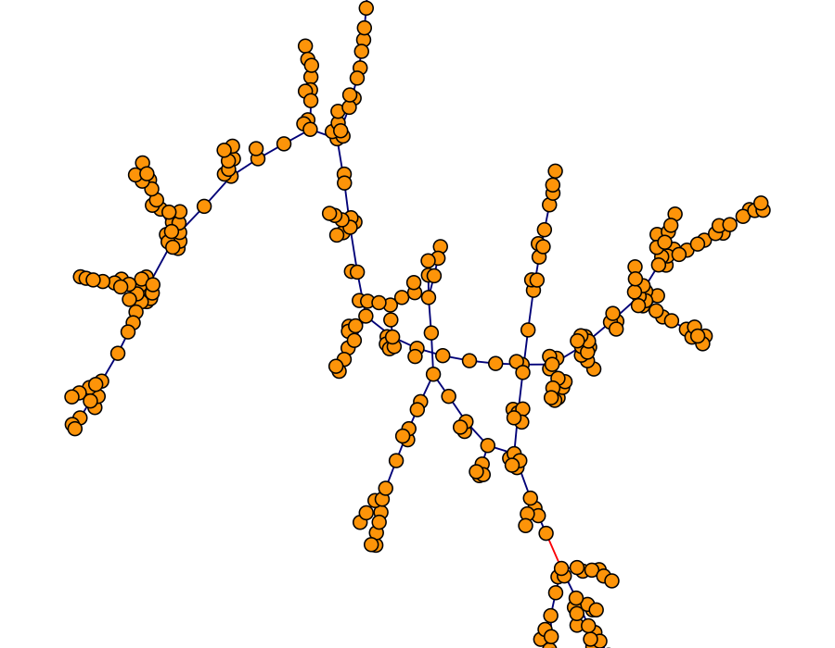
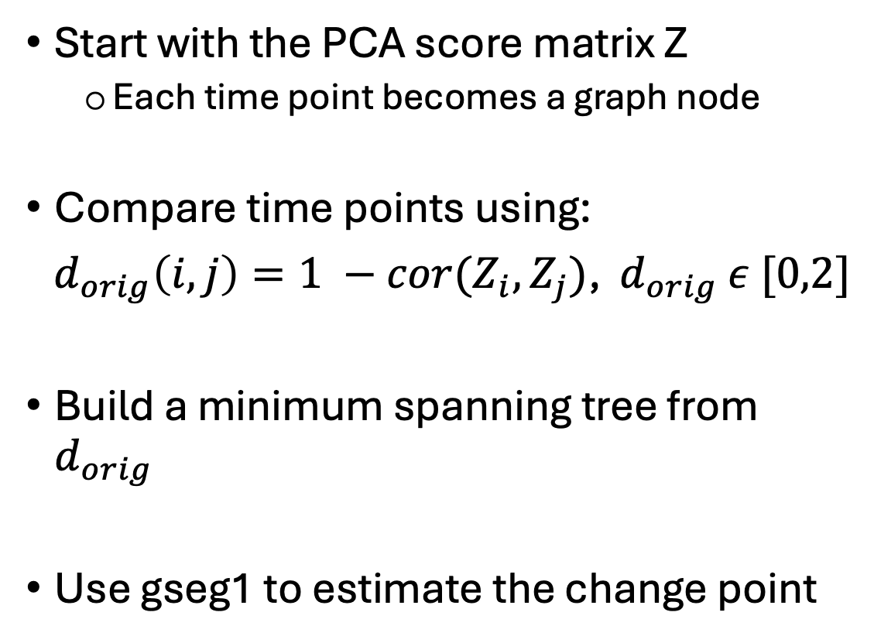
Graph-Based Change Point Detection
Start with the PCA score matrix Z
Each time point becomes a graph node
Compare time points using:
$d_{orig}\left(i,j\right)=1 −cor(Z_{i},Z_{j})$, $d_{orig}$ $ε [0,2]$
Build a minimum spanning tree from $d_{orig}$
Use gseg1 to estimate the change point

Slide 10
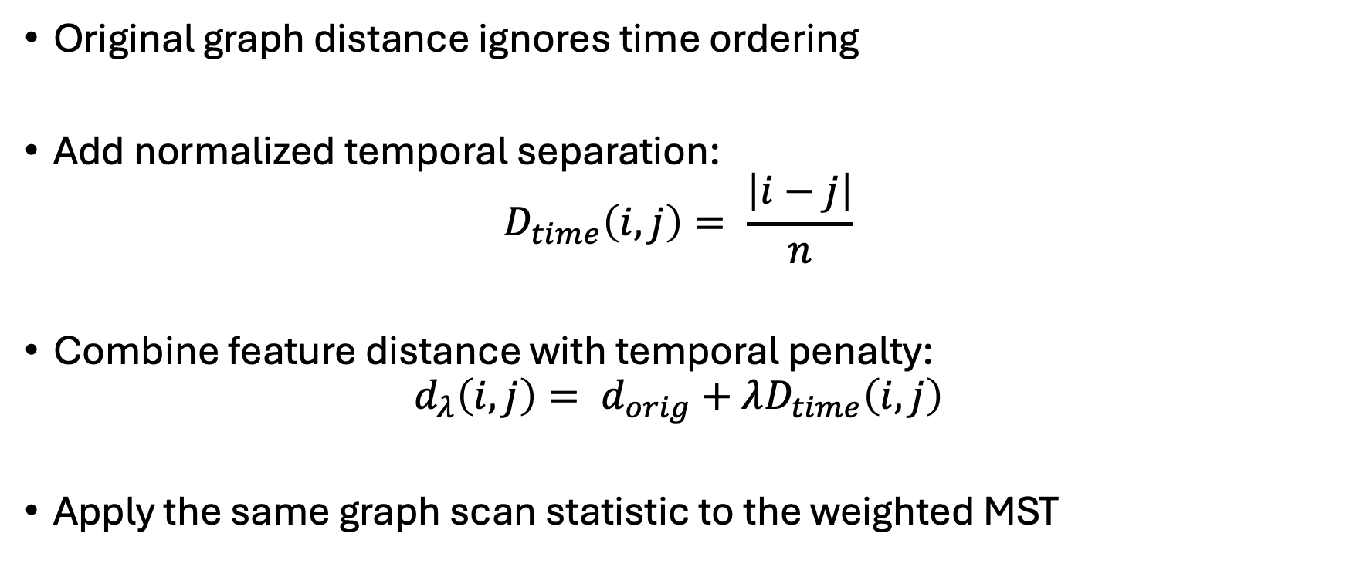
Temporally Weighted Graph Construction
Original graph distance ignores time ordering
Add normalized temporal separation:
$$D_{time}\left(i,j\right)= \frac{\left|i−j\right|}{n}$$
Combine feature distance with temporal penalty:
$$d_{λ}\left(i,j\right)= d_{orig}+λD_{time}\left(i,j\right)$$
Apply the same graph scan statistic to the weighted MST

Slide 11
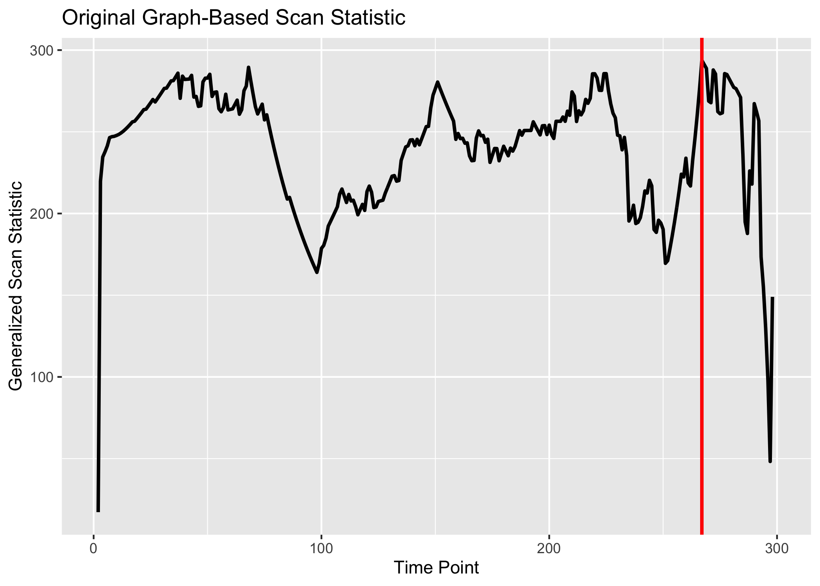

Original Graph-Based Result
Subject 01, no-feedback, run 01
Original graph method estimated ${\hat{τ}}_{orig}=267$

Slide 12
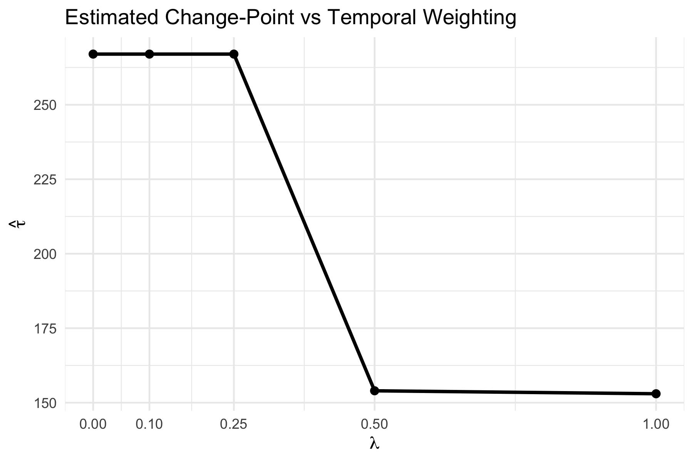



Effect of Temporal Weighting
Estimated change point depends on λ
For $λ≥0.5$, the estimate stabilizes near $\hat{τ}≈154$
$${\hat{τ}}_{orig}=267, p−value= 3.62 x {10}^{−63}$$
$${\hat{τ}}_{temp}=267, p−value=3.79 x {10}^{−63}$$

Slide 13
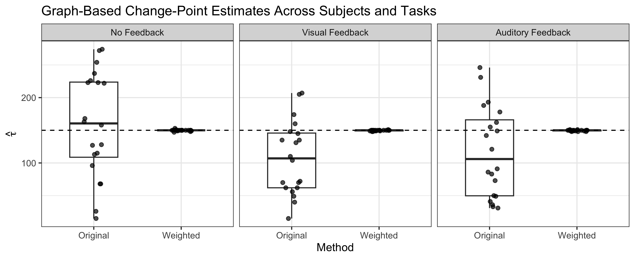
Estimated Change Points Across Tasks and Subjects
Temporal weighting improves stability across tasks
reduces variability in $\hat{τ}$

Slide 14
Interpreting Results in the Experiment Context
Change point indices were converted into experiment time
A 6-second delay was used to compare estimates with task blocks
Estimate | tauhat | Scan time (sec) | Delay_adjusted (sec) | Onset | Block location | Interpretation
Original | 267 | 532 | 526 | 504 | Start of 23 | Late-run change
Weighted | 150 | 298 | 292 | 288 | Start of 13 | Mid-run change
Stabilized weighted | 154 | 306 | 300 | 288 | Middle of 24 | Mid-run change

Slide 15
Limitations and Future Work
Limitations
Change points did not line up exactly with task blocks
Method depends on PCA dimension choice (k)
Future Work
Apply to other fMRI datasets to validate findings
Explore adaptive or data-driven λ selection

Slide 16
Conclusion
Developed a graph-based change point method for fMRI data
Temporal weighting stabilized change point estimates
Results suggest mid-run shifts in brain activity patterns
Without temporal weighting, distant brain states appear more similar
This method opens new avenues for fMRI change point research

