Slide 1
Structural Change Detection Using Supervised Learning Residuals
By Andrew Olson
STAT 5080 Project
Professor: Dr. Yan Wang
Spring 2026

Slide 2
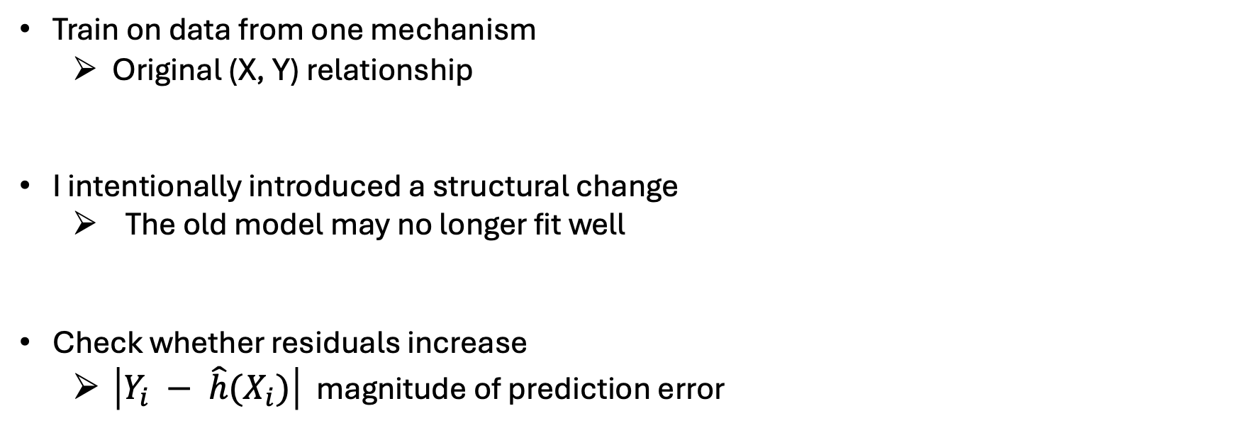
Project Question
Can prediction errors reveal a structural change?
Train on data from one mechanism
Original (X, Y) relationship
I intentionally introduced a structural change
The old model may no longer fit well
Check whether residuals increase
$\left|Y_{i} − \hat{h}(X_{i})\right|$ magnitude of prediction error

Slide 3

Supervised Learning Framework
$$\hat{h} :X →Y$$
$$\left|Y_{i} −\hat{h}(X_{i})\right|$$
Goal: Use features X to predict a response Y
Choose a model class then learn a predictor
Calculate prediction quality
Larger residuals may indicate structural change
Learned predictor
Absolute residual

Slide 4
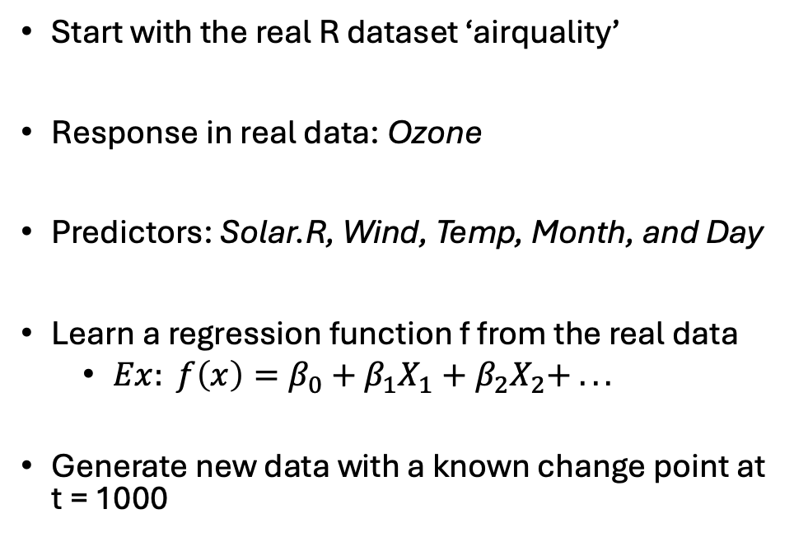

Data Construction
Start with the real R dataset ‘airquality’
Response in real data: Ozone
Predictors: Solar.R, Wind, Temp, Month, and Day
Learn a regression function f from the real data
$Ex: f\left(x\right)=β_{0}+β_{1}X_{1}+β_{2}X_{2}+ . . .$
Generate new data with a known change point at t = 1000
Unchanged mechanism:
$Y_{i} =f\left(X_{i}\right)+ ε_{i}, i \text{≤}\text{ 1000}$
Changed mechanism:
$$Y_{i}=g\left(X_{i}\right)+ε_{i}, i >1000,$$
where $g\left(X_{i}\right)=f\left(X_{i}\right)+change$

Slide 5
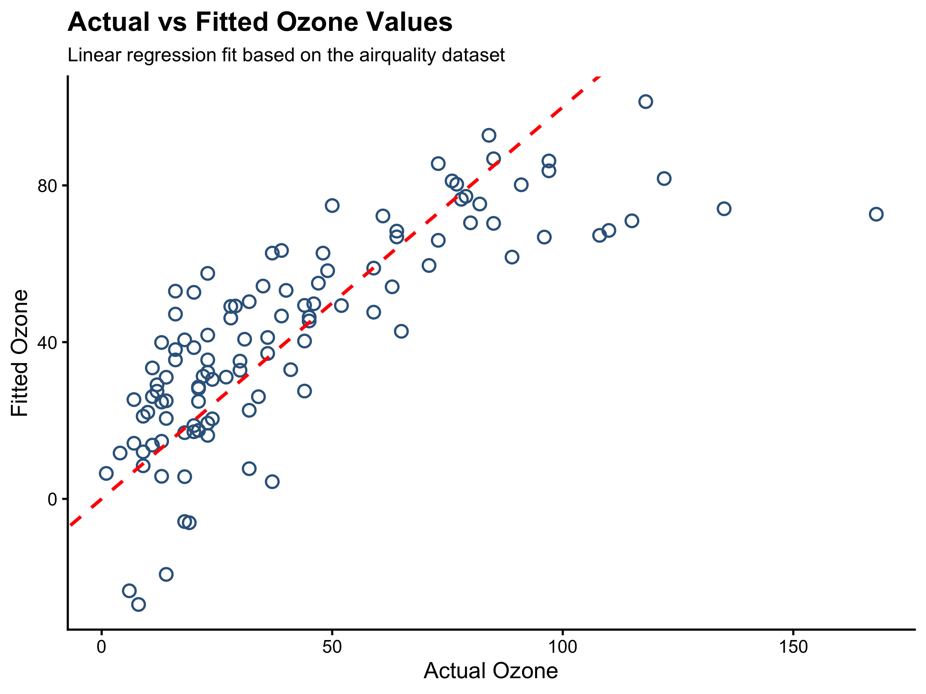
Learning the Baseline Function
Cleaned airquality dataset: 111 observations
Model: linear regression
Adjusted R^2 = 0.607
61% of ozone explained
Fitted model becomes the baseline function f
*f(x) = -64.12 + 0.0503 × Solar.R - 3.32 × Wind + 1.90 × Temp - 3.04 × Month + 0.27 × Day.

Slide 6
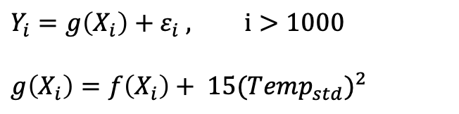


Constructing a Known Change Point
$$Y_{i}=g\left(X_{i}\right)+ε_{i} , i>1000$$
$$g\left(X_{i}\right)=f\left(X_{i}\right)+ {15({Temp}_{std})}^{2}$$
$${f(X}_{i})$$
$$Y_{i} =f\left(X_{i}\right) +ε_{i}, i≤1000$$
Use the fitted model f as the baseline relationship
Generate 2000 observations with known change point
After t = 1000, replace f with our modified function g
Finally, check whether prediction errors increase after the change

Slide 7
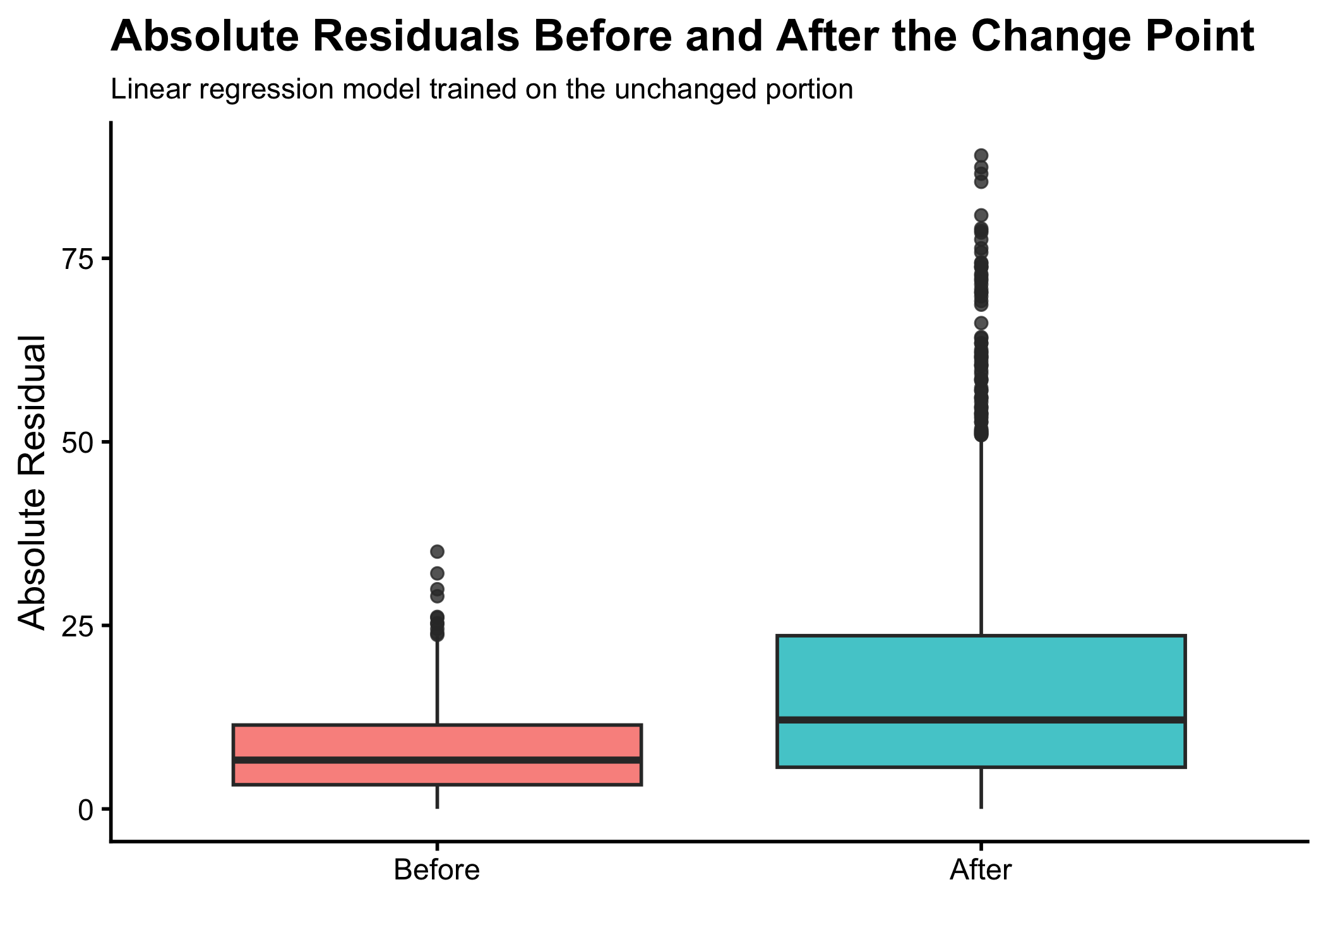
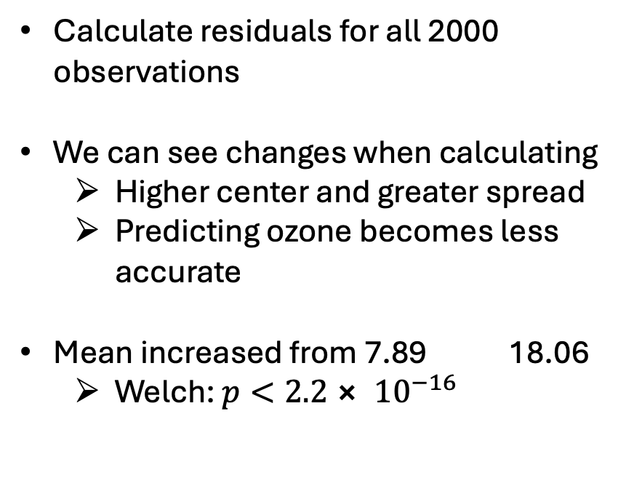
Residuals Before and After the Change Point
Calculate residuals for all 2000 observations
We can see changes when calculating
Higher center and greater spread
Predicting ozone becomes less accurate
Mean increased from 7.89 18.06
Welch: $p<2.2⨯ {10}^{−16}$

Slide 8
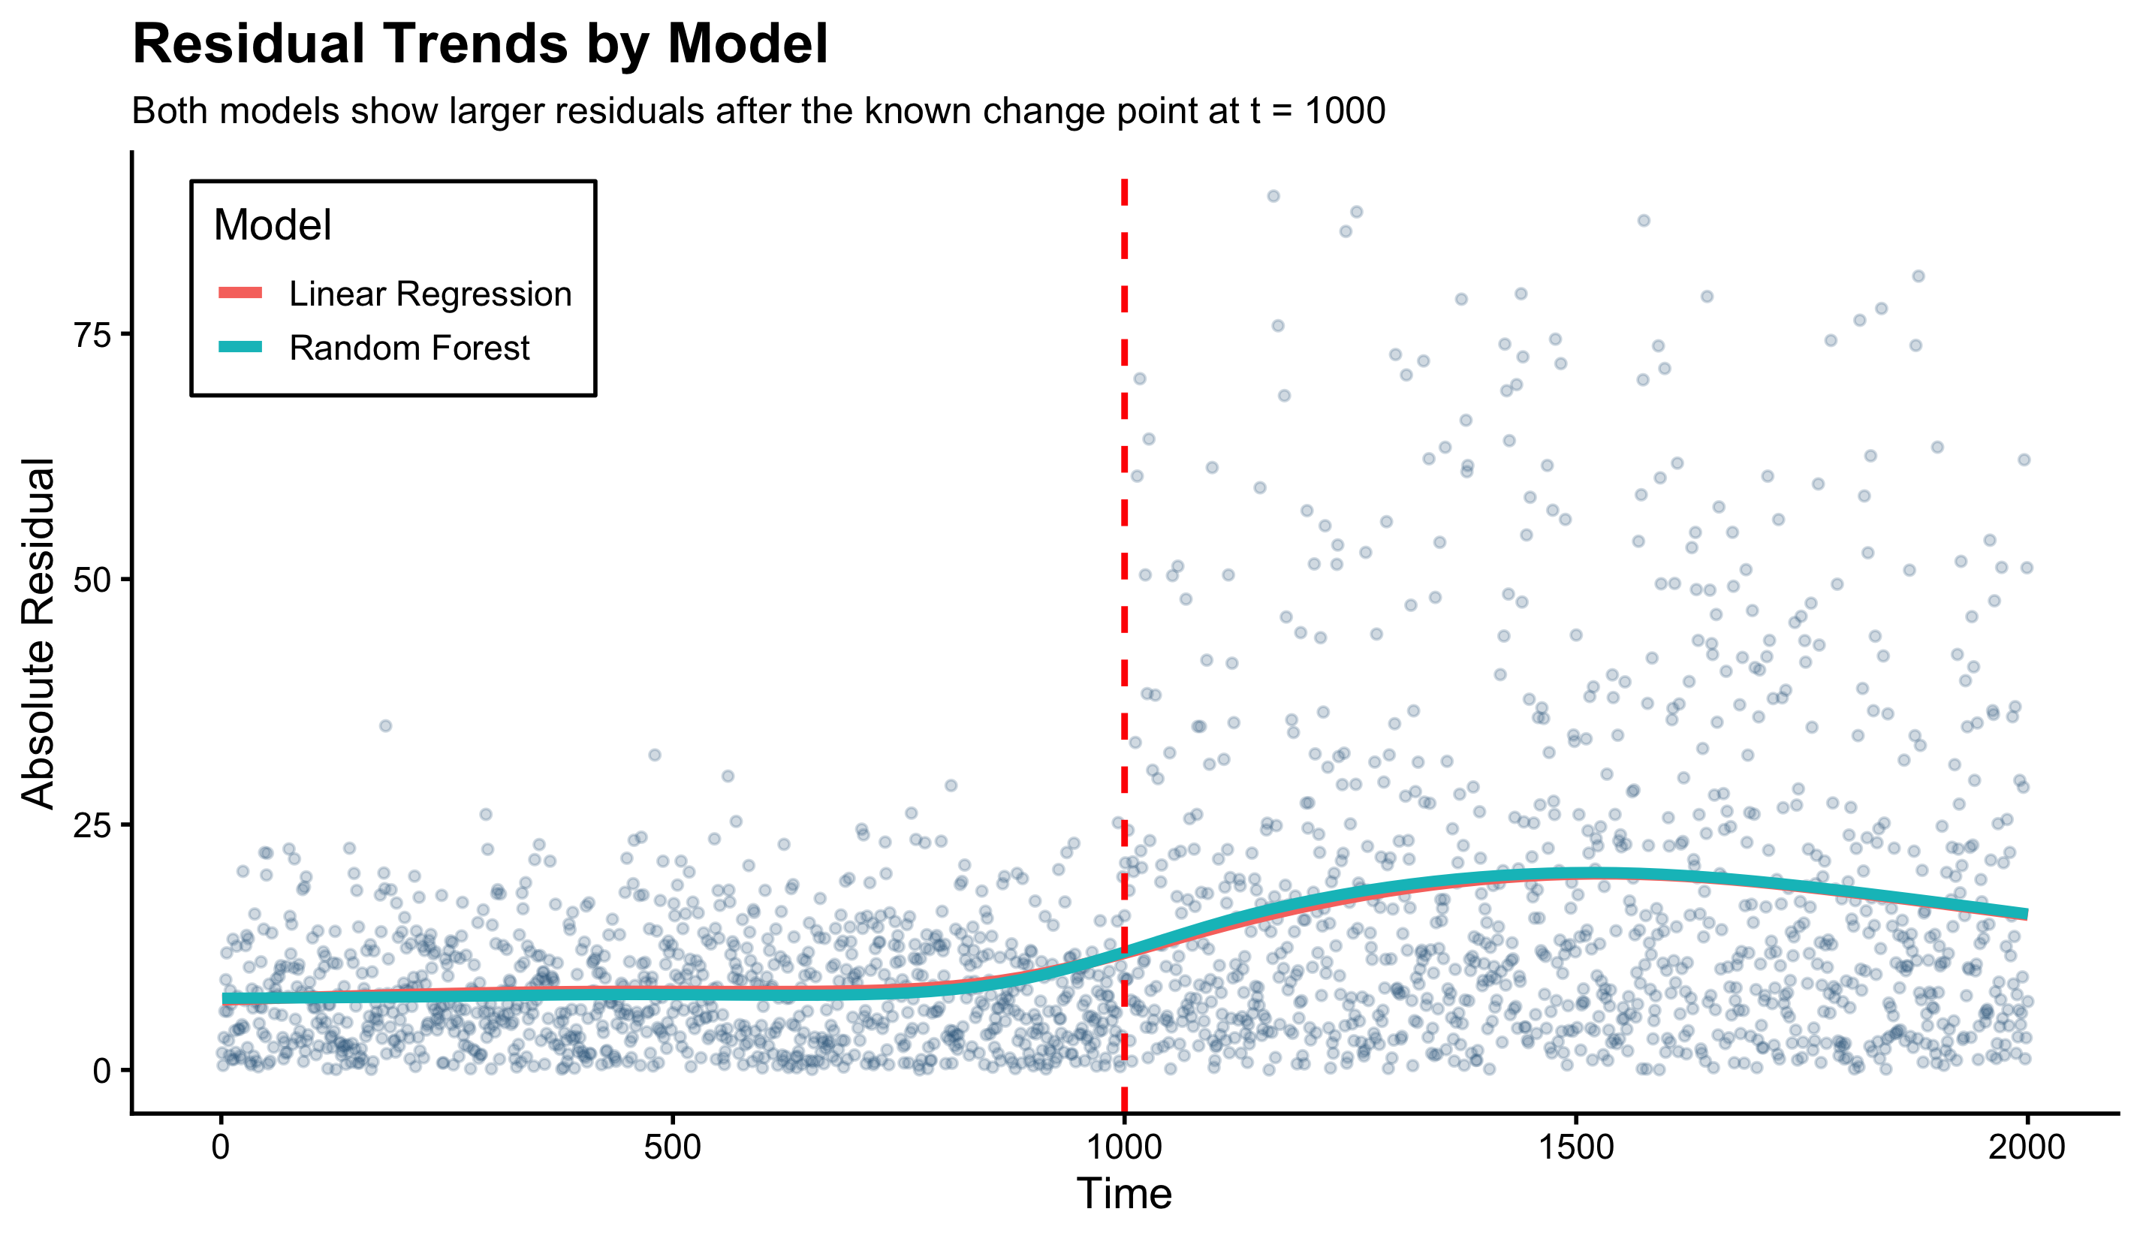
Model Comparison
Fit two models on the unchanged period
LR is simple and interpretable
RF is more flexible
Both show a similar increase
LR: 10.17
RF: 10.69

Slide 9
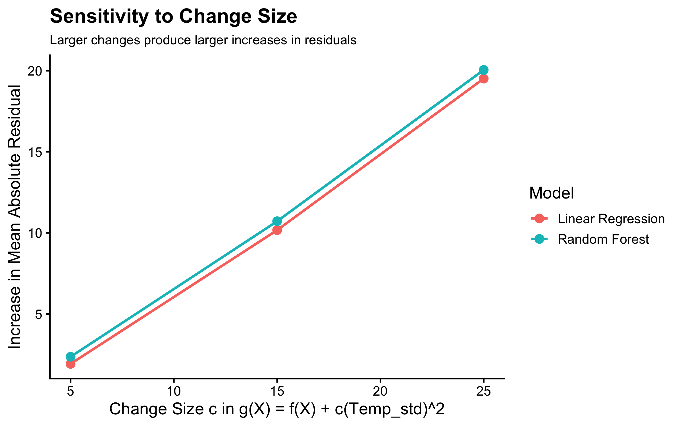
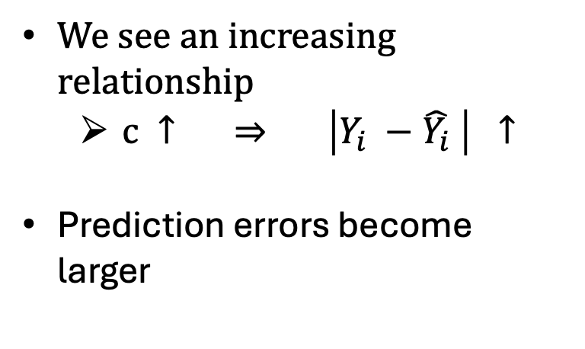
Sensitivity to a Greater Structural Change
We see an increasing relationship
$c ↑ ⇒ \left|Y_{i} −\hat{Y_{i}} \right| ↑$
Prediction errors become larger

Slide 10
Conclusion
We learned a baseline function f from real air quality data
Checked the model will detect a structural change
Takeaway: we now have a model for future analysis
Future work: run this model on future data

