Slide 1
Research and Analysis on Graph Pooling
Bowen Pei

Slide 2
Pooling layer in CNN
Function:
(1) Retaining the main features while reducing parameters (lowering latitude, similar to PCA) and calculations to prevent overfitting
(2) Invariance, this invariance includes translation, rotation, scale
——> Preserve the graph structure

Slide 3
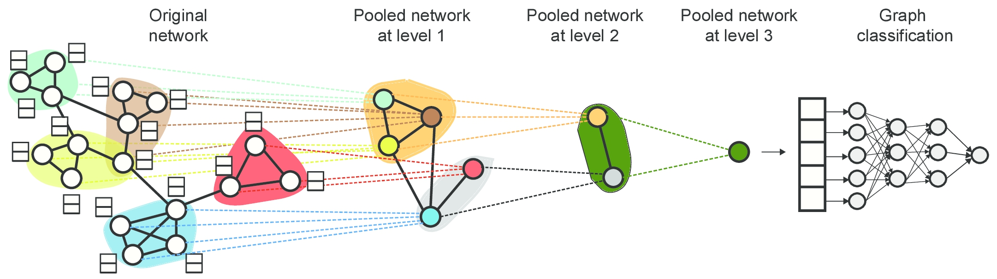
Pooling
Schematic diagram

Slide 4
Notations：
G = {E, V},
V = {v₁, . . . ,v_{N} } is the set of N nodes
E is the set of edges.
Adjacency matrix A ∈ R^{N ×N} .
Node feature matrix X ∈ R^{N ×d} , d is the dimension of features.
Node embedding matrix Z ∈ R^{N ×d}

Slide 5

DiffPool
Assignment matrix
Note that these two GNNs consume the same input data but have distinct parameterizations and play separate roles.
Computational performance:
×Storage complexity: O（k|V|^2）
×Time complexity: O（k|V|^3）where V and k denote vertices and pooling ratio

Slide 6
DiffPool
Pros:
(a) It can generate hierarchical representations of graphs.
(b) It can be combined with various graph neural network architectures in an end-to-end fashion.
Cons:
(a) ×The number of clusters has to be chosen in advance, which might cause performance issues when used on datasets with different graph sizes.
(b) ×Since cluster assignment is based only on node features, nodes are assigned to the same cluster based on their features, ignoring distances.
(c) ×The cluster assignment matrix is dense and the complexity is large.

Slide 7
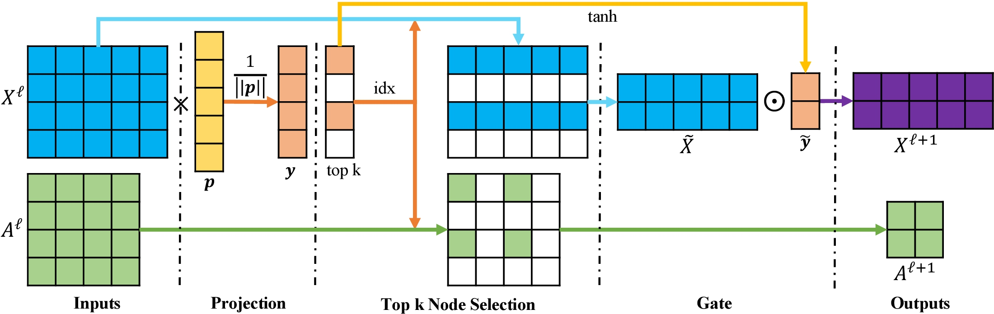
TopKPool
Schematic diagram

Slide 8
TopKPool
Pros:
(a) ×Sparse, the computational complexity is reduced to O(|E|). Storage complexity: O(|V|+|E|) where V , E, and k denote vertices, edges, and pooling ratio, respectively
(b) ×Variable in graph size.
Cons:
(a) ×Adding nodes to a graph can change the pooling result of the whole graph. (locally dependent)
(b) Whole areas of a graph might see no node chosen, which causes loss of information.

Slide 9
SAGPool
A variant of TopKPool, SAGPool no longer uses only node features to compute node scores but uses graph convolutions to take neighbouring node features into account.
The self-attention score Z ∈ R^{N×1} is calculated as follows:
The top k*N nodes are selected based on the value of Z.

Slide 10
SAGPool
Pros:
(a) Sparse, the same complexity
(b) ×It can be both H architecture and G architecture. Therefore, it can be used to learn both many vertexes and few vertexes graph.
Cons:
(a) ×Adding nodes to a graph can change the pooling result of the whole graph. (locally dependent)
(b) ×Cannot parameterize the pooling ratios to find optimal values for each graph.

Slide 11
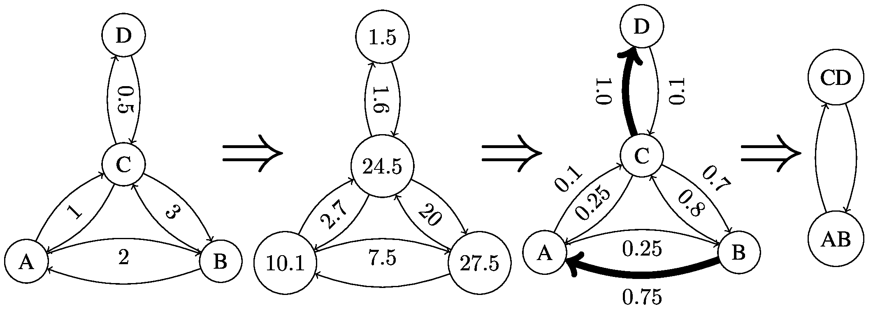
EdgePool

Slide 12
EdgePool
Based on edge contraction
1) Choosing edges. For an edge from node i to node j, we compute the raw score r as
Where n_{i} and n_{j} are the node features and W and b are learned parameters.
2) Computing new node features:
3) ×Integrating edge features:

Slide 13
EdgePool
Pros:
(a) ×Both runtime and memory scales linearly in the number of edges.
(b) ×Locally independent: As long as the node scores of two nodes n_{i} and n_{j} and of their neighbours do not change (by changing nodes within the receptive fields), the choice of edge e_{ij} will not change.
Cons:
(a) Fixed pooling ratio. (50%)

Slide 14
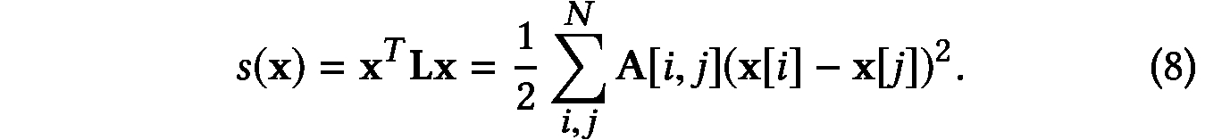
EigenPool
1) Graph Coarsening: we adopt spectral clustering to obtain the subgraphs.
2) Transform the original graph signal information into the graph signal defined on the coarsened graph:
Based on local graph Fourier transform
Define the smoothness:
......
Too much math, so omit

Slide 15
EigenPool
Pros:
(a) Can extract subgraph information utilizing both node features and structure of the subgraph.
Cons:
(a) Code not available.
(b) Locally dependent.

Slide 16
THANKS!

