Slide 1
Brain Hemorrhage Detection
G-0053: Andrew Pham, Khang Duc Duy Huynh, Sebastian Duran, Stephanie Snow

Slide 2

Overview
G-0053
The human brain, the most complex and crucial organ we have, serves as the command center for the entire body controlling how we move, respond, and think. Brain hemorrhages, otherwise known as a brain bleed, is a serious condition that could possibly be fatal if left untreated. It is estimated that there are approximately 40,000 to 67,000 brain hemorrhages every year in the United States. Mortality can range from 51% to 65% within the first year, with half of these deaths happening in the first two days. Because of this, accurately identifying a hemorrhage is pivotal for the life and well being of the patient.

Slide 3
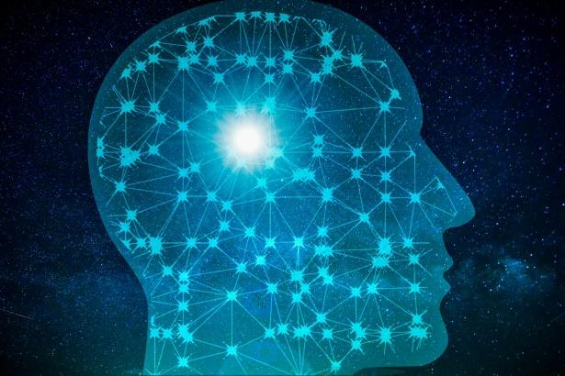
Background
G-0053
Scope of Research: Explore the performance of neural network models compared to traditional learning models using a kaggle dataset containing x-ray images of brains with/without brain hemorrhages.
Traditional Models: Use SVM and Logistic Regression as a baseline to compare the accuracy scores from deep learning.
Neural Networks: Focus on CNN and RNN with their ability to detect sophisticated patterns.
Comparison: Based on our prior knowledge, evaluate the discrepancies in accuracy and time across the different models.

Slide 4
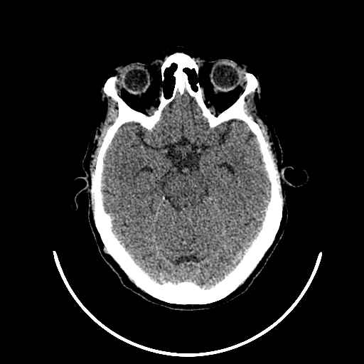
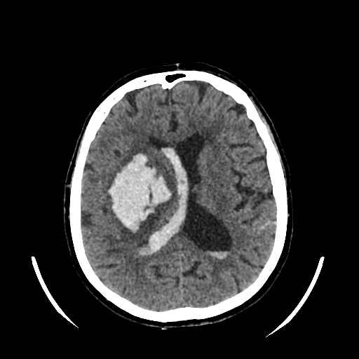
Objective
G-0053
Distinguish between normal, healthy CT scans and hemorrhagic brain scans.
The purpose of this research is to provide advancements in detecting brain hemorrhages using machine learning techniques and in doing so improve early diagnosis and patient recovery outcomes.
Normal
Hemorrhagic

Slide 5
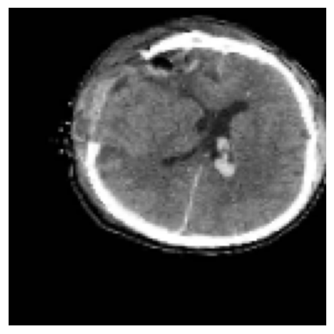
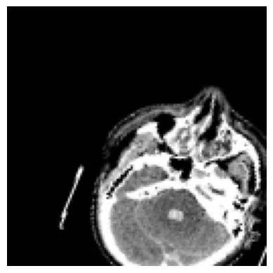
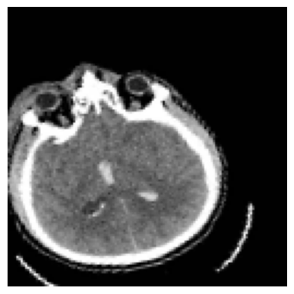
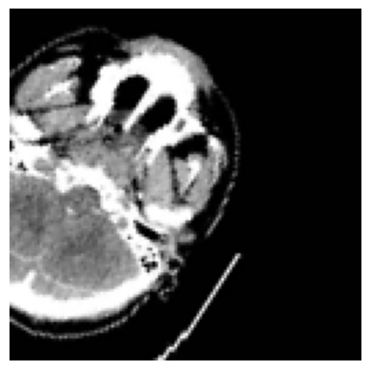
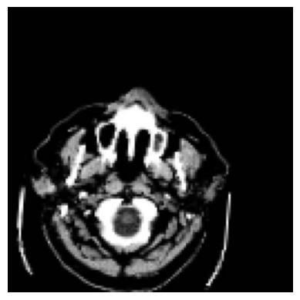
Preprocessing
G-0053
Original Dataset: 6795 images, 512 x 512 grayscale, 2 Categories (Normal and Hemorrhage)
Preprocessing: Rescale images to 128 x 128. Randomly apply horizontal and vertical shifts, rotations, zooms, shears, and horizontal flips.
Training and Validation Set: Training 70% shuffled, Validation 30%

Slide 6
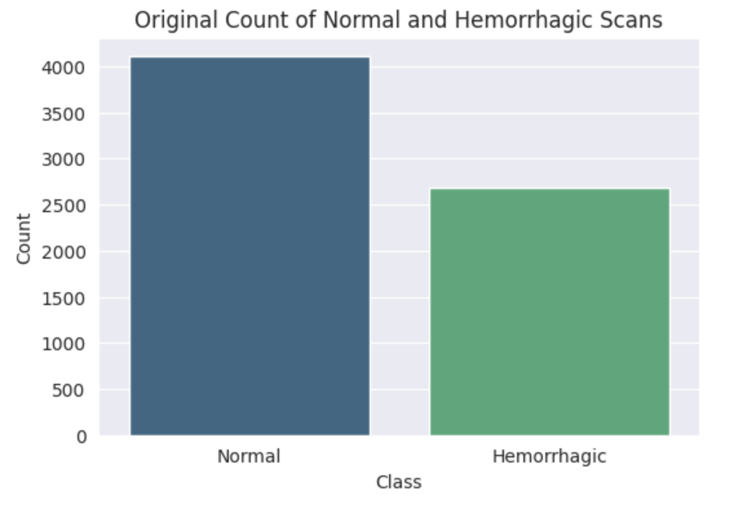
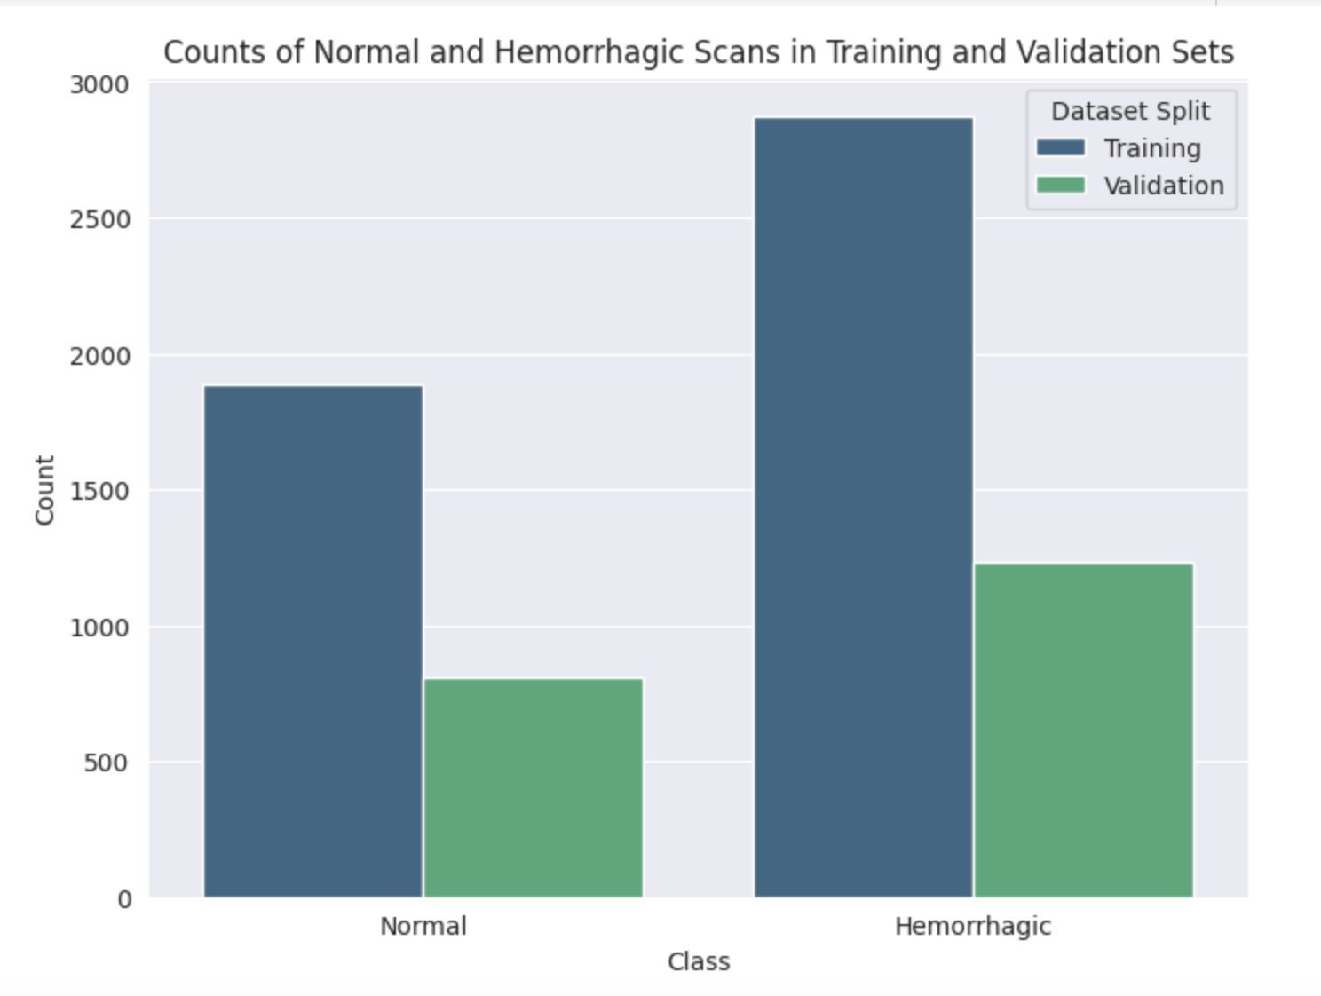
G-0053

Slide 7
Traditional Learning Models
G-0053
Logistic Regression and SVM

Slide 8
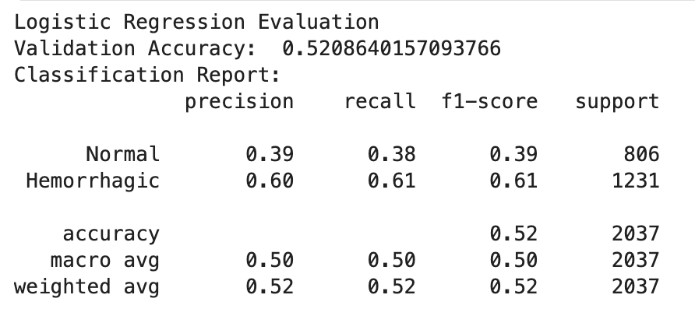
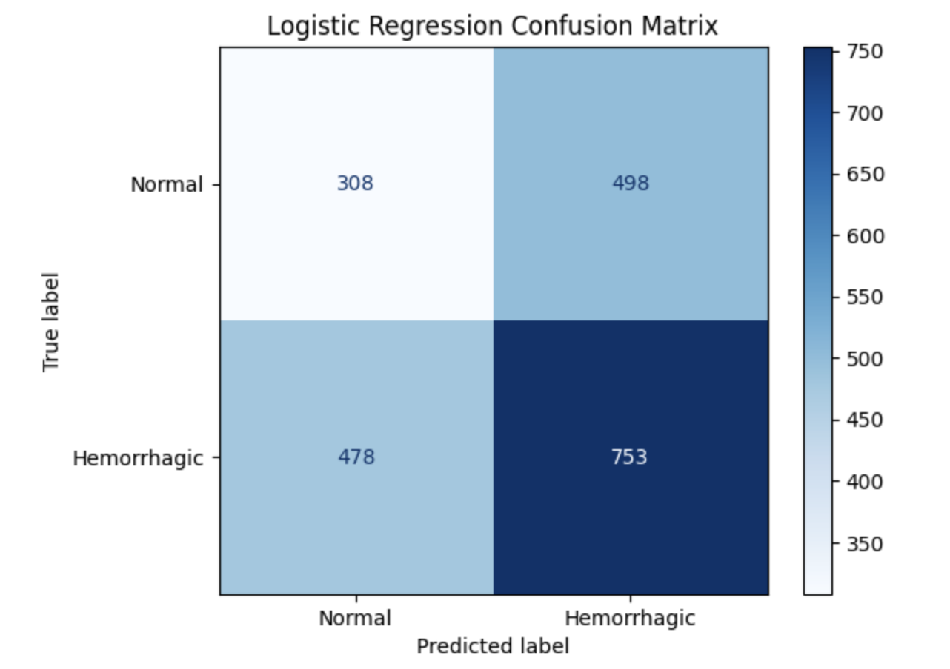
Logistic Regression
G-0053
Benchmark test
This model took about 5 minutes to run and had a max iteration of 1000.
The highest accuracy for logistic regression was 0.521.

Slide 9
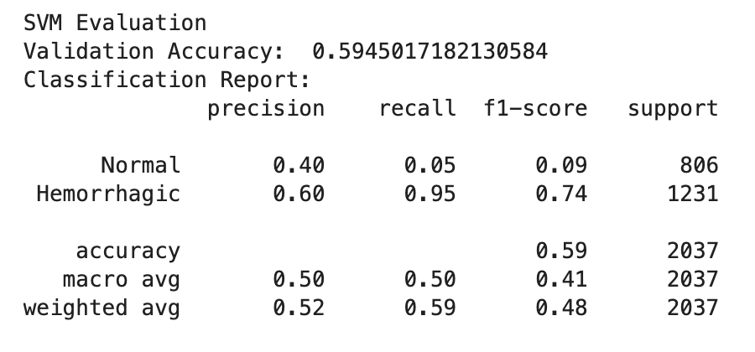
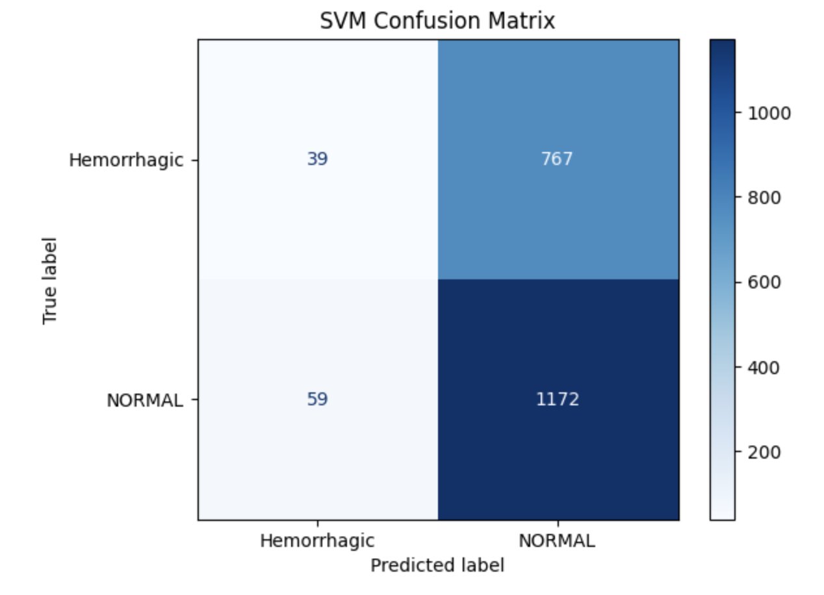
SVM
G-0053
The highest accuracy from SVM was 0.595 when using radial basis function (RBF) kernel.
Other kernels had slightly lower accuracy with linear having 0.52 and polynomial having 0.58.

Slide 10
Neural Networks
G-0053
CNN and RNN

Slide 11
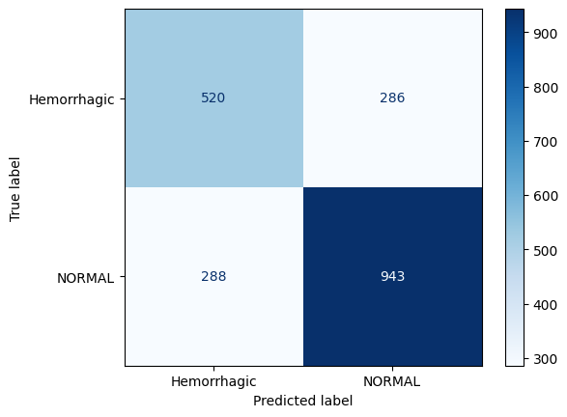
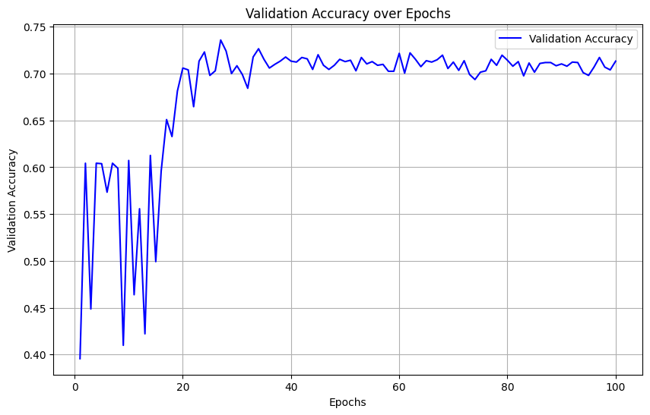
CNN
G-0053
5 Layers using batch normalization, dropout, L2 regularization, and automatically adjusting the learning rate.
The validation accuracy was 0.731 after 50 epochs taking a total of 35 minutes and 0.7133 after 100 epochs taking a total of ~1 hr
The training accuracy at 50 and 100 epochs was ~0.94 indicating overfitting to the training data.

Slide 12
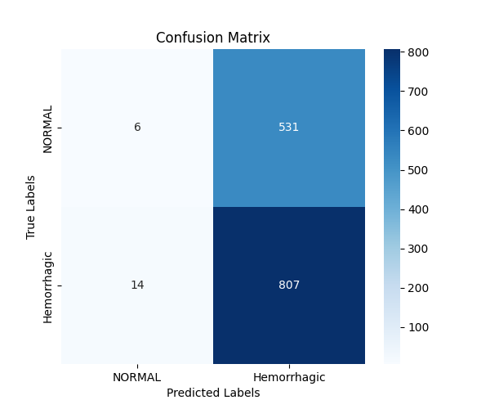
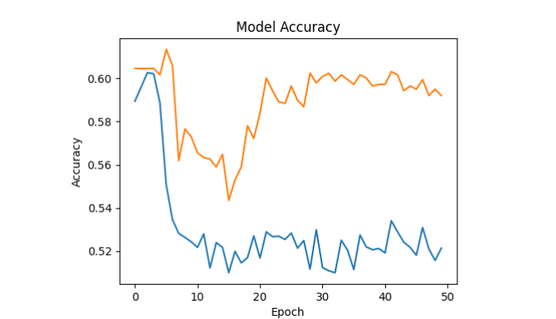
RNN
G-0053
6 layers with input, 2 LSTM layers, dense, dropout and output layers
Validation accuracy is 59.2 % after 50 epochs, above average
Model is underfitting and can’t capture the pattern
Model heavily favors predicting hemorrhagic over normal

Slide 13
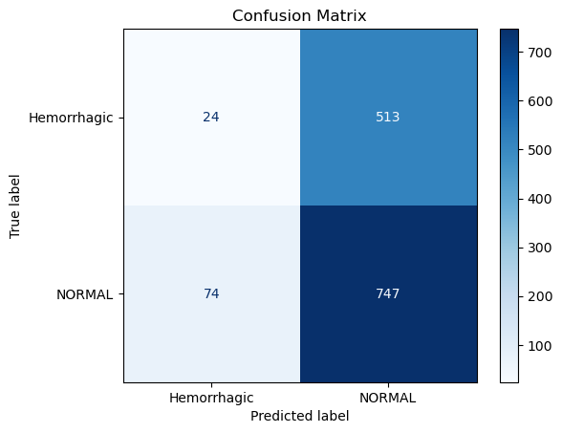
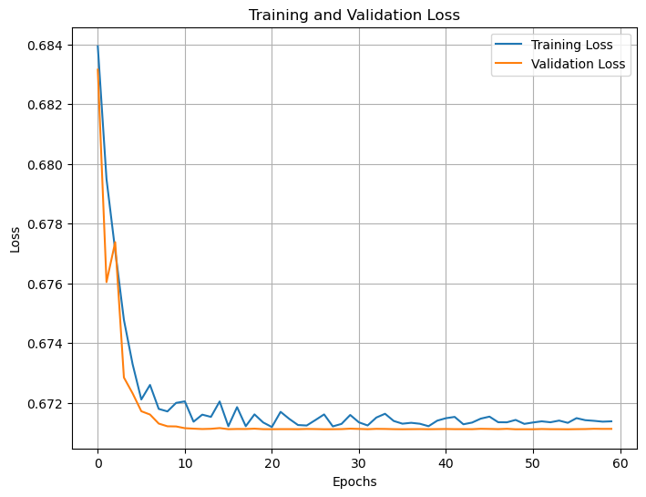
Attention-based RNN
G-0053
Architecture:
The first component of the model consists of two LSTM layers, each using a tanh activation function, a kernel regularizer (0.01), and followed by a dropout layer with a dropout rate of 0.3. After the second lstm layer, an attention mechanism is applied to focus on the most relevant features.
The second component includes a dense layer with 128 neurons, a ReLU activation function, a kernel regularizer (.01), and a dropout layer with a dropout rate of 0.3.
Performance:
The training accuracy was 0.78 after 60 epochs ; the loss converged to ~.67 and it took ~30 min to train the model. The validation accuracy was 0.60 and validation loss converged to ~0.67.

Slide 14
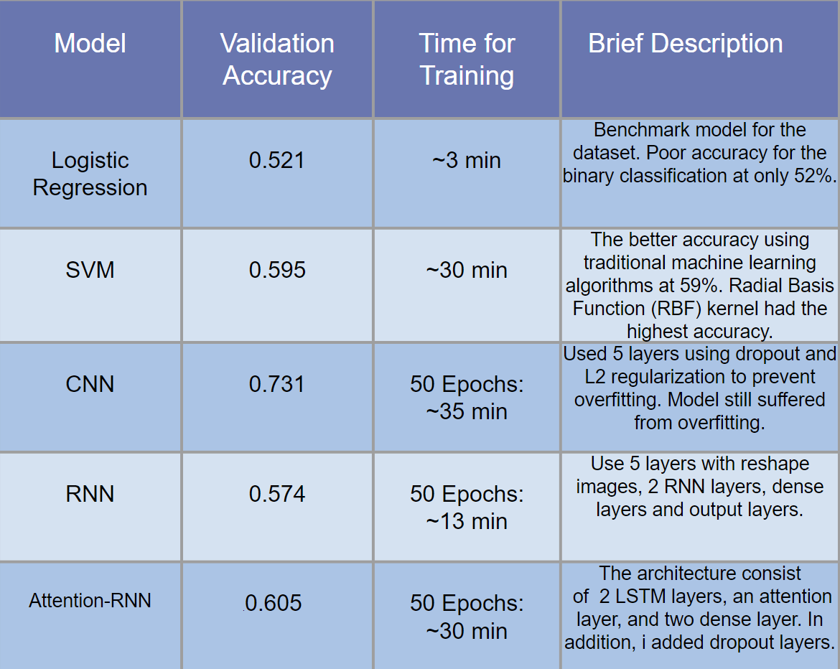
Conclusion
G-0053
Based on the performance of each model, we can conclude that CNNs are significantly better at modeling datasets with spatial information, as expected, compared to traditional and sequential machine learning models. However, due to the limited data and uneven class distribution, all models struggled to generalize, leading to overfitting. Interestingly, traditional machine learning methods, particularly SVMs, outperformed the vanilla RNN despite their inability to learn complex patterns as effectively as neural networks.

Slide 15


Improvements?
G-0053
Better hardware for faster computation
Larger and more balance dataset from more patients
Adjusting model’s parameters for better optimization.

