Slide 1


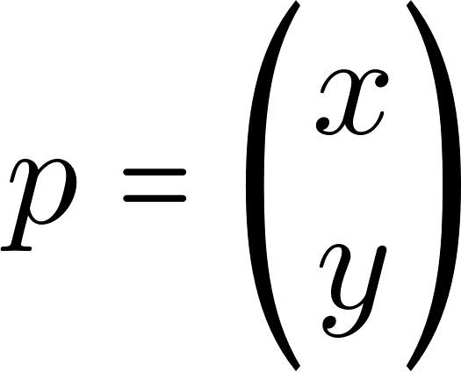


Slide 3



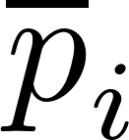

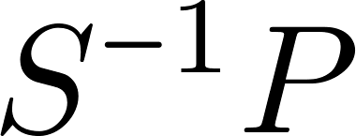


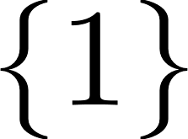

Slide 4
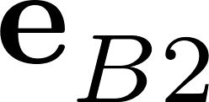






Slide 6
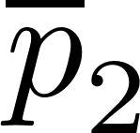
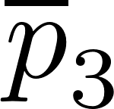
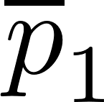
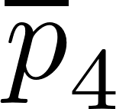
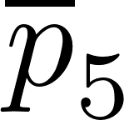

Slide 7


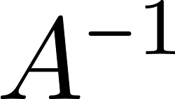

Slide 8
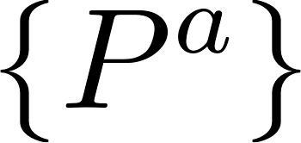





Robot a
Robot b

Slide 9
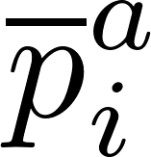

Robot a
Robot a
Robot b
Robot b

Slide 10
Robot a
Robot b

Slide 11





y-axis
x-axis
z-axis

Slide 12

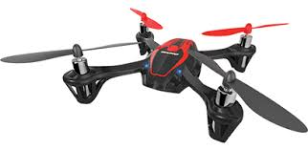



y-axis
z-axis
x-axis

Slide 13


y-axis
z-axis
x-axis
y-axis
x-axis
z-axis

Slide 14

y-axis
z-axis
x-axis
y-axis
x-axis
z-axis

Slide 15

Coordinate frame
The coordinate frame in which the physical variable is expressed.
Symbol representing the type of physical variable
An index symbol to specify the target.
Observer reference frame relative to which the physical variable is measured.
Reference frame
Target object

Slide 16

y-axis
z-axis
x-axis
y-axis
x-axis
z-axis

Slide 17


y-axis
z-axis
x-axis
y-axis
x-axis
z-axis

Slide 18


y-axis
z-axis
x-axis
y-axis
x-axis
z-axis

Slide 19

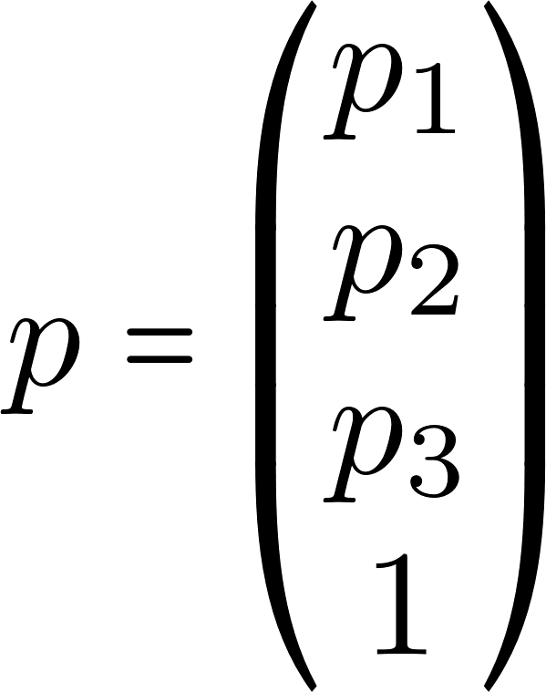

Slide 20
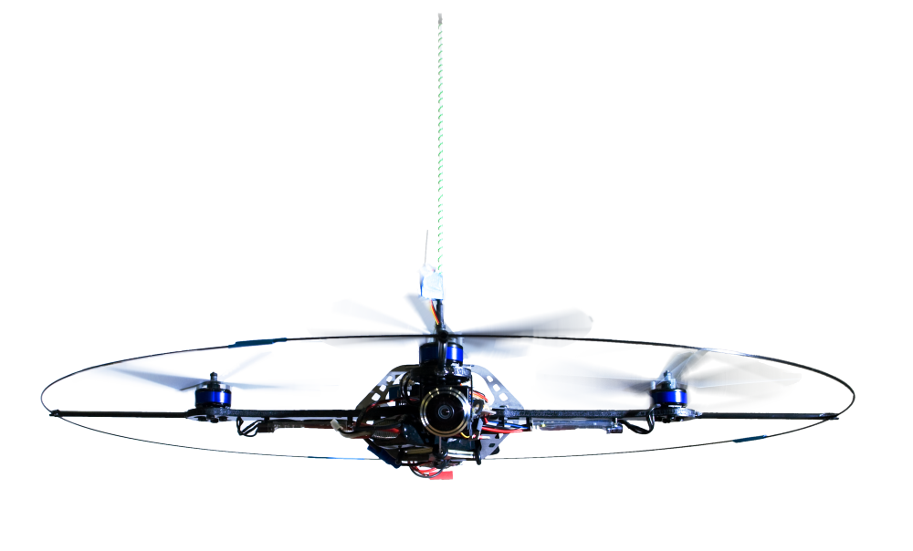
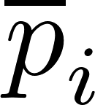


Slide 21


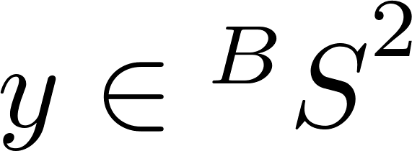




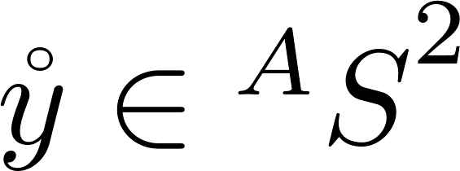

Slide 22




Slide 23


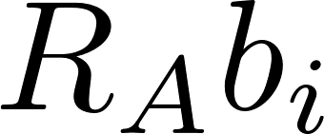



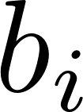




Slide 24
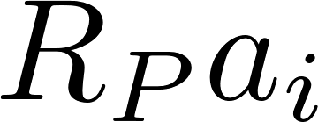




Slide 25


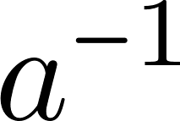
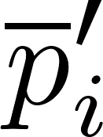
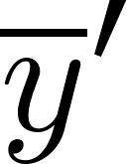
Notes:
VSLAM action

Slide 27



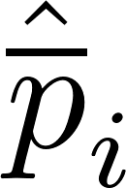


Slide 28



Slide 29



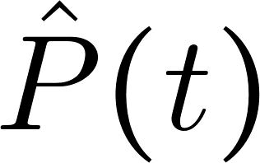

Slide 30
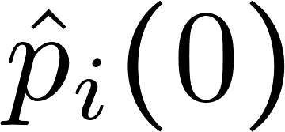
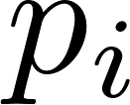



Slide 31
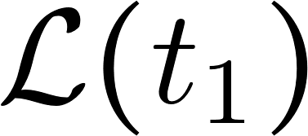
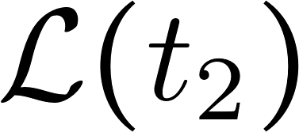
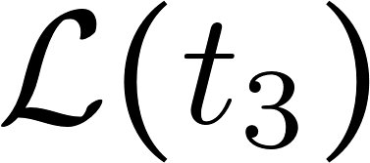

Slide 32

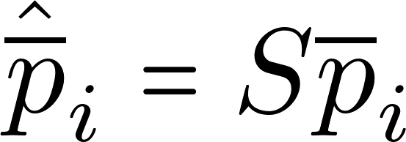


Slide 34


