Slide 1
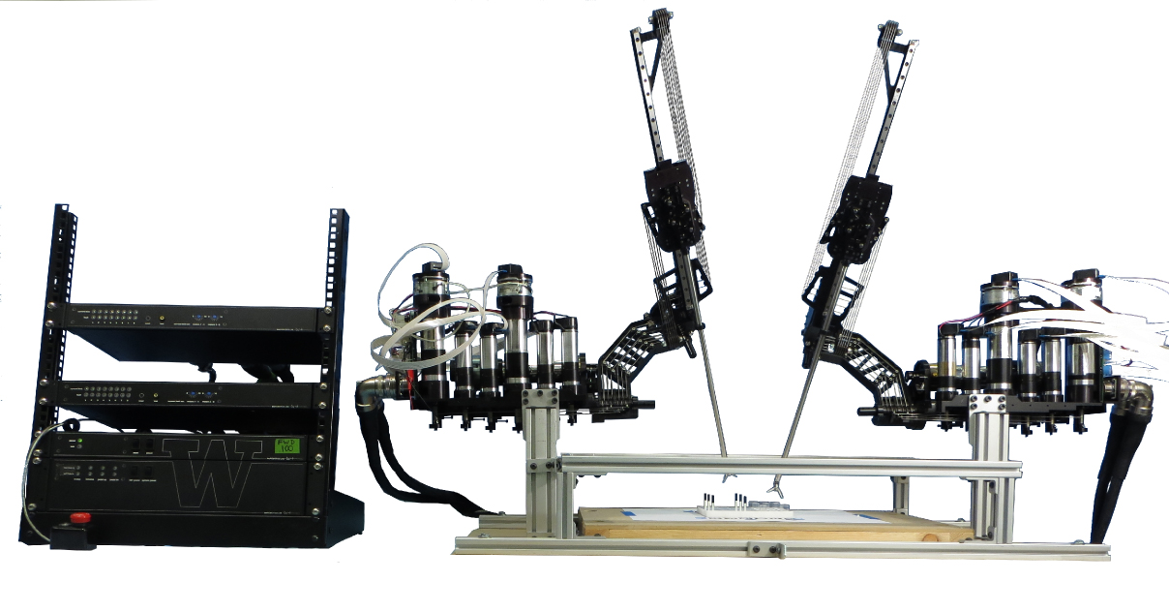

Slide 2
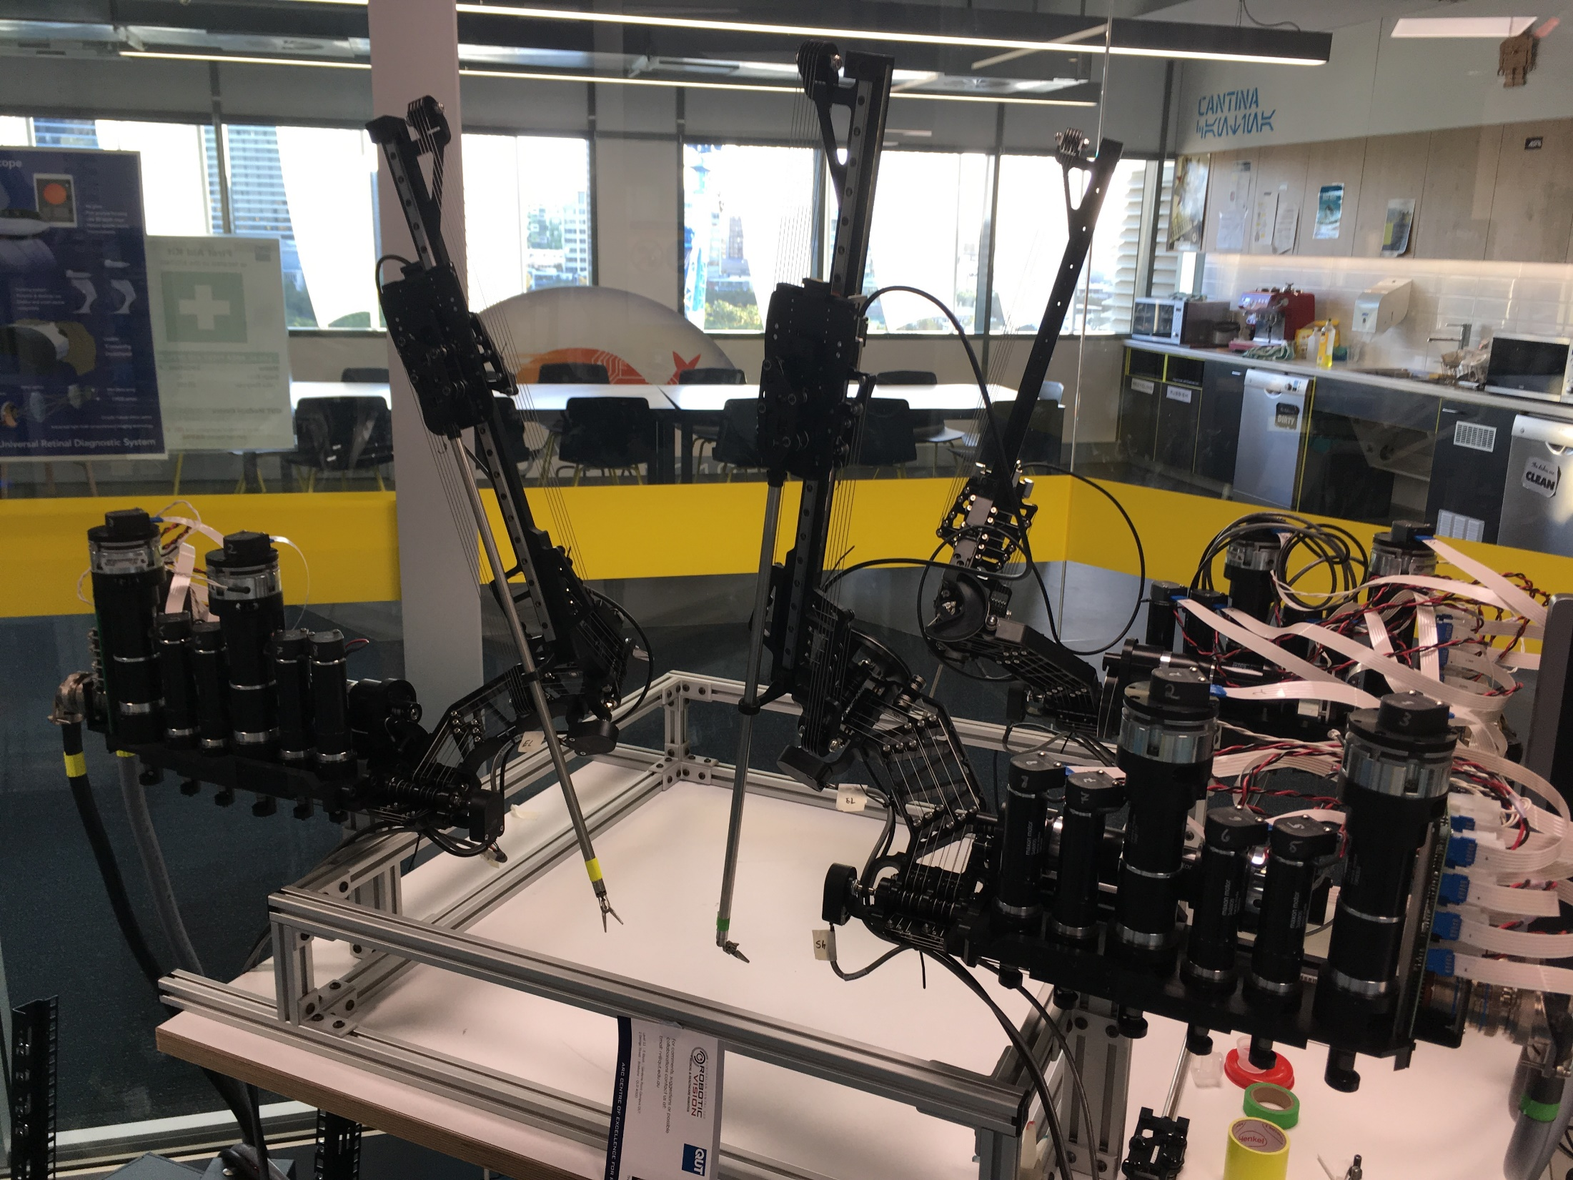

Slide 3
Summary
Applied dexterity, 7(6+1) dof arms, cable-driven, capable of operating autonomously or using tele-/co-manipulation, has been used for tissue debridement, suturing and brain tumour ablation
https://github.com/uw-biorobotics/raven2/wiki <- has a lot of good details including specs and stuff

Slide 4
The RAVEN II is an open-source robotic platform from Applied Dexterity [1] capable of performing non-clinical surgical tasks [2]. It has up to four cable driven 6+1 degrees of freedom arms, is closely modelled on the da Vinci clinical minimally-invasive surgical robot from Intuitive Surgical [3] and is designed to be a research platform with a large support community. The RAVEN is designed to be teleoperated but can also be run autonomously.
Most research using the RAVEN is related to teleoperation [4] and use of the robot in extreme conditions such as undersea enclosures [5] or low-gravity environments [6]. Other research that has been performed using the system includes autonomous tissue debridement [7], brain tumour ablation [8] and surgeon training [9].

Slide 5
[1] Applied Dexterity, “Applied Dexterity - Driving Innovation in Surgical Robotics,” 2018. [Online]. Available: http://applieddexterity.com/.
[2] B. Hannaford et al., “Raven-II: An open platform for surgical robotics research,” IEEE Trans. Biomed. Eng., 2013.
[3] Intuitive Surgical Inc., “Intuitive Surgical - da Vinci Surgical System,” 2018. [Online]. Available: https://www.intuitivesurgical.com/products/davinci_surgical_system/.
[4] M. J. H. Lum, J. Rosen, T. S. Lendvay, A. S. Wright, M. N. Sinanan, and B. Hannaford, “TeleRobotic Fundamentals of Laparoscopic Surgery (FLS): Effects of Time Delay -Pilot Study,” 2008.
[5] C. R. Doarn, M. Anvari, T. Low, and T. J. Broderick, “Evaluation of Teleoperated Surgical Robots in an Enclosed Undersea Environment,” Telemed. e-Health, 2009.
[6] A. Lewis and B. Hannaford, “Dynamically evaluated gravity compensation for the RAVEN surgical robot,” in Proceedings - IEEE International Conference on Robotics and Automation, 2014.
[7] B. Kehoe et al., “Autonomous multilateral debridement with the Raven surgical robot,” in Proceedings - IEEE International Conference on Robotics and Automation, 2014.
[8] D. Hu, Y. Gong, B. Hannaford, and E. J. Seibel, “Semi-autonomous simulated brain tumor ablation with RAVENII Surgical Robot using behavior tree,” in Proceedings - IEEE International Conference on Robotics and Automation, 2015.
[9] X. Li, H. Alemzadeh, D. Chen, Z. Kalbarczyk, R. K. Iyer, and T. Kesavadas, “Surgeon Training in Telerobotic Surgery via a Hardware-in-the-Loop Simulator,” J. Healthc. Eng., 2017.

