Slide 1
Emotional State Classification with Biometric Sensor Data
Group 4:
David Havrilla
Andrew Rendler
Justin Teufel

Slide 2
Project Description
Our objective is to develop a model that will evaluate wearable-generated biometric information and return a prediction of the user’s current level of stress or excitement, defined by three potential states:
- Neutral
- Stress
- Amusement

Slide 3
Questions
Is temperature a good predictor for stress? What is a better predictor of stress?
How do we identify an emotional state, as to alert a user that they may be approaching a stressed state?
Notes:
Variables reviewed, which were highest correlated

Slide 4
Datasets
WESAD (Wearable Stress and Affect Detection) Data Set
Https://uni-siegen.sciebo.de/s/pYjSgfOVs6Ntahr/download
Each member of our team has an independent copy of the source data.

Slide 5
Prior Work
The original WESAD work will be our primary reference material, along with other related research.
Introducing WESAD, a Multimodal Dataset for Wearable Stress and Affect Detection
Schmidt, Philip & Reiss, Attila & Duerichen, Robert & Marberger, Claus & Van Laerhoven, Kristof. (2018)
https://dl.acm.org/doi/10.1145/3242969.3242985

Slide 6
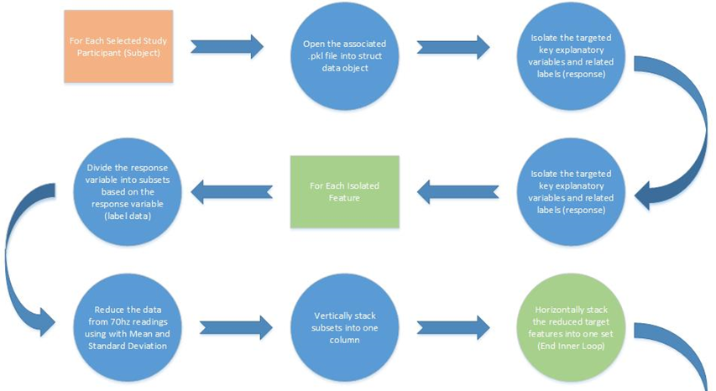
Data Preparation Work

Slide 7
Tools
Python
- pandas: open-source, statistical analysis
- numpy: user-friendly computation
- matplotlib: graph plotting library
- sklearn: machine learning library

Slide 8
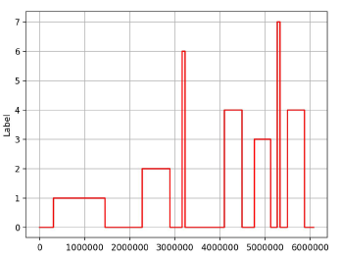
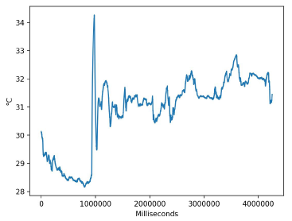
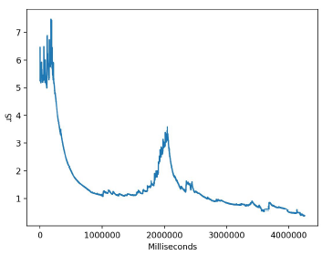
Graphs – Subject 4
Label
EDA
Temperature

Slide 9
Classification/Clustering/etc.
Initial approach evaluate performance of multiple approaches/models:
Linear-regression
Decision-tree
Linear-discriminate analysis
K-nearest neighbors
K-nearest neighbors classification provided best performance
Average ~99.9% accuracy

Slide 10
Knowledge Gained
Chest monitor had higher accuracy
ECG, Temp, EDA, and EMG were variables most strongly related to emotional state
Able to preemptively identify user’s emotional state

Slide 11
How That Knowledge Can Be Applied
Many Applications Possible
Consumer Use
Workplace Use
This type of technology could be applied in the area of workplace ergonomics, for example in high stress environments like police work.
Protection in the workplace
Worker safety

