Slide 1

CryptoTracker
Ben Kupernik
Ryan Power
Andrew Rendler
Trent Resh

Slide 2
Our goal is to provide an elegant dashboard optimized for viewing real-time metrics of leading cryptocurrencies, empowering our users to make informed trading decisions.

Slide 3
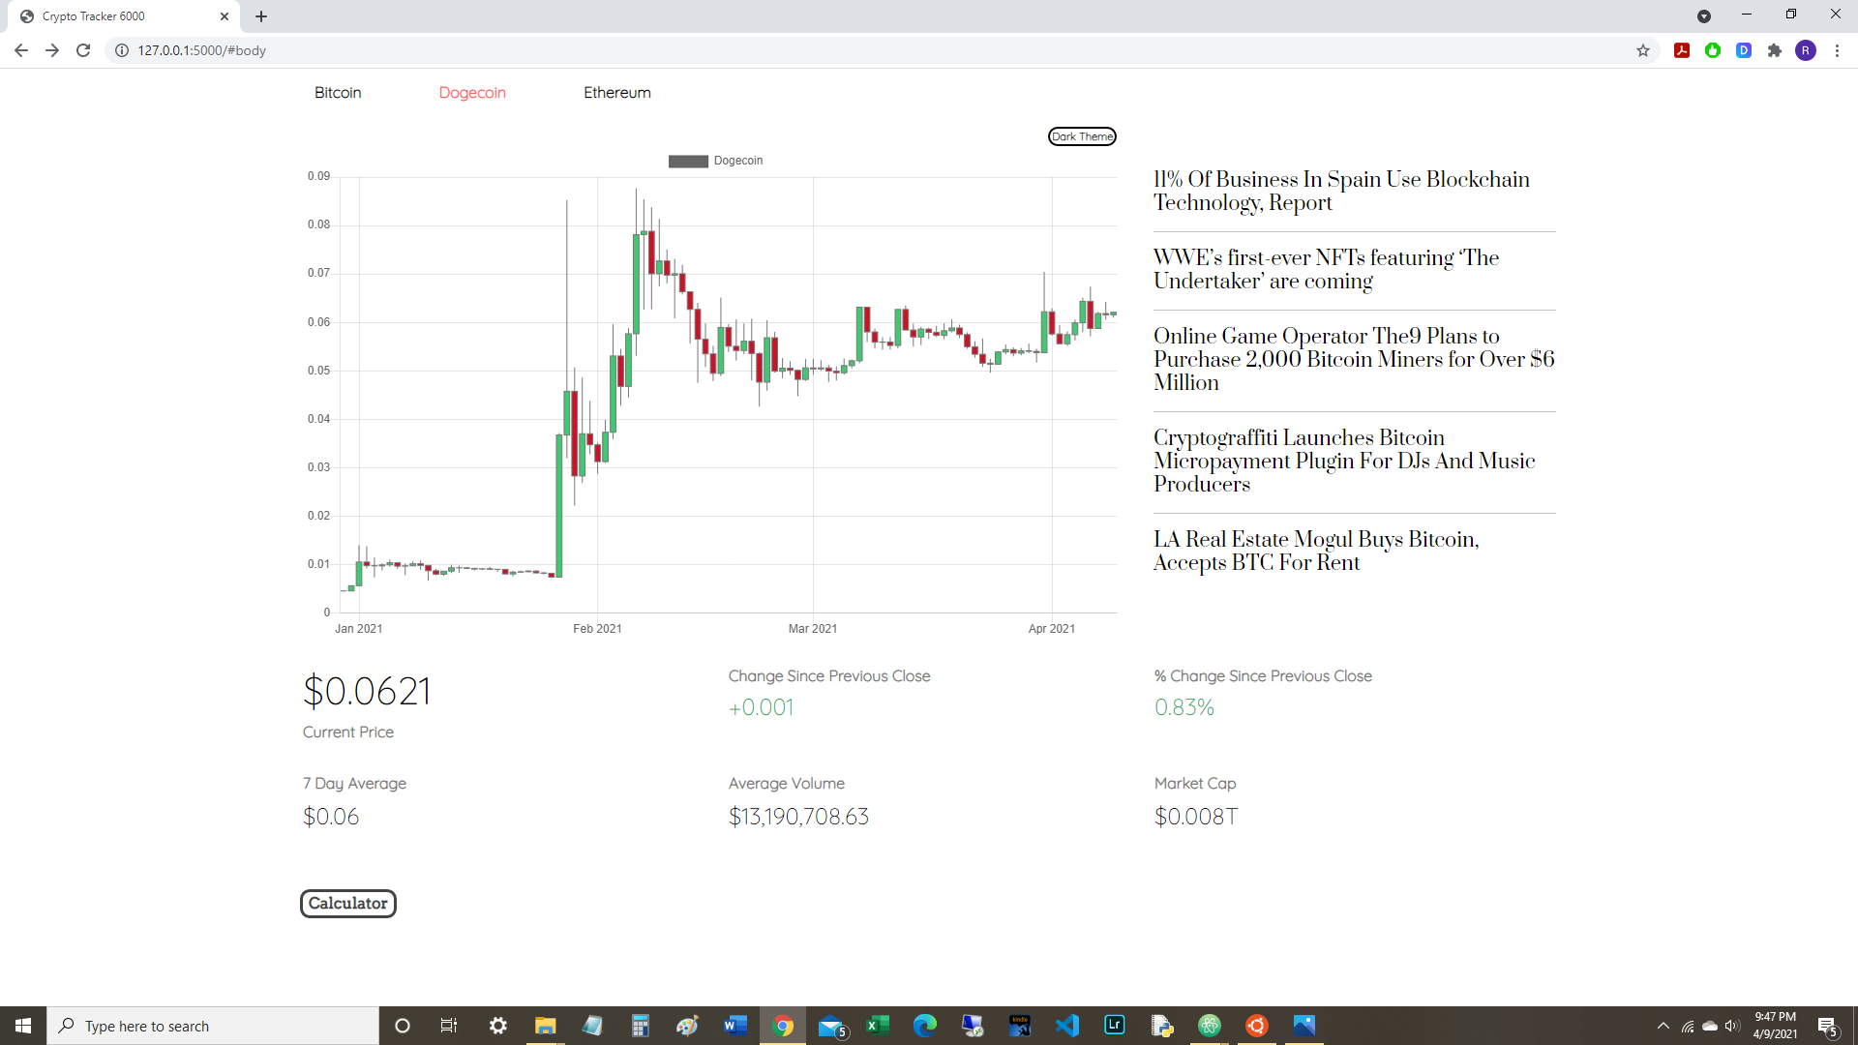

Slide 4
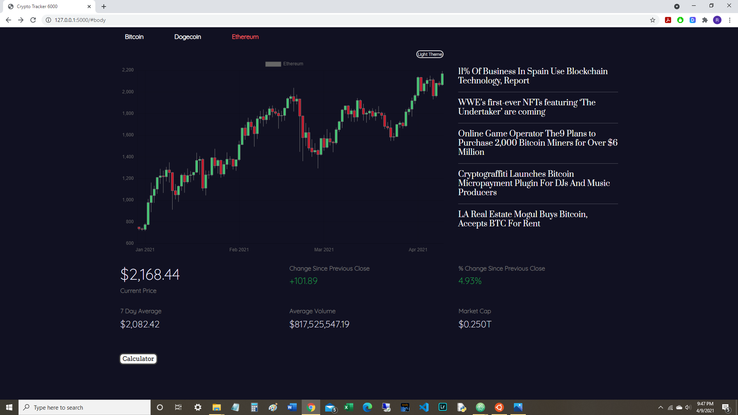

Slide 5
Tools & Technology

Slide 6
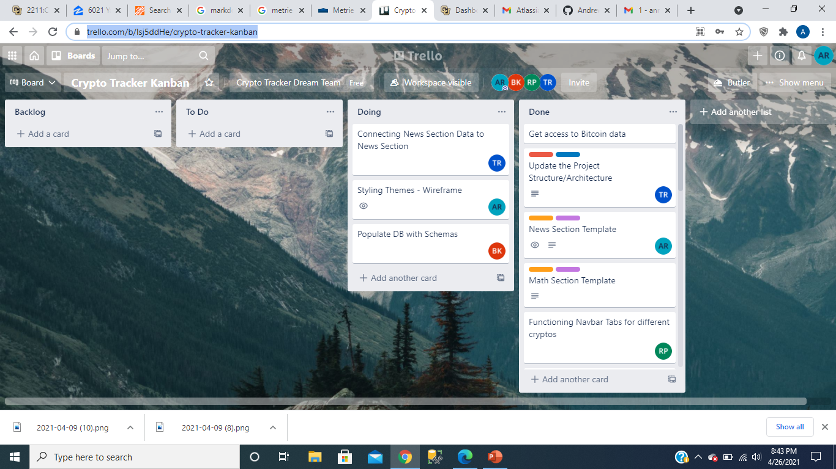
Trello

Slide 7
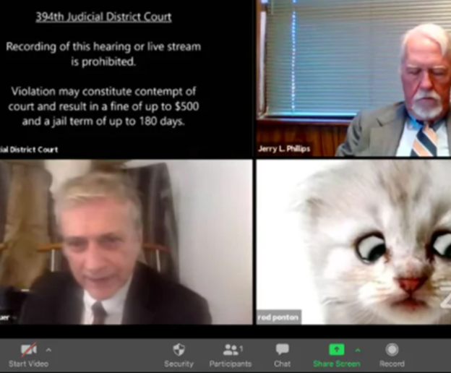
Zoom

Slide 8
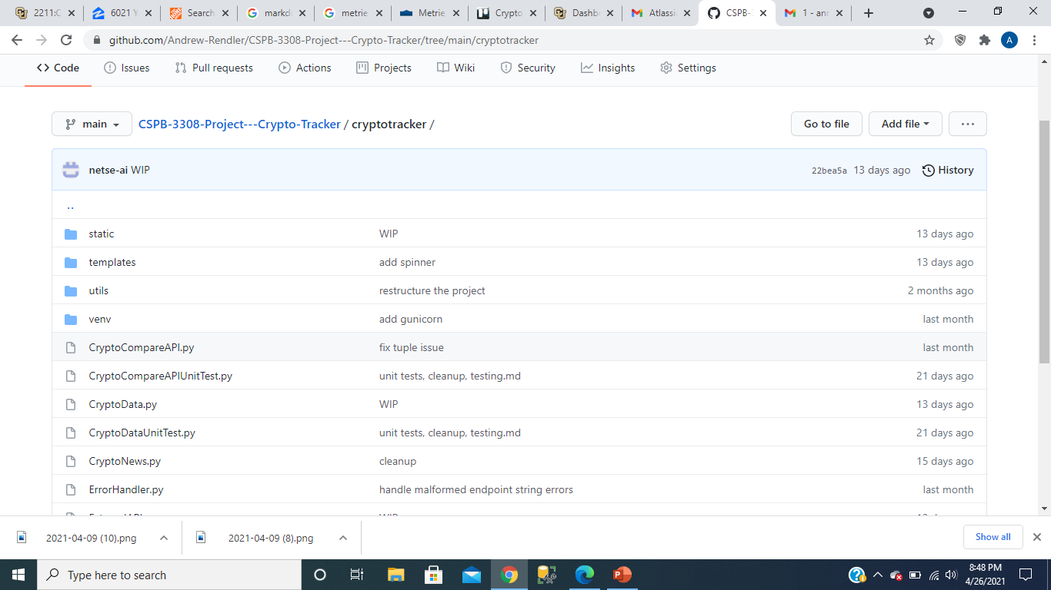
Github

Slide 9
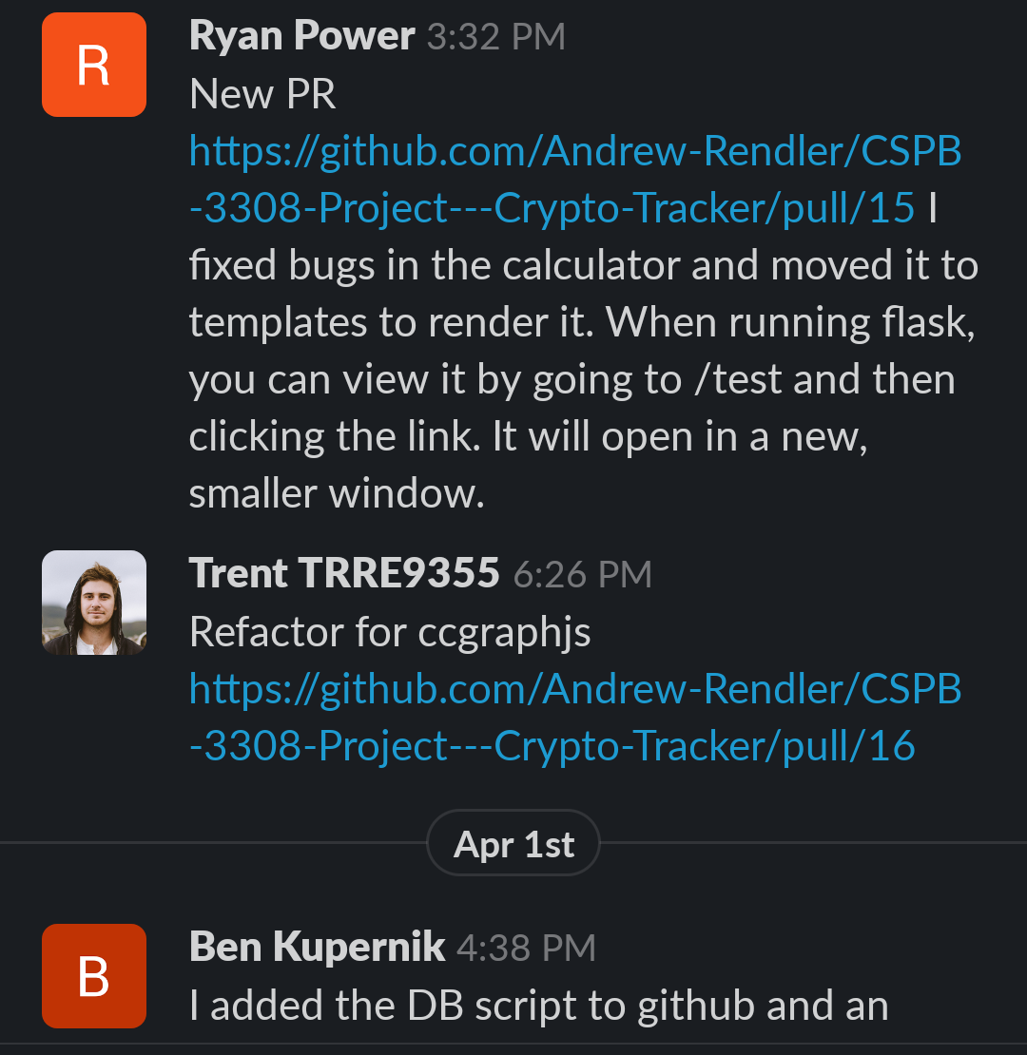
Slack

Slide 10

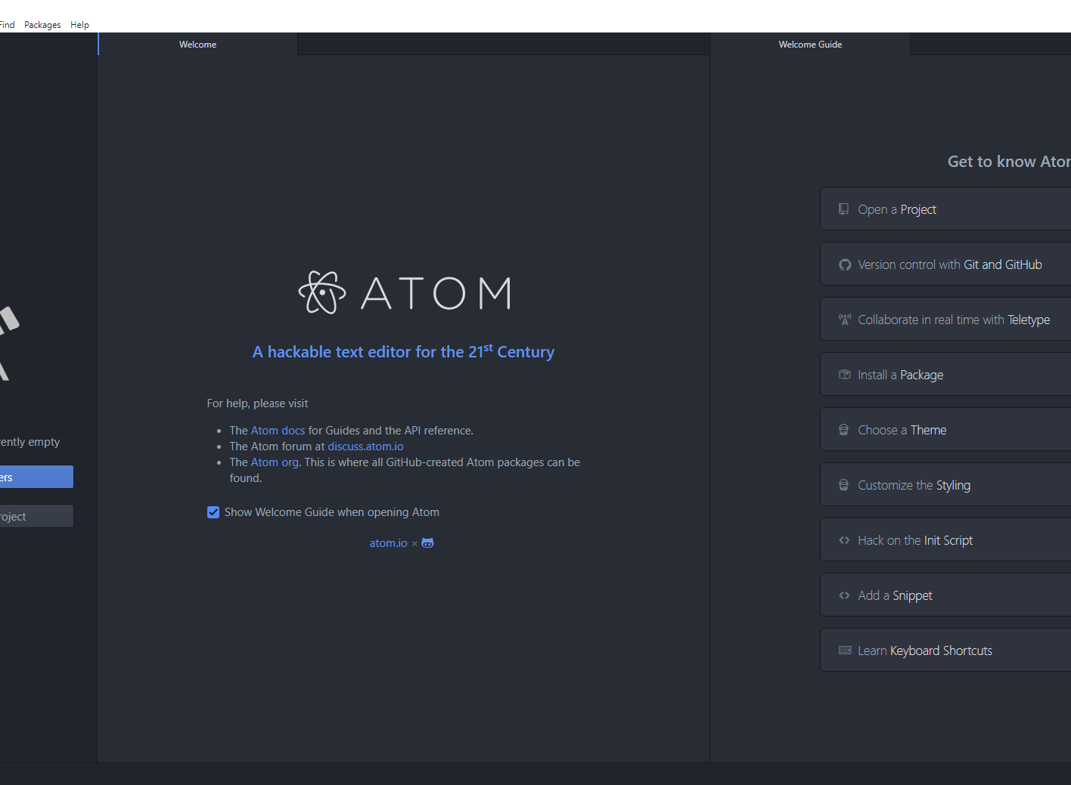
Code Editor

Slide 11

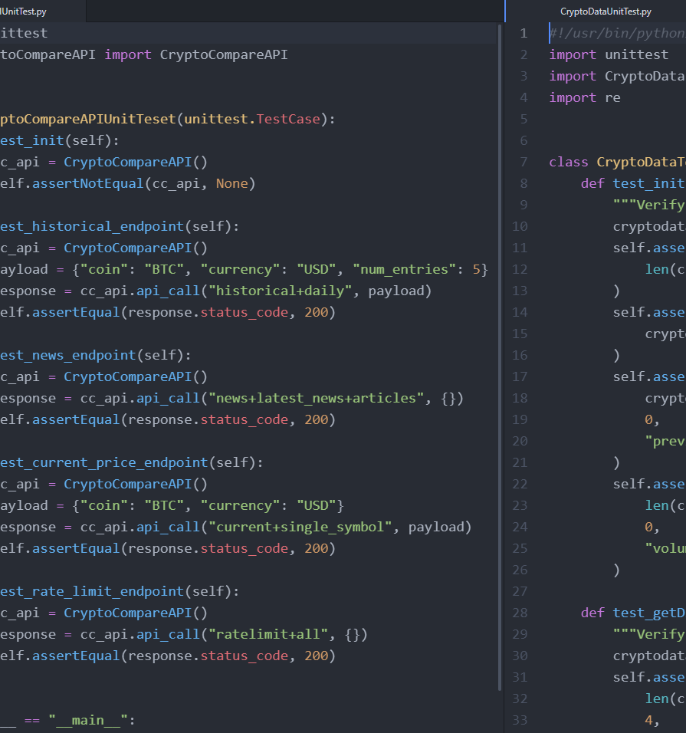
Automated Unit Tests

Slide 12
Languages
Framework \ Environment
HTML
CSS
Python
JavaScript
SQL
Flask
Bootstrap
Heroku
PostgreSQL
Cryptocompare API

Slide 13
Challenges

Slide 14
Demonstration and Q&A

