Slide 1

CryptoTracker
Ben Kupernik
Ryan Power
Andrew Rendler
Trent Resh

Slide 2
Our goal is to provide an elegant dashboard optimized for viewing real-time metrics of leading cryptocurrencies, empowering our users to make informed trading decisions.

Slide 3
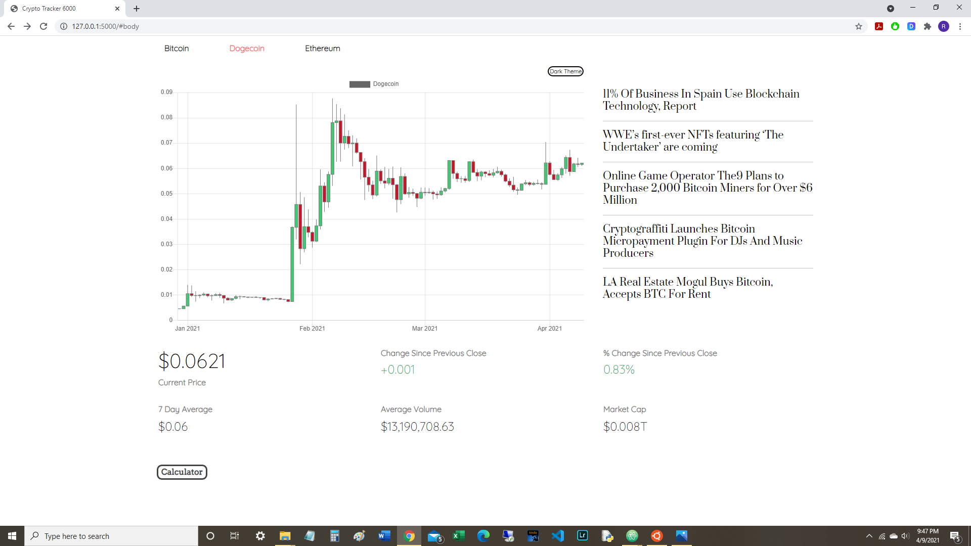

Slide 4
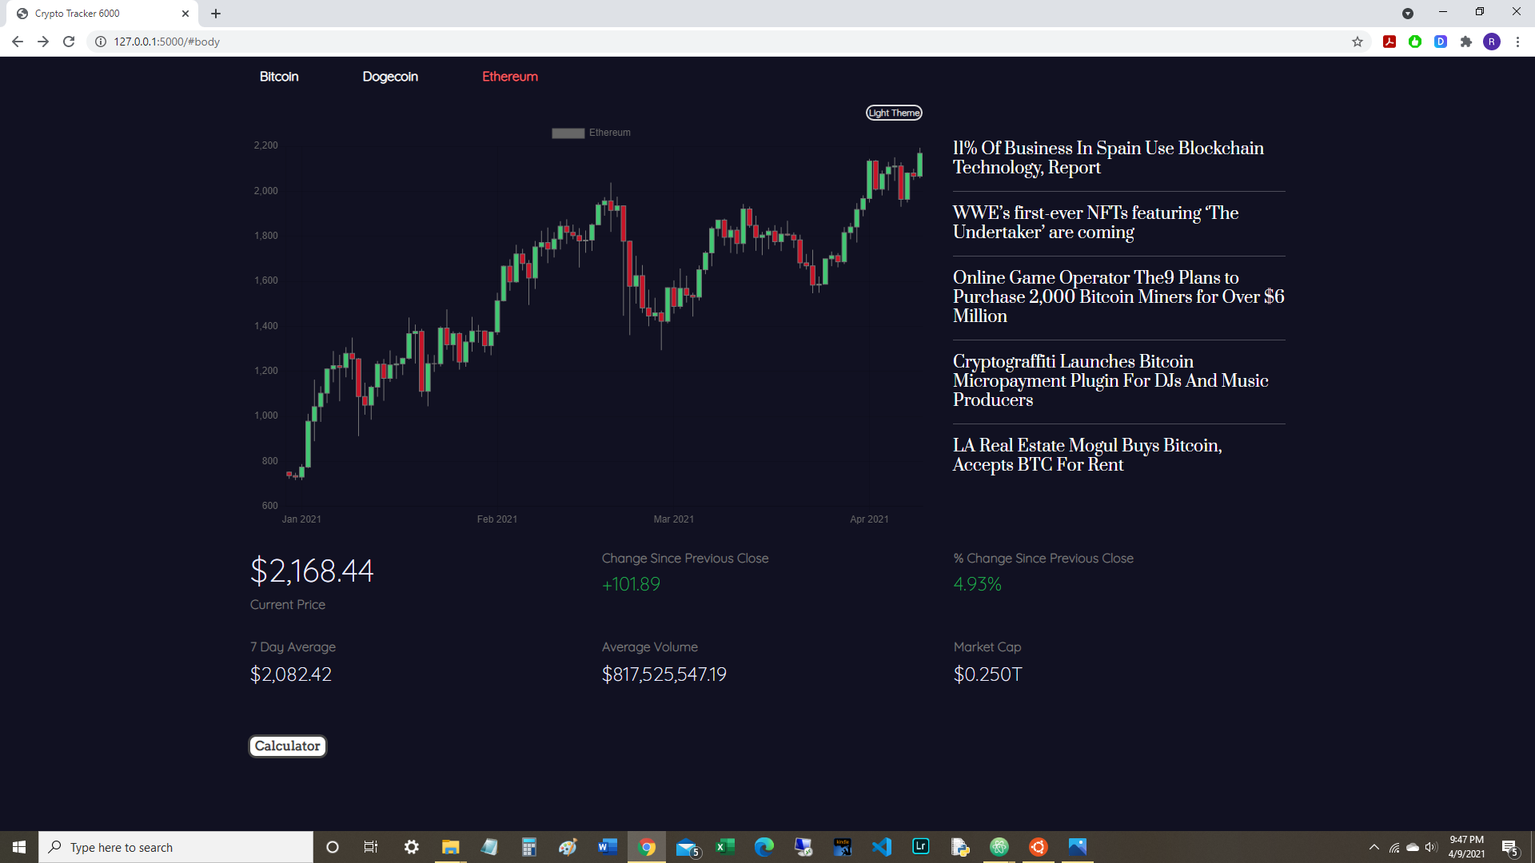

Slide 5
Tools & Technology

Slide 6
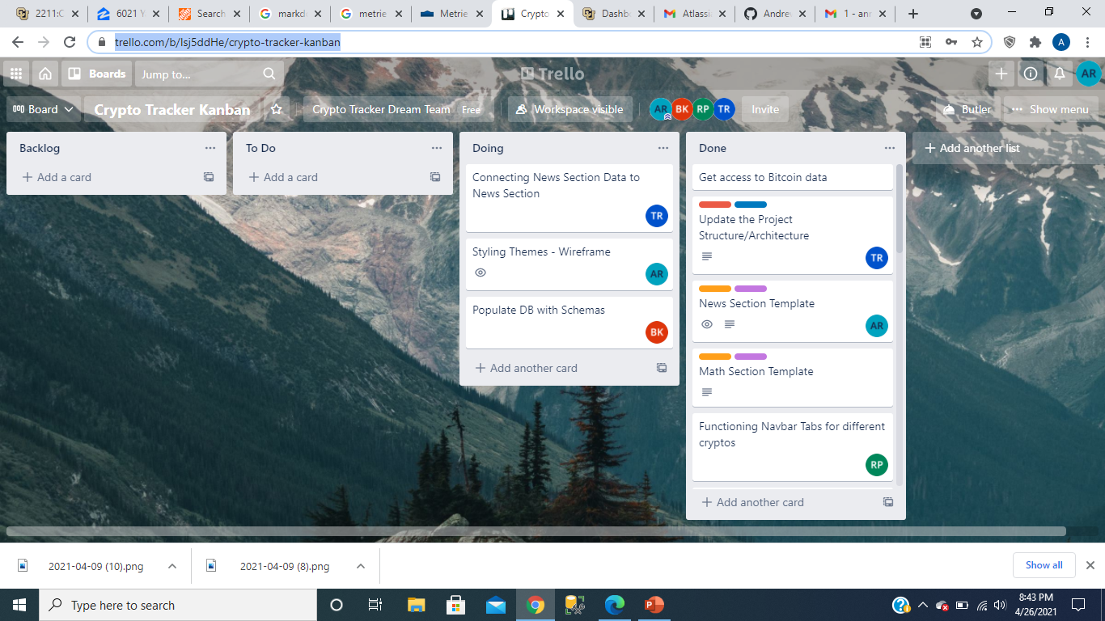
Trello

Slide 7
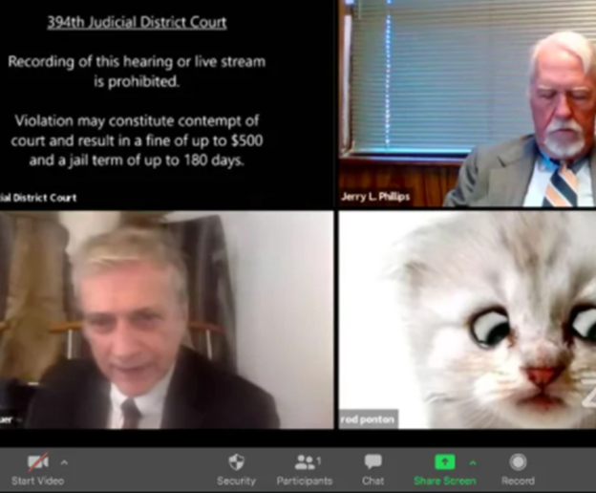
Zoom

Slide 8
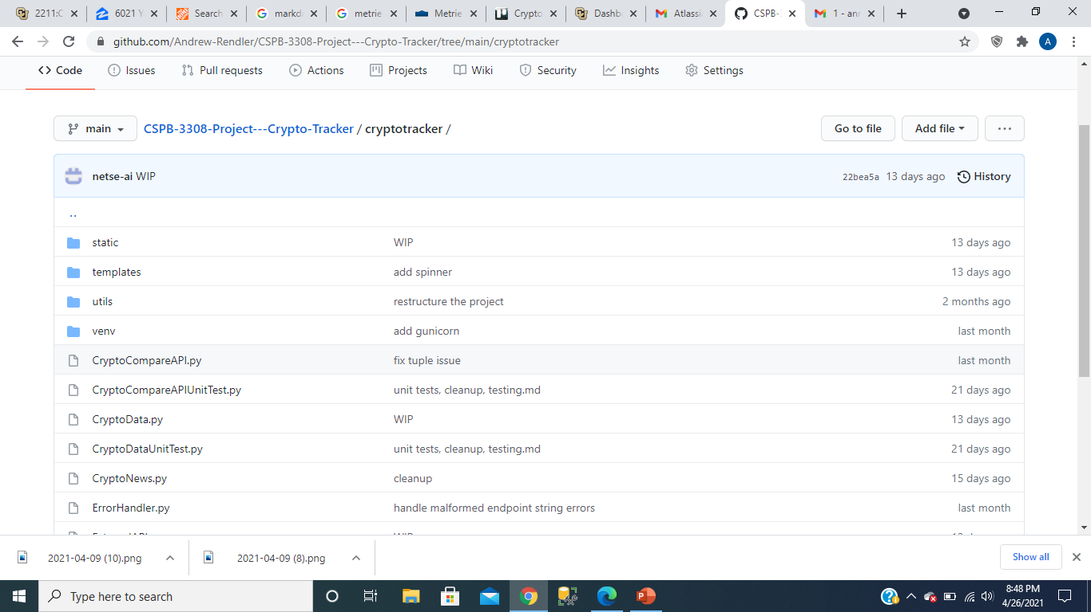
Github

Slide 9
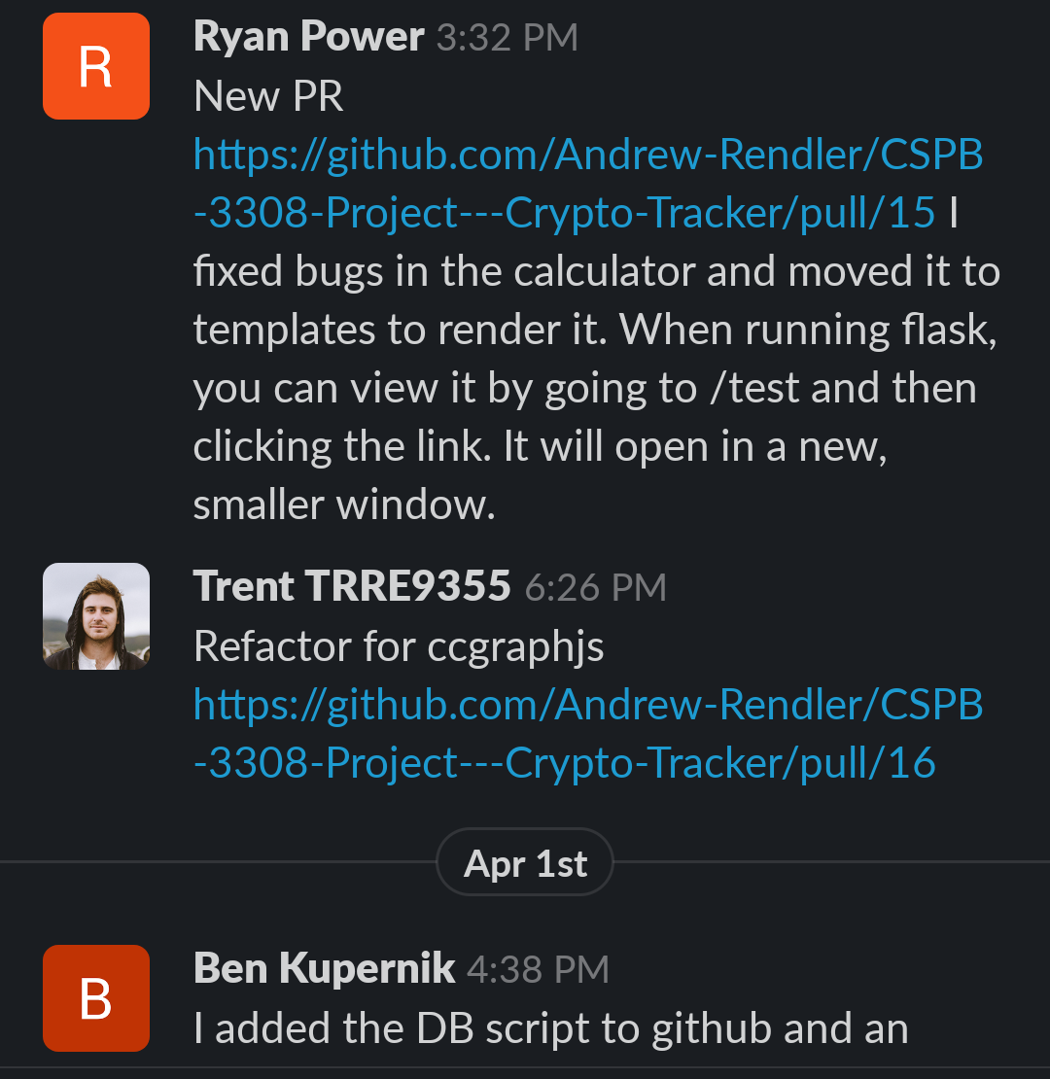
Slack

Slide 10

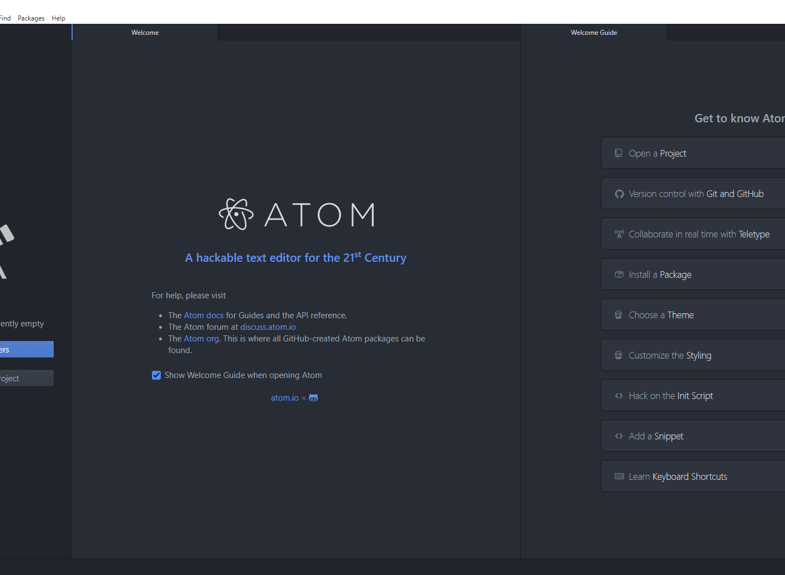
Code Editor

Slide 11

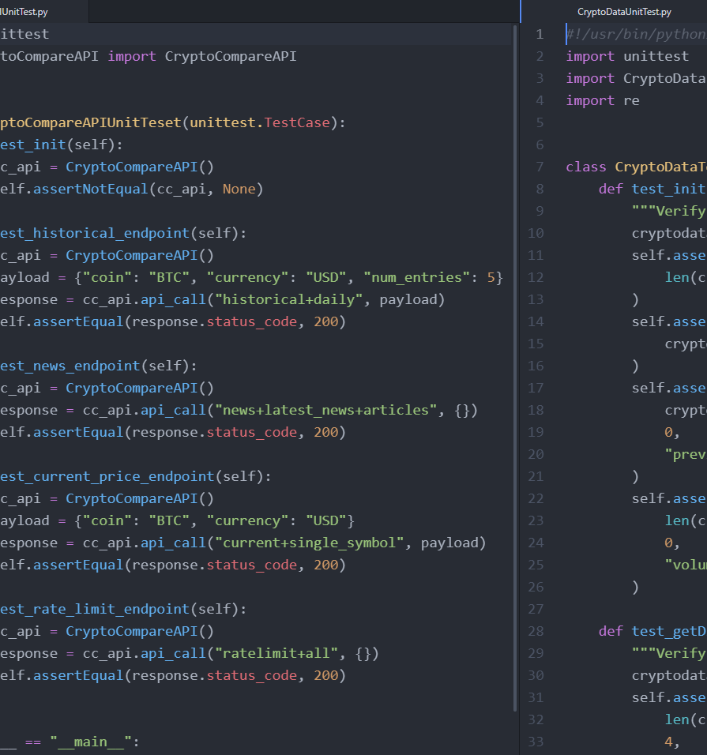
Automated Unit Tests

Slide 12
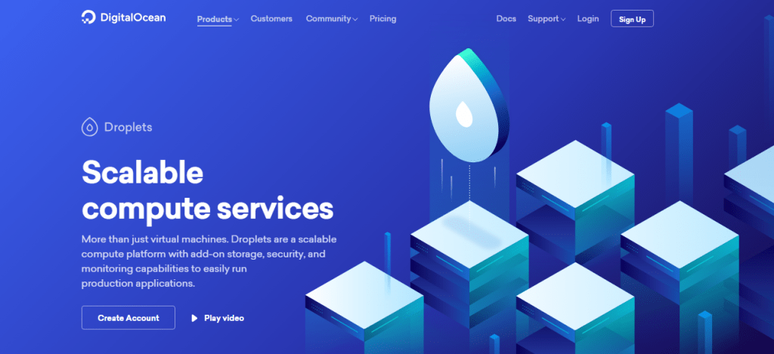
Deployment Environment
Digital Ocean
Virtual Private Server
Linux Ubuntu 20.02
Flask
RestAPI Endpoints
Flask SQL Alchemy
Cryptocompare API
Postgresql
Bitcoin
Ethereum
Dogecoin

Slide 13
Languages
Framework \ Environment
HTML
CSS
Python
JavaScript
SQL
Flask
Bootstrap
Heroku
PostgreSQL
Cryptocompare API

Slide 14
Challenges

Slide 15
Demonstration and Q&A

