Slide 1
Lens Updates: 2D Results, Slowable Molecules, Axial Length Scan, Laser Slowing
Thursday, September 17, 2020
YbOH/CaOH Subgroup Meeting

Slide 2
Experimental Setup: Two Lenses
4K Aperture,
1 cm diameter
Beam Shutter,
1.4 cm diameter
2.54 cm
2.54 cm
1 cm³
10 cm (fixed)
Cell
Varied
Lens
Varied
Lens
Varied
31 cm (fixed)
MOT Region
26 cm (fixed)
67 cm (fixed)

Slide 3
Two-Lens Scan in 2D: CaOCH₃
Number enhancement peaked when lenses are almost next to each other (hottest area is clustered around 15-25 cm)
Consistent with previous week’s results, suggesting placement of lens ~30 cm from cell aperture

Slide 4
Two-Lens Scan in 2D: CaOH

Slide 5
Capturable Molecules

Slide 6
Varying Lens Axial Length

Slide 7
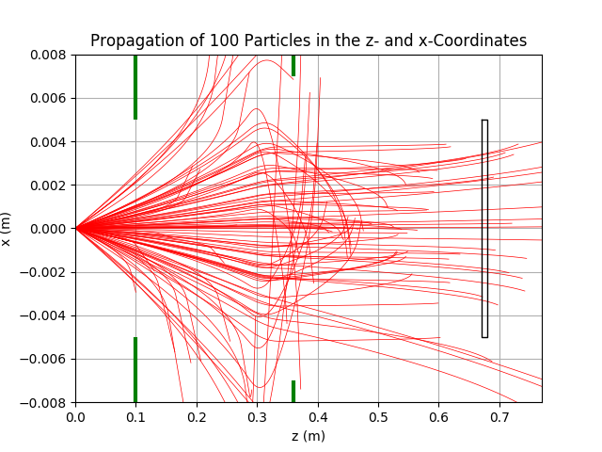
Laser Slowing: Preliminary Results
See evidence of turning inwards; the trajectories actually reverse direction in the magnet and are funneled inwards

Slide 8
Laser Slowing: Preliminary Results
Number enhancement is maximized when laser slowing with a lens placement slightly further
Preliminary; ran with only 1e2 molecules, no spatial distribution (runtime)

