Slide 1
Magnetic Lens and Monte Carlo Particle Trajectory Simulations
Andrew Winnicki
Thursday, June 18, 2020

Slide 2
Outline
Halbach Cylinder
Molecular Parameters
Experimental Setup
Monte Carlo Particle Trajectory Simulations

Slide 3
Background
Leverages Halbach Array
Specifically, a Halbach cylinder
Confined, enhanced magnetic field
Attenuated outside the magnet
Hexapole configuration of of 12 permanent 1T magnets
Uniformly magnetized, spatially rotating magnetic field
Simulated in Mathematica using Radia magnetostatics package
ESRF
http://www.esrf.eu/Accelerators/Groups/InsertionDevices/Software/Radia

Slide 4
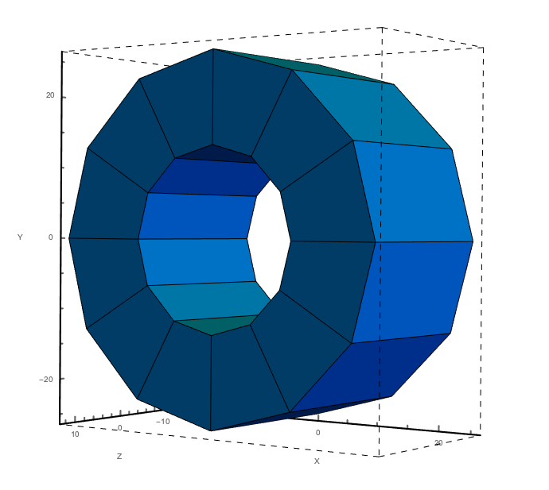
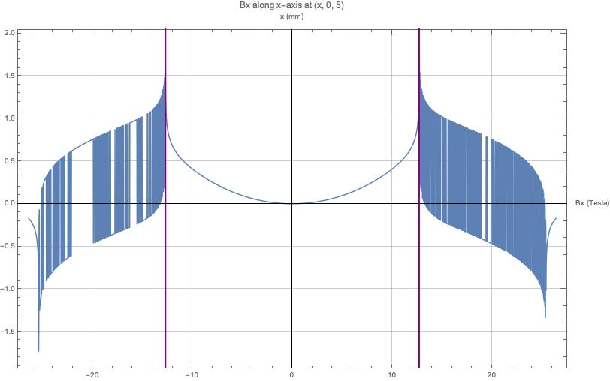
Halbach Cylinder
Inner bore radius: 12.5 mm, outer radius: 25.4 mm
Axial length: 25.4 mm
k = 4

Slide 5
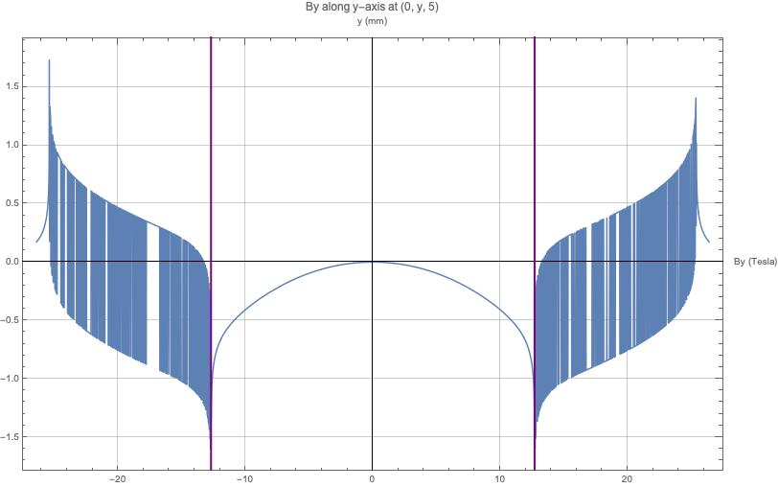
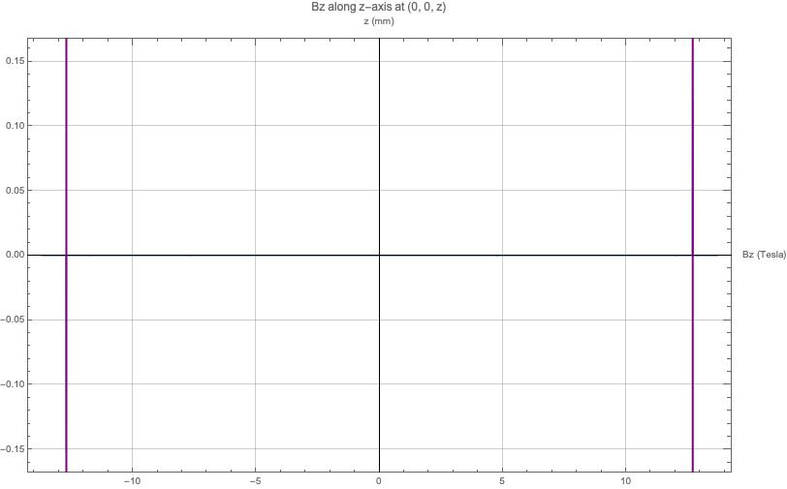
Halbach Cylinder

Slide 6
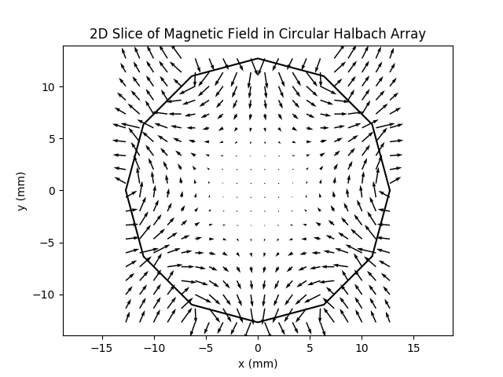
Halbach Cylinder

Slide 7
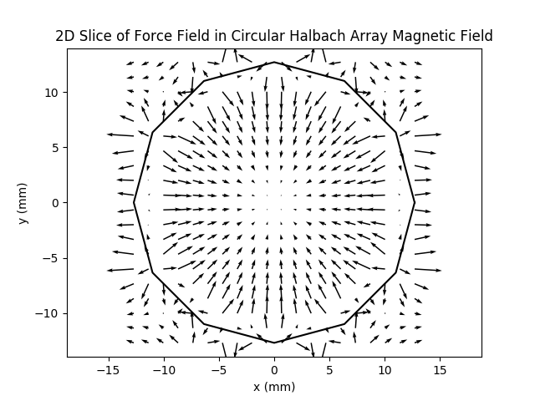
Halbach Cylinder

Slide 8
Experimental Setup
4K Aperture
Beam Shutter
2.54 cm
Cell
20 cm
Lens
32 cm
MOT Region

Slide 9
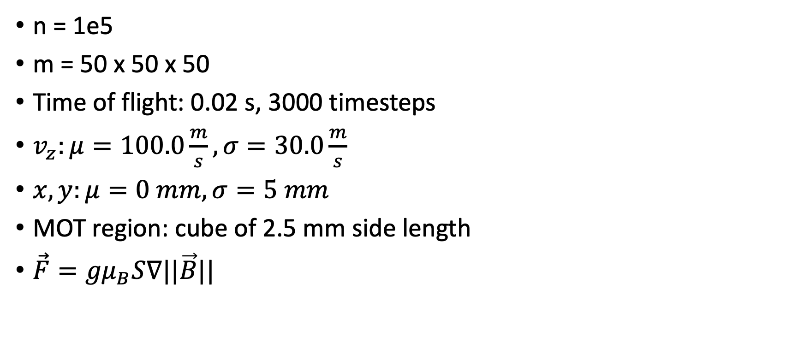
Trajectory Parameters
n = 1e5
m = 50 x 50 x 50
Time of flight: 0.02 s, 3000 timesteps
$v_{z}:μ=100.0\frac{m}{s}, σ=30.0\frac{m}{s}$
$x, y:μ=0 mm, σ=5 mm$
MOT region: cube of 2.5 mm side length
$\vec{F}={gμ}_{B}S∇||\vec{B}||$

Slide 10
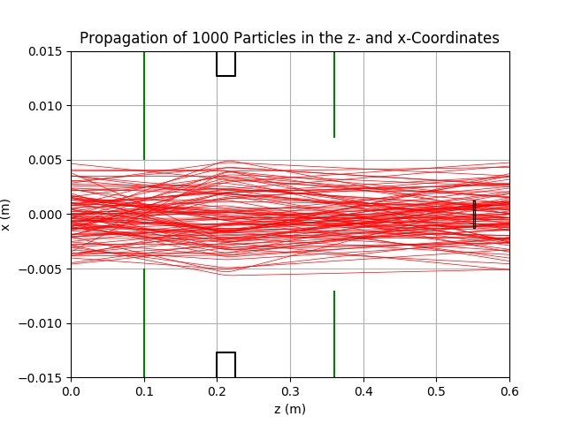
Monte Carlo Particle Trajectory Simulation
Lens
Yield ratio with lens: ~0.0142) (~111-140 particles make it into the MOT region)
Yield ratio without lens: ~0.0097 (~70-108 particles make it into the MOT region)
4K Aperture
Beam Aperture
MOT Region

Slide 11
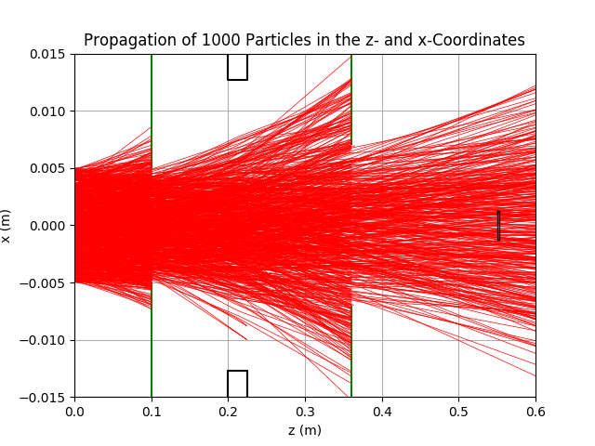
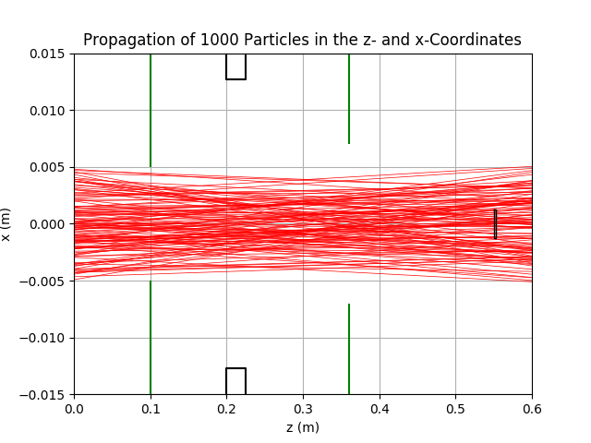
Monte Carlo Particle Trajectory Simulation
Lens
Lens
4K Aperture
Beam Aperture
Beam Aperture
4K Aperture
MOT Region
MOT Region
Unpruned Trajectories, With Lens
Without Lens

Slide 12
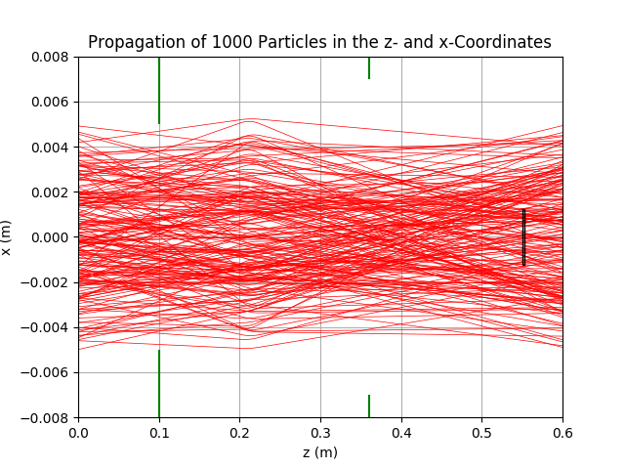
Monte Carlo Particle Trajectory Simulation
4K Aperture
Beam Aperture
MOT Region
Magnified, With Lens

Slide 13
Immediate Improvements
Denser mesh, more particles
Transverse velocity profile
Improved number enhancement calculations
Changing position of lens, aperture, beam shutter, and lens number
Series of lens, calibrated with focal point at geometric center of another lens
Benchmark for future experimentation
Code can be modified to use different magnet configurations and arrangements (coils, etc.)
Moving trap (Narevicius), Zeeman-Sisyphus slowing simulations
https://www.weizmann.ac.il/chemphys/edn/research-activities/moving-magnetic-trap

