Slide 1
Lens Updates: 2D Results, Slowable Molecules, Axial Length Scan, Laser Slowing
Thursday, September 17, 2020
YbOH/CaOH Subgroup Meeting

Slide 2
Experimental Setup: Two Lenses
4K Aperture,
1 cm diameter
Beam Shutter,
1.4 cm diameter
2.54 cm
2.54 cm
1 cm³
10 cm (fixed)
Cell
Varied
Lens
Varied
Lens
Varied
31 cm (fixed)
MOT Region
26 cm (fixed)
67 cm (fixed)

Slide 3
Two-Lens Scan in 2D: CaOH
Number enhancement peaked (11x) when lenses are quite near to each other (hottest area is clustered around 20-35 cm, branches to the right and left
Consistent with previous week’s results, suggesting placement of lens ~20-35 cm from cell aperture

Slide 4
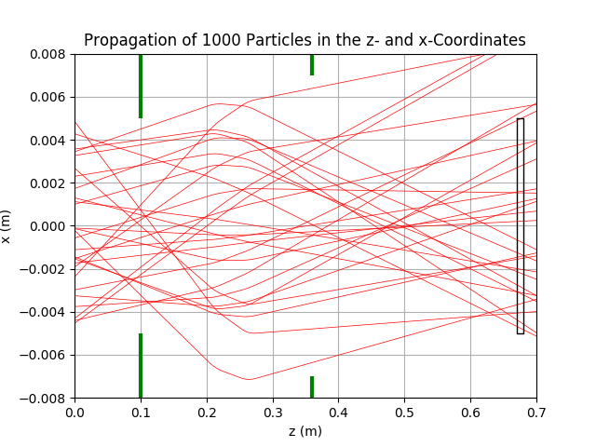
Two-Lens Scan in 2D: CaOH
Lensing effect enhanced when two lenses are used, focuses more strongly towards the MOT region (~1 cubic cm)

Slide 5
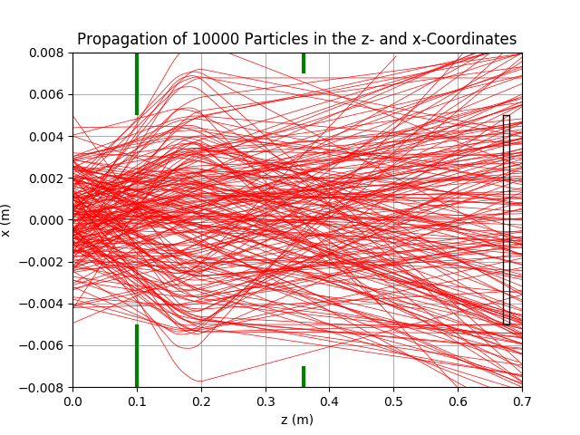
Two-Lens Scan in 2D: CaOH

Slide 6
Two-Lens Scan in 2D: CaOCH₃
Similarly, number enhancement maximized when lenses are quite near each other (hottest area is clustered around 25-35 cm)
Consistent with previous week’s results, suggesting placement of lens ~25-30 cm from the cell aperture

Slide 7
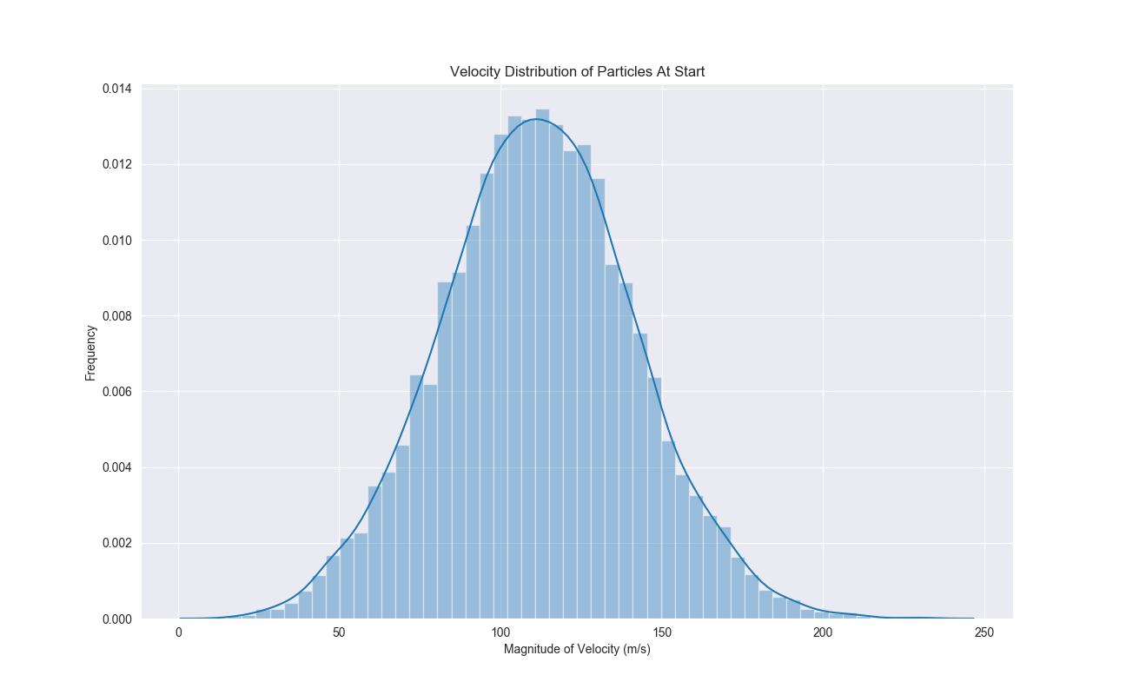
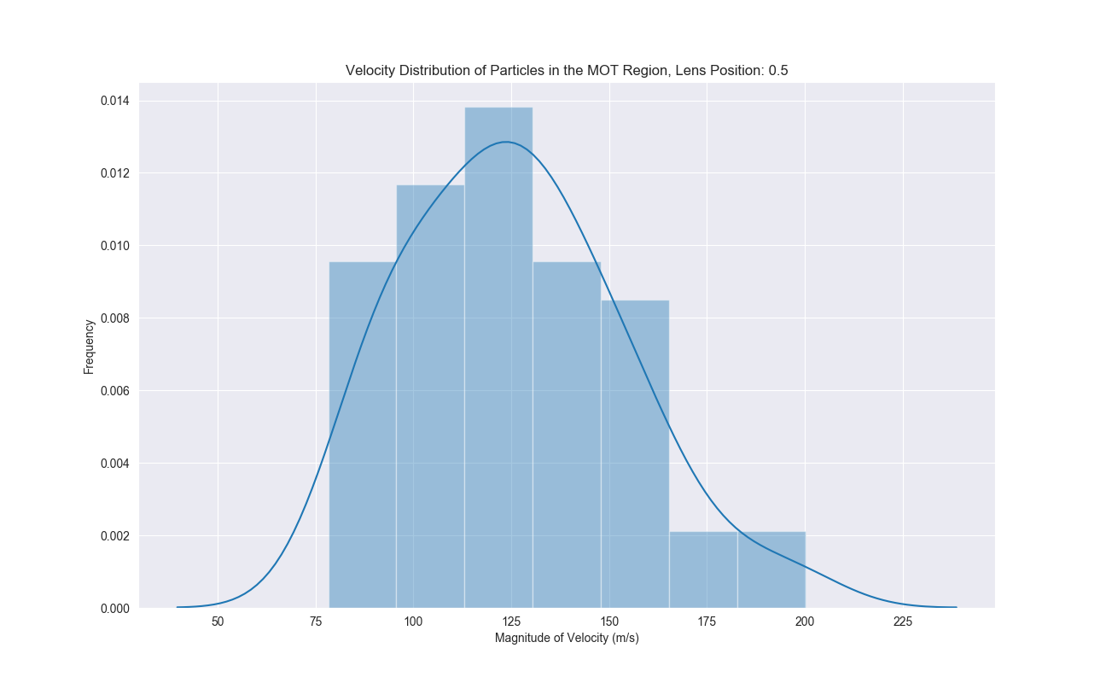
Capturable Molecules

Slide 8
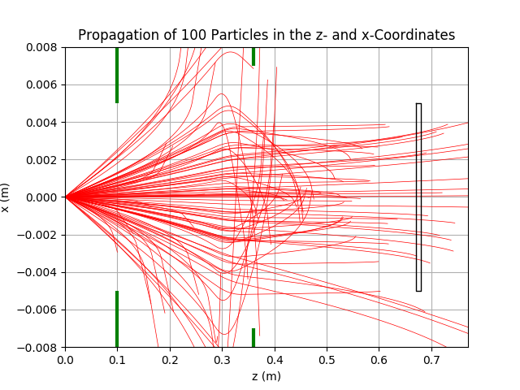
Laser Slowing: Preliminary Results
See evidence of turning inwards; the trajectories actually reverse direction in the magnet and are funneled inwards, compounding the focusing effect

Slide 9
Laser Slowing: Preliminary Results
Number enhancement is maximized when laser slowing with a lens placement slightly further
Preliminary; ran with only 1e2 molecules, no spatial distribution (runtime issues)

Slide 10
Varying Lens Axial Length

