Slide 1

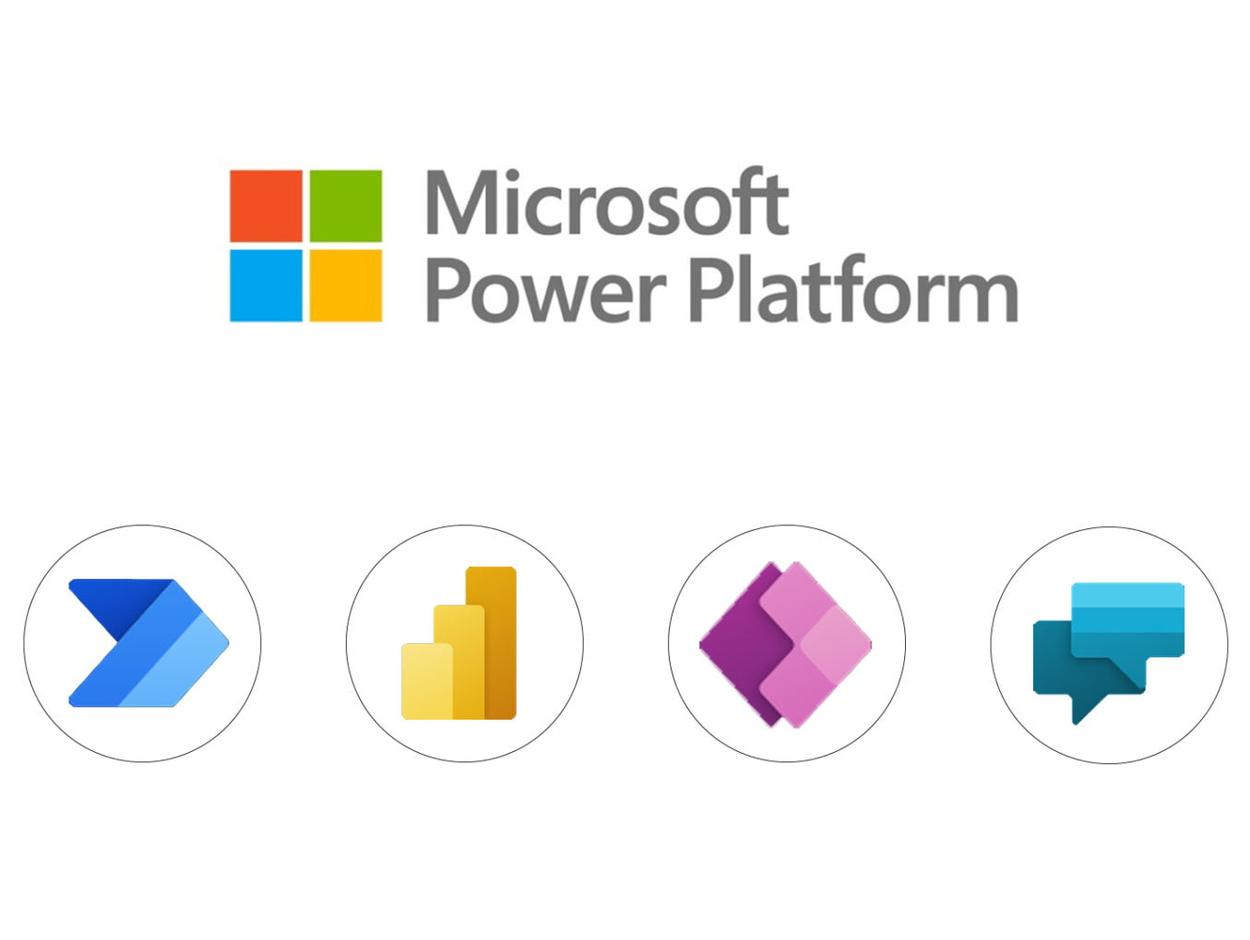



Microsoft Power Platform with IBM Watson Platform Connectors
COMP0016: 2022-23 - Team 16
Client:
Microsoft: Lee Stott, Julia Muiruri
IBM: Jon Mc Namara
Team Member:
Ivan Leong
Kin Cheung
Lucas Titus
Andew Lau
Team Email:
i.leong.21@ucl.ac.uk
chun.cheung.21@ucl.ac.uk
lucas.titus.21@ucl.ac.uk
andrew.lau.21@ucl.ac.uk

Slide 2
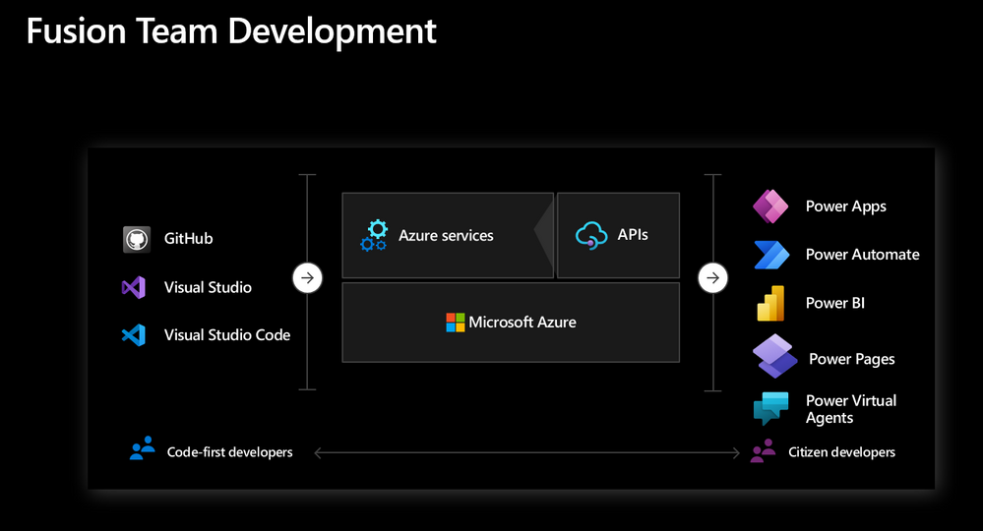
Project Overview/Proposal
Overview:
Build connector between Power Platform(MPP) and Watson
Import Watson AI service into MPP by using open APIs
Scenario:
Improve efficiency of healthcare industry (NHS) by utilising AI automation
Proposal:
Construct AI Assistant connectors
Handle quantitative and repetitive paperwork
Booking and preliminary diagnosis
Figure 1: Fusion Team Development demonstrated by Microsoft Power Platform

Slide 3
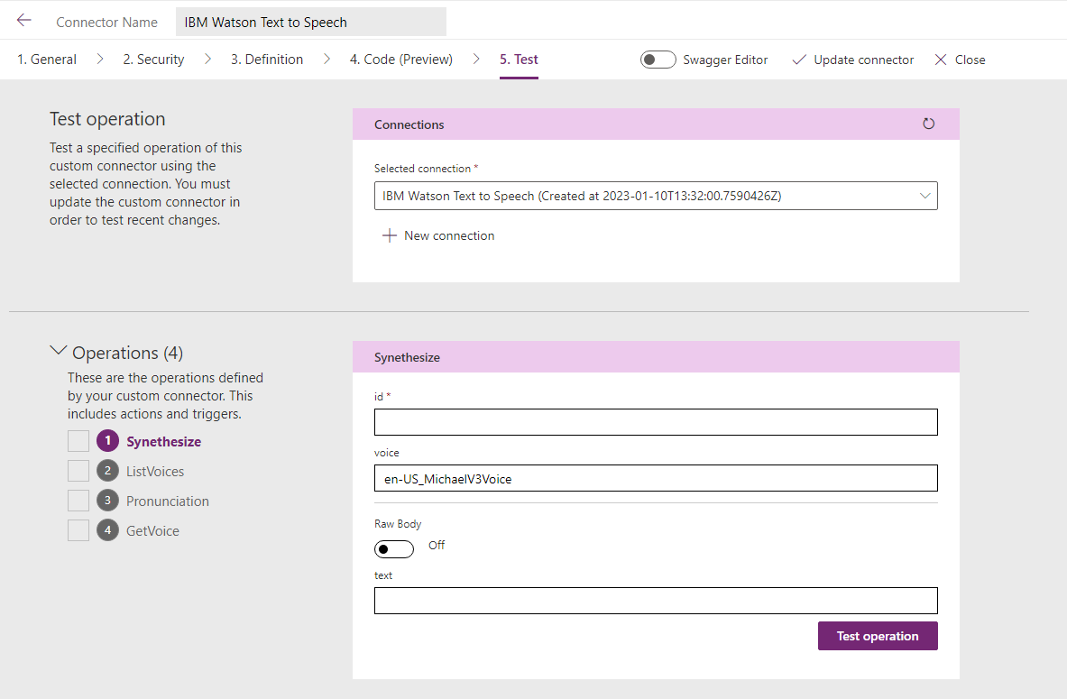
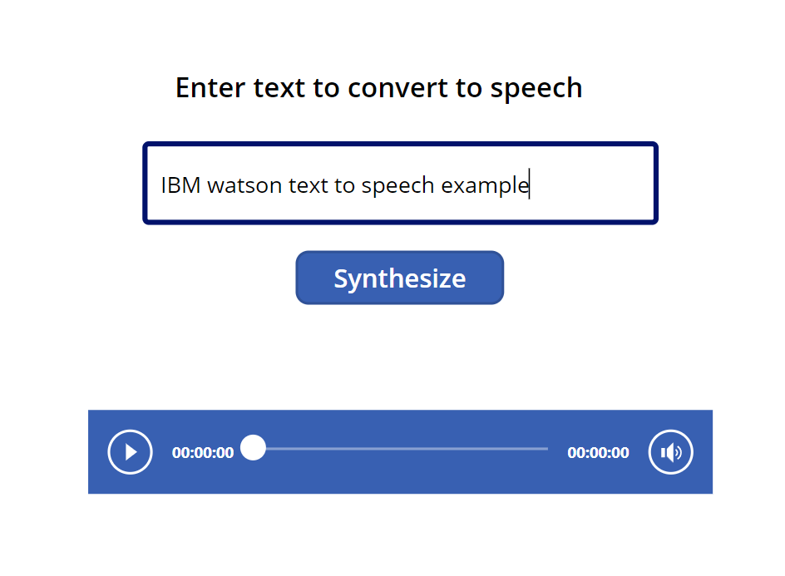
Project Prototype/Deliverables
Prototype:
Text to Speech Connector (Testing, figure 2a)
Deliverables:
Watson Discovery Connector (preliminary diagnosis)
Watson Assistant (automate booking system)
Microsoft PowerApp Canvas (example usage, figure 2b)
Potential future work:
Infinite possibility (MPP)
Import all IBM Watson open APIs
Figure 2a.
Text to Speech Connector Prototype and its Operation for Testing
Figure 2b.
Testing Canvas in PowerApp

Slide 4
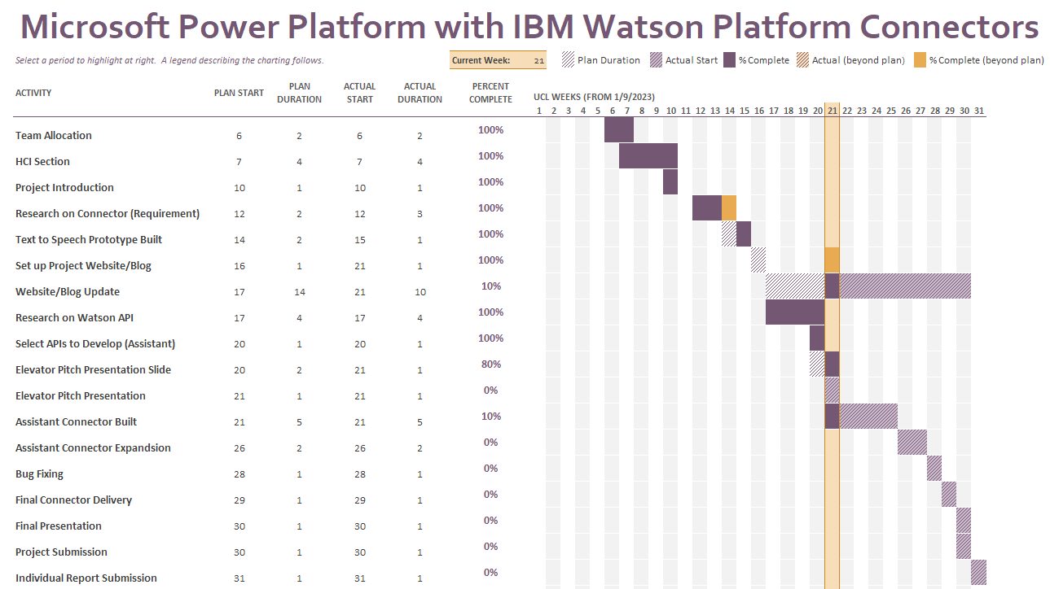
Thank you!
DEPARTMENT OF COMPUTER SCIENCE
Github
https://github.com/Andrew0000000/COMP0016
Blog http://students.cs.ucl.ac.uk/2022/group16/home.html
Figure 3: Project Timeline

