Slide 1
CubeX
The smart cube for work and home

Slide 2
43 Billion

Slide 3

Goals
Accessability
Usability

Slide 4

Agenda
Architecture
Telegram Bot
Cube API
Django
Timeline
Demo

Slide 5
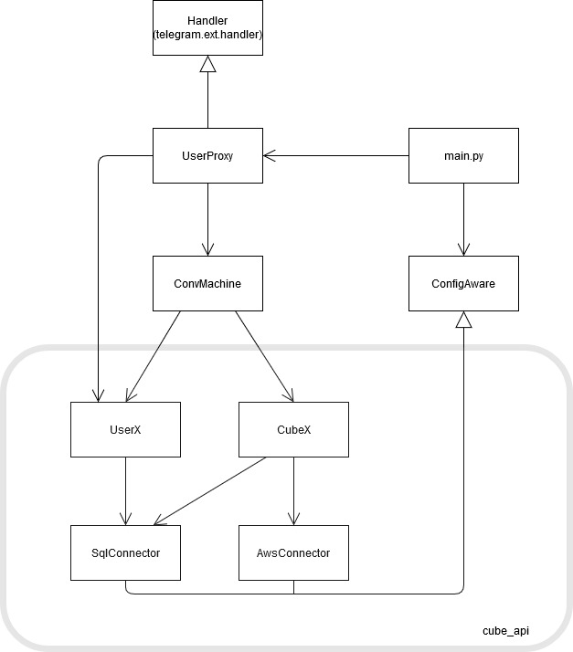
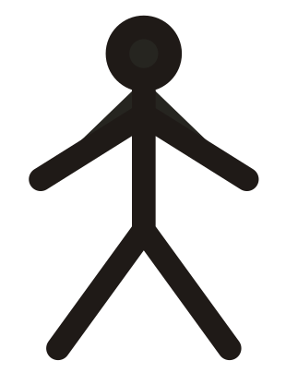

Architecture
telegram_api
User
telegram_bot
main.py
AWS
cube_api
database
Smart Cube
Website

Slide 6
Telegram Bot
map
_task
_select _task
_error
cube selected
invalid input
return_state
map_task
valid input
no cube selected
start
select _cube
invalid input
_select _side
select_cube
invalid input
no cube selected
valid input
cancel
show_sides
return_state
show _sides
_optional _add_cube
valid input
invalid input
valid input | skip

Slide 7
CubeX API
Two packages UserX and CubeX
AwsConnector for MQTT
SqlConnector with PostGreSql

Slide 8
Django
Basic functions
Extendable and Powerful
Works well with existing Database
Model-View-Controller Pattern

Slide 9
Timeline
18.02
28.02
14.02
24.02
05.03

